Slide 1
Absorption/Stripping
Gas-liquid separation processes
(Ch. 10)
TexPoint fonts used in EMF.
Read the TexPoint manual before you delete this box.: AAAAAAAAAAAAA

Slide 2
COUNTER-CURRENT MULTISTAGE CONTACT OF GAS AND LIQUID
Distillation(Ch.11)
Absorption (Ch.10)
Stripping (Ch.10)
A
Cleaned
Gas B
Absorbent
C
B+A
Polluted
feed liquid
Cooling
(condenser)
A
C+A
A
B
A
A
Feed
A+B
A
B
B
Stripping
gas B
Cleaned
Liquid C
Heat
(reboiler)
Polluted
feed gas
B + A
B (heavy)
C+A
Two key components (A+B)
One feed (normally)
Two pure products
Two sections
Heating and cooling
Boiling mixture
Three components
Inert gas B (e.g., air)
Inert liquid C (e.g., water)
Solute A (e.g., CO2) goes from gas -> liquid
Two feeds
One pure product (at most)
One section
Non-boiling mixture
so p and T can be set independently; see Exercise
Stripping: Reverse of absorption.
Solute A goes from liquid -> gas

Slide 3
«VANNVASK»
4 identical absorption columns
using pure water to absorb CO₂
from N₂/H₂ in ammonia plant.
The only one in the world, as far as I know
Originally, the CO₂ was used to make urea
but now the CO₂ is the main supply of
«brus» in Norway and Sweden.
Designed about 1963 by Ingulf Skogestad, Norsk Hydro Engineering Office, Oslo.
Built at Herøya (Porsgrunn) about 1967 (Norsk Hydro ammonia plant NII, now Yara)
Sigurd Skogestad and Jan-Fredrik Arnulf (2013)

Slide 4
EXAM, Dec. 2016
Pure water from lake, 2000 m3/h
0
Water recycle, 6000 m3/h
10
Gas to
ammonia
Plant
0,3% CO2
Pump
2
3
9
Abs.
Tower
(4 towers,
Each
D=3.3m
h=35m
77 trays)
24 bar
10 C
CO₂ product
Air
with CO2
6
5
Flash
5.5 bar
10 C
1.1 bar
10 C
7
Turbine
4
Blower
8
1
0.39% CO2
Water to sea
Synthesis gas, 6700 kmol/h
17% CO2, 35C
Air
220 000 Nm3/h
Revidert SiS. 24. jan. 2017

Slide 5
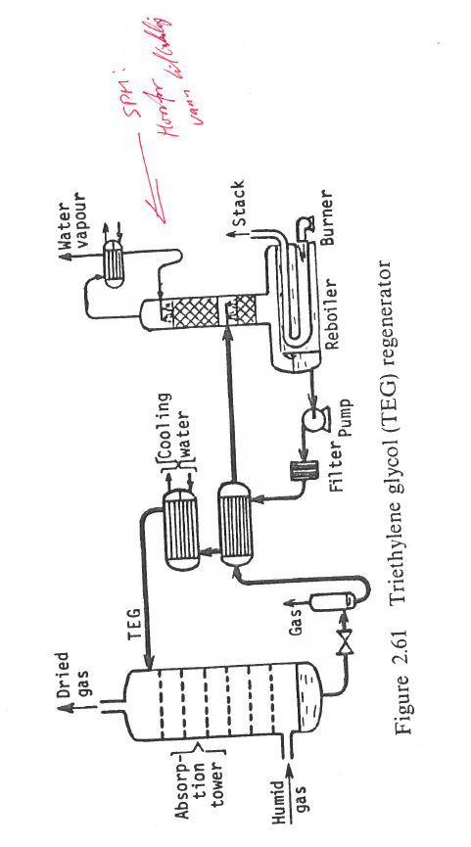
Remove water from natural gas

Slide 6
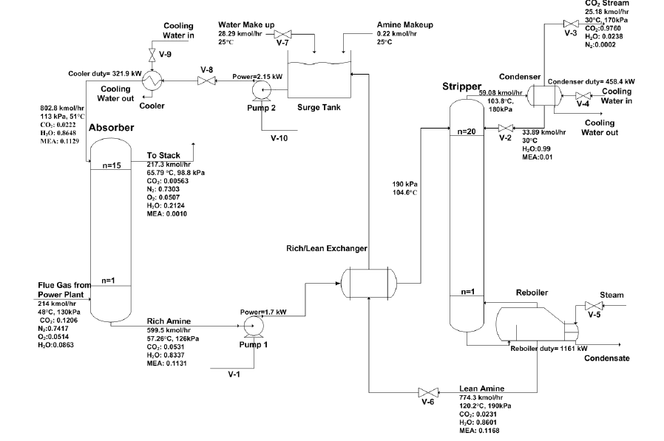
Example: CO2 capture from coal power plant (A=CO2)
Partial
A=CO2
B=steam (generated by reboiler)
C=water/amine
A=CO2
B=air
C=water/amine

Slide 7
Absorption/stripping
Two solution approaches
Equilibrium-stage model (Ch. 10.3). Find N
Similar to distillation
(A) Graphical: McCabe-Thiele (any VLE)
(B) Analytical: Kremser (VLE: Assume dilute solution. 1) Henry’s law, y = mx, +2) assume L/V constant)
Mass transfer model, (Ch. 10.4+10.6).
Find A=aSz (A=interfacial area)
Similar to heat transfer in heat exchanger
(A) Graphical: Must combine with integration
(B) Analytical (Henry’s law): Log-mean driving, (y-y*)_{LM}

Slide 8
Graphical method (McCabe-Thiele) for absorption/stripping
Equilibrium line usually straight line because of dilute solution
Operating line goes through end points
These point are not on the diagonal*
Usually straight operating line because of dilute mixture
*Note: For distillation the operating lines go through (x_{D},x_{D}) and (x_{B},x_{B}), which are on the diagonal.
Reason: Reflux/boilup generates “feed stream” with same composition as product.

Slide 9
Flows [mol/s]
Flows generally vary through the column
L = L’/(1-x)
V = V’/(1-y)
x, y = mole fractions of component being transferred (A)
L’ = inert liquid molar flow (C)
V’ = inert vapor molar flow (B)
For dilute mixtures we can assume (1-x)=1 and (1-y)=1 so L and V are constant through the column.

Slide 10
m=2.53, L/V=3
L=90 kmol/h, V=30 kmol/h

Slide 11
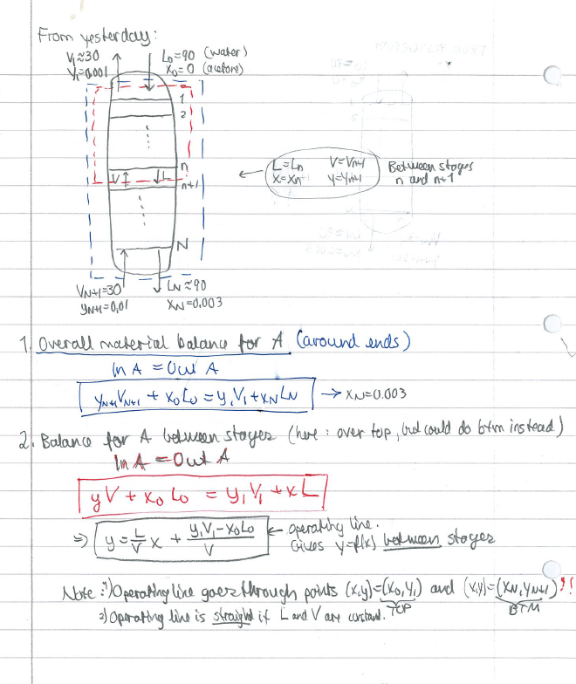
From last time:

Slide 12
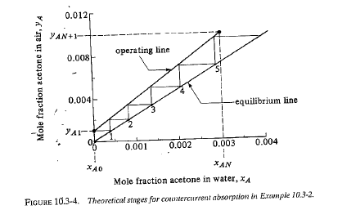
(x_{N}, y_{N+1}): Bottom end
(x₀, y₁): Top end
m=2.53, L/V=3
L=90 kmol/h, V=30 kmol/h
Solution: Need N=5.2 (approx.)

Slide 13
Minimum flows Absorption: L_{min} Stripping: V_{min}
Absorption: Pinch (equilibrium) in bottom where vapor feed enters
Stripping: Pinch (equilibrium) in top where liquid feed enters
Corresponds to N=1

Slide 14
L_{min}: Back to example
Operating line with L_{min}
x’_{N} = x*_{N+1} = y_{N+1}/m = 0.01/2.53 = 0.004
From figure: L_{min}/V = (y_{N+1} – y₁)/(x*_{N+1}-x₀) = (0.01-0.001)/(0.004-0)= 2.277
So: L_{min} = 30*2.277 = 68.3 kmol/h
* = in equlibrium with the other phase
Example: x*_{N+1} is (imaginary) liquid composition in equlibrium with y*_{N+1}

Slide 15
L_{min}: «Alternative» derivation
From overall mass balance (assuming constant flows)
V y_{N+1} + L x₀ = V y₁ + L x_{N}
Assume equlibrium in bottom (pinch)
x_{N} = x*_{N+1} = y_{N+1}/m = 0.0040
Get min. reflux. L_{min}/V = (y_{N+1} – y₁)/(x*_{N+1}-x₀)

Slide 16
Minimum stages, N_{min}
No such thing for absorption/stripping (N_{min}=0)
Example: 1 stage is OK if we increase flows enough
Absorption: increase L enough
Stripping: increase V enough

Slide 17
N=1: Back to example
Operating line with N=1
x*₁ = y₁/m = 0.001/2.53 = 0.0004
From figure: L/V = (y_{N+1} – y₁)/(x*₁-x₀) = (0.01-0.001)/(0.0004-0)= 22.77
So: L = 30*22.77 = 683 kmol/h

Slide 18
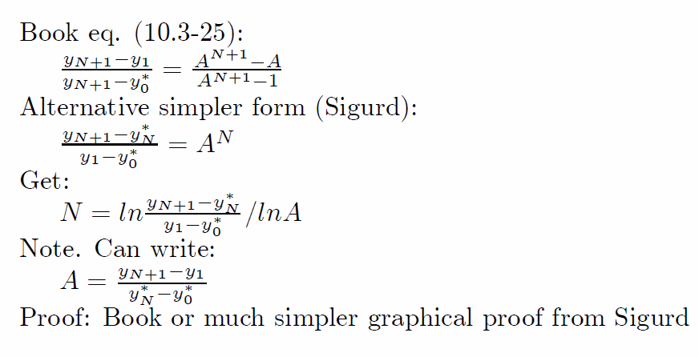
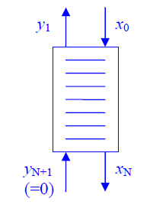
Kremser equations
Analytical solution for case with straight equilibrium line (y=mx) and L/V constant (dilute mixtures)
A = (L/V)/m – absorption factor = ratio of slopes for operating and equilibrium lines
Absorption: want A large
Stripping: Want A small
V
L
y*₀ = mx₀
V
L
y*_{N} = mx_{N}
(next page)
= in equilibrium with other phase
(could be imaginary composition, like y*₀)

Slide 19
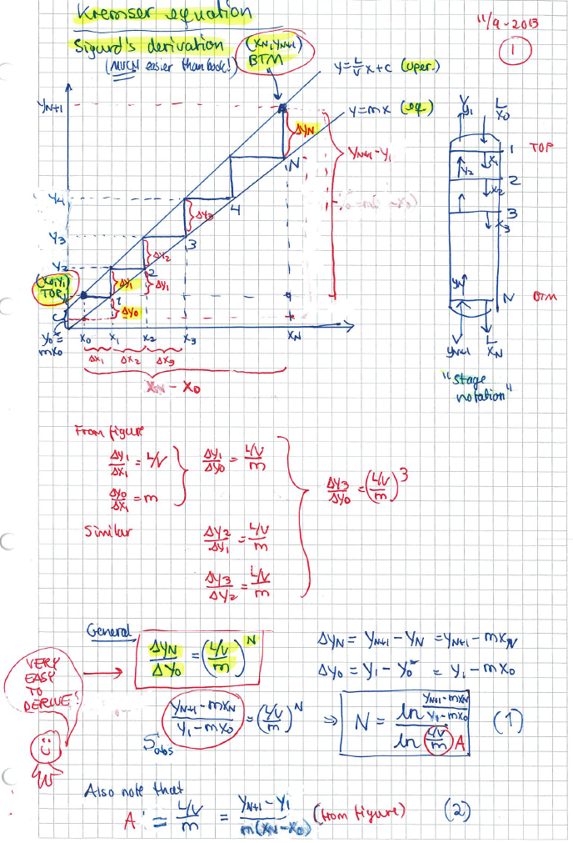
*

Slide 20
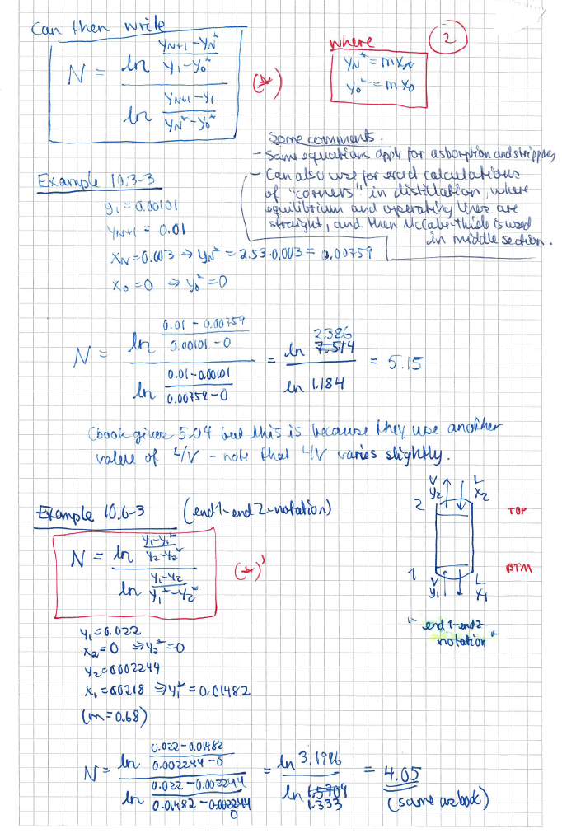

Slide 21
Example 1: A fun absorption problem
Minimum flows
Dear Absorption and distillation experts: Can you solve this? This problem is based on a true story. My father, Ingulf Skogestad, got his degree as a chemical engineer at NTH in Trondheim in 1948. It was difficult to find good process jobs in Norway at that time, so his career got a boost when he during 1956-61 worked at two ammonia plants that ICI operated in South Africa.
This is a story from Modderfontein near Johannesburg in 1959 where they had a problem of not reaching the gas spec. in an absorption tower. They build an identical tower no. 2 (in series) but still they could not reach the spec. My father found a solution that worked: He took the absorbent (liquid) from tower 2 and used it in tower 1 (and left tower 2 as a spare). This was at the time explained by the fact that there was too little liquid in tower 1 to get proper wetting of the packing, but I think it may have been a more fundamental mass balance problem.
To illustrate this I have made the following problem: A gas stream of 1 mol/s has 4 mol% of component A, and it should be reduced to 0.1% in an absorption tower with use of 6 mol/s pure water. However, in spite of the tower being very tall, the fraction of A in the gas product is too high (about 1.6% A). To reduce the concentration of A, an identical tower 2 is build, where the exit gas from tower 1 (with 1.6% A) is treated with 6 mol/s pure water. However, one still is not able to reach the desired 0.1% A. Data: Henry's law for component A: y = mx, where m = H/p = 10 (p is the column pressure, which is 1 bar). (a) Make a flowsheet for the two alternatives. (b) Can it be correct that one achieves 1.6% A in tower 1? (c) What is the concentration of A in the gas leaving tower 2? (d) An engineer always finds a solution! In this case it is to use all the water (12 mol/s) in tower 1 (and leave tower 2 as a spare). Can you explain why this works, and find the exit gas concentration of A in this case.

Slide 22
Original design:
(One tower, 6 mol/s water)
2. New design
(Two towers in series,
total 12 mol/s water)
3. Final design**
(One tower, 12 mol/s water)
Cleaned gas
Desired: y₂ = 0.001
(c) Actual: y₂=0.0064
V’y’₂ = V’y’₁ – L’x’₁) y’₂=0.0064
Cleaned gas
Desired: y₂ = 0.001
Actual: y₂=0.016
(b) Vy₂ = Vy₁ – Lx₁) y₂=0.016
L=6 mol/s
x₂=0
Cleaned gas
Desired: y₂ = 0.0012
Actual: y₂<0.001
(d) Not enough data to find exact y
(need N or similar)
L=12 mol/s
x2=0 (pure water)
L=6 mol/s
x₂=0 (pure water)
L=6 mol/s
x₂=0
end 2
end 1
Btm:
Close to equilibrium (pinch):
x₁=x₁*=y₁/m=0.04/10=0.004.
(L/V)_{min}= (0.04-0.001)/0.004=9.75
Pinch:
x'₁=x’₁*=0.016/10=0.0016
Polluted gas
V=1 mol/s
y₁ = 0.04
Polluted gas
V=1 mol/s
y₁ = 0.04
Polluted gas
V=1 mol/s
y₁ = 0.04
y’₁=y₂=0.016
**If liquid load too large:
Can split the gas and have
two towers in parallel.
Each with half L and V.

Slide 23
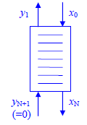
Example 2 (Problem 2, exam 2004)
Minimum flows
PROBLEM 2. STRIPPING.
Water from an oil installation contains 8 mg benzene per liter water. It should be reduced to 0.4 mg benzene per liter by stripping with air at 2 atm.
(a) Find the minimum amount of air (m3 air/m3 water). How many equilibrium stages does this require?
SOLUTION. General approach:
Convert everything to molar + (Find product streams from mass balance)
Minimum flows: This is with infinite no. of stages and it occurs when we have “pinch”
For absorption/stripping: “Pinch” at one end -> product and feed in equilibrium!
Assume: L and V constant through column (dilute-> x and y small)
+ Assume T=300K (not given!) + assume ideal gas
(i) Conversion to molar: “8 mg benzene per liter water”.
n_{b} = 8 mg benzene = 8e-3 g / 78 g/mol = 1.026e-4 mol
n_{w}= 1 liter water = 1 kg water = 1000g/ 18 g/mol = 55.55 mol
x₀ = n_{b}/(n_{b}+n_{x}) = 1.846 e-6 = 1.846 ppm
Similar: x_{N} = x₀*0.4/8 = 0.05 x₀ = 9.231 e-8 = 0.092 ppm
Infinite number of stages: y₁ and x₀ are in equilibrium -> y₁ = (H/p) x₀ = (383.5 bar/2bar)*1.846e-6 = 3.54e-4 = 354 ppm
(ii) Can now find minimum air flow from overall material balance:
Lx₀ + Vy_{N+1} = Lx_{N} + Vy₁
Or L(x₀-x_{N}) = V (y₁-y_{N+1})
Or V = L(x₀-x_{N})/(y₁-y_{N+1}) = L (1.846-0.092)/(354-0) = 0.00495 L [mol/s]
Water: Given L = 1 m3 = 1000 kg = 55.55 kmol
Air: Get V = 0.00495 L = 0.275 kmol = 275 mol = 275 (RT/p) [m3] = 275*8.31*300/2e5 [m3] = 3.43 m3 (gas)
eq.
L (water+ benzene)
V (air)

Slide 24
Diffusion (Two-film theory)
See lecture no. 3 from Jana
Mass transfer based on bulk compositiums
N_{A} = K_{y} (y-y*) = K_{x} (x-x*) [mol/s m²]
K_{y} = m K_{x}
Assume dilute mixture, so that drift of film can be neglected:
K_{y} = K’_{y}
To find overall mass transfer coefficient: Add resistances: 1/K_{y} = 1/k_{y} + m/k_{x}

Slide 26
Mass transfer approach
Two-film mass transfer model
Bulk phases not in equilibrium
Dilute mixtures (1-x ¼1)
Henry’s law: y*_{i} = m x_{i}
Constant (molar) flows: L ¼ L’ (inert)
Mass transfer (Non-equilibrium) model
Get differential equation (dn_{A}/dz=…) instead of difference equations:
Mass transfer: N_{A} = K_{y} (y – y*) [mol A/s, m2]
Mass balance over dz: dn_{A} = Vdy = N_{A} dA, where dA = aSdz
Combine: dz = V dy / K_{y} a S (y-y*)
Packing height (integrate):
Integrate expression for N_{OG} numerically (computer) or graphically (exercise)
For dilute mixtures (Analytical Log-mean approximation):
H_{OG} [m]
= hight of
transfer unit
N_{OG} [-]
= number of
transfer units
N_{OG} =

Slide 27
Proof of expression for N_{OG}
y-y* is the difference between the operating and equilibrium lines and for dilute mixtures it changes linearly with x (and with y) so write¹:
y-y* = ky + b
Book (p. 671) says that this «can be integrated» to get the desired result, but skips the details. Here is a proof.
Integral of 1/(y-y*)=1/(ky+b) is ln(ky+b)/k = ln(y-y*)/k
Integrate this from end 2 to end 1, get
N_{OG} = ln [(y-y*)₁/(y-y*)₂] * 1/k
Now the «trick» comes. Note that k is the slope of (y-y*) as a function of y. So using the two ends 1 and 2, we have
k = [(y-y*)₁-(y-y*)₂] / [y₁ – y₂]
QED
1. Comment: By writing y=(L/V)x+a and y*=mx, we have that y-y*=(L/V - m)x + a, and by using x = (y-a)/(L/V) we find that k = (L/V – m)/(L/V) = 1 – 1/A where A=(L/V)/m

Slide 28
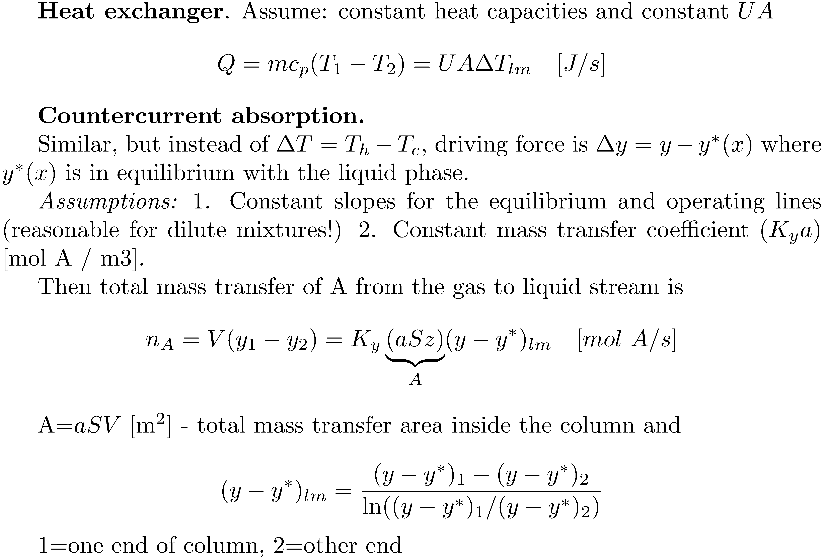
Absorption/stripping in packed towers. Useful log-mean formula for dilute mixtures
2
z
1
y
y*=mx

Slide 29
Multistage separation with given products: Minimum number of stages
There is no “minimum number of stages” in absorption/stripping
Can have N -> 0 if we have very large flow (of solvent or stripping gas).
Note: Purities of incoming streams (column ends) are fixed, and this limits product purities, independent of the number of stages.
Distillation is different: Here we “recycle” at the column ends and can achieve any product purity by increasing the number of stages.
Fenske: N_{min} = lnS/ln®

Slide 30
Multistage separation with given products: Minimum flows (Lmin, Vmin)
Absorption/stripping: minimum solvent/stripping gas
Obtained with infinite large column (infinite no. of stages)
General: Occurs when we have “pinch” somewhere
No change in composition between stages
= Crossing of equilibrium and operating line
= Compositions between stages in equilibrium
Absorption/stripping: usually occurs at column end
-> one product is in equilibrium with its feed

Slide 31
10.6C Pressure drop and flooding in packed columns
To find column diameter and pressure drop:
Obtain packing factor F_{p} (from Table)
Find flooding pressure drop
Find corresponding flooding gas velocity (using pressure drop correlation in Figure)
Typical: v_{flood} is about 6.6 ft/s = 2 m/s
Choose diameter such that gas velocity is about half of this
Typical: Design for v = 1 m/s
Find pressure drop in column (from pressure drop correlation in Figure)

Slide 32
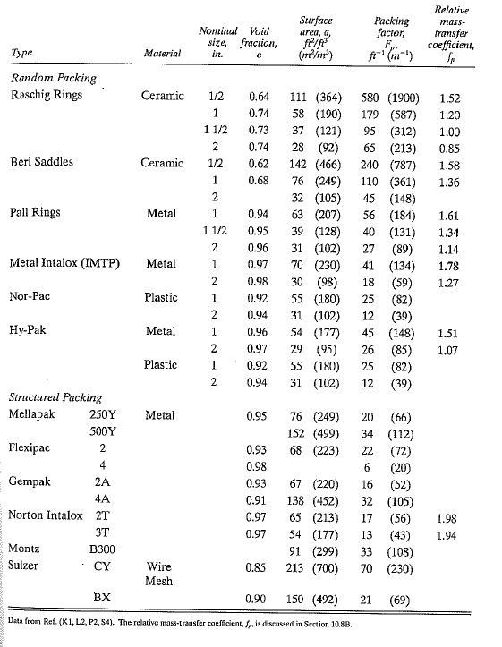
Table 10.6-1.
Packing factors F_{p}

Slide 33
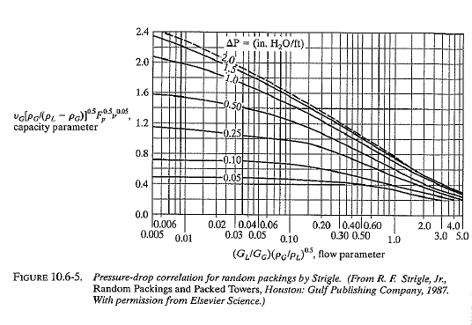
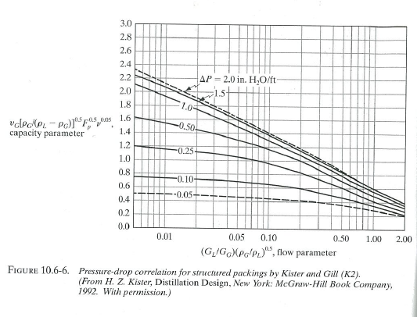
Pressure drop correlations

Slide 34
11.5F Flooding velocity and Diameter of tray towers
To find column diameter and pressure drop:
Obtain tray factor K_{v} [ft/s] (from Figure)
Find entrainment gas velocity from eq. 11.5-14 (occurs just before flooding). Fair correlation:
Choose diameter so that gas velocity is about v = 0.7 v_{max}
Pressure drop: Usually much larger than in packed columns, because of pressure drop for gas to pass through liquid on trays

Slide 35
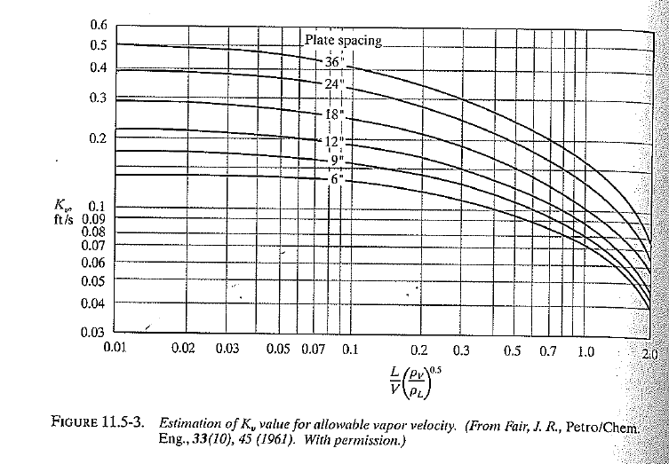
6’’ = 6 inches = 18 cm

Slide 36
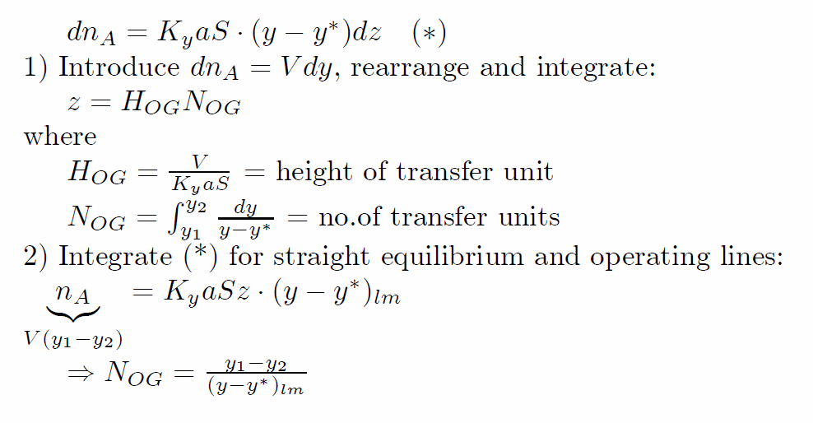
Summary: Absorption/Stripping
Single section
Notation varies…
Dilute mixtures:
1-x ¼1
Henry’s law: p_{i} = H x_{i}
Using p_{i} = y_{i} p gives
y_{i} = (H/p) x_{i} = m x_{i}
Constant (molar) flows: L ¼ L’ (inert)
Modelling. Two approaches
Equilibrium stage (as for distillation, but simpler)
(A) Graphical: McCabe Thiele for nonideal VLE
(B) Analytical for dilute mixtures: Kremser formulas. A = (L/V)/m
Mass transfer (Non-equilibrium) models

Slide 37
Summary countercurrent vapor-liquid separation
 | Stage model (Tray column) | Differential model (Packed column)
Equilibrium (between liquid and vapor bulk phases) | Eq. stage. (Most common model in practice!) McCabe-Thiele Dilute: Fenske, Kremser | (Not possible with differential model*) (But one can use eq. stage + HETP!)
Non-equilibrium | (Not covered in this course) Non-equilibrium between bulk phases is used sometimes. May use two-film theory on stages | Most common is two-film approach. Nondilute: Numerical integration Dilute mixtures: log-mean formula.
*Would give column with height=0

Slide 38
