Slide 1
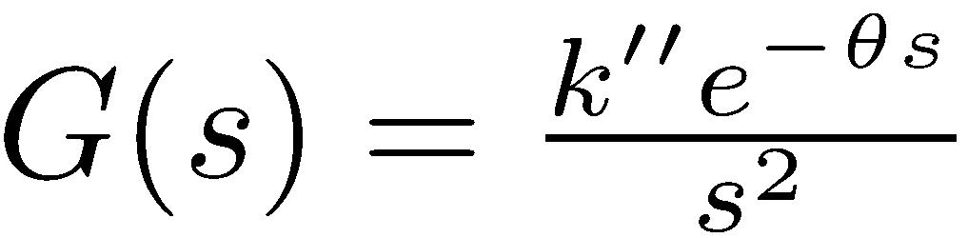
Optimal PID control
of double integrating processes
Chriss Grimholt* and Sigurd Skogestad
*Present affiliation: ABB, Olso

Slide 2
Double integrators: Outline
They are common
They are difficult to control
Control approaches
SIMC PID-tunings
Optimal trade-off between performance (J=IAE) and robustness (M_{s})
Comparison of SIMC with IAE-optimal PID tunings
Optimal Serial vs. Optimal Parallel PID
Generalized SIMC for “slow” second-order process
Conclusion

Slide 3


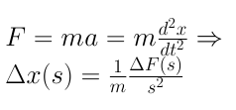
Double integrating processes are common
Example 1: Force (F) to position (x)
u = F
y = x
x
Example 2 (almost integrating): Two large tanks in series
T₀
u = Q
y = T₂
Q
8
8
T₁
T₂
T₂

Slide 4
Double integrators are difficult to control
Unstable with P-only control (so Ziegler-Nichols does not work)
With I-action: Need derivative action (PI unstable)
Nyquist plot of L=GK
Bode plot of L=GK
Both an upper and lower gain margin (GM)

Slide 5
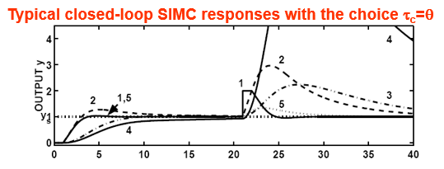

Double integrators are difficult to control
d_{u}
1.
2.
d_{y}
d_{u}
4.
Input disturbance for double int.: IAE(y) ~ θ³

Slide 6
How to control double integrator?
1. Easy if we can use two measurement (y, y’): Cascade control or State feedback
T₀
Q
u = Q
y’ = T₁
y = T₂
T₂
TC
T₁
8
8
TC
T₂
T_{1s}
T_{2s}
2. Only measurememnt of y: Need a well-tuned controller (PID sufficient)
u = Q
y = T₂
T₀
T₂
Q
T₁
8
8
TC
T₂
T_{2s}

Slide 7
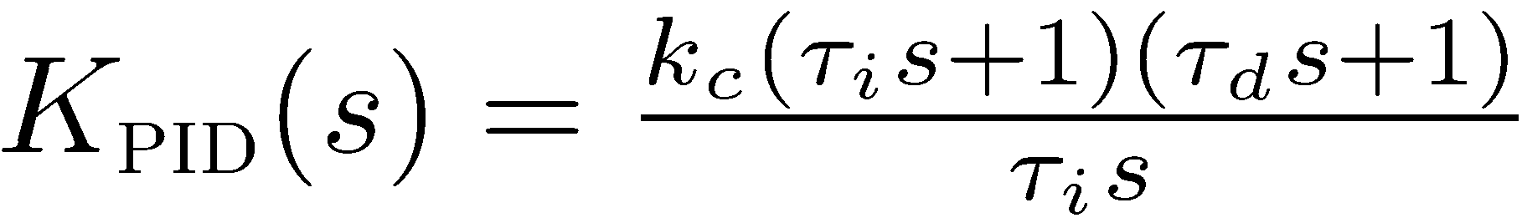
SIMC PID-tunings for double integrator
(Skogestad, 2003)
Model:
SIMC for double integrating process:
Tuning constant (τ_{c}):
Adjust to trade off between performance and robustness
Normally recommended value:
For double integrating, a better value is:
This is for the Serial PID controller:

Slide 8
Optimal PID control
Many issues to consider, including:
  Output Performance
  Stability robustness
  Input usage
  Noise sensitivity
Consider only the main trade-off (high-gain versus low gain)
  Output Performance (IAE)
  Robustness (M_{s}-value)

Slide 9
Quantifying the optimal: Performance
Performance: weighted sum of Integral absolute error (IAE) for input and output disturbances
Input and output disturbance performance
4.15
288.56
Input disturbance
Output disturbance
Normalization factors

Slide 10
Quantifying the optimal: Robustness
Robustness: Largest sensitivity peak (M_{s})
Closest distance to the critical point

Slide 11
Optimal trade-off between performance (J=IAE) and robustness (M_{s})
The optimal controller is found by solving:
Upper bound on robustness
Optimal trade-off curves are found solving the optimization problem repeatedly for different robustness (M_{s}) levels
Good robustness
Poor robustness
Note: Results are with k’’=1 and θ = 1.

Slide 12


Optimal* PID vs. SIMC-PID
Simple SIMC-rukes are Almost Optimal !!!
This came as a surprise to us
Good robustness
*OptimaL serial form PID

Slide 13
Optimal* vs. SIMC
Good robustness
*OptimaL serial form PID

Slide 14
Optimal Serial vs. Optimal Parallel PID
Serial PID:
Small difference!
Convert serial parameters to parallel by
(especially in high performance region)
Parallel (=“Ideal”) PID:
Parallel is more general: Can have complex zeros

Slide 15
Time response comparison

Slide 16
Generalized SIMC for “slow” second-order process
Second order process:
1. “Original” SIMC PID-rule for second-order process: τ_{d} = τ₂
2. For large time constants (τ₂ > 8θ, approx.) second-order process can be considered as double integrating
with
New parts
Get improved PID-rule:

Slide 17
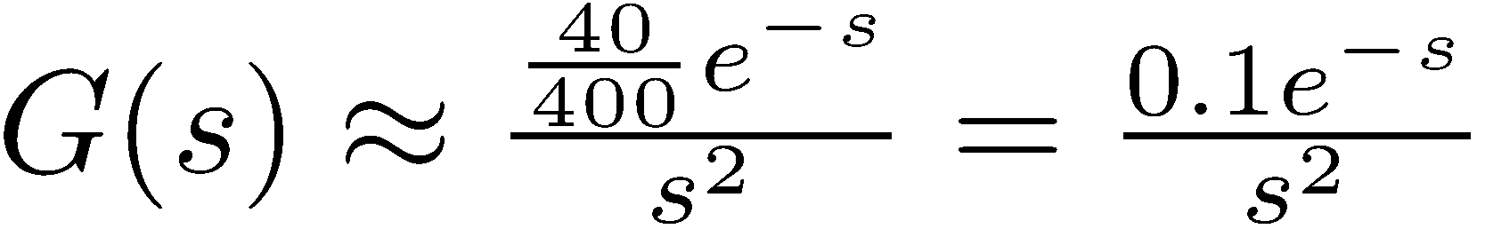
Generalized SIMC for “slow” second-order process
Second order process w/large time constant:
Approximate double integrating process:
Much better to approximate
as double integrating!

Slide 18

Conclusions
Double integrating processes are common, but difficult to control, IAE ~ θ³
If possible: Introduce extra measurements closer to input and use cascade control
Otherwise: Use well-tuned controller
  SIMC-tunings for double integrating process are simple
  And close to optimal !!
  SIMC: τ_{c} = 1.5θ is a good starting point for double integrating processes.

