Slide 1
Modelica as a modeling tool for online optimizing control and estimation
Lars Imsland
Pål Kittilsen, Tor Steinar Schei
Cybernetica AS
TexPoint fonts used in EMF.
Read the TexPoint manual before you delete this box.: AAAAAAAAAAA

Slide 2
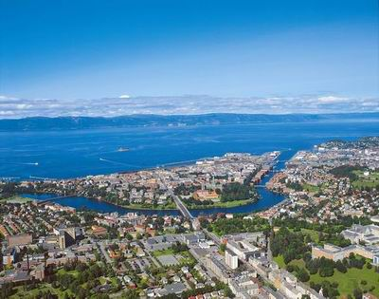
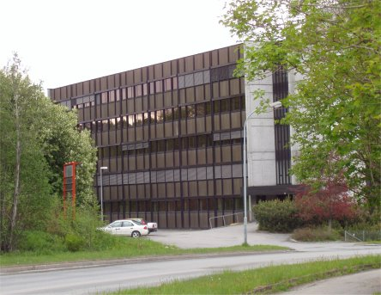
CYBERNETICA AS
Office in Trondheim, Norway
Founded in 2000
At present 15 employees
A spin-off company from the research groups in process control and engineering cybernetics at SINTEF, NTNU and Statoil
Strategic agreement with SINTEF

Slide 3
Cybernetica’s business idea
Develop, implement and maintain
specialized solutions for
model-based control, supervision and optimization
of selected industrial processes
Notes:
Har egne produkt
driver en del konsulentjenester, oppdrag med andres software (Statoil MPC – Septic)

Slide 4
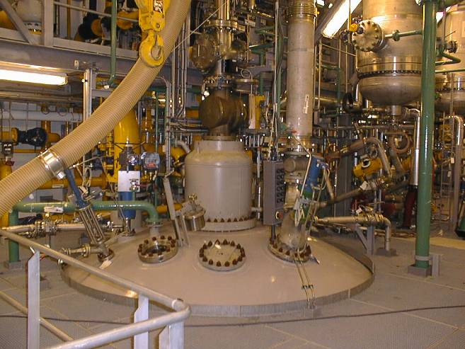
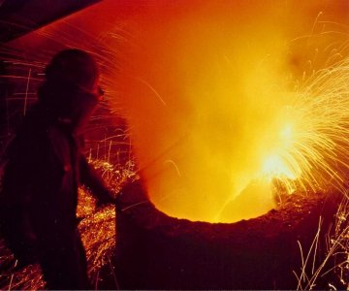
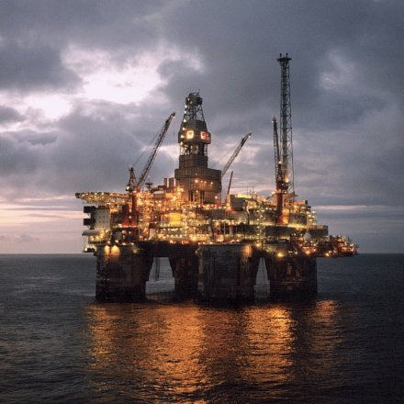
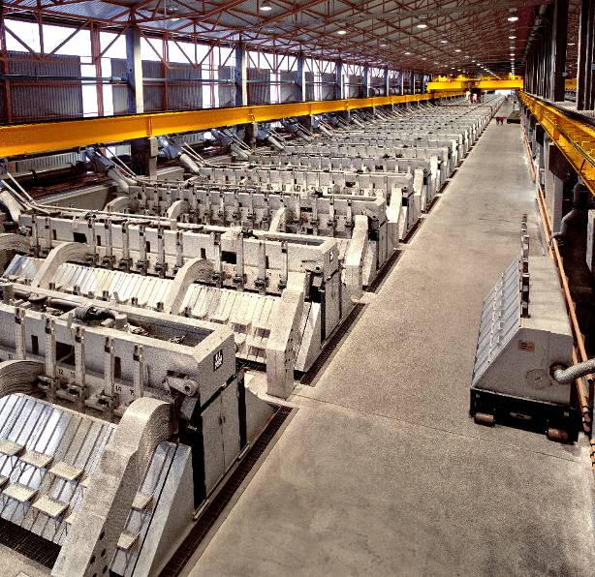
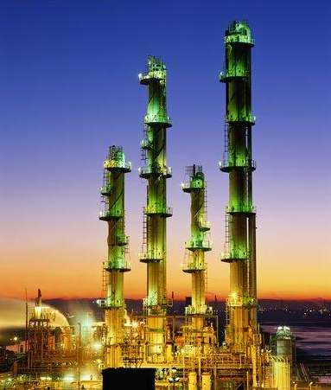
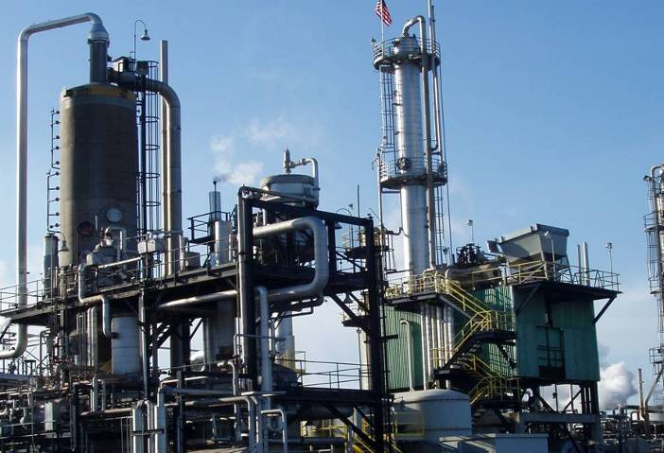
Cybernetica – Markets
Polymer industry; Metals; Oil and gas
Notes:
Kunder:
Polymer: Hydro Polymers, Dynea, Repsol
Lettmetall: Hydro Aluminium, Eramet, Elkem
O&G: StatoilHydro (Statoil og Hydro)

Slide 5
Outline
Background
  Advanced modeling tools in NMPC applications
Software integration
  Dymola/Modelica and Cybernetica CENIT
Modeling issues
  Thermodynamics, networks
Two case studies
  Offshore oil and gas production, estimation and NMPC
Summary and conclusions

Slide 6
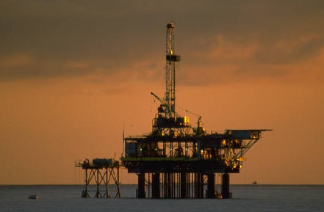

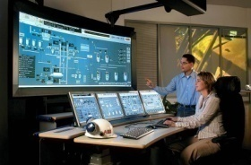
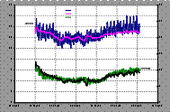
Background
Cybernetica provides advanced model-based control systems for the process industry
  Based on non-linear first principles (mechanistic) models
  Nonlinear state- and parameter estimation (EKF, MHE)
  Online dynamic optimization (nonlinear model predictive control, NMPC)
Process physics
Model fit for purpose
CENIT
Kernel
Model
Predictive
Controller
Plant
Plant personnel
Model
Component
OPC
Estimator
Process data

Slide 7
Background, cont’d
Previously: Model component hand-coded in C
Desirable: Cost reduction by use of advanced
modeling environments
  Model reuse, model libraries
  Ease of model implementation
  Exploitation of modeling effort in other contexts
  Possibly easier integration of external (e.g. customer) models
  Exploit analytical Jacobians in simulation, optimization and estimation
Screening of tools: Modelica/Dymola found to best fit requirements
  Modelica/Dymola tested since beginning of 2007
CENIT
Kernel
Model
Predictive
Controller
Model
Component
Estimator

Slide 8
Some criteria for modeling tools
Implementation of user-defined models – modeling language
  Graphical model configuration, modularity (model reuse)
Accessibility of models, model representation
  Software integration
  Class of dynamic equation systems
    ODE – DAE – PDE, compatibility with Cybernetica CENIT NMPC solver
  Support for symbolic differentiation
Thermodynamics and model libraries
Open standards
  CAPE-OPEN ESO (Equation Set Object): Standard for representing system equations
  Modelica: Standardized modeling language
Other issues
  Vendor reliability, software reliability, price
  Other features: Simulation (with advanced scheduling), visualization of simulated data, parameter estimation, dynamic optimization, inclusion of external data/software, …

Slide 9
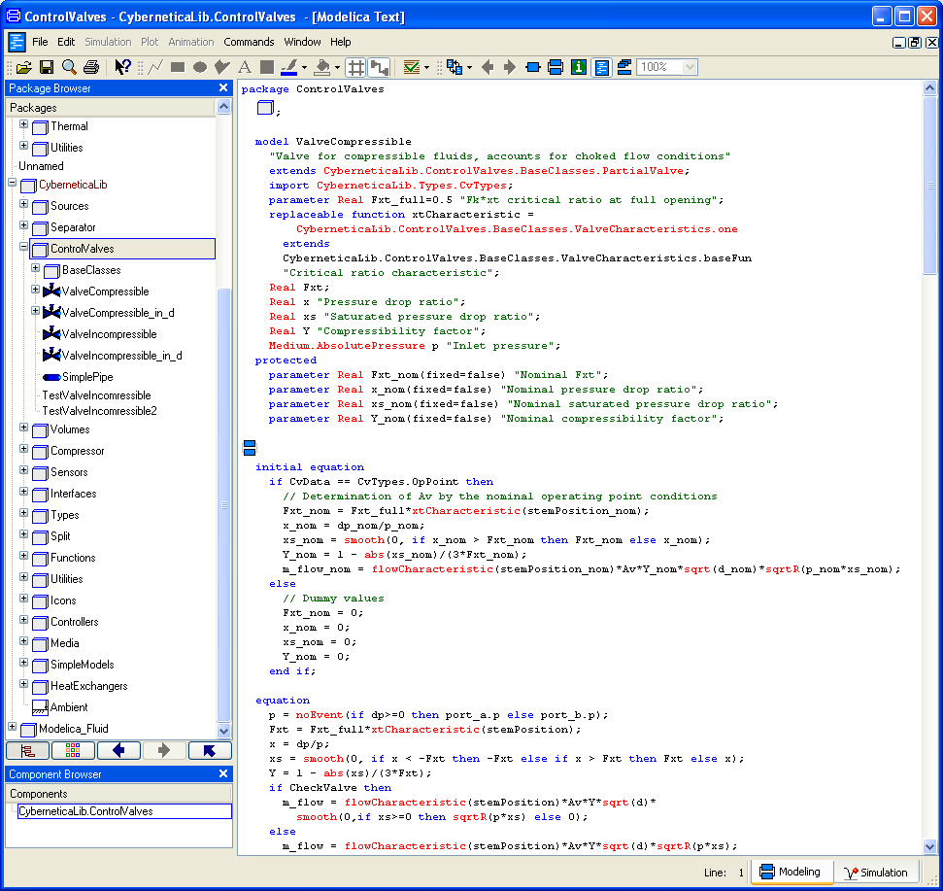
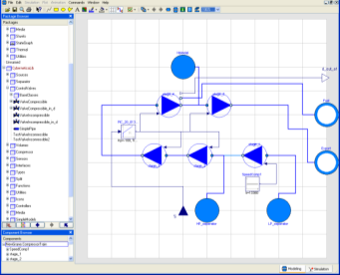
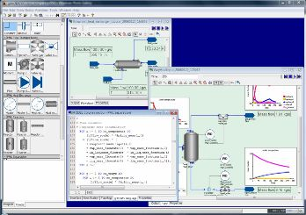
Modeling tools (not exhaustive)
Modelica-based tools
  Dymola
  SimulationX, Mosilab, MathModelica, OpenModelica
  MapleSim
Other major tools
  gPROMS
  Aspen Custom Modeler
  Jacobian (commercial continuation of ABACUSS II – Barton, MIT)
  EcoSimPro
  (Matlab, Simulink)
Other tools (mostly academic projects):
  Ascend IV
  CapeML + ADiCape
  Diva/Diana/Promot
  EMSO
  ...
  Several tools aimed at specific applications
    power systems, hydraulics, electronics, education, ...

Slide 10
Our choice: Dymola
Standardized modeling language
  Convenient, modular, graphical, reuse
  Can use models developed in Dymola with other Modelica-software
    (at least in principle)
C-code model export
  Can compile models together with Cybernetica CENIT
    Efficiency, control
  Also on targets that does not support COM, CORBA, etc.
Modelica Standard Library
  Especially: Modelica.Media, Modelica.Fluid
Mature vendor, mature language
Export of analytical Jacobians
  Faster simulations, optimizations

Slide 11
Outline
Background
  Advanced modeling tools in NMPC applications
Software integration
  Dymola/Modelica and Cybernetica CENIT
Modeling issues
  Thermodynamics, networks
Two case studies
  Offshore oil and gas production, estimation and NMPC
Summary and conclusions

Slide 12
Interface Modelica model – CENIT
Specialized CENIT model component for Modelica models from Dymola
Dymola model compilation:
CENIT
Kernel
Model
Predictive
Controller
Dymola/Modelica (*.mo)
⇩
Flat model (*.mof)
⇩
dsmodel.c
⇩
dymosim.exe
Model
Component
dsmodel.c
Estimator
model_mpc.c
Model component
NMPC
solver.c
model_est.c
EST
model.c
modint.c
dsmodel.c
model_XXX1.c
XXX1
Model specific interfaces
to variable indexing,
initialization,
integration, etc.
General interface for
initialization, computation
of derivatives and outputs,
sensitivities
Autogenerated code by
Dymola (model specific)
model_XXX2.c
XXX2
Notes:
Have made an interface to dsmodel.c
Inititialization, simulation/integration, test of AD
Sensitivities
Now: Sensitivities found by finite differences
Ongoing: Adapt CENIT to use AD information in NMPC/MHE
Use integration methods with sensitivities
Main need for extra interface to dsmodel.c: inputs -> u, par (MV, DV, noise); outputs y, z

Slide 13
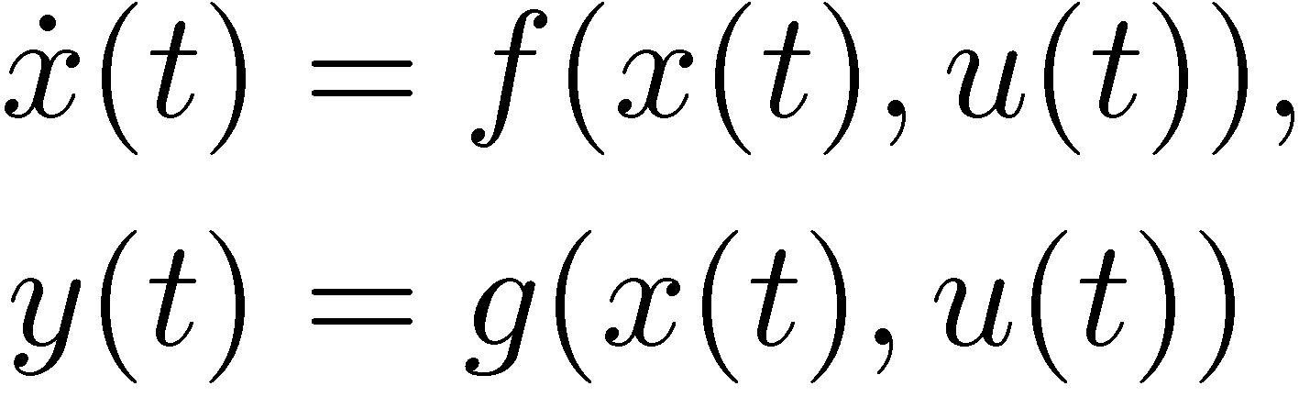
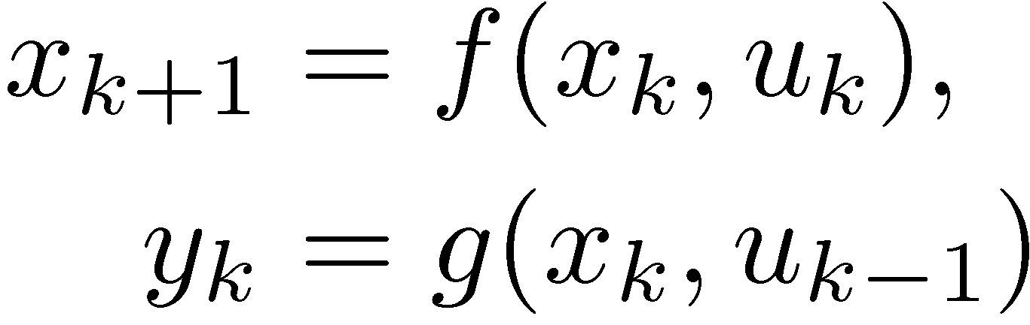
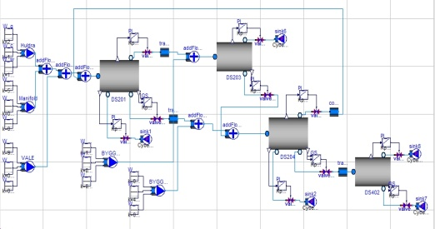
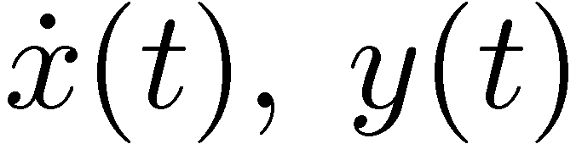
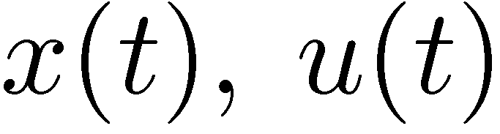
CENIT with Dymola: Data flow
Dymola
Model Component
dsmodel.c
ODE Solver
Map variables
  (MVs, CVs, DVs, measurements, noise, ...)
Model initialization
Initial tuning, etc.
NMPC
MVs, CVs, ...
MVs, DVs, noise, ...
EKF, MHE
GUI
user
engineering
OPC
Engineering tools
Simulation
Parameter estimation
Testing, HIL (OPC server)
NMPC
EKF, MHE
XXX
Plant

Slide 14
Use of system Jacobians
Dymola offers analytical system Jacobians
These can be used (in CENIT) for:
  Solving ODEs (discretizing continuous time ODEs)
  Calculating NMPC sensitivities
  Calculating MHE sensitivities
  Calculating EKF linearizations

Slide 15
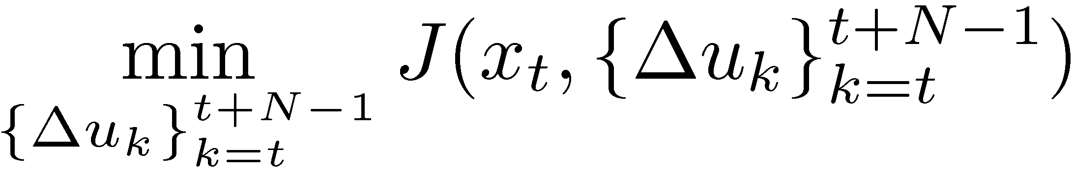
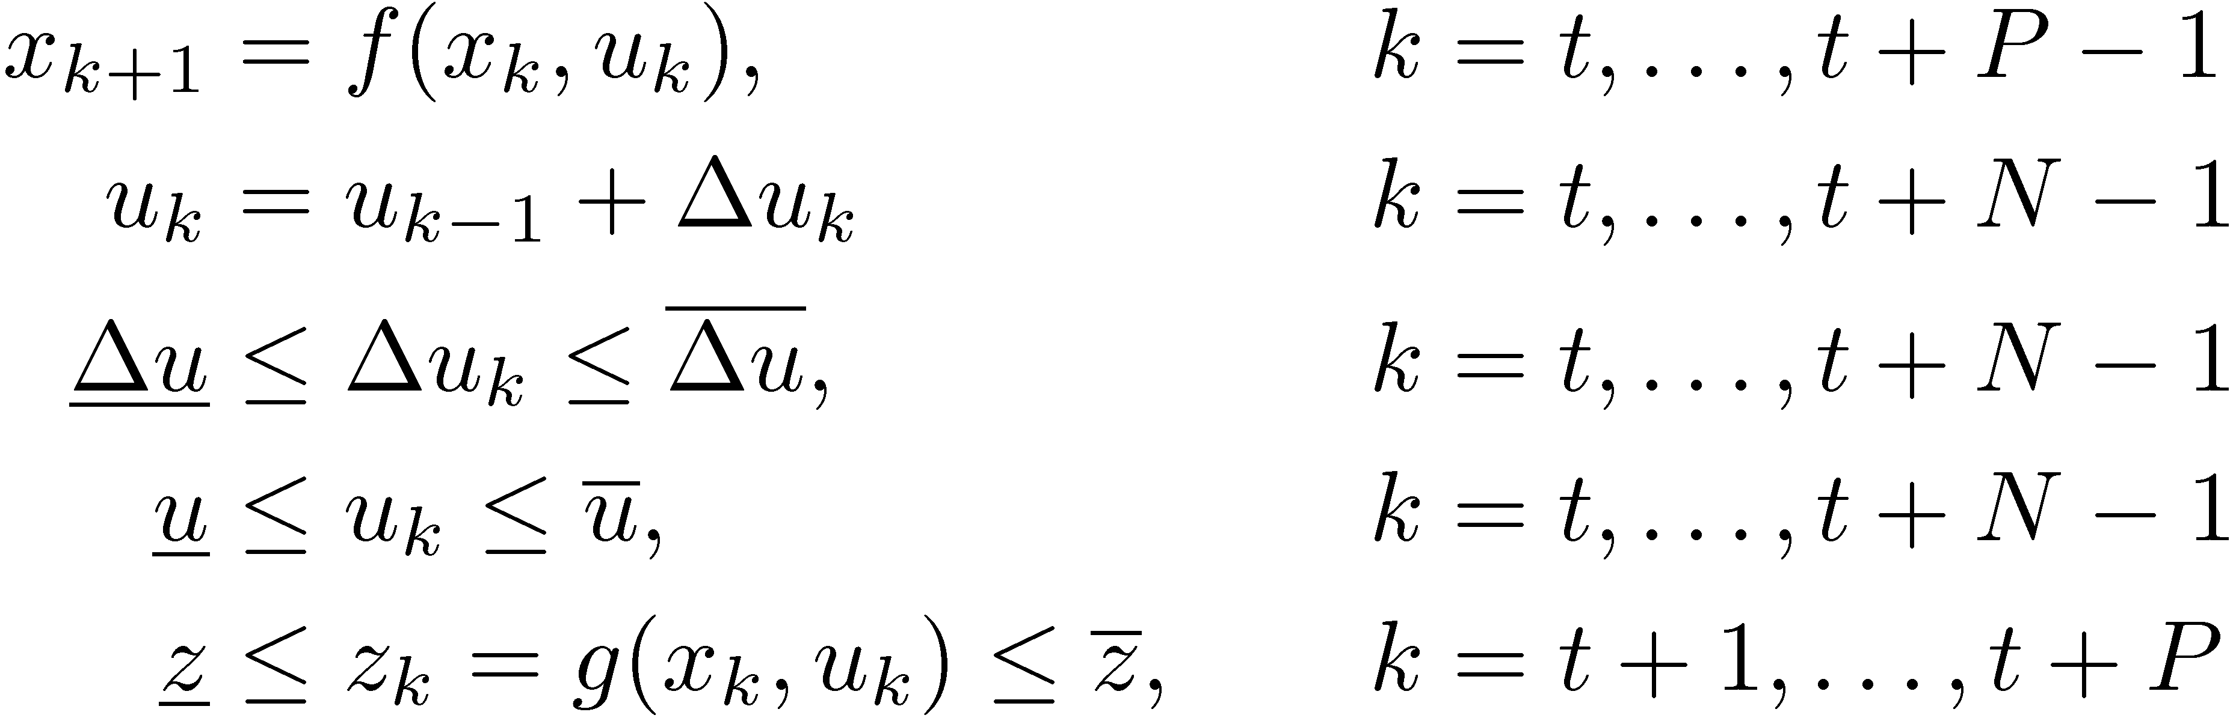
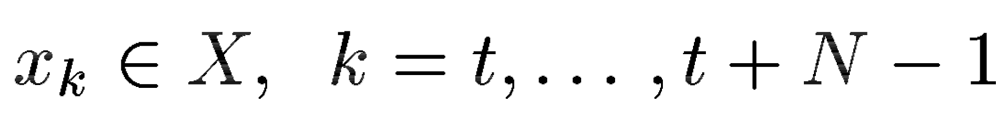
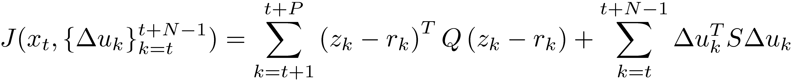
NMPC Discrete-time Open Loop
Optimal Control Problem
Solve
subject to
with
t
t+1
t+N
t+P
Notes:
PAUSE!?
Sammenligne med lineær MPC
- Viktig forskjell: ulineær dynamikk!

Slide 16
Implementation issues
Standard methods for complexity reduction
  Input blocking, zero or first order hold
  Coincidence points
  Longer NMPC sample intervals
State estimation (typically EKF or MHE) is essential
Solving the NMPC optimization problem: SQP
  Simultaneous approach (Biegler, ...)
    Model as explicit equality constraints
    Large, sparse optimization problem, highly structured
  Sequential approach (Biegler, Marquardt, ... and Cybernetica CENIT)
    Model substituted for (simulated), no equality constraints
    Smaller, dense optimization problem
  ”In-between”: Multiple shooting (Bock, Diehl, ...)

Slide 17
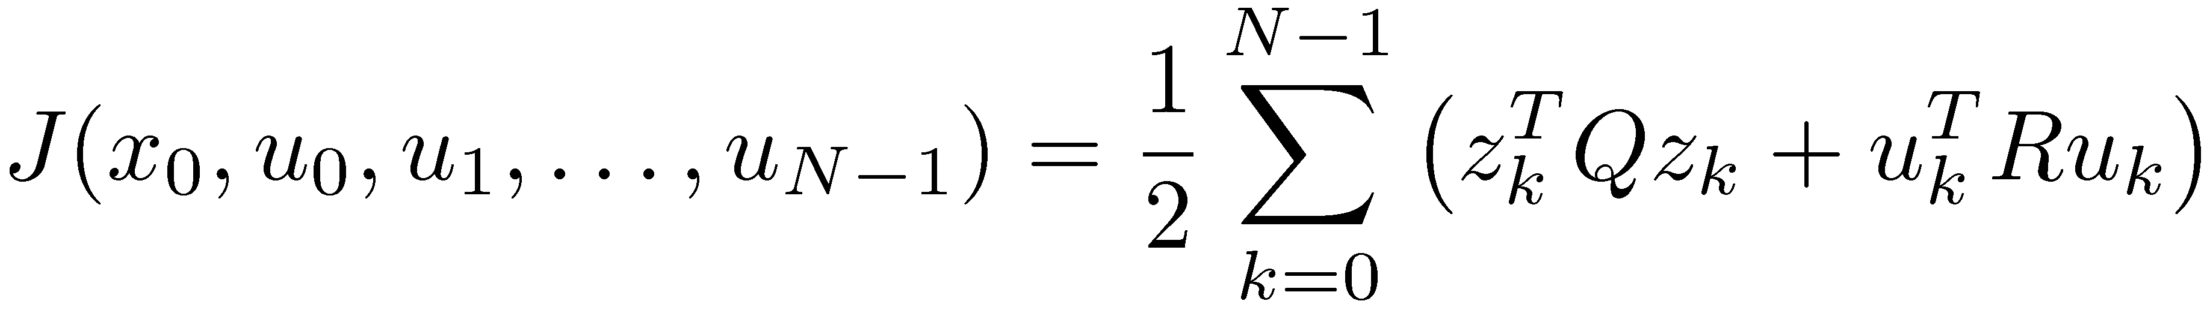
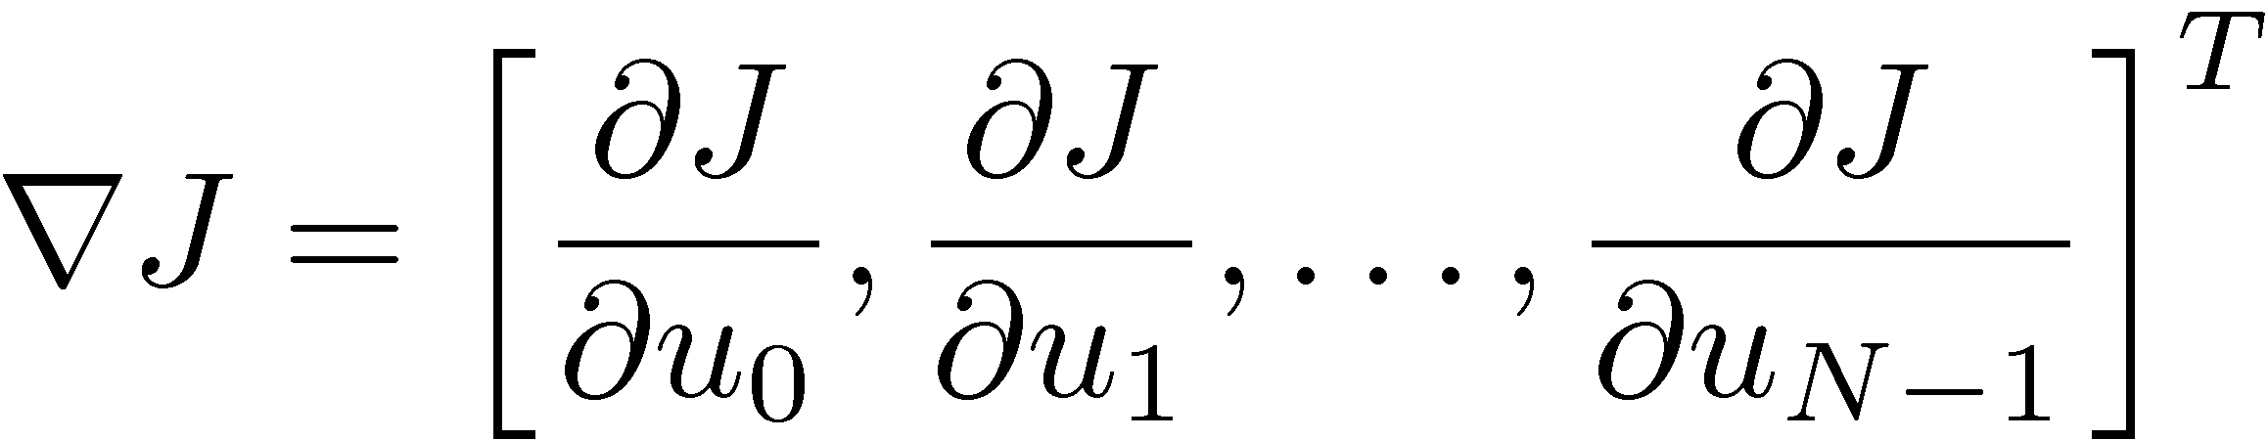
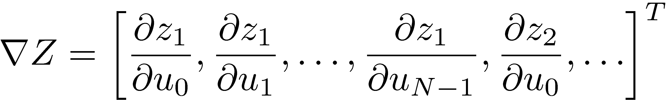
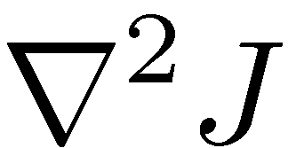
Gradients in sequential NMPC
For simplicity of presentation:
  We optimize u instead of ¢u
  Assume r_{k} = 0 (and x_{s} = f(x_{s},0), 0 = g(x_{s},0))
  Assume N = P
Objective function
We need (for QP step in SQP algorithms)
  Objective function gradient
  Output constraints gradient
  Hessian

Slide 18
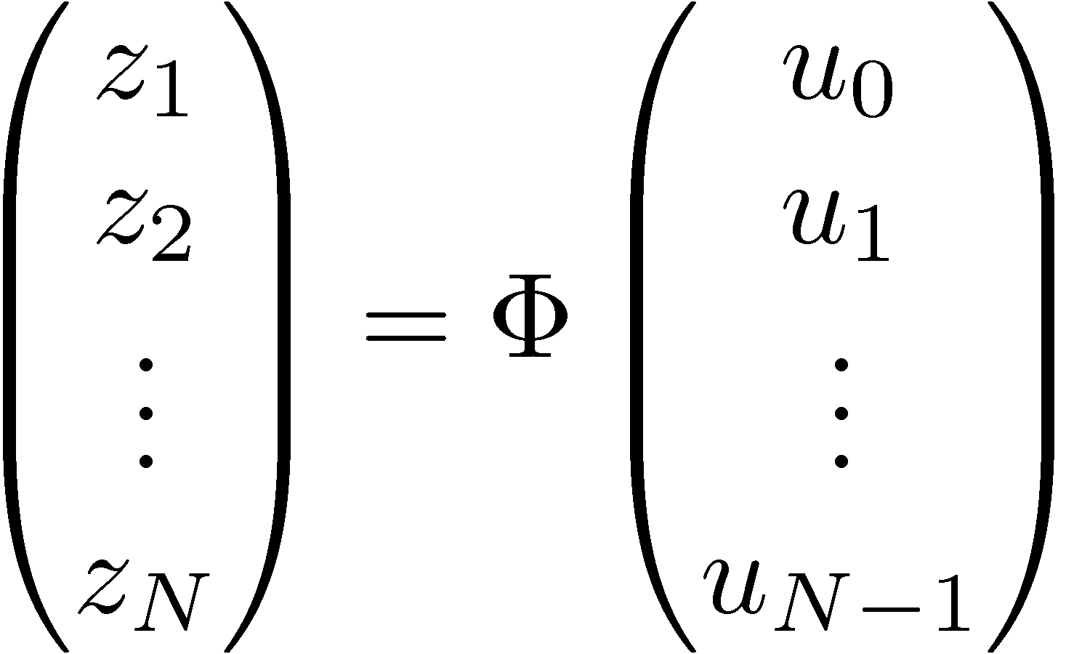


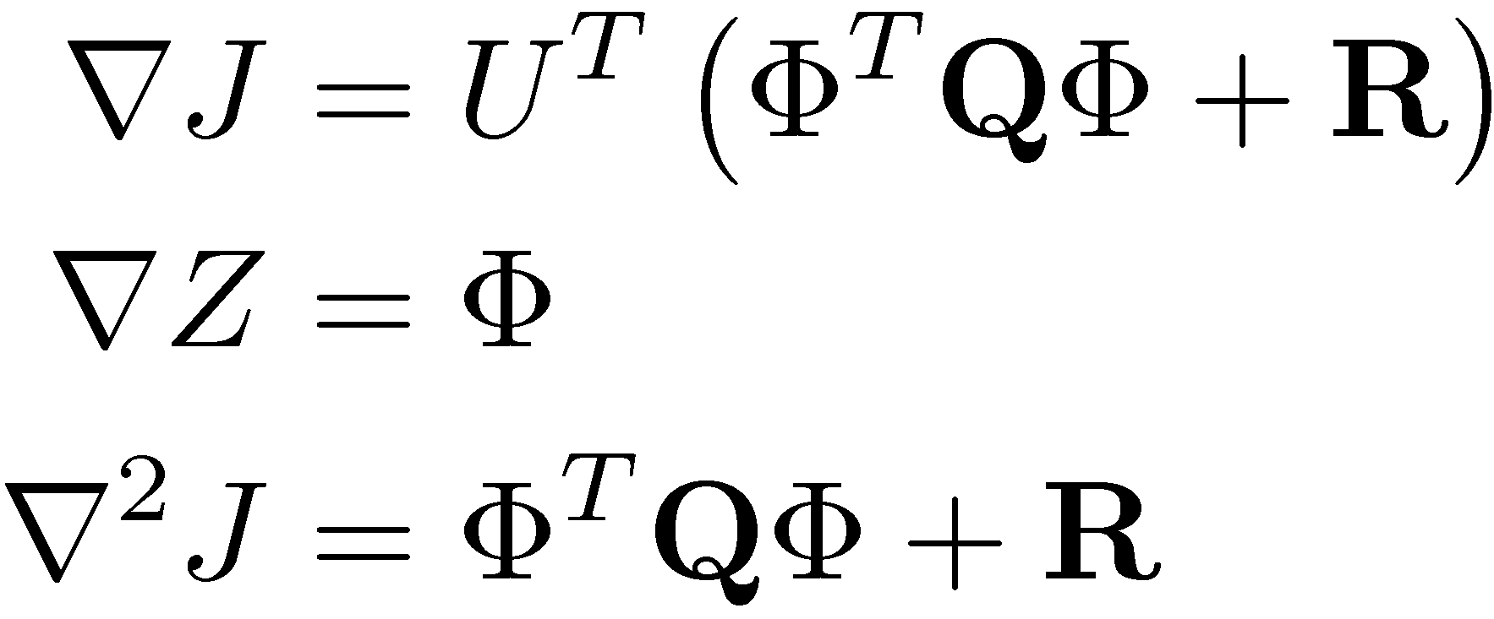
Gradients, cont’d
Linearization along nominal input and output trajectories:
  Impulse/step response matrix
  (Deviation variables)
Objective function:
Gradients, Hessian
How to find ©?

Slide 19
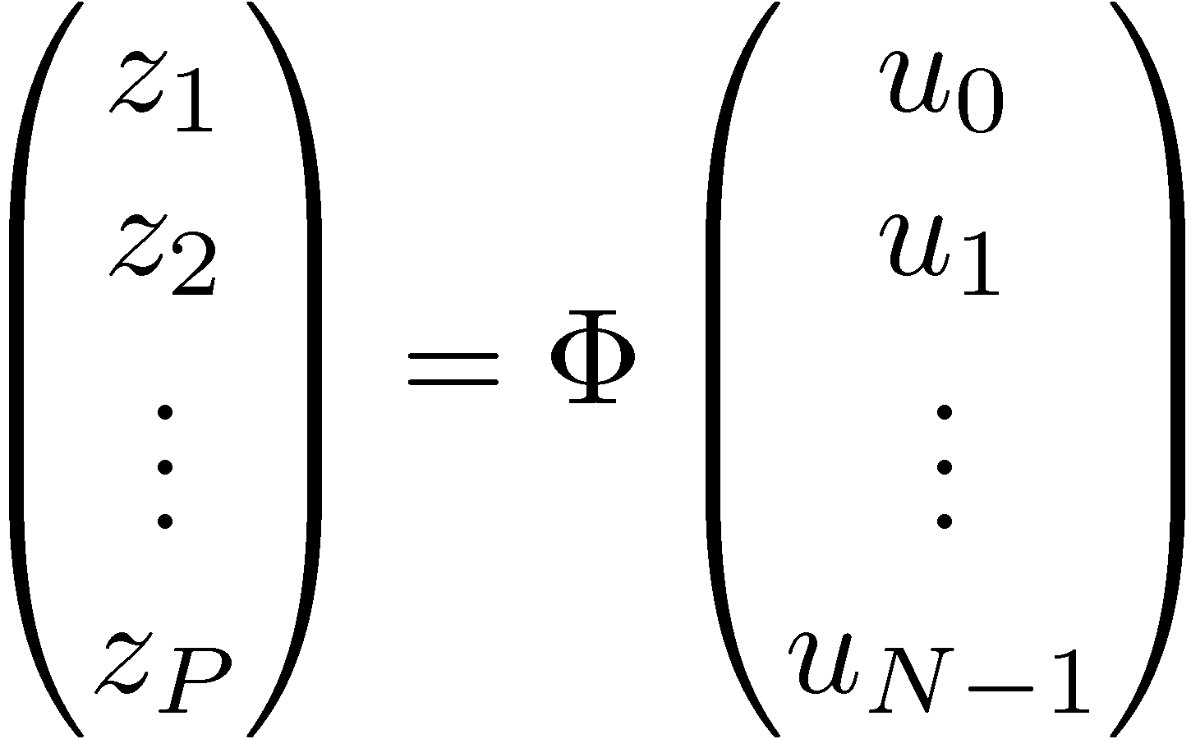
Methods for gradient computation
– finding ©
Finite differences
  Simple to implement, but expensive
    Always?
  Choice of perturbation size – accuracy vs. “numerical noise”
  What about constraints?
Forward methods
  Integrate ODE sensitivities, compute step response matrix
  Large (n_{x} + (n_{x} +n_{u})n_{x} states) system of ODEs, but highly structured
Adjoint methods
  Holds promise, but what about constraint gradients?

Slide 20
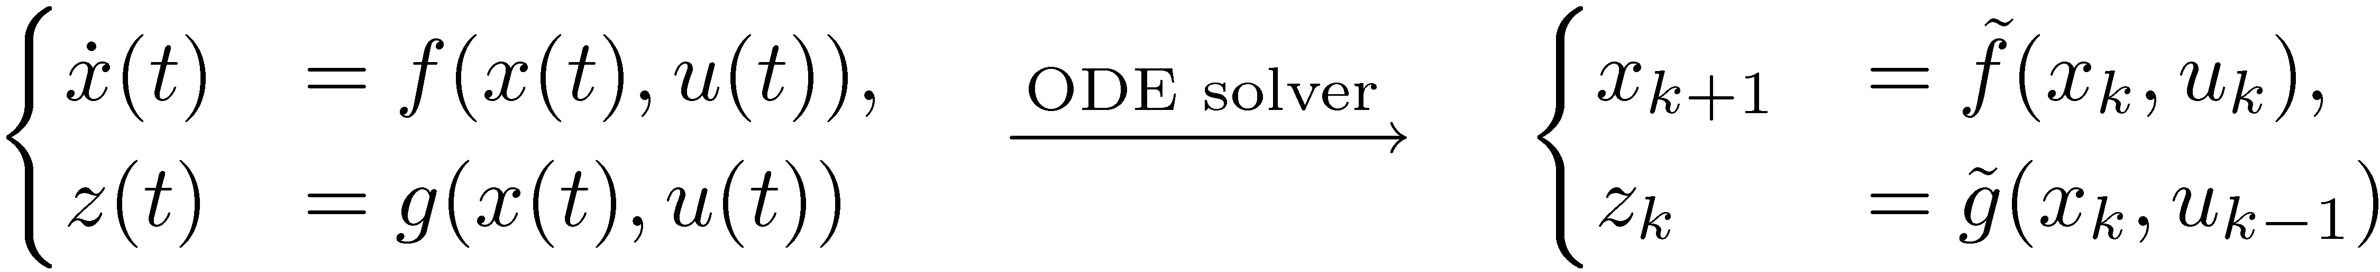
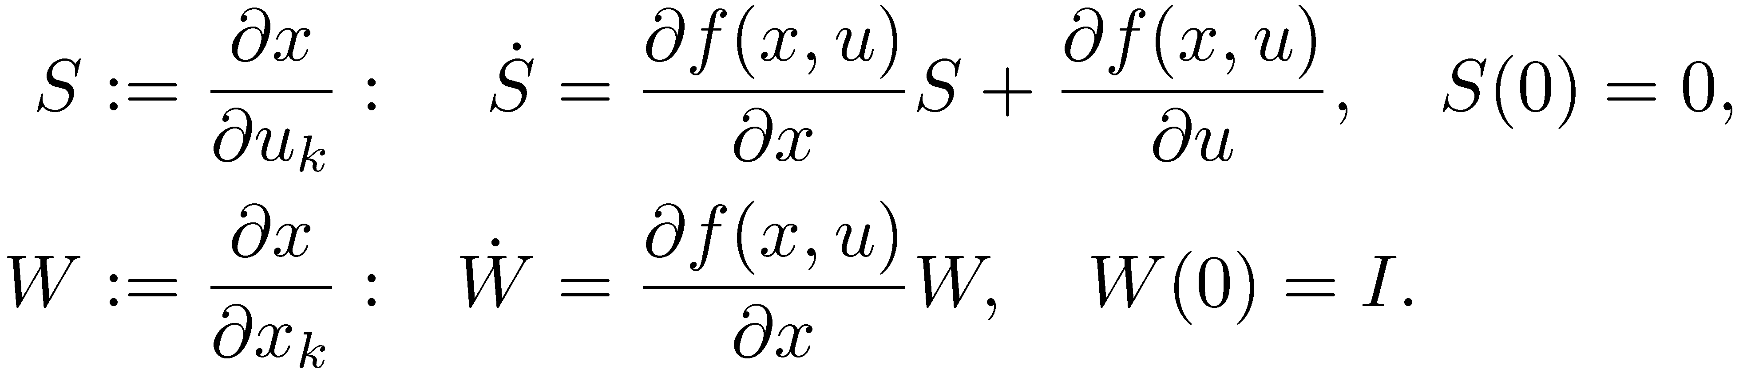
Analytical gradients: Forward methods
Discretization in model component
Define:
  Same Jacobian!
Linearization of discrete-time system:
From Dymola or AD

Slide 21
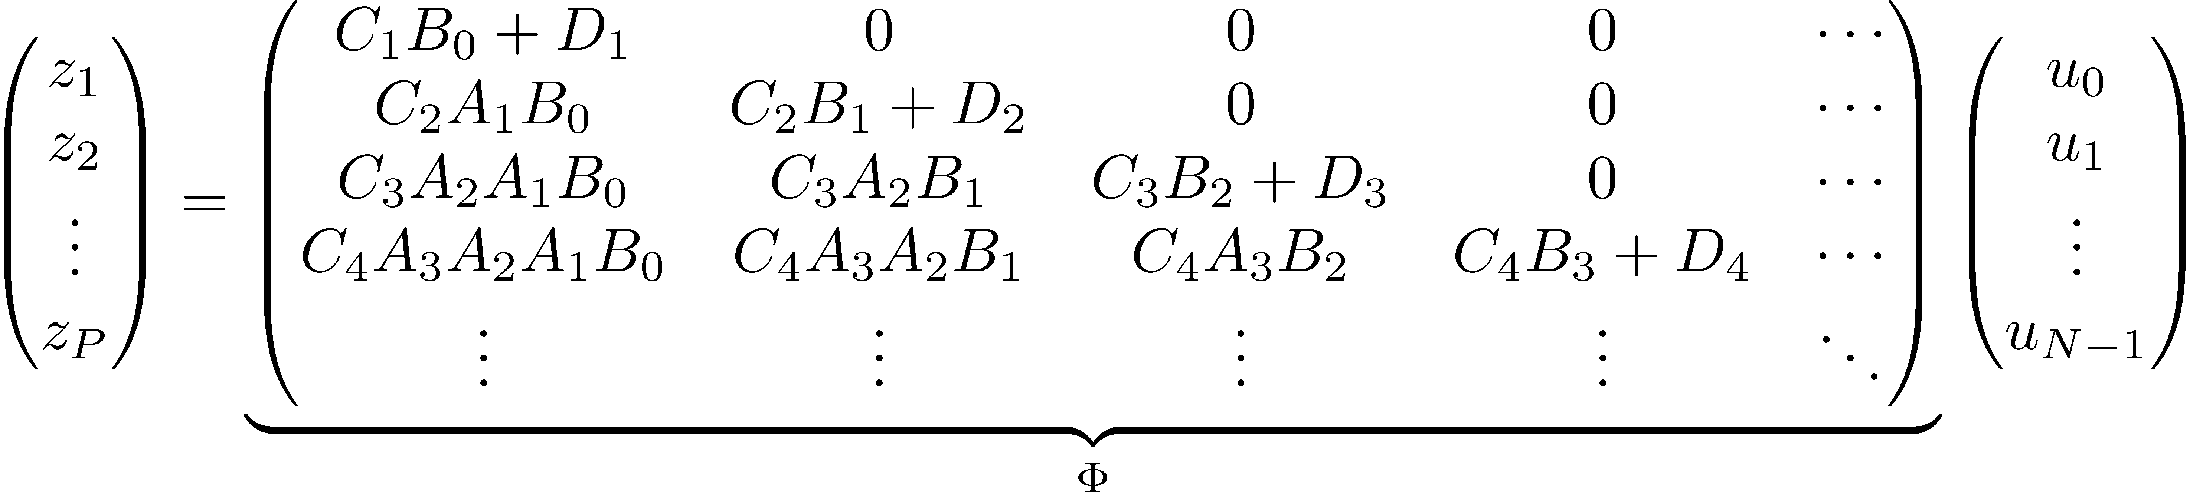
Build step-response matrix
Forward methods:
+ Obtain all information in one simulation (no perturbations – many simulations),
- Must integrate ODE sensitivities (large system, but highly structured Jacobian!)
- Must compute step response matrix, potentially very large
Finite differences:
Forward method:

Slide 22
Forward methods vs finite differences
Finite differences
Non-stiff systems
  Fixed-step ODE integration
Can use for non-differentiable system equations (?)
Forward methods
Stiff systems
  Variable-step ODE solvers
ODE solver with sensitivity integration
  CVODES (Sundials)
Model with analytical derivatives
  Symbolic differentiation
    CENIT: Using Dymola
  Algorithmic differentiation
    CENIT: Using CppAD (C models)

Slide 23
Outline
Background
  Advanced modeling tools in NMPC applications
Software integration
  Dymola/Modelica and Cybernetica CENIT
Modeling issues
  Thermodynamics, networks
Two case studies
  Offshore oil and gas production, estimation and NMPC
Summary and conclusions

Slide 24
Modeling & simulation issues
Models for NMPC applications must have real time capabilities
  Simulate 100-1000 times faster than real time
  Simulate robustly & reliably
Issues
  Balanced complexity – models built for purpose
    Accuracy vs. computational load
  Claim: In many cases real-time demands (speed and/or robustness) dictate ODE models
  Modelica models generally DAE models
    Dymola gives some help in “quest for implicit equations”
Notes:
Use of terms:
- ODE – without nonlinear equation sets,
- DAE – with nonlinear equation sets.

Slide 25
Thermodynamics in Modelica/Dymola
Modelica.Media
  “Media models for liquids and gases”, 1250 media, high precision water
  Thermodynamic properties: T, d, p, h, u and X_{i}
    The media component provides 3 equations (in addition to constants, etc.)
      Rest is mass- and energy balances (flowsheet)
    Functions for calculating thermodynamic properties for a given thermodynamic state
    One or more components, one or more phases
  We use this framework for implementing our own material properties
Modelica.Fluid (beta)
  “One-dimensional thermo-fluid flow in networks of pipes”
    Connectors for fluids using media models from Modelica.Media
  Purpose: Combination networks/thermodynamics must be done “right” to obtain efficient simulation models
  We use this (presently with some modifications) in our models
    Intriguing developments in Modelica 3.0/Dymola 7.1
Other parts of Modelica Standard Library
  Modelica.Blocks, Modelica.Math, Modelica.Constants, Modelica.SIUnits, Modelica.Electrical, Modelica.Mechanics, Modelica.Thermal (and some others)

Slide 26
CyberneticaLib - Offshore process modeling
Implemented in Modelica using Dymola
  Inspiration from Modelica Standard Library
    Fluid properties as in Modelica.Media
    Connectors, etc. as in Modelica.Fluid
  Developed generic unit models
Models built for online applications
  Avoid discontinuities
  Balanced complexity - fast and accurate enough for the purpose
  Avoided implicit equations
    Use of ‘semi-physical’ nodes between flow-setting devices
    ‘Manual’ inversion of selected functions
    ...
Notes:
Avoid implicit equations:
Several places: original and inverse function
Avvoid backward flow
”Rules” on how to connect units. Use of nodes

Slide 27
Outline
Background
  Advanced modeling tools in NMPC applications
Software integration
  Dymola/Modelica and Cybernetica CENIT
Modeling issues
  Thermodynamics, networks
Two case studies
  Offshore oil and gas production, estimation and NMPC
Summary and conclusions

Slide 28
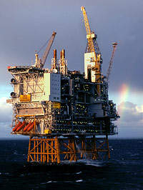
Cases: Offshore oil and gas processing plants
Feed-stream
  Oil, gas and water from underground reservoirs (wells)
Tasks of offshore platforms:
  Separate oil – gas – water, export oil and gas
  Compress gas (for export or re-injection)
  Handle variations in feed-stream
Main process units
  Separators
  Compressors

Slide 29
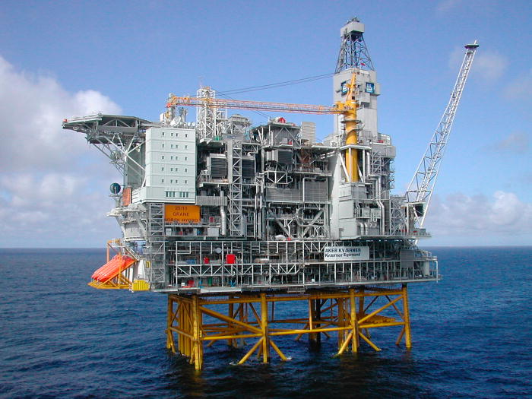
Case 1: State and parameter estimation
Oil-(water)-gas separation, gas compression
Challenges
  Plant is rather well instrumented,
  but hard to get an overall view
  Flow measurements in various units
  Inconsistencies in flow measurements
    Inlet multiphase flow measurements
Possible applications
  Get a ‘balanced’ picture of process state from measurements
  Fault detection
  An up-dated simulator, ‘what-if’-scenarios
  Optimization, de-bottlenecking
  Basis for later implementation of online optimizing control (NMPC)

Slide 30
Topside process model overview
38 dynamic states
38 active measurements
19 measured inputs
33 estimated parameters
True ODE model
Model is stiff
  Used implicit, variable step-
  length ODE solver from Sundials-suite (CVODE)
Application CPU-time:
  > 10 times faster than real-time
  60 sec sample interval

Slide 31
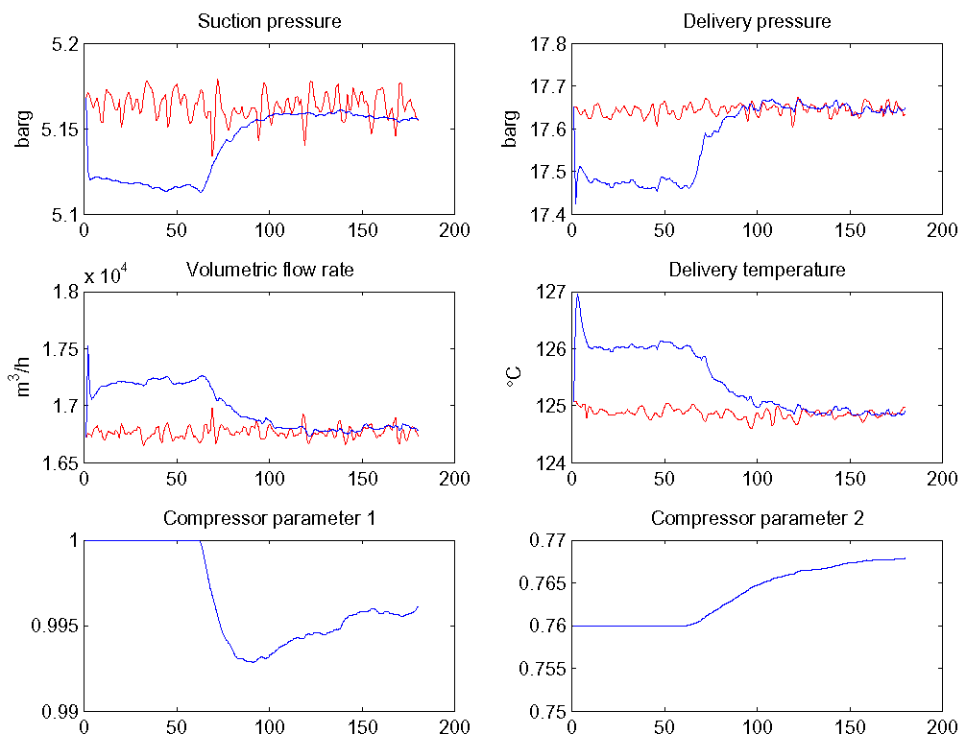
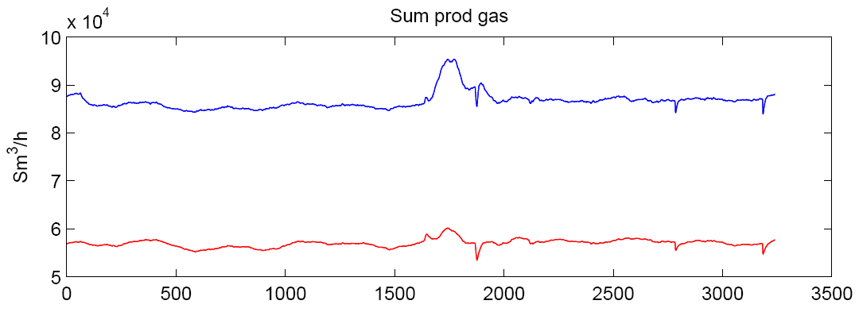
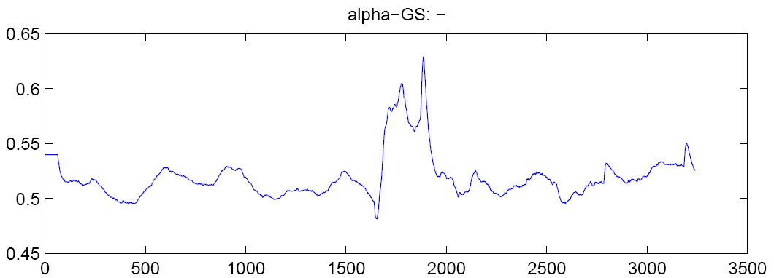
Results – Parameter and state estimation
Measurement
Estimated
Feedback from measurements activated after 60 min.
Excerpt (one compressor stage) from a longer data set
EKF converges to no stationary error in active measurements

Slide 32
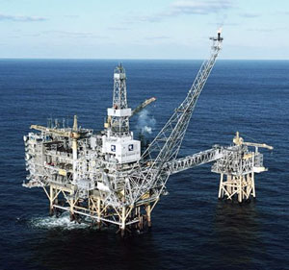

Case 2: NMPC for disturbance rejection
Separation of oil, water and gas
Aim: Reduce effect of ‘slugs’ in inlet flows by
exploiting buffer tank capacity
Simulation study, based on/tuned to real
process
Notes:
* 2625 eqn
40 state variables (mass, mole, energy) + (integrate in controllers)
sensors convert from SI to engineering units

Slide 33

NMPC structure
~14 Controlled Variables (CV)
Controlled to setpoint (6)
  Separator levels of oil and water
6 variables controlled within limits
Rate-of-change
  Exit oil flow
  Exit glycol concentration in water
6 Manipulated Variables (MV)
Setpoints of PID controllers:
  Oil levels
  Water levels
Disturbance Variables (DV)
Estimated inflow rates of gas
and liquid
Some properties
ODE model has 29 states
Not very stiff
  Forward Euler ODE solver
Application (estimation+NMPC) faster than five times real time
Sample interval 6s
Comparison with C model
Pure Modelica model:
  CPU time ~ 2 x ’pure C’
Modelica model with functions in C:
  CPU time < 1.2 x ’pure C’
Notes:
Possible new CVs:
RVP out of stabilizer tower
RVP in buffer tank
Possible new MVs:
Valves (replacing level setpoints)
Level valves
Gas valves
Choke valve to first separator
Stabilizer tower variables
Gas and condensate export

Slide 34
Results with slugging feed
No MPC
MPC

Slide 35
Outline
Background
  Advanced modeling tools in NMPC applications
Software integration
  Dymola/Modelica and Cybernetica CENIT
Modeling issues
  Thermodynamics, networks
Two case studies
  Offshore oil and gas production, estimation and NMPC
Summary and conclusions

Slide 36
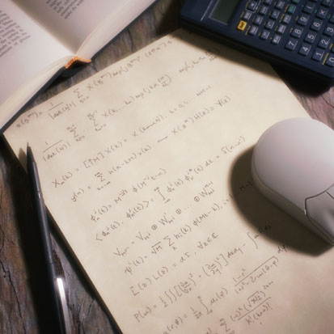
Experiences – modeling
Modelica/Dymola modeling more convenient than C
  High-level language
  Hierarchical, component-based graphical interface reflecting ‘real’ process topology
  Model re-use, libraries
  Modifications through inheritance
    Powerful, but use with care
Issues
  Debugging
  DAE initialization

Slide 37
Experiences – software integration
Modelica model access – Dymola C-export
  Gives efficient software (especially with Modelica functions coded in C)
  Control system with model can be compiled on different targets
  Interface not standardized (Dymola specific)
Modelica simulation model must be prepared for software integration
(inputs and outputs must be specified)
  Modelica model: Inputs and outputs
  NMPC model:
    Inputs: control signals (MV), measured inputs (DV), estimated parameters, noise, …
    Outputs: measured (PV), controlled (CV), …
  Makes development and maintenance more cumbersome and error-prone than it needs to be
Desirable: Information&structure (grouping) of inputs and outputs (and states?)
  Auto-configuration, auto-indexing – avoid specifying same information in two places
  Purpose: Tuning of NMPC and EKF, information in HMI, …

Slide 38
Concluding remarks
Using Dymola models for NMPC applications
  Case studies & some ongoing ‘real’ projects: Success
  Models must be developed with care and understanding
  Project development/maintenance can become more streamlined by improvements in model interface
Conclusion
  Will continue to develop, and aim for use in more projects

Slide 39

Acknowledgements
Colleagues at
Research Centre in Porsgrunn for providing cases and process data

Slide 40
NMPC variables
Dymola states are NMPC states
  Mass (pressures, levels), temperatures, ...
Dymola inputs are
  Controlled inputs (MVs)
    Valves, pumps, ...
  Measured inputs (DVs)
    Feed inflow, ...
  Parameters
    Candidates for estimation
    Valve constants, reaction rates, split factors, pipe friction, ...
Dymola outputs are NMPC
  Controlled outputs (CVs)
  Measured outputs
Dymola parameters are NMPC constants

