Slide 1

Overview and Classification of online process optimization approaches
IFAC DYCOPS Pre-symposium workshop
Sigurd Skogestad
Johannes Jäschke
Dinesh Krishnamoorthy

Slide 2




Trondheim

Slide 3
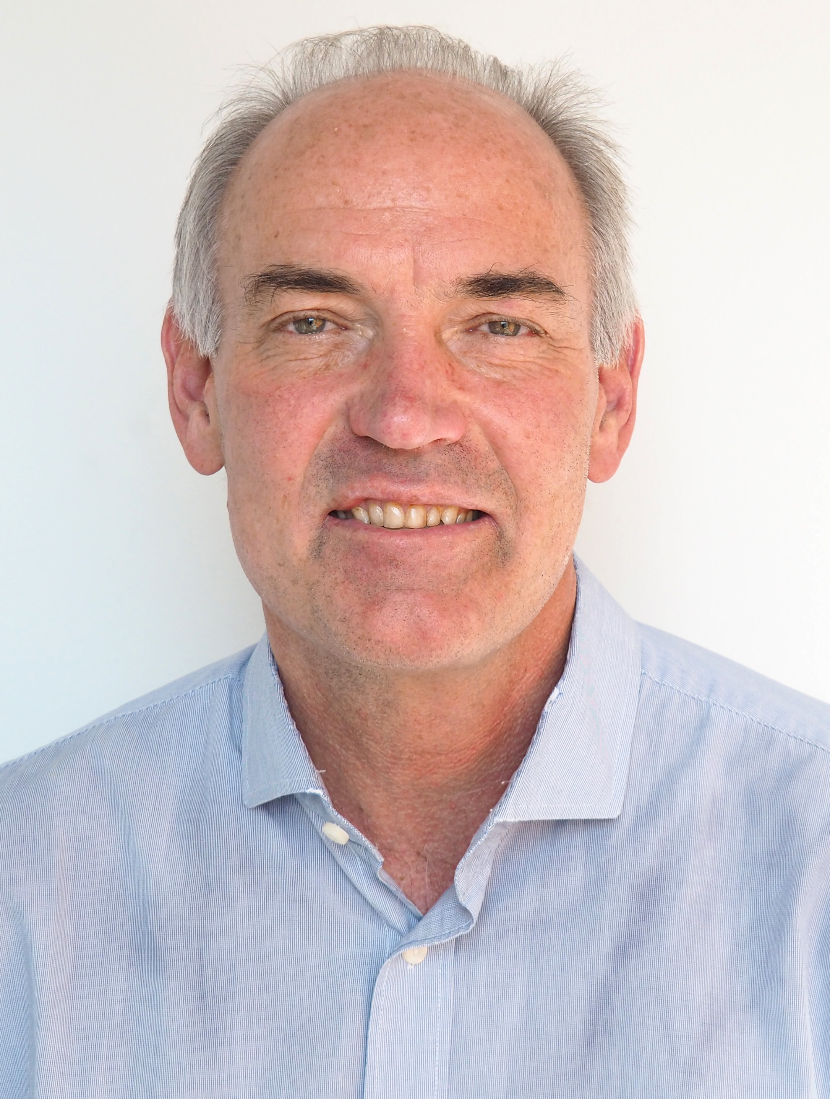

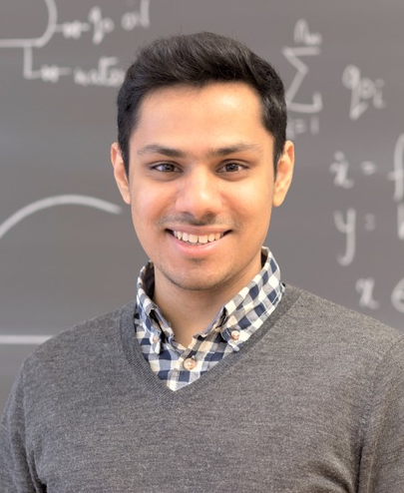
Presenters
Sigurd Skogestad
Professor NTNU
PhD Caltech (1987)
Johannes Jäschke
Associate Prof. NTNU
PhD NTNU (2011)
Dinesh Krishnamoorthy
PhD student NTNU (2019)
MS Imperial College (2012)

Slide 4
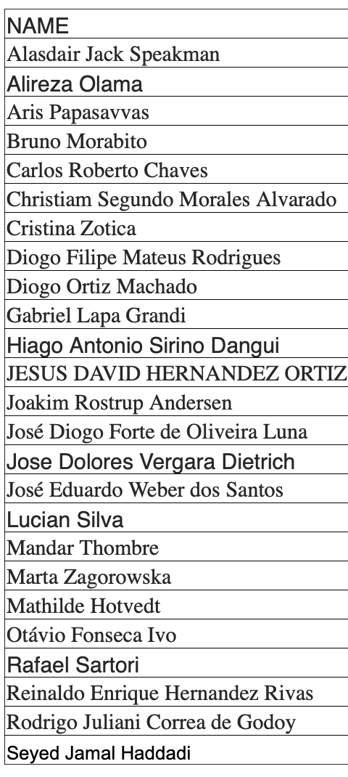

Slide 5
Agenda
13:30 – 13:50 | Welcome and info
13:50 – 14:00 | Introduction Real time optimization (Sigurd Skogestad)
14:00 – 14:10 | 1. Conventional approach: Steady-state optimization - and challenges (Sigurd Skogestad)
14:10 – 14:40 | 2. Academic approach: Economic MPC and Dynamic RTO (Johannes Jäschke)
14:40 – 15:00 | 3. Steady-state optimization with transient measurements – Hybrid RTO (Dinesh Krishnamoorthy)
15:00 – 15:20 | 4. Feedback-based RTO using model-based gradient estimation (Dinesh Krishnamoorthy)
15:20 – 15:40 | 5. Extremum seeking control (Dinesh Krishnamoorthy)
15:40 – 16:00 | Coffee Break
16:00 – 16:20 | 6. Modifier Adaptation (Johannes Jäschke)
16:20 – 16:40 | 7. Self-optimizing Control (Sigurd Skogestad)
16:40 – 17:00 | 8. Classical Approach: Optimal operation using conventional advanced control (Sigurd Skogestad
17:00 – 17:30 | The different approaches are complementary, not contradictory! (Johannes Jäschke)
17:30 – 18:00 | Discussion and Concluding remarks (all)

Slide 7
Introduction to Real time optimization
IFAC DYCOPS Pre-symposium workshop
Sigurd Skogestad

Slide 8
Main objectives control system
Economics: Implementation of acceptable (near-optimal) operation
Regulation: Stable operation
ARE THESE OBJECTIVES CONFLICTING?
Usually NOT
  Different time scales
    Stabilization fast time scale
  Stabilization doesn’t “use up” any degrees of freedom
    Reference value (setpoint) available for layer above
    But it “uses up” part of the time window (frequency range)

Slide 9
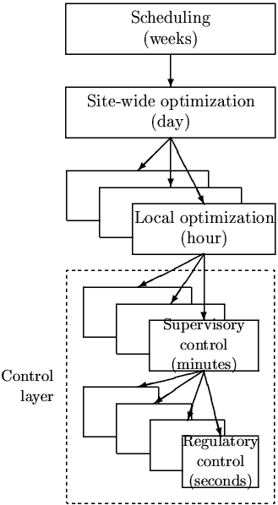
In theory: Centralized controller is always optimal (e.g., EMPC)
Objectives
Approach:
  Model of overall system
  Estimate present state
  Optimize all degrees of freedom
Process control:
  Excellent candidate for centralized control
Problems:
  Model not available
  Objectives = ?
  Optimization complex
  Not robust (difficult to handle uncertainty)
  Slow response time
CENTRALIZED
OPTIMIZER
Present state
Model of system
(Physical) Degrees of freedom, u= valve positions

Slide 10
In practice: Hierarchical decision system based on time scale separation
Manager
Process engineer
Focus of this workshop
min J (economics)
Operator/RTO
Setpoint control
(+ look after other variables)
”Advanced classical control”/MPC
Stabilize + avoid drift
PID-control
u = valves

Slide 11
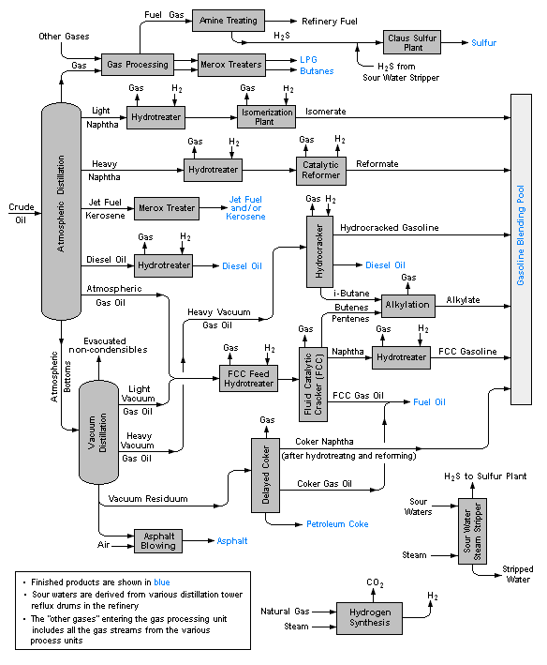
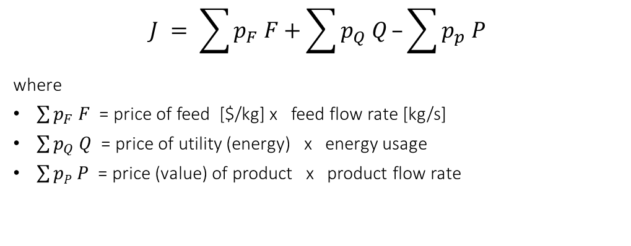
General objective process operation (RTO):
Minimize cost J = maximize profit (–J) [$/s] subject to constraints
$$J = \sum{p_{F} F}+\sum{p_{Q} Q}–\sum{p_{p} P}$$
where
$\sum{p_{F} F}$ = price of feed [$/kg] x feed flow rate [kg/s]
$\sum{p_{Q} Q}$ = price of utility (energy) x energy usage
$\sum{pP P}$ = price (value) of product x product flow rate
Note: No capital costs or costs for operators
(assumed fixed for time scale of interest, a few hours)
Typical process constraints:
  Product quality (purity)
  Environment (amount and purity of waste products)
  Equipment (max. and min. flows, pressures)
Typical degrees of freedom (decision variables) (u)
  Flowrates: Feeds, splits (recycles), heating/cooling

Slide 12
Two main operation modes
  I. Sales limited by market: Given production (constraint)
    Optimal with high energy efficiency (good for environment)
  II. High price product and high demand: Maximize production
    Lower energy efficiency
    Optimal to overpurify waste products to recover more (good for environment)

Slide 13
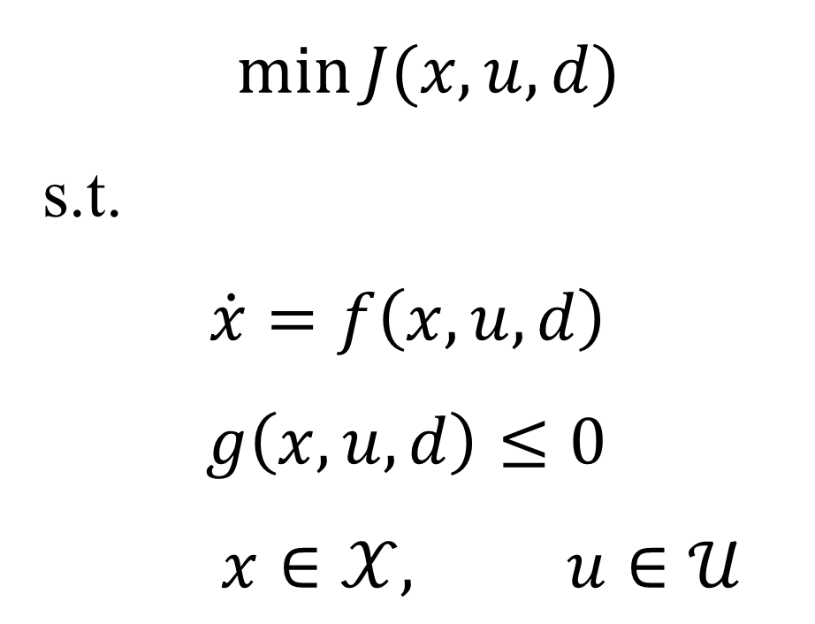
Formulation of Real time optimization
Process Model
Process constraints
Optimal decision variables (u) / Optimal setpoints (y)
Economic Model
$$\min{J(x,u,d)}$$
s.t.
$\dot{x}=f\left(x,u,d\right)$
$$g\left(x,u,d\right)≤0 \\ x∈𝒳, u∈𝒰$$
Internal variables
Decision variables
d: Parameter values / disturbances

Slide 14
1. Conventional approach: Steady-state Real time optimization
- and Challenges
IFAC DYCOPS Pre-symposium workshop
Sigurd Skogestad

Slide 15
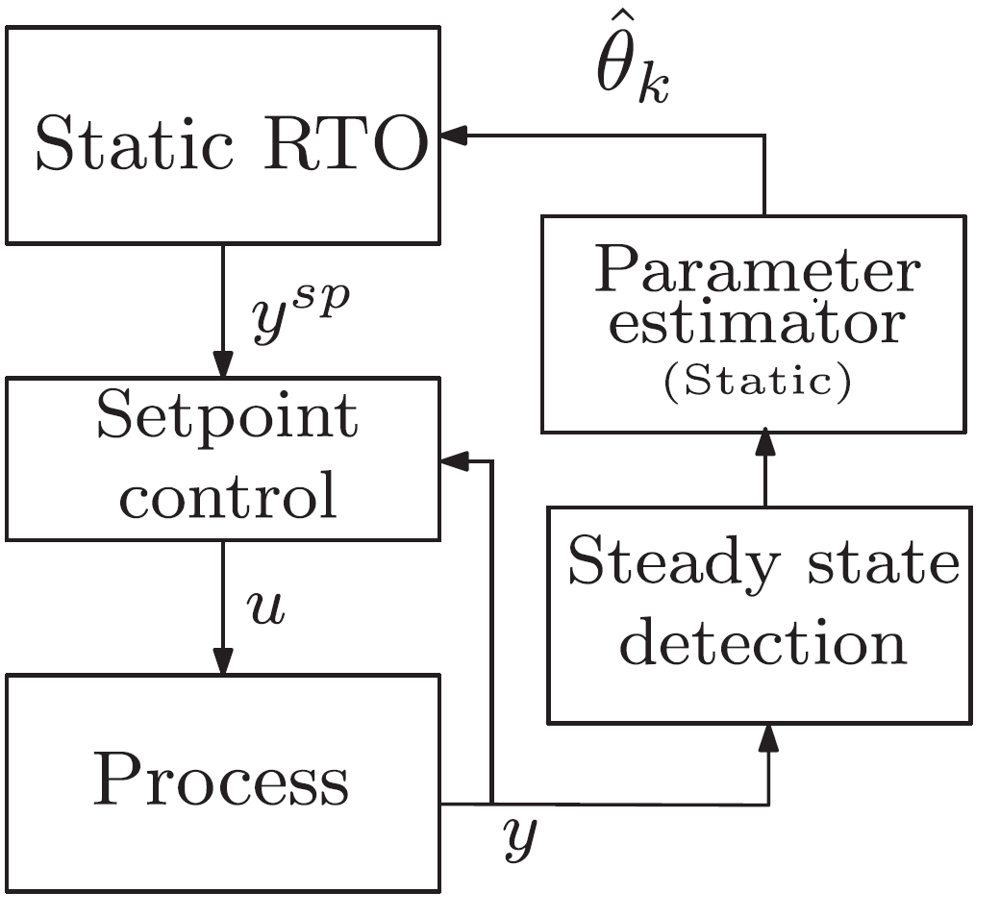
Conventional (commercial) steady-state RTO
dhat
Steady-state models
Two-step approach
  “Data reconciliation”:
    Steady-state detection
    Update estimate of d: model parameters, disturbances (feed), constraints
  Re-optimize to find new optimal steady state
Data reconciliation
d
D. E. Seborg, D. A. Mellichamp, T. F. Edgar, F. J. Doyle III, Process dynamics and control, John Wiley & Sons, 2010.

Slide 16
Conventional steady-state RTO
Typically uses detailed process models with full thermo package
  Hysys / Unisim (Honeywell)
  Aspen
  PROCESS
  …..
But traditional RTO less used in practice than one should expect
  Ethylene plants (furnace)
  Some refinery applications

Slide 17
Why is conventinal static RTO not commonly used?
Problems (in expected order of importance):
Cost of developing and updating the model (costly offline model update)
Wrong value of model parameters and disturbances d (slow online model update)
Not robust, including computational issues
Frequent grade changes make steady-state optimization less relevant
Dynamic limitations, including infeasibility due to (dynamic) constraint violation
Incorrect model structure
Not problems, but Challenges ☺

Slide 18
Challenge 1 - Costly offline model development and update
Lack of domain/expert knowledge
Change in process configuration
Model simplification
Possible Fix: Data-methods based on measuring Cost (J) (Extremum seeking control; see Approach 5)
Recent interest – Machine learning and AI to develop models

Slide 19
Challenge 2 - Steady-state wait time
  Frequent disturbances (d)
  Long settling times
Data reconciliation step is infrequent
Wrong value of model parameter/disturbances (dhat)
Process operates sub-optimally for long periods of time
dhat
Data reconciliation
d
Fix: Use dynamic model in estimation step (Hybrid RTO; see Approach 3)

Slide 20
Challenge 3 - Computational issues
Convergence issues and numerical failure
CPU times
scaling of variables
Complementary constraints
Fix – Methods that do not need to solve numerical optimization problems online (Novel Feedback RTO; see Approach 4)

Slide 21
Challenge 4 - Frequent grade changes
  Continuous process with frequent changes in feed, product specifications, market disturbances, slow dynamics/long settling time
  Continuous with frequent grade transitions
  Batch processes
  Cyclic operations
Source: Koller et al. (2017) Comput& Chem Eng, 106, pp.147-159.
Fix (if relevant) – Dynamic optimization methods (DRTO or EMPC; see Approach 2)

Slide 22
Challenge 5 - Dynamic limitations
Dynamic constraint violations
Force variables to fixed set points, may not utilize all degrees of freedom
A steady-state optimization layer and a control layer may lead to model inconsistency
Partial Fix – Use setpoint tracking control layer below RTO

Slide 23
Challenge 6 – Incorrect model structure
E.g. missing one chemical reaction
Cannot be fixed by parameter updates
Fix – Modifier adaptation based on measuring Cost (J)

Slide 24
2. Academic approach : Dynamic RTO and Economic MPC
IFAC DYCOPS Pre-symposium workshop
Johannes Jäschke

Slide 25
DRTO and Economic MPC
  Optimize not only steady state, but also transients
  Continuous process with frequent changes in feed, product specifications, market disturbances, slow dynamics/long settling time
  Continuous with frequent grade transitions
  Batch processes
  Energy storage
  Cyclic operations
Source: Koller et al. (2017) Comput& Chem Eng, 106, pp.147-159.
Directly address challenge 4 (frequent changes, non-negligible transient operation)

Slide 26
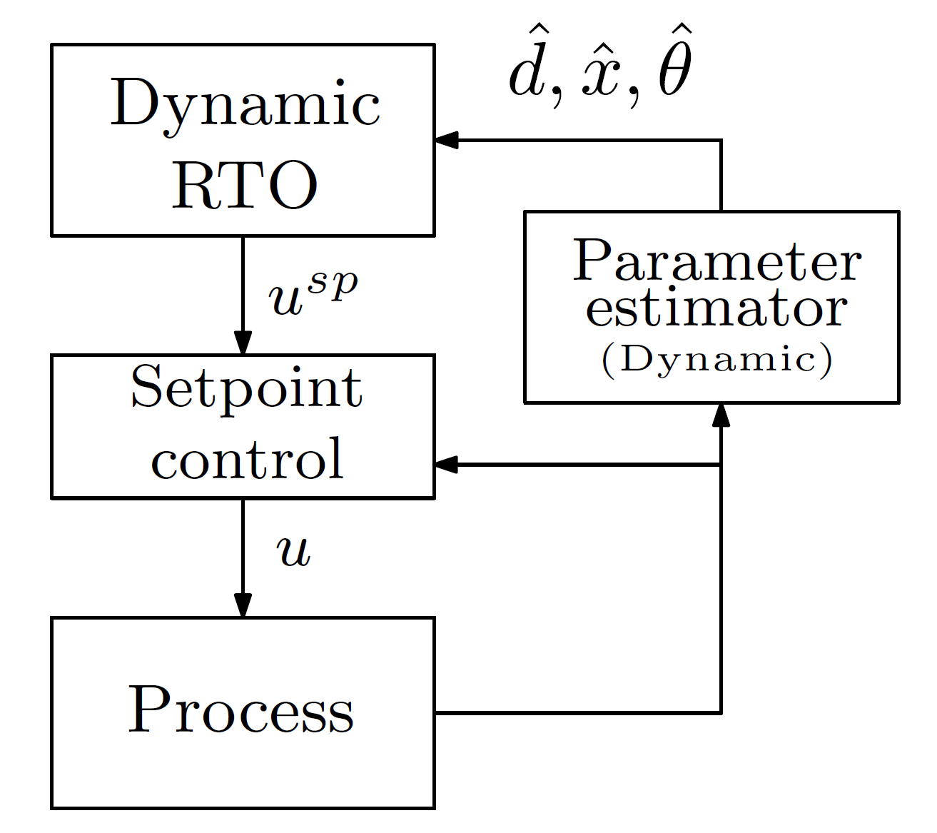
Dynamic RTO
Uses dynamic models online
Repeatedly solve Dynamic RTO problem
for a given horizon
Closely related to economic MPC

Slide 27
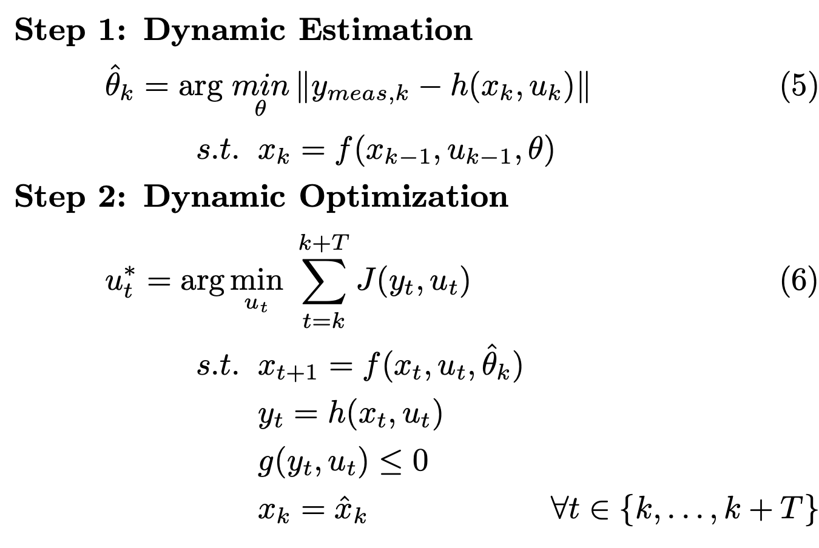
Main idea
measurements
states
Repeatedly solve
manipulated variable
sent to lower layer
past
future
estimation horizon
prediction horizon

Slide 28
Main idea
Repeatedly solve

Slide 29
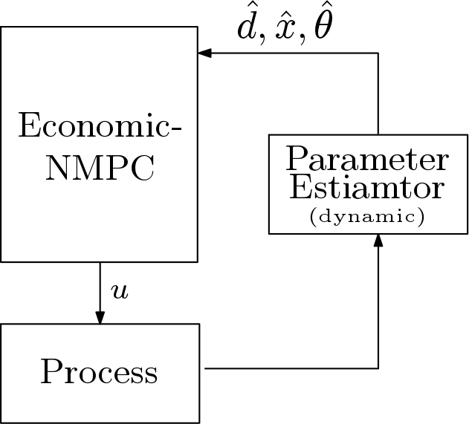
Economic MPC ~ Dynamic RTO
Centralized “All-in-one” optimizer
Higher sampling rates
Hierarchical layers with time scale separation
Lower sampling rates
Usually in Economic MPC a lower layer is also included, e.g. perfect level control, etc..

Slide 30
Industrial applications of Dynamic RTO
Bartusiak (2007)
  polyolefin polymerization processes
Odloak+Petrobras
  FCC unit
Cybernetica
  Polymerization reactors
HVAC (Stanford) Rawlings

Slide 31
Challenges with Dynamic RTO
Main Challenge: Manage complexity
Trade-off
Cost to make it work and improved profit.

Slide 32
Complexity: The challenge with Dynamic RTO
Obtaining and maintaining an accurate dynamic model
Computational issues
Robustness issues
Implementation issues

Slide 33
Obtaining and maintaining an accurate dynamic model
  Modelling efforts
  Requires plant testing over larger operation range
  Trade-off between learning model parameters and optimal operation

Slide 34
Computational issues
  Computational cost for solving the large NLP
    NLP solvers (IPOPT (Biegler) Conopt, others…
    Fast Sensitivity-based methods
      Realtime iterations (Diehl et al 2002)
      Advanced step NMPC (Zavala & Biegler 2009, Jäschke et al 2015)
    Convergence issues
      Thermodynamics model crashes, Flash computations
  Discrete and nonsmooth decisions
    Lead to mixed integer optimization problems
    Cannot be solved in real-time for large systems

Slide 35
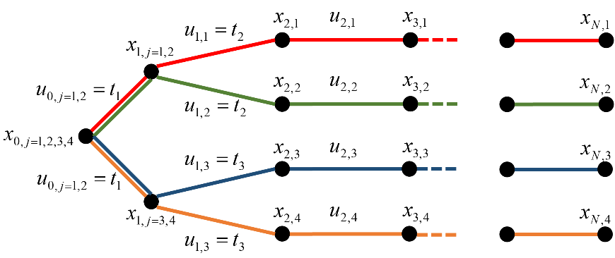
Robustness issues
Robustness issues
  Model errors
  Uncertain parameters (predictions)
  Implications for stability
  Tend to make computations significantly more complex

Slide 36
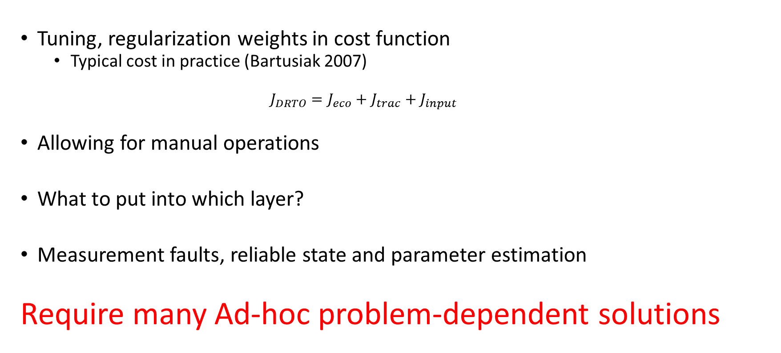
Implementation issues
Tuning, regularization weights in cost function
  Typical cost in practice (Bartusiak 2007)
    $$J_{DRTO}=J_{eco}+J_{trac}+J_{input}$$
Allowing for manual operations
What to put into which layer?
Measurement faults, reliable state and parameter estimation
Require many Ad-hoc problem-dependent solutions

Slide 37
Academia
Stability
Numerical issues
  Computation speed
  Decentralizing
Uncertainty
  Stochastic MPC
  Robust MPC
  Chance constraint
  Dual MPC
Proofs mainly of concern for academia
Handle complexity in real-time
Typically add complexity

Slide 38
DRTO and EMPC has many potential benefits
Reduced amount of off-spec product
Changing operational strategy:
  Agile operation switching productions
    Demand-side management
    Load-balancing services
For some processes, optimal operation is not at a steady state (Angeli 2011)
Promise: Truly optimal operation
  But that is hard/impossible to deliver

Slide 39
3. Steady-state optimization using Transient Measurements – Hybrid RTO
IFAC DYCOPS Pre-symposium workshop
Dinesh Krishnamoorthy
Krishnamoorthy, D., Foss, B. and Skogestad, S., 2018. Steady-state real-time optimization using transient measurements. Computers & Chemical Engineering, 115, pp.34-45.

Slide 40
Why is traditional static RTO not commonly used?
Cost of developing and updating the model (costly offline model update)
Wrong value of model parameters and disturbances (slow online model update)
Not robust, including computational issues
Frequent grade changes make steady-state optimization less relevant
Dynamic limitations, including infeasibility due to (dynamic) constraint violation
Incorrect model structure

Slide 41
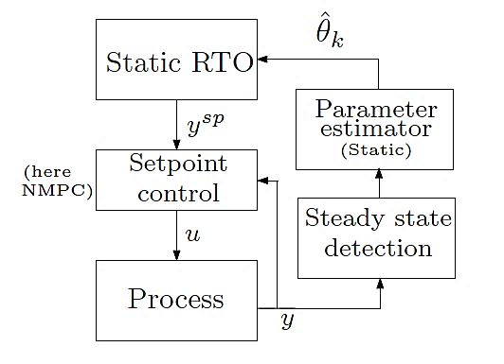
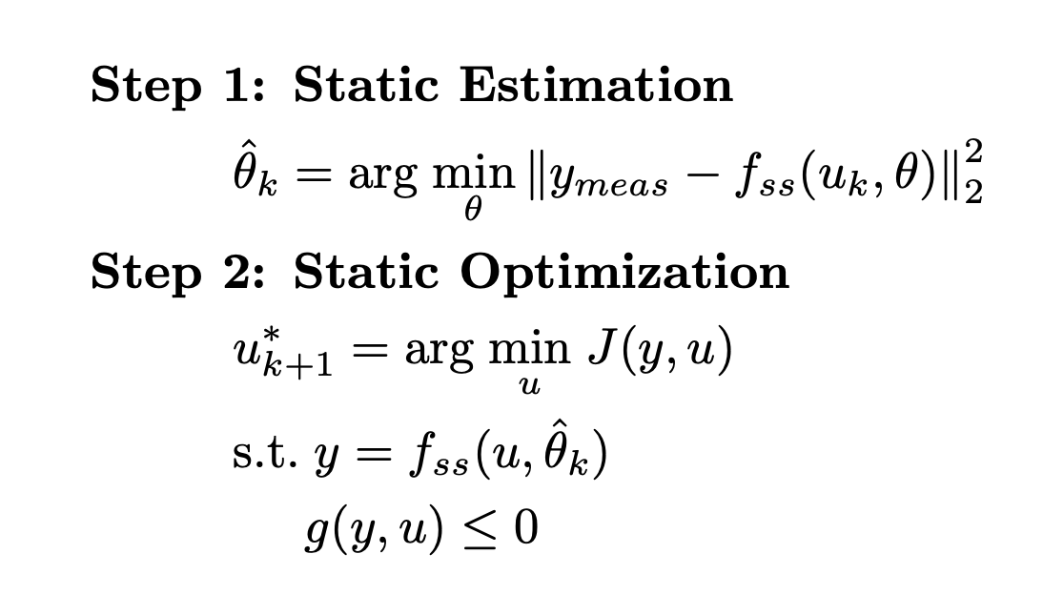
Traditional Steady-state RTO

Slide 42
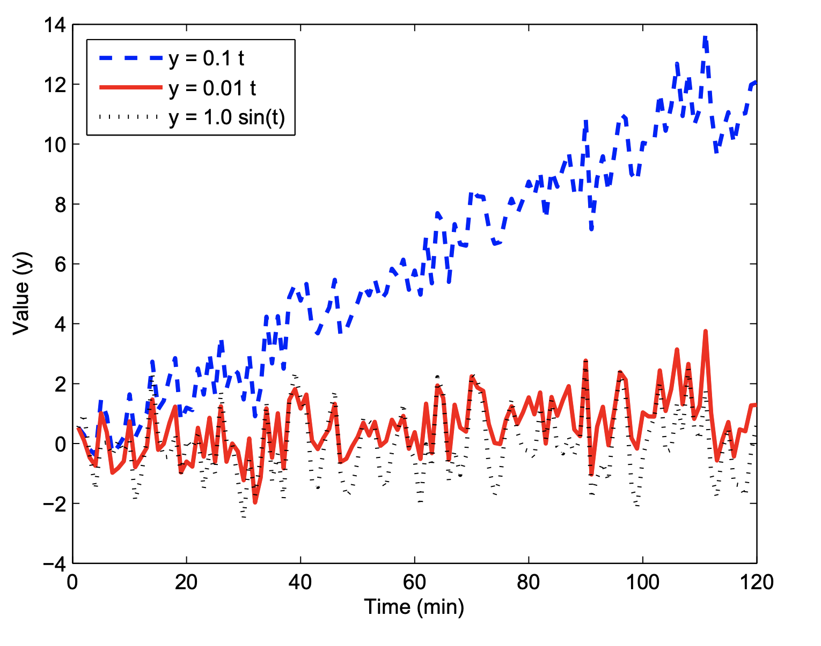
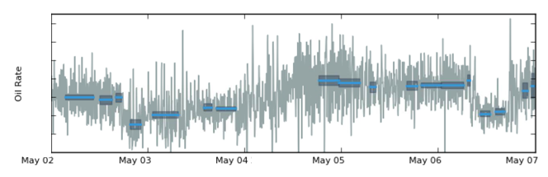
Steady-state wait time
Transient measurements cannot be used
Large chunks of data discarded
Steady state detection issues
  Erraneously accept transient data
  Non-stationary drifts
Source: Kelly, J.D. and Hedengren, J.D., 2013. A steady-state detection (SSD) algorithm to detect non-stationary drifts in processes. Journal of Process Control, 23(3), pp.326-331.

Slide 43
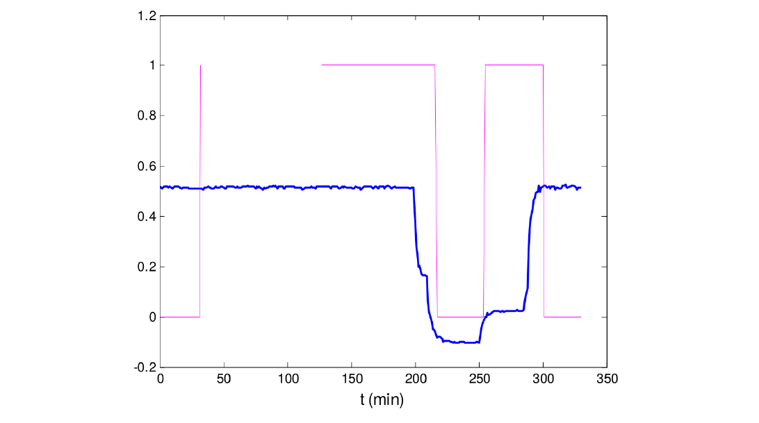
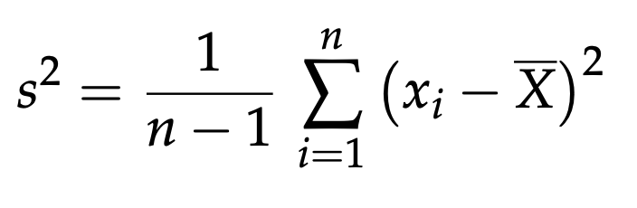
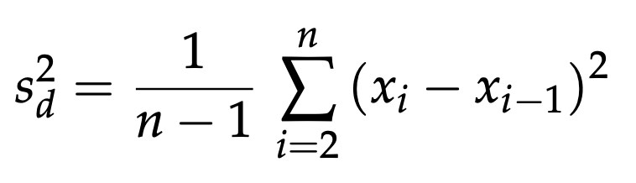
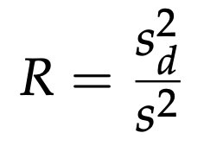
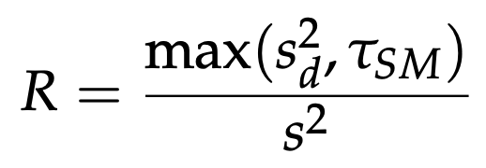
Steady-state wait time
Based on statistical tests,
e.g:
In practice - some heuristics
Source: Câmara MM, Quelhas AD, Pinto JC. Performance Evaluation of Real Industrial RTO Systems. Processes. 2016, 4(4).

Slide 44
How to address steady-state wait time?
OBVIOUS: DYNAMIC RTO
Dynamic RTO has problems – especially the optimization part

Slide 45
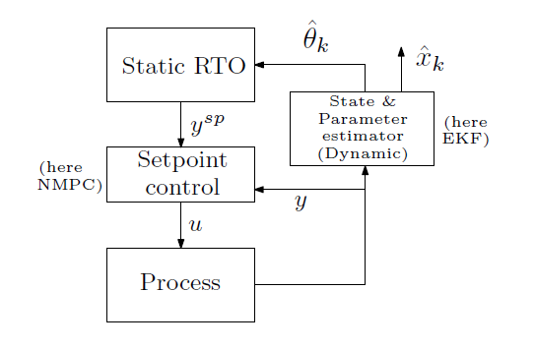
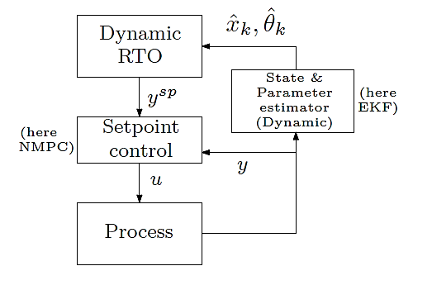
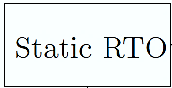
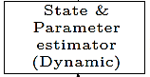
Hybrid RTO
Dynamic Estimation
+
Static Optimization
Krishnamoorthy, D., Foss, B. and Skogestad, S., 2018. Steady-State Real-time Optimization using Transient Measurements. Computers and Chemical Engineering, Vol 115, p.34-45.

Slide 46
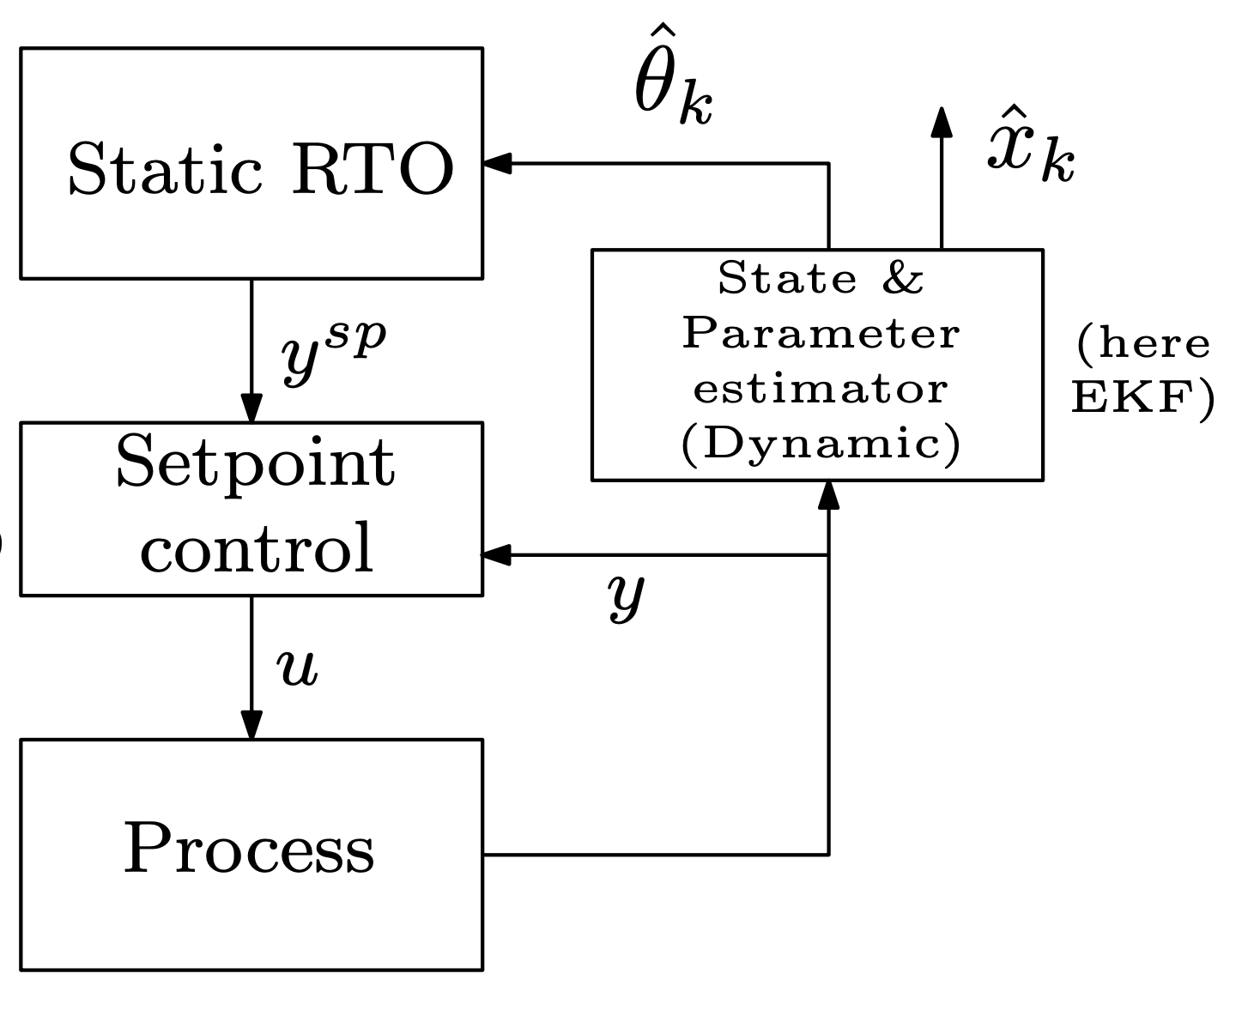
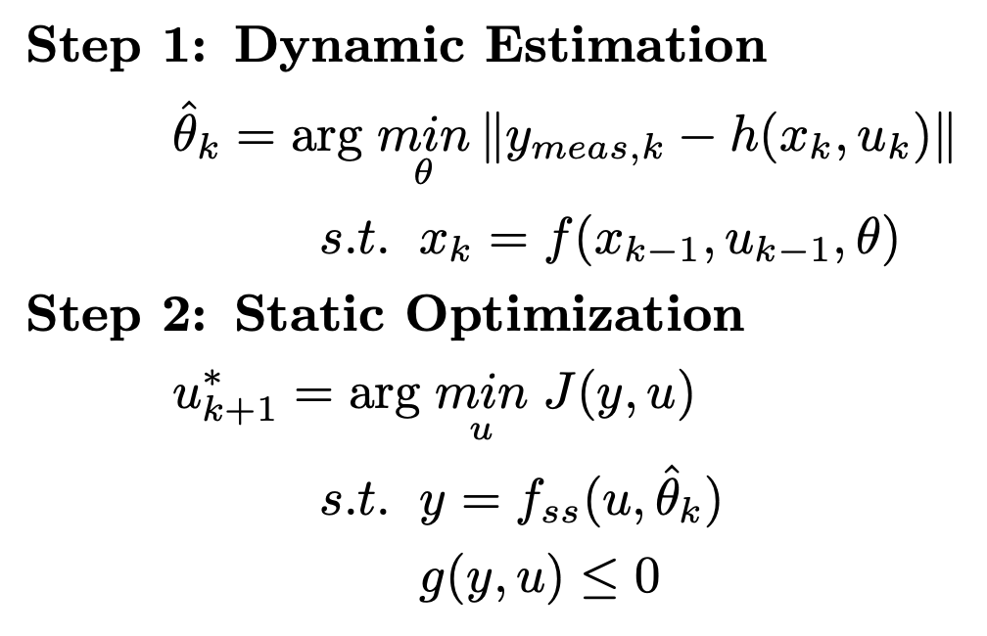
Hybrid RTO
Krishanmoorthy, Foss, Skogestad, Comput & Chem Eng (2018) – Hybrid RTO
Matias & Le Roux, J. Proc. Control (2018) – ROPA
Valluru & Patwardhan, Ind. Eng. Chem. Res (2019) – Frequent RTO

Slide 47
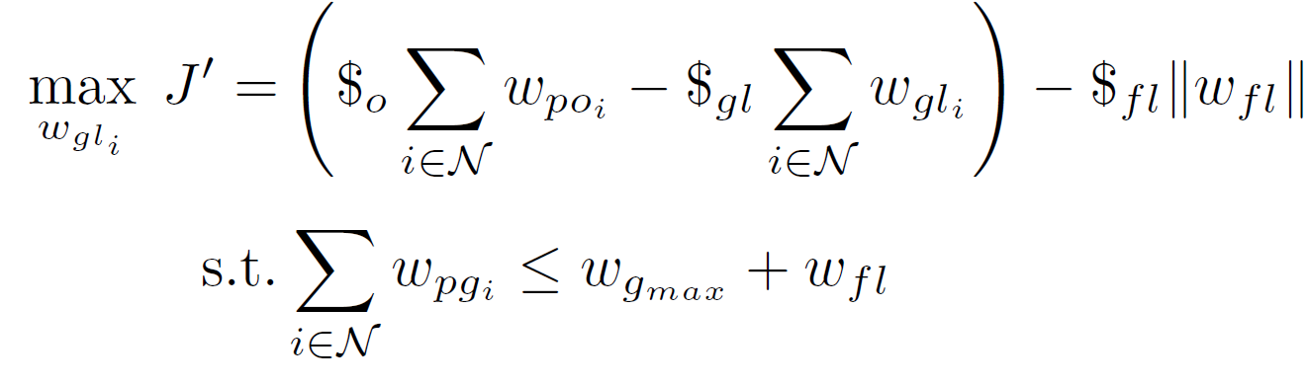



CASE STUDY: Gas lift
Constraint: Max Gas capacity
Main objective: Max oil prod.
$$w_{po}$$
$$w_{pg}$$
$$w_{gl}$$
MV₁
MV₂
Reservoir
GOR = Gas/Oil ratio in feed (reservoir)
Main disturbance (d): GOR variation
Notes:
$$\max_{w_{gl}}{}\$_{o}\sum{w_{po}} −\$_{gl}\sum{w_{gl}} −\$_{fl} w_{fl}$$
s.t.
$$\sum{w_{pg}}≤w_{g}^{max}+w_{fl}$$

Slide 48
Disturbance: GOR variation

Slide 49
Typical measured data (pressures and flowrates)

Slide 50
GOR estimation - using “data reconciliation” (traditional static RTO)
Problem: Steady-state wait time for data reconciliation

Slide 51
GOR estimation – using extended Kalman filter (DRTO & HRTO)

Slide 52
Oil and gas rates
SRTO = traditional static RTO
HRTO = hybrid RTO
DRTO = dynamic RTO

Slide 53
Results

Slide 54
Advantage of steady-state optimization (SRTO & HRTO)
Computation time & numerical robustness
Avoids causality issue / index problems
Allows optimization on decision variables other than the MVs
  Simplifies the optimization
  Slower time scale (choose slow varying variables as decision variables)

Slide 55
Why is traditional static RTO not commonly used?
Cost of developing and updating the model structure (costly offline model update)
Wrong value of model parameters and disturbances (slow online model update)
Not robust, including computational issues
Frequent grade changes make steady-state optimization less relevant
Dynamic limitations, including infeasibility due to (dynamic) constraint violation
Incorrect model structure

Slide 56
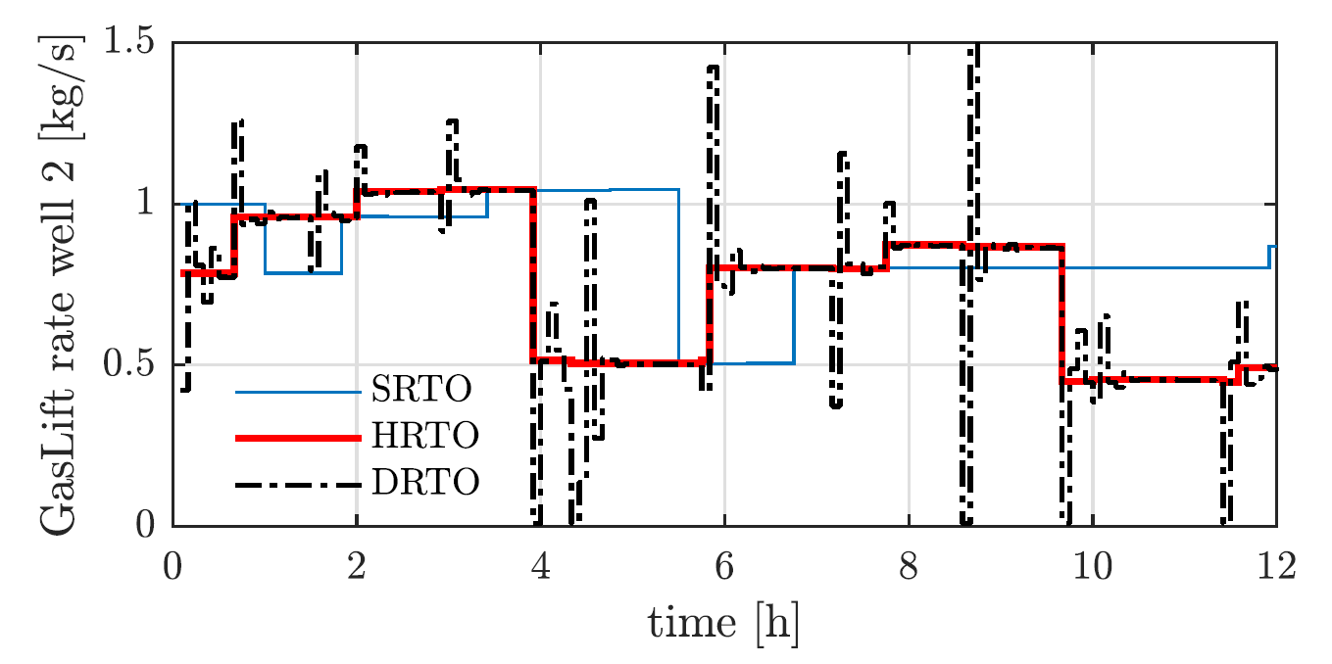
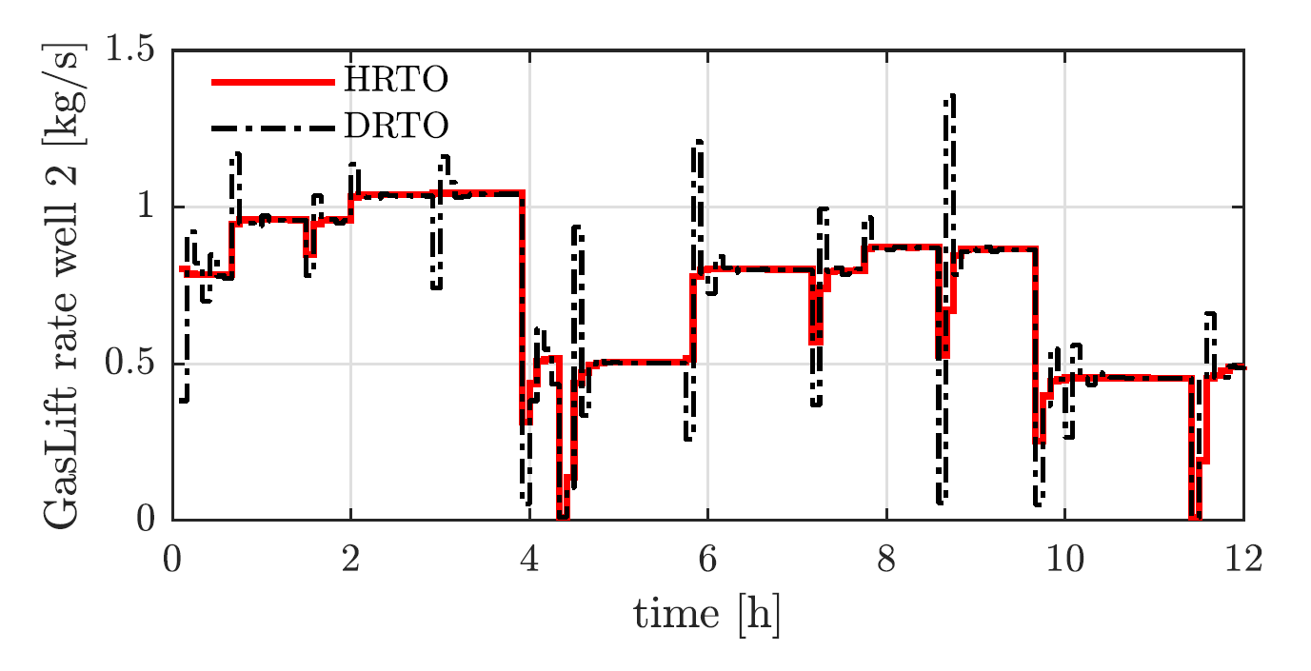
Dynamic limitations – not a big issue
MV2: Setpoint provided to tracking controller
Actual MV move by setpoint tracking controller
SRTO = traditional static RTO
HRTO = hybrid RTO
DRTO = dynamic RTO

Slide 57
Oil and gas rates
SRTO = traditional static RTO
HRTO = hybrid RTO
DRTO = dynamic RTO

Slide 58
4. Feedback RTO based on novel steady-state gradient estimation method
IFAC DYCOPS Pre-symposium workshop
Dinesh Krishnamoorthy
Krishnamoorthy, D., Jahanshahi, E. and Skogestad, S., 2019. Steady-state real-time optimization using transient measurements. Industrial and Engineering Chemistry Research 115, pp.34-45.

Slide 59
Why is traditional static RTO not commonly used?
Cost of developing and updating the model structure (costly offline model update)
Wrong value of model parameters and disturbances (slow online model update)
Not robust, including computational issues
Frequent grade changes make steady-state optimization less relevant
Dynamic limitations, including infeasibility due to (dynamic) constraint violation
Incorrect model structure

Slide 60
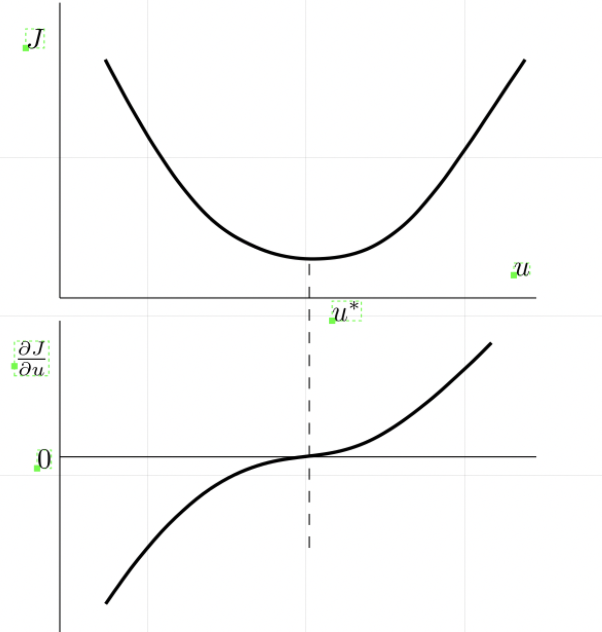
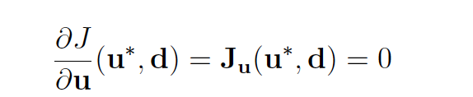
Necessary condition of optimality
The ideal controlled variable is the gradient
May use simple feedback controller to control the gradient to constant setpoint of zero.
Problem: We do not usually have gradients as measurements

Slide 61
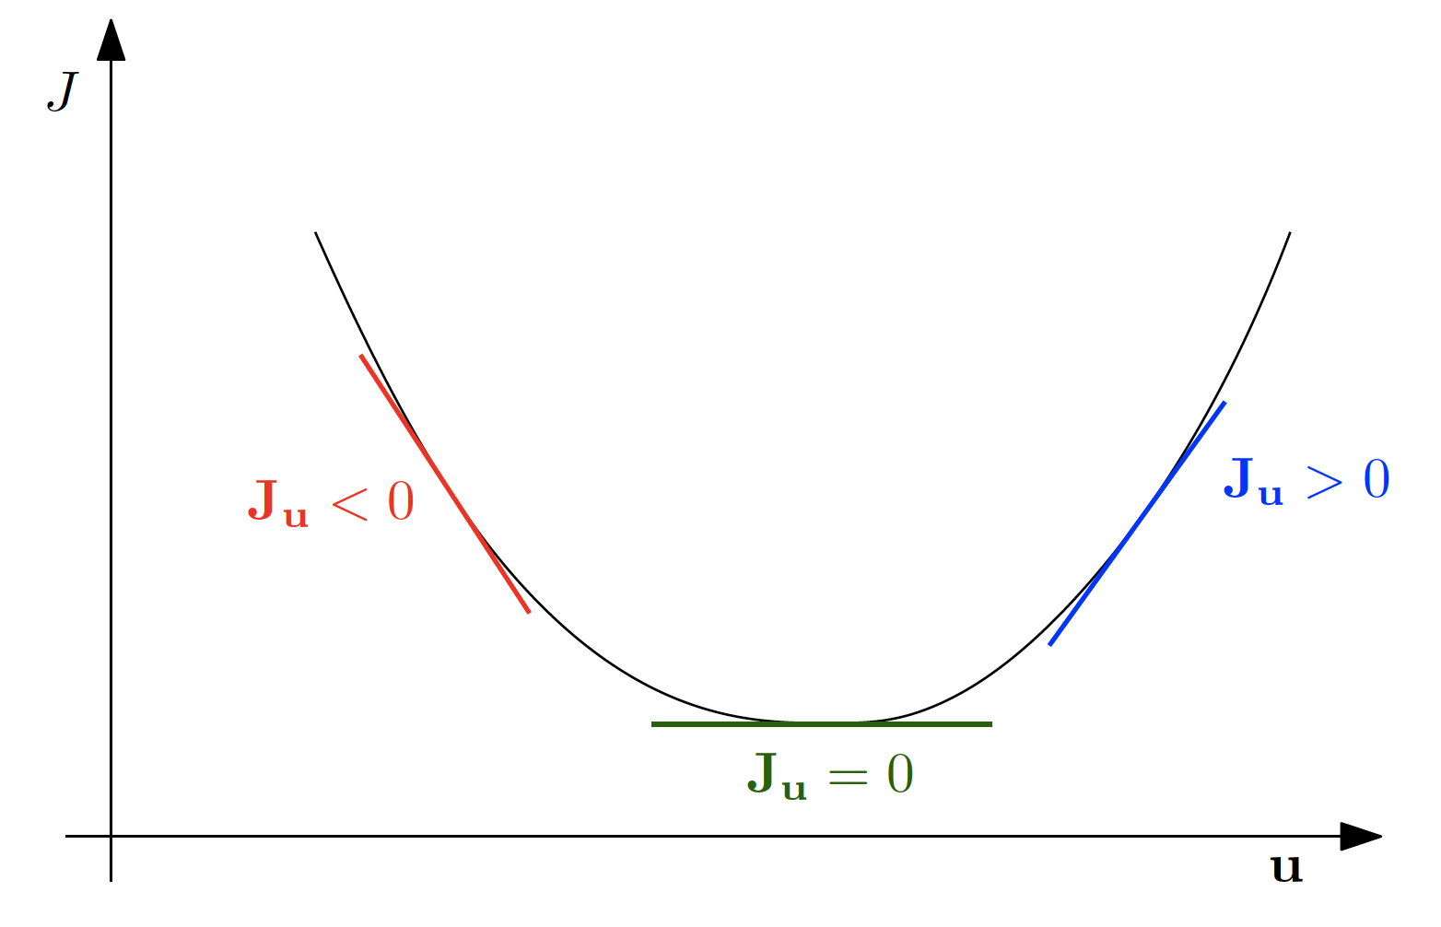
Feedback RTO
Krishnamoorthy, D., Jahanshahi, E. and Skogestad, S., 2018. A feedback real-time optimization strategy, Ind. Eng. Res. Chem

Slide 62
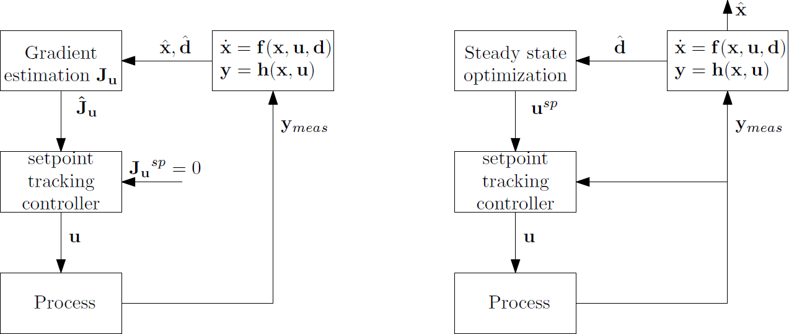
Feedback RTO: Replace steady-state optimization by feedback control
Feedback RTO
Hybrid RTO
Krishnamoorthy, D., Jahanshahi, E. and Skogestad, S., 2018. A feedback real-time optimization strategy, Ind. Eng. Res. Chem (submitted).

Slide 63
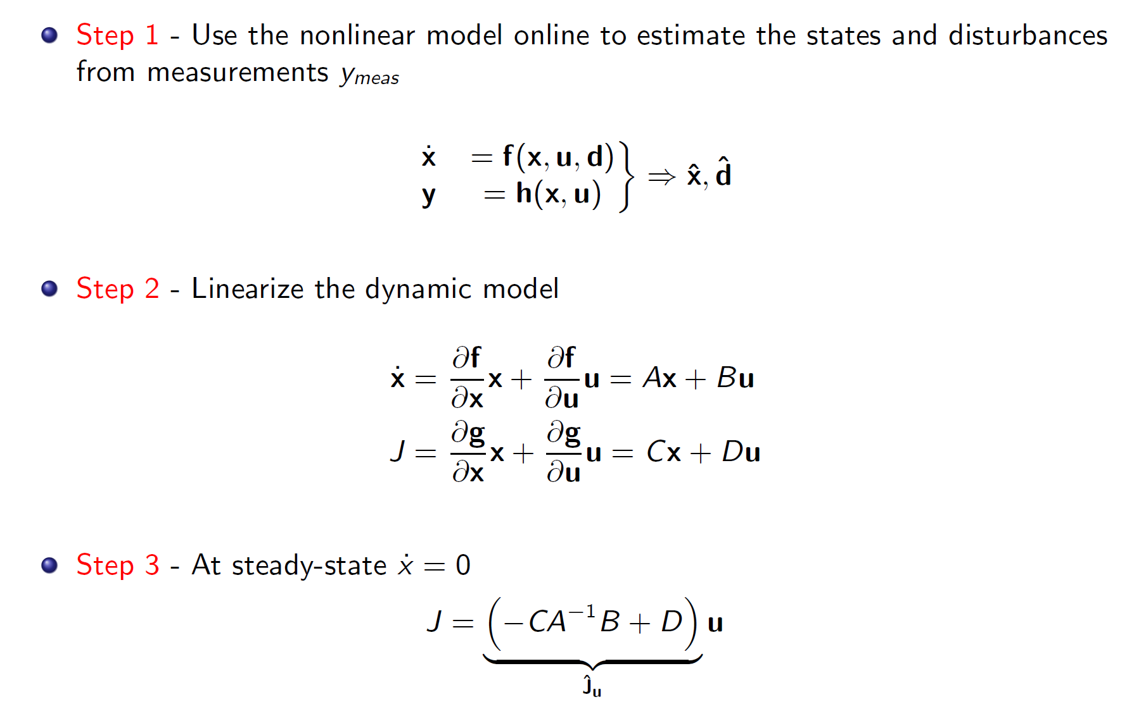
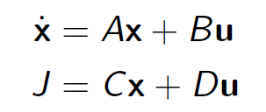
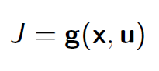
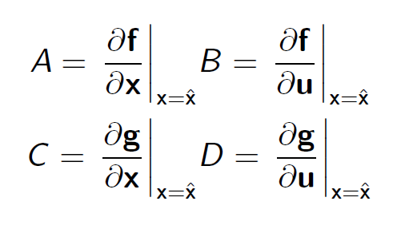
Feedback RTO
Krishnamoorthy, D., Jahanshahi, E. and Skogestad, S., 2018. A feedback real-time optimization strategy, Ind. Eng. Res. Chem (submitted).

Slide 64
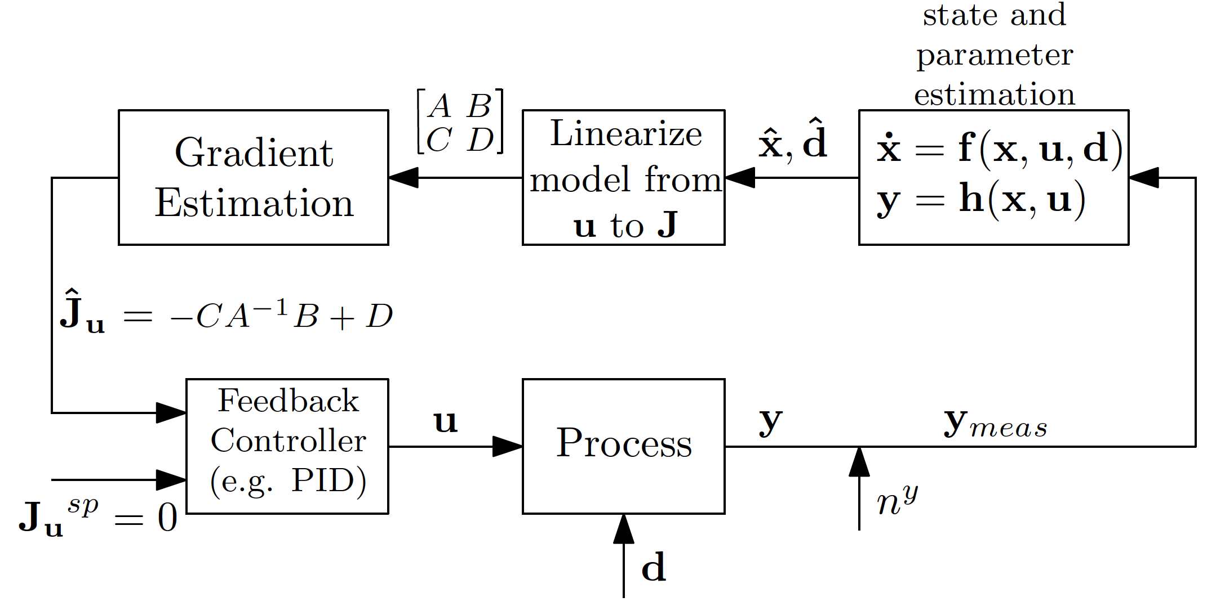
Feedback RTO
Krishnamoorthy, D., Jahanshahi, E. and Skogestad, S., 2018. A feedback real-time optimization strategy, Ind. Eng. Res. Chem (submitted).

Slide 65
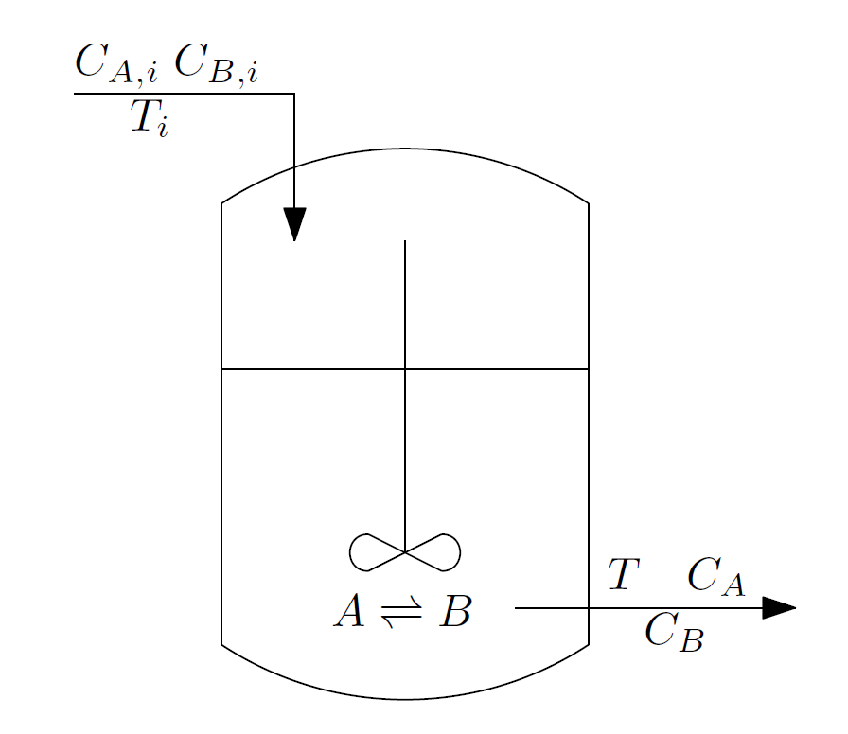
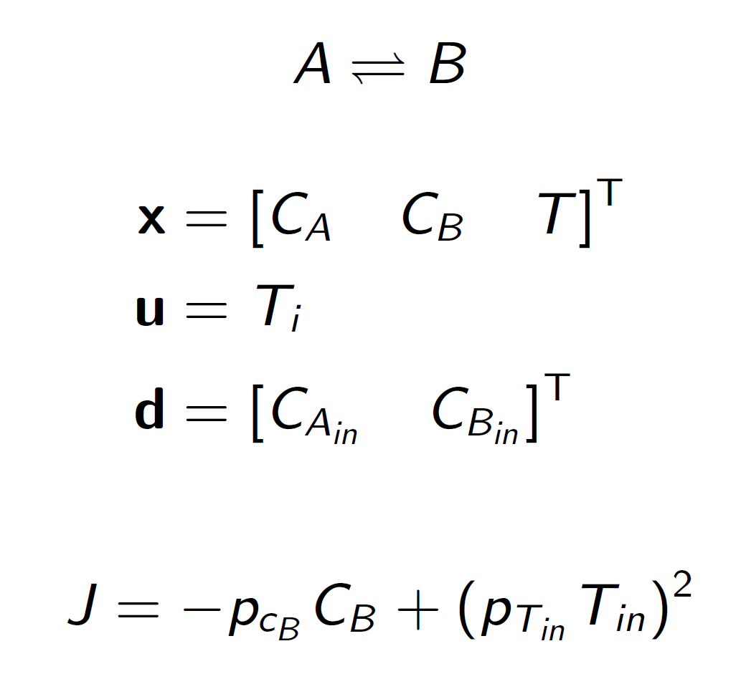
CSTR case study
Economou, C. G.; Morari, M.; Palsson, B. O. Internal model control: Extension to nonlinear system. Industrial & Engineering Chemistry Process Design and Development 1986, 25, 403–411.
Ye, L.; Cao, Y.; Li, Y.; Song, Z. Approximating Necessary Conditions of Optimality as Controlled Variables. Industrial & Engineering Chemistry Research 2013, 52, 798–808.

Slide 66
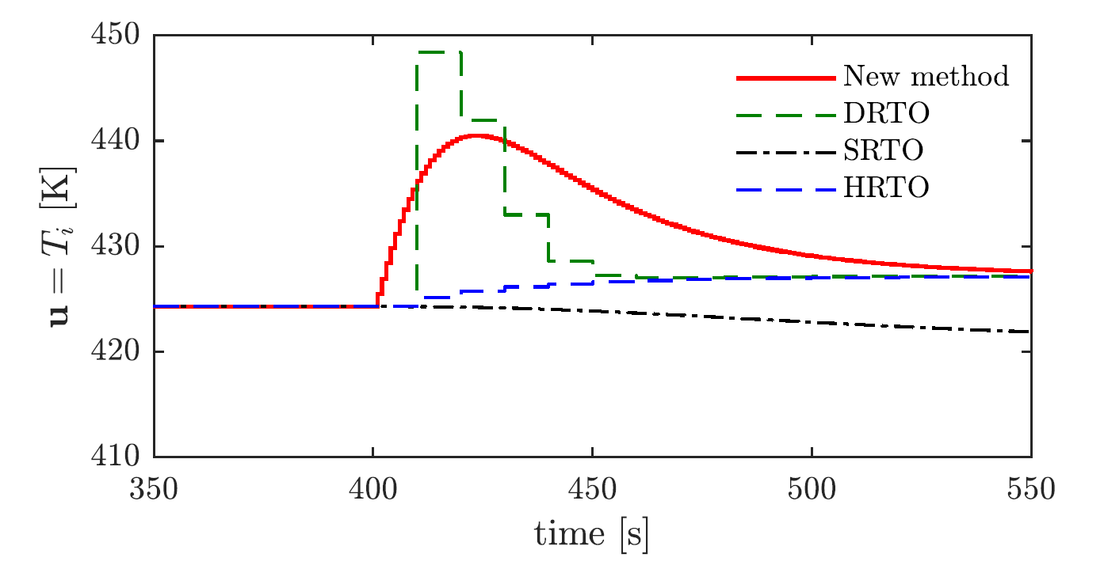
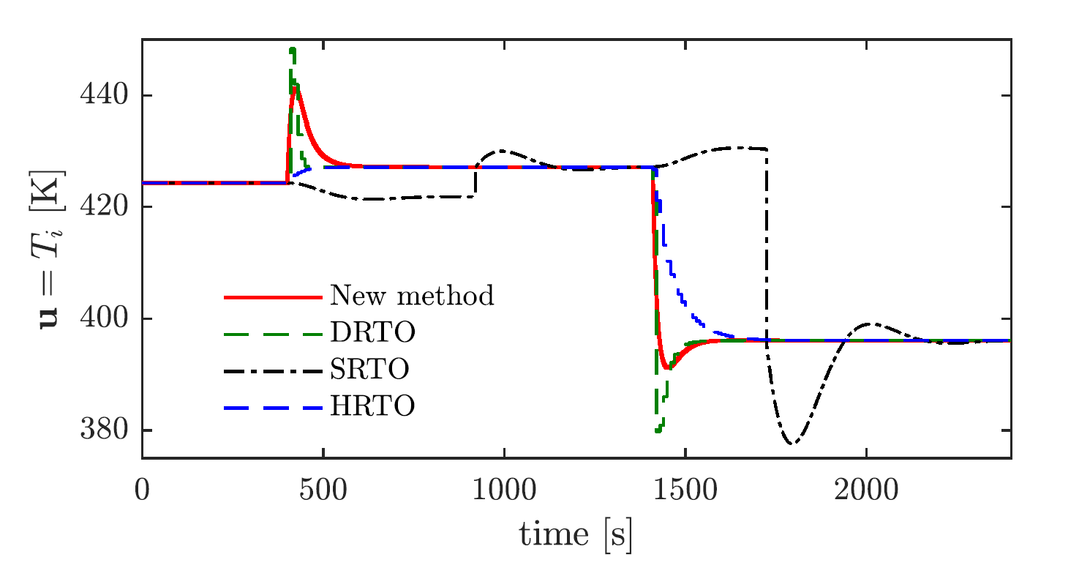
Comparison of RTO approaches: MV
SRTO = traditional static RTO
HRTO = hybrid RTO
DRTO = dynamic RTO
New method = Feedback RTO
closer look
t = 400 s, d1: Increase C_{Ain}
t = 1400 s, d2: Increase C_{Bin}

Slide 67
Comparison of RTO approaches
342.3
257.1
248.1
247.1
2
4
3
1

Slide 68
Feedback RTO - Other case studies
Evaporator process¹
Gas lift wells²
Ammonia reactor³
Krishnamoorthy, D., Jahanshahi, E. and Skogestad, S., Control of steady-state gradient for an Evaporator process, PSE Asia (Submitted 2019)
Krishnamoorthy, D., Jahanshahi, E. and Skogestad, S., 2018. Gas-lift Optimization by Controlling Marginal Gas-Oil Ratio using Transient Measurements (in-Press), IFAC OOGP, Esbjerg, Denmark
Bonnowitz, H., Straus, J., Krishnamoorthy, D., and Skogestad, S., 2018. Control of the Steady-State Gradient of an Ammonia Reactor usingTransient Measurements, Computer aided chemical engineering, Vol.43, p.1111-1116 (ESCAPE 28)

Slide 69
CASE STUDY: Gas lift
Constraint: Max Gas
Main objective: Max oil
$$w_{po}$$
$$w_{pg}$$
$$w_{gl}$$
MV₁
MV₂
Reservoir
GOR = Gas/Oil ratio in feed (reservoir)
Main disturbance (d): GOR variation
Notes:
$$\max_{w_{gl}}{}\$_{o}\sum{w_{po}} −\$_{gl}\sum{w_{gl}} −\$_{fl} w_{fl}$$
s.t.
$$\sum{w_{pg}}≤w_{g}^{max}+w_{fl}$$

Slide 70
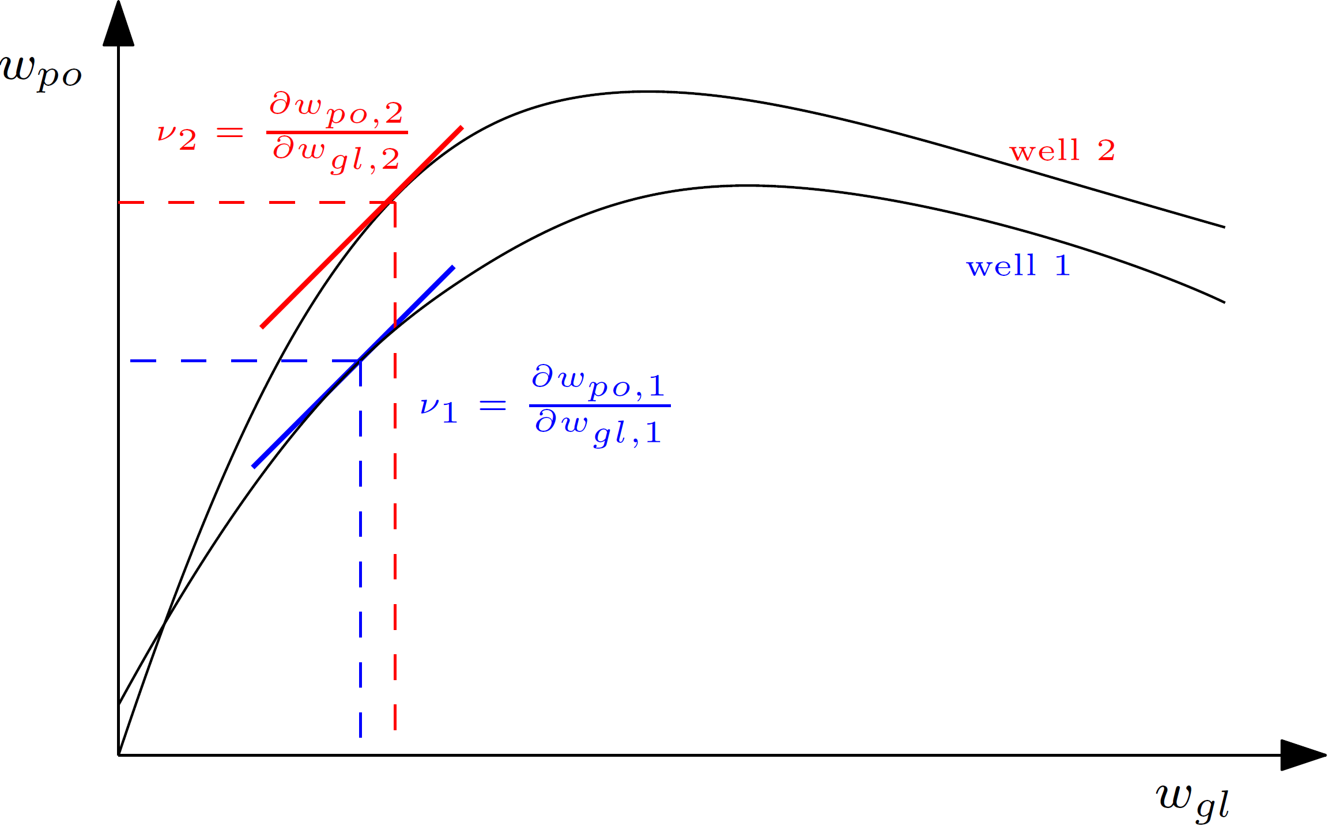
Marginal Gas-Oil Ratio (mGOR)
Marginal GOR
$$ν= \frac{∂w_{po}}{∂w_{gl}}$$

Slide 71
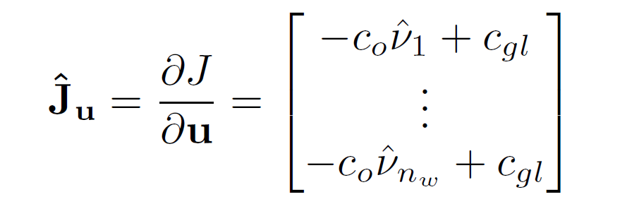
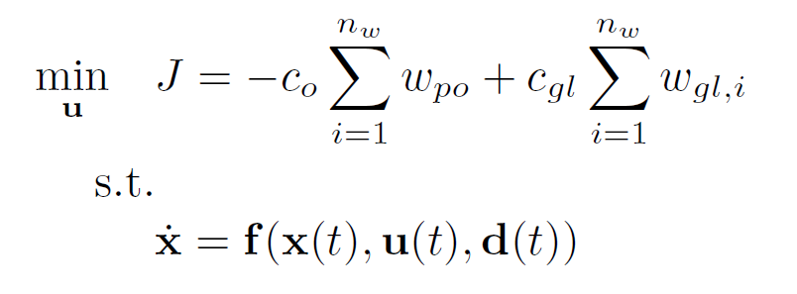
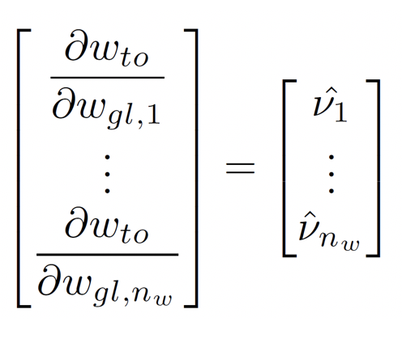

Unconstrained case

Slide 72
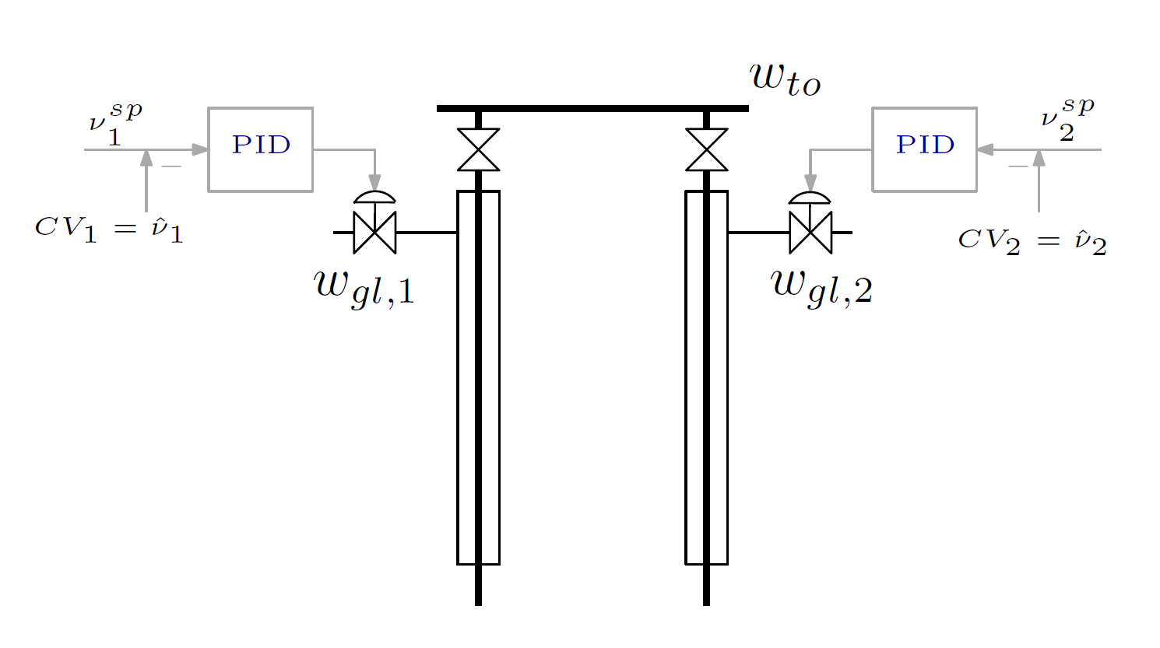

Control Structure

Slide 73
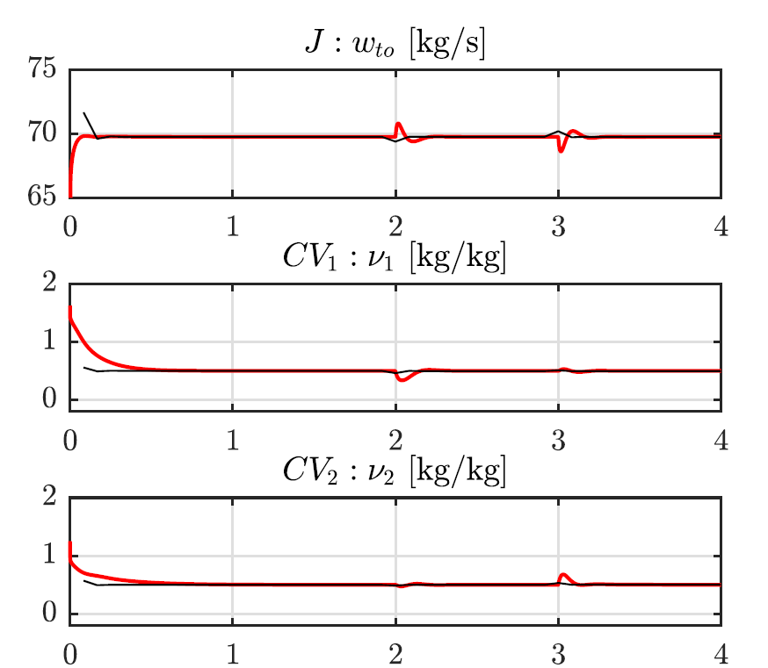

Simulation Results

Slide 74

Multivariable Example: Ammonia Reactor

Slide 75

Results

Slide 76

Results

Slide 77
5. Extremum Seeking Control
IFAC DYCOPS Pre-symposium workshop
Dinesh Krishnamoorthy

Slide 78
Why is traditional static RTO not commonly used?
Cost of developing and updating the model (costly offline model update)
Wrong value of model parameters and disturbances (slow online model update)
Not robust, including computational issues
Frequent grade changes make steady-state optimization less relevant
Dynamic limitations, including infeasibility due to (dynamic) constraint violation
Incorrect model structure

Slide 79
Necessary condition of optimality
The ideal controlled variable is the gradient
May use simple feedback controller to control the gradient to constant setpoint of zero.
Problem: We do not usually have gradients as measurements

Slide 80
Data-driven method
We do not use a model to estimate the gradient
Estimate gradient Experimentally
  NB! Need Cost measurement
Similar approaches
  Extremum seeking
  NCO tracking
  Hill climbing control
  Experimental optimization
  ....
Difference is in the way gradient is estimated

Slide 81



Steady-state gradient
J
$$∆J$$
u
$$∆u$$
$$J_{u}= \frac{ΔJ}{Δu}$$
Francois & Bonvin (2007)
Jäschke & Skogestad(2011)

Slide 82

Classical Extremum seeking control
Integral action
Gradient Estimation
Draper & Li (1951)
Krstic & Wang (2000)

Slide 83


Sinusoidal perturbation
J
u
Special case of Fast Fourier Transform (FFT) - single frequency case

Slide 84







Extremum Seeking Control
Probe the system
Observe how the cost changes
Estimate Gradient
Decide which way to move
$$J$$
$$∆J=0$$
$$∆J$$
$$u$$
$$∆u$$
$$∆u$$

Slide 85
Classical Extremum Seeking Control
Needs time scale separation to approximate plant as static map
Prohibitively slow convergence for systems with slow dynamics
Typically 100 times slower than the system dynamics !
Can we remove the static map assumption?
Come to my talk at....

Slide 86




CASE STUDY: Gas lift well
$$w_{po}$$
$$w_{pg}$$
$$w_{gl}$$
MV₁
Reservoir
GOR = Gas/Oil ratio in feed
Notes:
$$\max_{w_{gl}}{}\$_{o}\sum{w_{po}} −\$_{gl}\sum{w_{gl}} −\$_{fl} w_{fl}$$
s.t.
$$\sum{w_{pg}}≤w_{g}^{max}+w_{fl}$$

Slide 87


Least square Extremum seeking control
Fit a linear model
Using least squares fit
Hunnekens et al. (2011)

Slide 88


Least square Extremum seeking control
u
Image source: Hunnekens et al. (2011)

Slide 89
Other gradient estimation schemes
Multiple units (Srinivasan et al. 2007)
Recursive least squares estimation (Chioua, 2016)
Phasor based extremum seeking control (Trolleberg & Jacobsen, 2012)
... and some other model-based schemes
Neibhouring extremals (Gros et al. 2009)
Parameter estimation (Adetola & Guay, 2007)

Slide 90

Issues with Extremum seeking
Need Cost measurement
  Often cost function is a sum of several terms
  All terms must be measured
  Estimation of cost requires model (dependency on model – no longer model free)
Time scale separation
  Process dynamics affects gradient estimation
  Prohibitively slow convergence to the optimum
Constant probing of the system
Unknown and abrupt disturbances affects gradient estimation
ESC more suited for single units, but not for entire chemical plants
$$J = \sum{p_{F} F}+\sum{p_{Q} Q}–\sum{p_{p} P}$$

Slide 91

Effect of abrupt disturbances
d1
d2

Slide 92

Measured disturbance handled using feedforward

Slide 93
6. Modifier Adaptation
IFAC DYCOPS Pre-symposium workshop
Johannes Jäschke

Slide 94
Why is traditional static RTO not commonly used?
Cost of developing and updating the model (costly offline model update)
Wrong value of model parameters and disturbances (slow online model update)
Not robust, including computational issues
Frequent grade changes make steady-state optimization less relevant
Dynamic limitations, including infeasibility due to (dynamic) constraint violation
Wrong model structure

Slide 95





Modifier adaptation addresses the problem of plant model mismatch
RTO
Mismatch between model and plant leads to performance loss
$u$ from RTO (setpoints)
Supervisory control (MPC)
Cost $J$
Loss
Regulatory control
Process
Input $u$
Optimal input $u$
From model
Optimal input $u_{p}$
of the plant

Slide 96
Modifier adaptation addresses the problem of plant model mismatch
RTO
Mismatch between model and plant leads to constraint violations (infeasibility)
$u$ from RTO (setpoints)
Supervisory control (MPC)
Cost $J$
Loss
Regulatory control
Infeasible for plant
Process
Input $u$
Optimal input $u$
From model
Optimal input $u_{p}$
of the plant

Slide 97
Possible solutions
Find a better model
  Better parameters
  Better structure (that matches the plant better)
Modify optimization problem directly (Marchetti et al, 2009, Gao et al 2016)
  Use plant measurements
  No need to have an exact model
Marchetti et al. 2009, Ind. Eng. Chem. Res., 48 (13), pp 6022–6033
Gao et al.2016 Comp. & Chem. Eng. 91, pp 318–328

Slide 98



How should modify the optimization problem
Plant Optimization problem
$$\min_{u}{J_{p} }$$
s.t.
$$g_{p}\left(u\right)≤0$$
Model optimization problem
$$\min_{u}{J }$$
s.t.
$$g\left(u\right)≤0$$
Key idea
  Add modifiers to make “optimality conditions” of the plant and optimality conditions of the model match
Iteratively repeat the optimization at sample times $k$.

Slide 99

How should modify the optimization problem
Plant Optimization problem
$$\min_{u}{J_{p} }$$
s.t.
$$g_{p}\left(u\right)≤0$$
Modified model optimization problem
$$\min_{u}{J_{m}=J(u)+ε_{k}^{J}+λ_{k}^{J}(u−u_{k}) }$$
s.t.
$$g_{m}=g\left(u\right)+ε_{k}^{g}+λ_{k}^{g}\left(u−u_{k}\right)≤0$$
Key idea
  Add modifiers to make “optimality conditions” of the plant and optimality conditions of the model match
Iteratively repeat the optimization at sample times $k$.

Slide 100







Modifiers to match plant derivatives
Plant and modified model function gradients are equal
$$\frac{∂J_{p}}{∂u}= \frac{∂J_{m}}{∂u}$$
And
$$\frac{∂g_{p}}{∂u}= \frac{∂g_{m}}{∂u}$$
$g_{p}=g_{m}$
Constraints
$g_{m}(u)$
$$g_{p}(u)$$
$$ε^{g}$$
$$g(u)$$
$${λ^{g}}^{T}(u−u_{k})$$
$$u$$
Input
Cost and constraint gradients are modified to match Plant and model optimum coincide

Slide 101


How to compute modifiers
Zero order modifiers
$$ε^{J}=J_{p}\left(u\right)−J\left(u\right)$$
$$ε^{g}=g_{p}\left(u\right)−g\left(u\right)$$
First order modifiers
$${{λ }^{J}}^{T} =\frac{∂J_{p}(u)}{∂u}−\frac{∂J\left(u\right)}{∂u}$$
$${{λ }^{g_{i}}}^{T} =\frac{∂g_{p,i}(u)}{∂u}−\frac{∂g_{i}(u)}{∂u}$$
Gradients from real plant

Slide 102
Challenges
Finding gradients of the plant
Requires excitation
  Finite differences (Marchetti et al. 2009),
    Experiments and past points
  Broydens method
  Gradients from fitted surface (Gao et al 2016, Matias, J. 2019)
  Dynamic model identification (using transient data)
  Parallel units (Srinivasan 2007)

Slide 103


Case Study
Gas lifted oil well
2Degrees of freedom
$u={\left[w_{gl1} w_{gl2}\right]}^{T}$
Constraints:
  Max gas lift for each well
  Max total gas handling capacity
Objective
$$J=w_{o}^{tot}−0.5(w_{g1}^{2}+w_{g2}^{2})$$

Slide 104

Case Study – Plant-model mismatch
Plant
Model
Blue dashed line: max gas constraint
Black dashed line: max individual gas flow rate

Slide 105

Iterative RTO using Modifier adaptation
Circle: and Diamond:
Points from: MA-RTO iterations
Stars: Probing point for estimating gradients

Slide 106

Alternative: Output modifier adaptation
Instead of adjusting cost and constraints, adjust output model
$$y_{m}\left(u\right)=y\left(u\right)+ε^{y}+{λ^{y}}^{T}\left(u−u_{k}\right)$$
Modified RTO problem
$$u_{k+1}=arg min J_{m} ≔J(u,y\left(u\right)+ε^{y}+{λ_{k}^{y}}^{T}\left(u−u_{k}\right))$$
s.t.
$$g(u,y\left(u\right)+ε^{y}+{λ_{k}^{y}}^{T}\left(u−u_{k}\right)≤0$$
Marchetti et al 2009
Cost and constraint gradients are modified to match Plant and model optimum coincide

Slide 107
Conclusion
A effective way to handle plant-model mismatch
  Combines properties from model-based and data-based optimization
Optimization problem is updated using plant gradient estimates
  Same gradient estimation problems as ESC
Iteratively converges to an optimum.
  Relatively slow, but we start at a better point (from the model).
  Can (should) be combined with other approaches
  Better than doing nothing, and living with the mismatch
Other refinements
  Decentralized schemes (Schneider et al. 2018)
  Second order modifiers (Faulwasser, Bonvin 2014)

Slide 108
7. Self-optimizing control
“Move the optimization into the control layer”
IFAC DYCOPS Pre-symposium workshop
Sigurd Skogestad

Slide 109
Do we really need real-time optimization?
Often not!
We often know or can guess the active constraints
  Example: Assume it’s optimal with max. reactor temperature
  No need to have a comples dynamic model with energy balance to find the optimal cooling
  Just use a PI-controller
    CV = reactor temperature
    MV = cooling

Slide 110

Systematic procedure for economic process control
Start “top-down” with economics (steady state):
Step 1: Define operational objectives (J) and constraints
Step 2: Optimize steady-state operation
Step 3: Decide what to control (CVs)
  Step 3A: Identify active constraints = primary CV1.
  Step 3B: Remaining unconstrained DOFs: Self-optimizing CV1 (find H)
Step 4: Where do we set the throughput? TPM location
Then bottom-up (dynamics):
Step 5: Regulatory control
  Control variables to stop “drift” (sensitive temperatures, pressures, ....)
Finally: Make link between “top-down” and “bottom up”
Step 6: “Advanced/supervisory control”
    Control economic CVs: Active constraints and self-optimizing variables
    Look after variables in regulatory layer below (e.g., avoid saturation)
Step 7: Real-time optimization (Do we need it?)
RTO
CV₁
CV₂
MVs
Process
S. Skogestad, ``Control structure design for complete chemical plants'',
Computers and Chemical Engineering, 28 (1-2), 219-234 (2004).

Slide 111
Engineer: Must choose what to control in both layers (H₂ and H)
Optimizer (RTO)
Optimally constant valves
CV_{1s}
Always active constraints
CV₁
Supervisory controller (MPC)
CV_{2s}
Regulatory controller (PID)
CV₂
H₂
H
Physical
inputs (valves)
d
PROCESS
y
Stabilized process
n^{y}

Slide 112
Step 1. Define optimal operation (economics)
Usually steady state
Minimize cost J = J(u,x,d)
  subject to:
  Model equations: f(u,x,d) = 0
  Operational constraints: g(u,x,d) < 0
  u = degrees of freedom
  x = states (internal variables)
  d = disturbances
J
J^{opt}
u^{opt}
Typical cost function in process control:
J = cost feed + cost energy – value of products

Slide 113
(a) Identify degrees of freedom
(b) Optimize for expected disturbances
constraint
Step 2. Optimize
J
J^{opt}
Need good model, usually steady-state is OK
Optimization is time consuming! But it is offline
Main goal: Identify ACTIVE CONSTRAINTS
A good engineer can often guess the active constraints
u^{opt}

Slide 114
Active constraints
Active constraints:
  variables that should optimally be kept at their limiting value.
Active constraint region:
  region in the disturbance space defined by which constraints are active within it.
Region 3
Optimal operation:
Need to switch between regions using control system
Disturbance 2
Region 2
Region 1
Disturbance 1

Slide 115
How many active constraints regions?
Maximum:
  n_{c} = number of constraints
BUT there are usually fewer in practice
Certain constraints are always active (reduces effective n_{c})
Only n_{u} can be active at a given time
  n_{u} = number of MVs (degrees of freedom)
Certain constraints combinations are not possibe
  For example, max and min on the same variable (e.g. flow)
Certain regions are not reached by the assumed disturbance set
Distillation
n_{c} = 5
  2⁵ = 32
x_{B} always active
2^4 = 16
-1 = 15
In practice = 8

Slide 116
Step 3. Implementation of optimal operation
Have found the optimal way of operation. How should it be implemented?
What to control ? (CV₁).
  Active constraints
  Self-optimizing variables (for unconstrained degrees of freedom)
Always try first: Move optimization into control layer

Slide 117


Optimization with PI-controller
Active constraint control using PI-controller
y^{sp} = y^{max}
PI
max y
s.t. y ≤ y^{max}
u ≤ u^{max}
Example: Drive as fast as possible to airport (u=power, y=speed, y^{max} = 120 km/h)
Optimal solution has two active constraint regions:
  y = y^{max} → speed limit
  u = u^{max} → max power
Note: Positive gain from MV (u) to CV (y)
Solved with PI-controller
  y^{sp} = y^{max}
  Anti-windup: I-action is off when u=u^{max}
s.t. = subject to
y = CV = controlled variable

Slide 118
The less obvious case: Unconstrained optimum
J
u: unconstrained MV
What to control? y=CV=?
J^{opt}
u^{opt}

Slide 119

Example: Optimal operation of runner
  Cost to be minimized, J=T
  One degree of freedom (u=power)
  What should we control?

Slide 120
1. Optimal operation of Sprinter
  100m. J=T
  Active constraint control:
    Maximum speed (”no thinking required”)
    CV = power (at max)

Slide 121
2. Optimal operation of Marathon runner
    40 km. J=T
    What should we control? CV=?
    Unconstrained optimum
J=T
u_{opt}
u=power

Slide 122
Marathon runner (40 km)
Any self-optimizing variable (to control at constant setpoint)?
    c₁ = distance to leader of race
    c₂ = speed
    c₃ = heart rate
    c₄ = level of lactate in muscles

Slide 123


Conclusion Marathon runner
J=T
c_{opt}
c=heart rate
select one measurement
CV₁ = heart rate
CV = heart rate is good “self-optimizing” variable
Simple and robust implementation
Disturbances are indirectly handled by keeping a constant heart rate
May have infrequent adjustment of setpoint (c_{s})

Slide 124



Self-optimizing control
Self-optimizing control is when we can achieve an acceptable loss with constant setpoint values for the controlled variables

Slide 125
The ideal “self-optimizing” variable is the gradient, J_{u}
Unconstrained degrees of freedom
c = ∂ J/∂ u = J_{u}
  Keep gradient at zero for all disturbances (c = J_{u}=0)
cost J
J_{u}<0
J_{u}<0
J_{u}=0
u_{opt}
u
J_{u}
0
Problem: Usually no measurement of gradient
Notes:
125

Slide 126


Unconstrained degrees of freedom
Ideal: c = J_{u}
In practise, use available measurements: c = H y. Task: Select H!
H

Slide 127
Combinations of measurements, c= Hy
Nullspace method for H (Alstad):
HF=0 where F=dy_{opt}/dd
Unconstrained degrees of freedom
Proof. Appendix B in: Jäschke and Skogestad, ”NCO tracking and self-optimizing control in the context of real-time optimization”, Journal of Process Control, 1407-1416 (2011)
.

Slide 128
Example. Nullspace Method for Marathon runner
Unconstrained degrees of freedom
u = power, d = slope [degrees]
y₁ = hr [beat/min], y₂ = v [m/s]
c = Hy, H = [h₁ h₂]]
F = dy_{opt}/dd = [0.25 -0.2]’
HF = 0 -> h₁ f₁ + h₂ f₂ = 0.25 h₁ – 0.2 h₂ = 0
Choose h₁ = 1 -> h₂ = 0.25/0.2 = 1.25
Conclusion: c = hr + 1.25 v
Control c = constant -> hr increases when v decreases (OK uphill!)

Slide 129

With measurement noise
Exact local method for H
“=0” in nullspace method (no noise)
“Minimize” in Maximum gain rule
( maximize S₁ G J_{uu}^{-1/2} , G=HG^{y} )
“Scaling” S₁
Notes:
129

Slide 130

What variable c=Hy should we control? (self-optimizing variables)
Unconstrained degrees of freedom in practice
2
1
The optimal value of c should be insensitive to disturbances
  Small HF = dc_{opt}/dd
The value of c should be sensitive to the inputs (“maximum gain rule”)
  Large G = HG^{y} = dc/du
  Equivalent: Want flat optimum
Good
Good
BAD

Slide 131
Example: CO2 refrigeration cycle
p_{H}
J = W_{s} (work supplied)
DOF = u (valve opening, z)
Main disturbances:
  d₁ = T_{H}
  d₂ = T_{Cs} (setpoint)
  d₃ = UA_{loss}
What should we control?

Slide 132
CO2 refrigeration cycle
Step 1. One (remaining) degree of freedom (u=z)
Step 2. Objective function. J = W_{s} (compressor work)
Step 3. Optimize operation for disturbances (d₁=T_{C}, d₂=T_{H}, d₃=UA)
    Optimum always unconstrained
Step 4. Implementation of optimal operation
    No good single measurements (all give large losses):
      p_{h}, T_{h}, z, …
    Nullspace method: Need to combine n_{u}+n_{d}=1+3=4 measurements to have zero disturbance loss
    Simpler: Try combining two measurements. Exact local method:
      c = h₁ p_{h} + h₂ T_{h} = p_{h} + k T_{h}; k = -8.53 bar/K
    Nonlinear evaluation of loss: OK!

Slide 133



CO2 cycle: Maximum gain rule

Slide 134
Refrigeration cycle: Proposed control structure
CV=Measurement combination
CV1= Room temperature
CV2= “temperature-corrected high CO2 pressure”

Slide 135
Summary Step 3. What should we control (CV₁)?
Selection of primary controlled variables c = CV₁
  Control active constraints!
  Unconstrained variables: Control self-optimizing variables!
Self-optimizing control is an old idea (Morari et al., 1980):
“We want to find a function c of the process variables which when held constant, leads automatically to the optimal adjustments of the manipulated variables, and with it, the optimal operating conditions.”

Slide 136
Self-optimizing control (SOC)
Local approximation: c = Hy.
Need detailed steady-state model to find optimal H
  Nullspace method
  Exact local method
Must reoptimize for each expected disturbance
But calculations are offline
Challenges SOC:
Nonlinearity
Need new SOC variables for each active constraint region
  Similar to multiparametric optimization and lookup tables

Slide 137
8. Classical Approach: Optimal operation using conventional advanced control
IFAC DYCOPS Pre-symposium workshop
Sigurd Skogestad

Slide 138
Supervisory control layer
Alternative implementations:
Model predictive control (MPC)
Classical advanced control structures (PID, selectors, etc.)
RTO

Slide 139
Model predictive control (MPC)
Can include constraints explicitly
If lack of DOF to meet control specifications:
  Conventional: Use weights
    (Partially) give up variables with small weights in objective function.
  Use two-stage MPC with constraint priority list:
    Stage 1. Check for steady-state feasibility and give up low-priority constraints if needed Stage 2. Solve conventional dynamic MPC

Slide 140
Classical “Advanced control” structures
Cascade control (measure and control internal variable)
Feedforward control (measure disturbance, d)
    Including ratio control
Change in CV: Selectors (max,min)
Extra MV dynamically: Valve position control (=Input resetting =midranging)
Extra MV steady state: Split range control (+2 alternatives)
Multivariable control (MIMO)
    Single-loop control (decentralized)
    Decoupling
    MPC (model predictive control)
Extensively used in practice, but almost no academic work
CV = controlled variable (y)
MV = manipulated variable (u)

Slide 141


Split range control:
Donald Eckman (1945)

Slide 142
Changing active contraints
Procedure for maintaining optimal operation when changing between active constraint regions
Step 1: Define all the constraints
Step 2: Identify relevant active constraint combinations and switches
Step 3: Propose a control structure for the nominal operating point.
Step 4: Propose switching schemes (see next)
Step 5: Design controllers for all cases (active constraint combinations)

Slide 143
Switching between active constraints
1. Output to Output (CV - CV) switching (SIMO)
  Selector
2. Input to output (CV – MV) switching
  Do nothing if we follow the pairing rule: «Pair MV that saturates with CV that can be given up»
3. Input to input (MV – MV) switching (MISO)
  Split range control
  OR: Controllers with different setpoint value
  OR: Valve position control (= midranging control)

Slide 144
Optimization with PI-controller
CV-MV switching
y^{sp} = y^{max}
PI
max y
s.t. y ≤ y^{max}
u ≤ u^{max}
Example: Drive as fast as possible to airport (u=power, y=speed, y^{max} = 120 km/h)
Optimal solution has two active constraint regions:
  y = y^{max} → speed limit
  u = u^{max} → max power
Note: Positive gain from MV (u) to CV (y)
Solved with PI-controller
  y^{sp} = y^{max}
  Anti-windup: I-action is off when u=u^{max}
s.t. = subject to
y = CV = controlled variable

Slide 145

Optimization with PI-controller
CV-MV switching
y^{sp} = y^{min}
PI
min u
s.t. y ≥ y^{min}
u ≥ u^{min}
Example: Minimize heating cost (u=heating, y=temperature, y^{min}=20 °C)
Optimal solution has two active constraint regions:
  y = y^{min} → minimum temperature
  u = u^{min} → heating off
Note: Positive gain from MV (u) to CV (y)
Solved with PI-controller
  y^{sp} = y^{min}
  Anti-windup: I-action is off when u=u^{min}
s.t. = subject to
y = CV = controlled variable

Slide 146
Optimization with PI-controller
CV-MV switching
The two examples:
Optimal operation: Switch between CV constraint and MV saturation
A simple PI-controller was possible because we followed the pairing rule:
  «Pair MV that saturates with CV that can be given up»

Slide 147


MV-MV switching
Split-range control (SRC): One CV (y). Two or more MVs (u1,u2)
Example: Room heating with 4 MVs
MVs:
AC (expensive cooling)
CW (cooling water; cheap)
HW (hot water, quite cheap)
Electric heat, EH (expensive)
y=T

Slide 148

Simulation PI-control: Setpoint changes temperature
MV-MV switching

Slide 149
MV-MV switching
Example: Room heating with 4 MVs
MVs:
AC (expensive cooling)
CW (cooling water; cheap)
HW (hot water, quite cheap)
Electric heat, EH (expensive)
y=T
  Three Alternatives:
  Split range control (SP=22C)
  Controllers with different setpoint values (SP=24C, 23C, 22C, 21C)
  Valve position control (= midranging control) (Use always HW for SP=22C)

Slide 150

Blending process with max selector
CV-CV switching
SUGAR with some impurity
WATER
CV1
CV2
MV = Water feed (F₂)
CV1 = Sugar concentration (Should be at SP=0.1 whenever feasible|)
CV2 = Impurity concentarion (Max. 0.001)
Disturbances: Variation in sugar feed (F₁) and concentration of impurity in sugar

Slide 151

CV-CV switching

Slide 152
Conclusion: Systematic procedure to avoid RTO-layer and even MPC-layer
Start “top-down” with economics (steady state):
Step 1: Define operational objectives and constraints
Step 2: Optimize steady-state operation
Step 3: Decide what to control (CVs)
  Step 3A: Identify active constraints = primary CV1.
  Step 3B: Remaining unconstrained DOFs: Self-optimizing CV1 (find H)
Step 4: Where do we set the throughput? TPM location
Then bottom-up (dynamics):
Step 5: Regulatory control
  Control variables to stop “drift” (sensitive temperatures, pressures, ....)
Finally: Make link between “top-down” and “bottom up”
Step 6: “Advanced/supervisory control”
    Control economic CVs: Active constraints and self-optimizing variables
    Look after variables in regulatory layer below (e.g., avoid saturation)
RTO
CV₁
CV₂
MVs
Process
S. Skogestad, ``Control structure design for complete chemical plants'',
Computers and Chemical Engineering, 28 (1-2), 219-234 (2004).

Slide 153
Hierarchical Combination of different approaches
IFAC DYCOPS Pre-symposium workshop
Johannes Jäschke
Dinesh Krishnamoorthy

Slide 154
Why not combine different approaches to give improved performance?!
Examples:
Combining model and data-based approaches
Combining online and offline methods
Some benefits
Faster rejection of known disturbances
Capability of handling unmodeled disturbances

Slide 155

Standart RTO + MPC + self-optimizing control
Idea: take the best from all worlds
  Self-optimizing Control
    Fast correction for known and modelled disturbances
  MPC:
    Predicting responses, and good constraint handling
  Standard RTO:
    Handling nonlinearity and large disturbances optimally
Graciano et al. 2015, Journal of Process Control 34, 35–48

Slide 156



Distillation Case Study
Separation of 3 components
RTO Problem
MPC
Setpoint tracking
  Standard (concentrations+temperature)
  Self-optimizing variable combinations
Constraint handling
  Enforce constraints as they become active

Slide 157

Profit of combined approach
--- standard MPC controlling
concentrations and 1 tray temp.
--- MPC Controlling SOC variables
Disturbances are rejected also inbetween RTO updates.

Slide 158
NCO tracking + self-optimizing control
Idea: take the best from both worlds
  Self-optimizing Control: Fast correction for known and modelled disturbances
  NCO tracking: use Plant gradient estimates to handle unmodeled disturbances

Slide 159


Self-optimizing Control and NCO tracking
Self-optimizing control
Find a good output combination
Control to zero with favourite controller
NCO tracking idea
Measure gradient
Adjust input to make it zero
Plant gradient
NCO: Necessary conditions of Optimality

Slide 160

Combination of self-optimizing control and NCO tracking
Fast time scale (lower layer):
  reject known (modelled) disturbances using self-optimizing control
Slow time scale (upper layer)
  reject unknown (unmodeled) disturbances in NCO tracking
Jäschke & Skogestad (2011)

Slide 161


Self-optimizing and NCO tracking (sampling time 10 min)
Combined Self-optimizing and NCO tracking (sampling time 25 min)

Slide 162

Similar approach: ESC/RTO + Self-optimizing control
Self-optimization control is always complementary
Can combine with
  Extremum-seeking control
  Traditional Static RTO
Straus. J, Krishnamoorthy, D., and Skogestad, S., 2018. On combining extremum seeking control and self-optimizing control. J. Proc. Control (In-Press).

Slide 163


Case study: Ammonia Reactor
Objective: Maximize extent of reaction
Response to disturbance in inlet mass flow rate

Slide 164
CONCLUSION:
Why is traditional static RTO not commonly used?
Some alternatives
Cost of developing and updating the model (costly offline model update)
→ Fix: estimate plant gradients directly, like extremum-seeking - Machine learning (new)
2. Wrong value of model parameters and disturbances (slow online model update)
→ Fix: DRTO, HRTO, self-optimizing control (fastest)
Not robust, including computational issues
→ Fix: Feedback RTO, self-optimizing control
Frequent grade changes make steady-state optimization less relevant
→ Fix: Dynamic RTO (DRTO) or EMPC
Dynamic limitations, including infeasibility due to (dynamic) constraint violation
→ Fix: DRTO, EMPC (also HRTO ok!)
Incorrect model Structure
→ Fix: Modifier adaptation

Slide 165
Proposal : Combine RTO with other approaches
ESC / modifier adaptation layer: make RTO approach the real optimum .
SOC layer: make optimization faster, reduce wait time for model update and online optimization

Slide 166
Conclusion
Data based approach
Plant gradient based method
J_{u}
Extremely slow (days)
Model free
J_{u,s}
Gradient estimator
Real-time optimization
(SRTO/DRTO/HRTO)
RTO:
Detailed model
(online)
Slow (hour)
y
c_{s}
Self-optimizing control
(in MPC/PID layer)
c
y
SOC:
Detailed model
(offline)
Fast (minute)
H
u
y
Process
d
Measurements
J
Thank you !

Slide 167
Next slide
Red box = bad,
green box = good,
No box = neutral

Slide 168


