Slide 1



Putting optimization into the control layer using the magic of feedback control
Sigurd Skogestad
Department of Chemical Engineering
Norwegian University of Science and Technology (NTNU)
Trondheim
ESCAPE’32. Toulouse, 13 June 2022
Thanks to: Adriana Reyes-Lúa, Cristina Zotică, Dinesh Krishnamoorthy

Slide 2
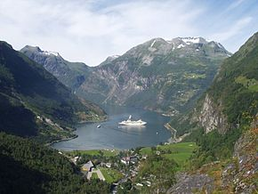
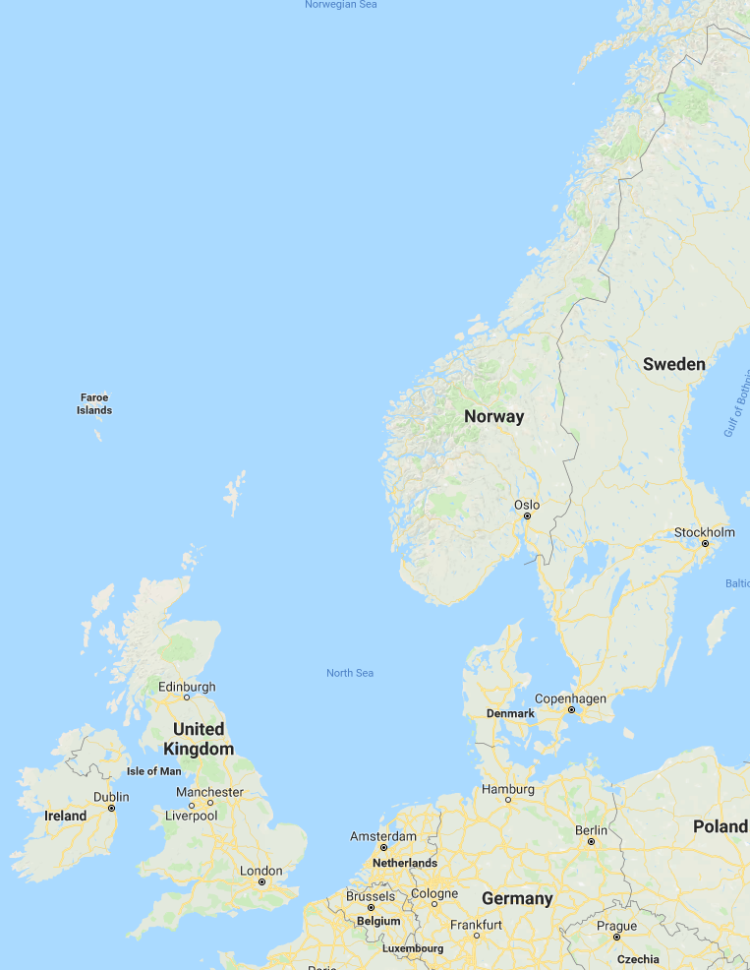


Trondheim
Arctic circle
Geiranger fjord
Trondheim

Slide 3
About Sigurd Skogestad
•1955: Born in Flekkefjord, Norway
• 1956-1961: Lived in South Africa
•1974-1978: MS (Siv.ing.) studies in chemical engineering at NTNU
•1979-1983: Worked at Norsk Hydro co. (process simulation)
•1983-1987: PhD student at Caltech (supervisor: Manfred Morari)
•1987-present: Professor of chemical engineering at NTNU
• 1994-95: Visiting Professor UC Berkeley
• 2001-02: Visiting Professor UC Santa Barbara
•1999-2009: Head of ChE Department, NTNU
•2015-..: Director SUBPRO (Subsea research center at NTNU)
Non-professional interests:
mountain skiing (cross country)
orienteering (running around with a map)
grouse hunting
1973

Slide 4
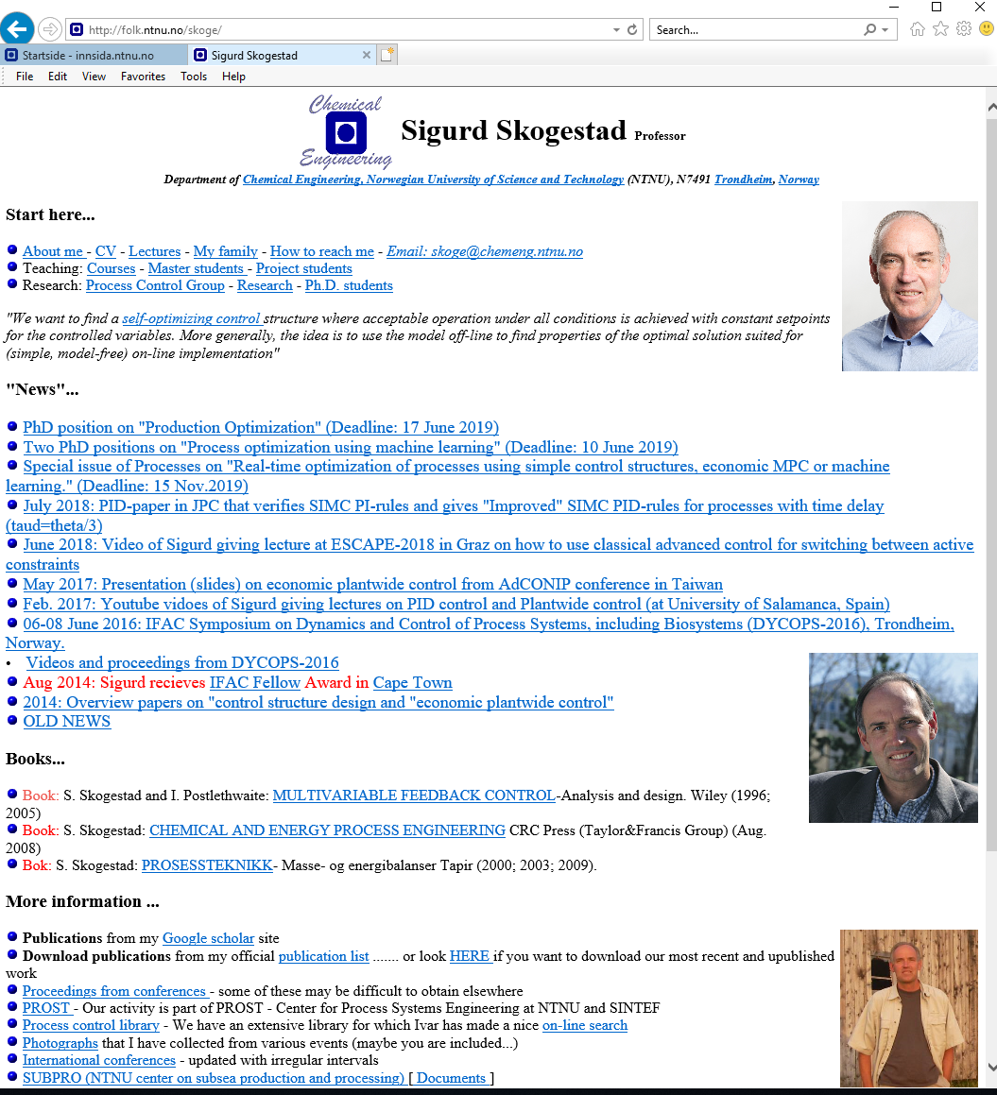
“The goal of my research is to develop simple yet rigorous methods to solve problems of engineering significance”

Slide 5
Outline
Introduction: Optimal economic operation of process plants
Control: Implementing optimal operation in practice
  Model predictive control (MPC)
  Conventional advanced Process control (APC)
Unconstrained Optimization: Self-optimizing variables
Constrained Optimization: Using conventional APC to handle changing active constraints
  Many examples
  PID-control, Selectors, Split range control
Systematic procedure for designing APC
  More Examples
Conclusion

Slide 6
Optimal economic operation
Minimize cost J = J(u,x,d)
Or: Maximize profit P=-J
u = degrees of freedom
x = states (internal variables)
d = disturbances
J
J^{opt}
u^{opt}
u
J = cost feed + cost energy – value of products

Slide 7
Optimal economic operation
constraint
Minimize cost J = J(u,x,d)
Subject to satisfying constraints
u = degrees of freedom
x = states (internal variables)
d = disturbances
J
J^{opt}
u^{opt}
u
J = cost feed + cost energy – value of products

Slide 8
Active constraints
Active constraints:
  variables that should optimally be kept at their limiting value.
Active constraint region:
  region in the disturbance space with fixed active constraints
Region 3
Optimal operation:
How switch between regions?
Disturbance 2
Region 2
Region 1
Disturbance 1

Slide 9
Control is about implementing optimal operation in practice
Many cases: Solution is fully constrained, but constraints change
Key is to control the active constraints
In practice: Don’t need to know regions
if we can measure and control the constraints
Region 3
Disturbance 2
Region 2
Region 1
Disturbance 1

Slide 10
2. Control hierarchy in a process plant
Key idea: Time scale separation
Optimization layer (RTO) (hour)
  Minimize economic cost J, satisfying constraints
Supervisory layer (APC or MPC) (minutes)
  Follow set points (CV1) from optimization layer
  Switch between active constraints (CV1 change)
  Look after regulatory layer
Regulatory control (PID) (seconds)
  Follow setpoints (CV2) from layers above
  Stabilize: Control drifting variables
Key decisions: Select CV1 and CV2
CV = Controlled variable
MV = Manipulated variable (process input)
RTO = Real-time optimization
APC = Conventional Advanced process control
MPC = Model predictive control
PID = Propertional-Integral-Derivative
MV

Slide 11
Optimal operation of process plants
Most people think
  You need a detailed nonlinear model and an on-line optimizer (RTO) if you want to optimize the process
  You need a dynamic model and model predictive control (MPC) if you want to handle constraints
  The alternative is Machine Learning
No! In many cases you just need to measure the constraints and use PID control
  «Coventional advanced process control (APC)»
How can this be possible?
  Because optimal operation is usually at constraints
  PID-controllers can be used to identify and control the active constraints
  For unconstrained degrees of freedom, one often have «self-optimizing» variables
This fact is not well known, even to control professors
  Because most APC-applications are ad hoc
  Few systematic design methods exists

Slide 12

Example: Optimal operation of runner
  Cost to be minimized, J=T
  One degree of freedom (u=power)
  What should we control?
Sigurd Skogestad. «Near-optimal operation by self-optimizing control: From process control to marathon running and business systems», Comp.Chem.Engng. (2004)

Slide 13
A. Optimal operation of Sprinter
Constrained optimum: Control active constraints
  100m. J=T
  Active constraint control:
    Run as fast as you can (”no thinking required”)
    CV = power (at max)

Slide 14
B. Optimal operation of Marathon runner
Unconstrained optimum: Not obvious what to control
    40 km. J=T
    What should we control? CV=?
    Unconstrained optimum
J=T
u_{opt}
u=power

Slide 15
Unconstrained optimum: Control self-optimizing variables
Marathon runner (40 km)
Any self-optimizing variable (to control at constant setpoint)?
    c₁ = distance to leader of race
    c₂ = speed
    c₃ = heart rate
    c₄ = level of lactate in muscles

Slide 16
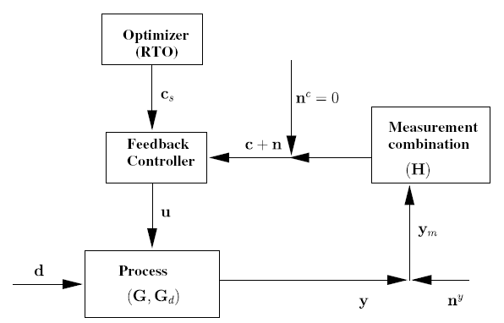

Conclusion Marathon runner
Control self-optimizing variables
J=T
c_{opt}
c=heart rate
select one measurement
CV₁ = heart rate
CV = heart rate is good “self-optimizing” variable
Simple and robust implementation
Disturbances (d) are indirectly handled by keeping a constant heart rate
May have infrequent adjustment of setpoint (c_{s})

Slide 17
3. Unconstrained optimization
Have unconstrained degree of freedom (u)
Available measurements: y
What should we control (c=CV1=Hy)?
  Not at all obvious
J
u_{opt}
u

Slide 18
Self-optimizing control
Self-optimizing control is when we can achieve an acceptable economic loss (between re-optimizations) with constant setpoint values for the controlled variables (c=CV1)
Self-optimizing control is an old idea (Morari et al., 1980):
“We want to find a function c of the process variables which when held constant, leads automatically to the optimal adjustments of the manipulated variables, and with it, the optimal operating conditions.”
S. Skogestad ``Plantwide control: the search for the self-optimizing control structure'', J. Proc. Control, 2000.

Slide 19
The ideal “self-optimizing” variable is the gradient, J_{u}
c = ∂ J/∂ u = J_{u}
  Keep gradient at zero for all disturbances (c = J_{u}=0)
cost J
J_{u}<0
J_{u}<0
J_{u}=0
u_{opt}
u
J_{u}
0
Problem: Usually no measurement of gradient
Notes:
19

Slide 20
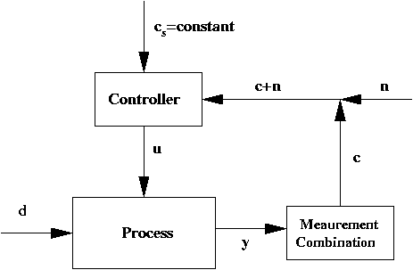
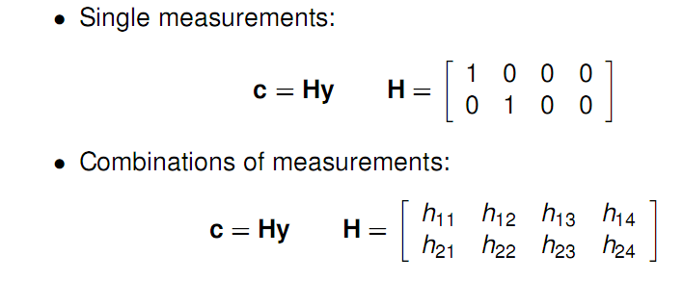
Ideal: c = J_{u}
In practise, use available measurements: c = H y. Task: Select H!
H

Slide 21
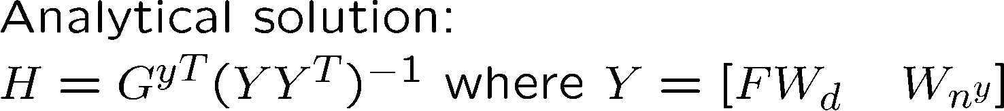
Self-optimizing variables: Model-based methods for c=Hy
Nullspace method for H
HF=0 where F=dy_{opt}/dd
Proof: Want c_{opt} independent of disturbance d
Have. y_{opt} = F d, so c_{opt} = H y_{opt} = HF d -> HF=0
Exact local method for H
V. Alstad and S. Skogestad, ``Null Space Method for Selecting Optimal Measurement Combinations as Controlled Variables'', Ind.Eng.Chem.Res, 46 (3), 846-853 (2007)
V. Alstad, S. Skogestad and E.S. Hori, ``Optimal measurement combinations as controlled variables'', Journal of Process Control, Vol.19, 128-148 (2009).

Slide 22
Example. Nullspace Method for Marathon runner
u = power, d = slope [degrees], J=Time
y₁ = hr [beat/min], y₂ = v [m/s]
c = Hy = h₁ y₁+ h₂ y₂
From model or data: F = dy_{opt}/dd = [0.25 -0.2]’
HF = 0 -> h₁ f₁ + h₂ f₂ = 0.25 h₁ – 0.2 h₂ = 0
Choose h₁ = 1 -> h₂ = 0.25/0.2 = 1.25
Conclusion: c = hr + 1.25 v
Control c = constant -> hr increases when v decreases (OK uphill!)

Slide 23
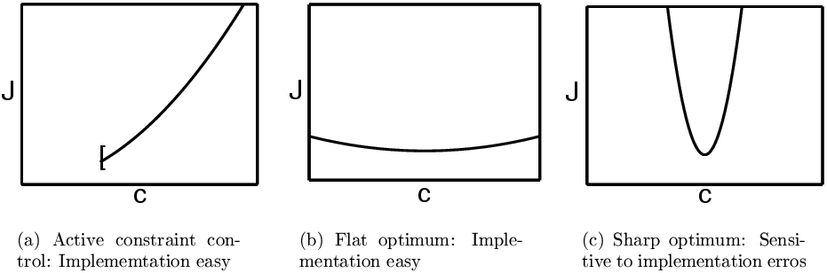
Self-optimizing variables: What should we control?
Engineering insight may be used if we don’t have model
The optimal value of c should be insensitive to disturbances
  Small F^{c} = HF = dc_{opt}/dd
The value of c should be sensitive to the inputs (“maximum gain rule”)
  Large gain, G^{c} = HG^{y} = dc/du
  Equivalent: Want flat optimum
Good
Good
BAD
NEVER try to control a variable that reaches max or min at the optimum
  In particular, never try to control directly the cost J
I.J. Halvorsen, S. Skogestad, J.C. Morud and V. Alstad, ``Optimal selection of controlled variables'', Ind. Eng. Chem. Res., 42 (14), 3273-3284 (2003)

Slide 24
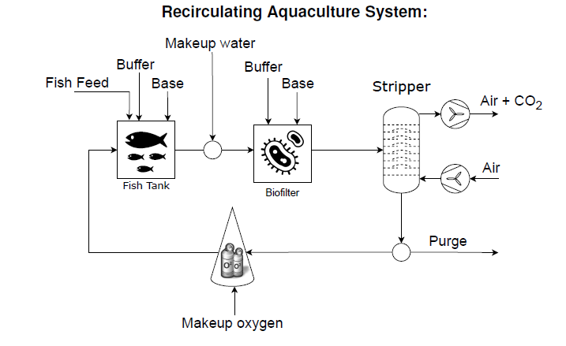
Example: Maximize growth of salmon fish (RAS)
One unconstrained degree of freedom: Buffer/base addition
What should we control?
Self-optimizing variable (CV1): pH in Fish tank
  Large gain (sensitive to changes in buffer/base)
  Small variations in optimal setpoint (7-7.5)
  Optimize with simple pH-controller
pHC
pHC
Regulatory layer: pH-control also provides stabilization
so we have CV2=CV!=pH, which is ideal
Allyne M. dos Santos et al., Soft sensor of key components in recirculation aquaculture systems, using feedforward networks, ESCAPE-32 Toulouse, 2022 (Poster today)

Slide 25
4. Constrained optimization
Obvious what we should control: Active constraints
  Can be measured in most cases and controlled with PID-controller
Reason for change in active constraints are
  Disturbances (including changes in parameters and prices)
Challenge control: Switch between active constraints
constraint
J
J^{opt}
u^{opt}

Slide 26
Conventional advanced control structures (ACS)
Used when single-loop PID is not sufficient.
Examples:
  Cascade control
  Feedforward control / Ratio control
  Decoupling
  Selectors
  Split range control (SRC)
  Input resetting or valve positioning control (VPC)
Can handle constraint changes

Slide 27
Conventional APC for changing active constraints
Four cases:
  MV-MV switching -> Split Range Control + 2 more options
  CV-CV switching -> Selectors
  Simple CV-MV switching -> Do nothing
  Complex CV-MV switching
DV
MV
CV
Process
MV = Manipulated Variable = Input (u)
CV = Controlled Variable = Output (y)
DV = Disturbance Variable (d)
Adriana Reyes-Lua and Sigurd Skogestad, Systematic Design of Active Constraint Switching Using Classical Advanced Control Structures, Ind.Eng.Chem.Res, 2020

Slide 28
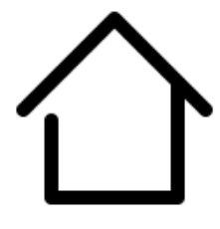
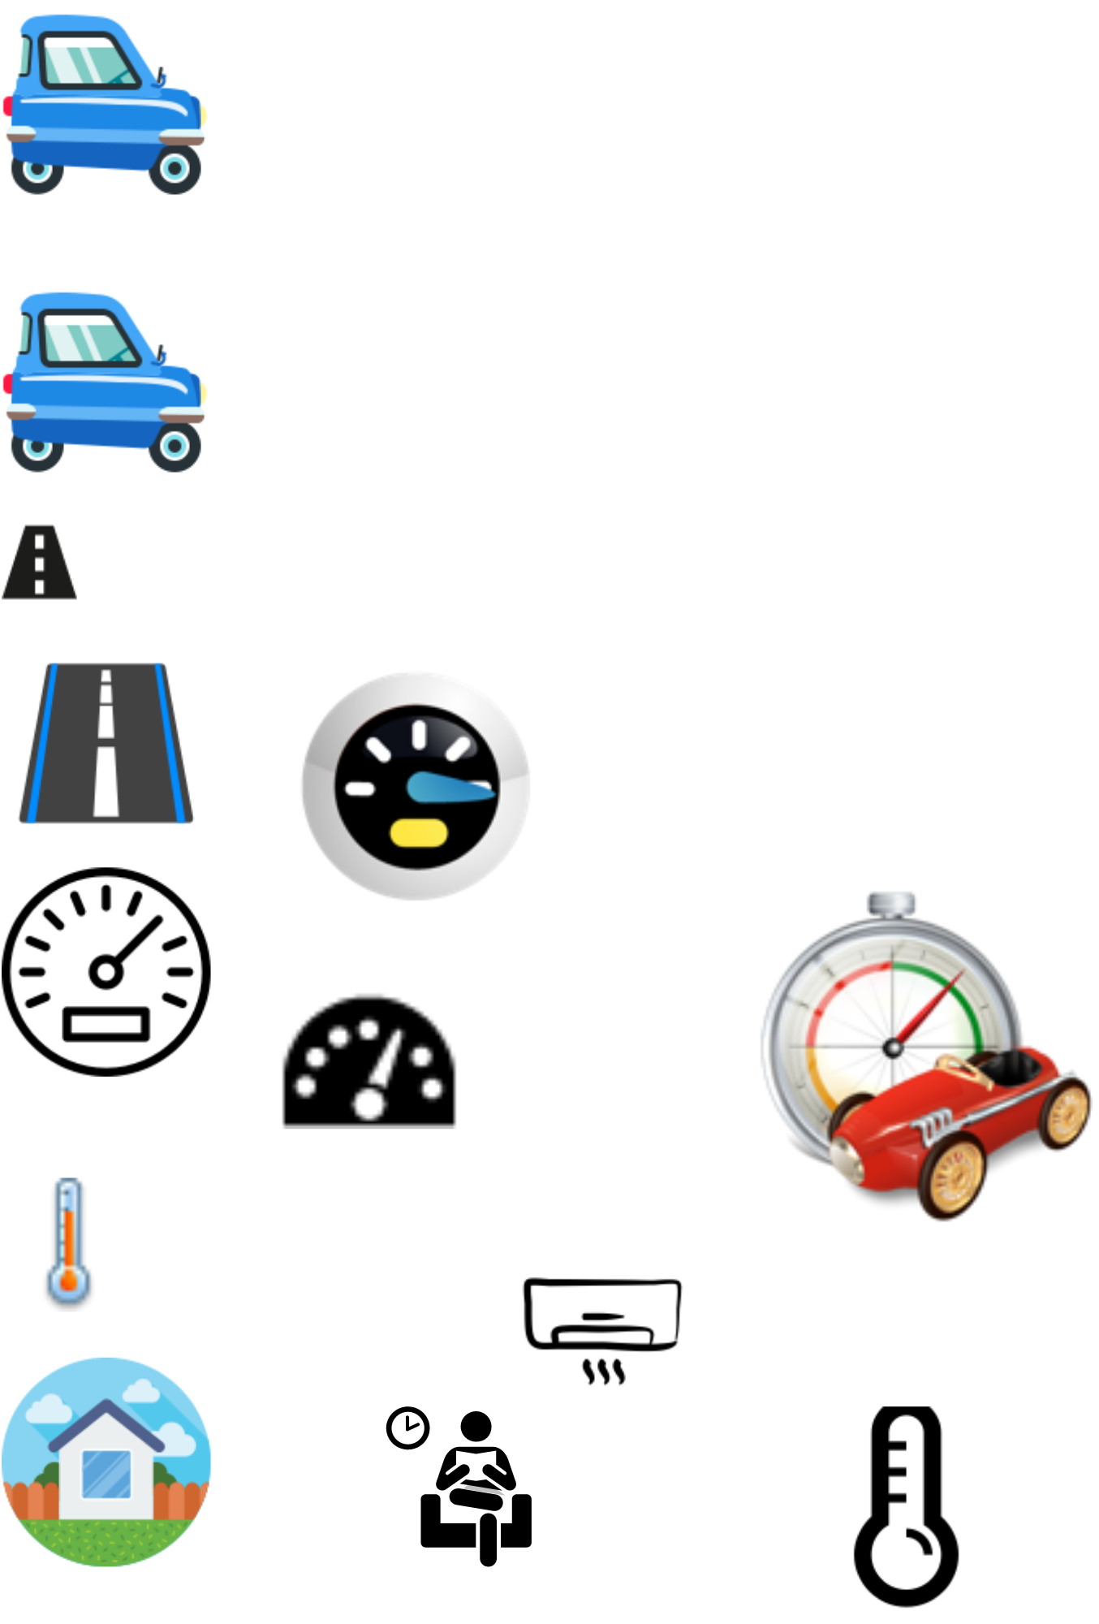
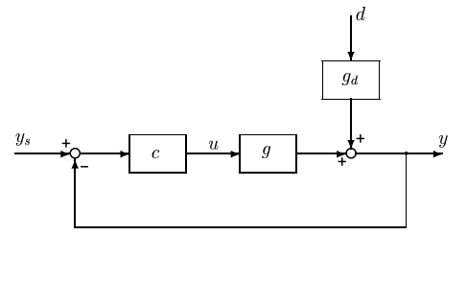
Optimization with PI-controller
This is simple CV-MV switching
Example: Minimize heating cost (Norway)
min u
s.t. y ≥ y^{min}
u ≥ u^{min} = 0
(u=heating, y=temperature, y^{min}=22 °C)
Disturbance (d): Outdoor temperature
Optimal solution has two active constraint regions:
  CV=y = y^{min} → minimum temperature (winter)
  MV=u = u^{min} → heating off (summer)
  No unconstrained region
Solved with PI-controller («thermostat»)
  y^{sp} = y^{min}
y^{sp} = y^{min}
PI
We satisfy the input saturation rule:
«When the MV (u) saturates (at 0), control of the CV (y) can be given up»
u = input = manipulated variable (MV)
y = output = controlled variable (CV)

Slide 29
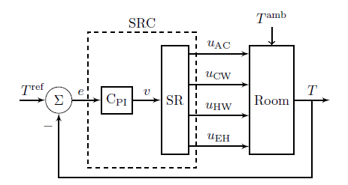
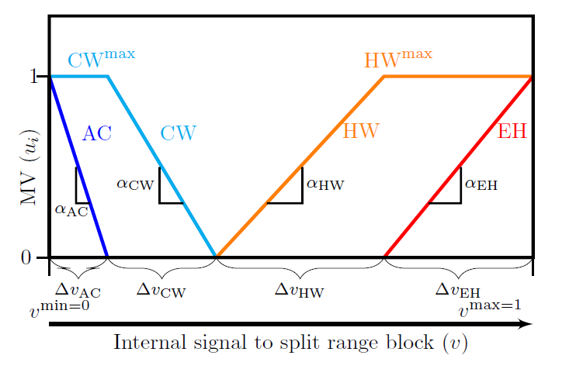
Temeperature control with 4 inputs (MVs)
This is MV-MV switching
MVs:
AC (expensive cooling)
CW (cooling water; cheap)
HW (hot water, quite cheap)
Electric heat, EH (expensive)
y=T
d=T^{amb}
Objective: Minimize cost
Use cheap MVs first and use only one MV at the time (difficult with MPC)
Solution: Split range control (SRC):
C_{PI} – same controller for all inputs (one integral time)
But get different gains by adjusting slopes α in SR-block

Slide 30
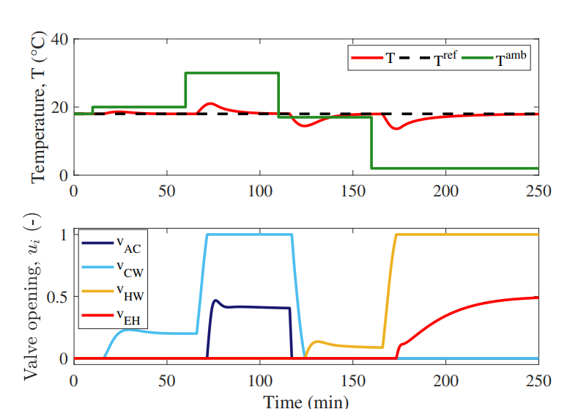
This is MV-MV switching
Split-range control (SRC): Simulation of disturbances in ambient temperature.
y(t), d(t)
u(t)
MPC: Similar output responses (y), BUT different inputs (u). Uses both heating and cooling in some cases
MPC: Needs dynamic model + more difficult to implement and tune
A. Reyes-Lúa and S. Skogestad. “Multi-input single-output control for extending the operating range: Generalized split range control using the baton strategy”. Journal of Process Control 91 (2020)

Slide 31
Optimization with PI-controller
This is simple CV-MV switching
Example: Drive as fast as possible to airport with small car
max y
s.t. y ≤ y^{max}
u ≤ u^{max}
(u=power, y=speed)
Disturbance (d): Slope of road
Optimal solution has two active constraint regions:
  CV=y = y^{max} = 120 km/h → speed limit
  MV=u = u^{max} → max power (steep hill)
Solved with PI-controller («cruise controller»)
  y^{sp} = y^{max}
  Anti-windup: I-action is off when u=u^{max}
y^{sp} = y^{max}
PI
We satisfy the input saturation rule:
«When the MV (u) saturates, control of the CV (y) can be given up»
u = input = manipulated variable (MV)
y = output = controlled variable (CV)

Slide 32
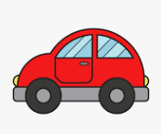
Optimization with safety constraint
Selector: This is CV-CV switching
Example: Drive as fast as possible but safely
max y
s.t. y₁ ≤ y₁^{max}
u ≤ u^{max}
y₂ ≥ y₂^{min}
(u=power, y=speed, y₂=distance to car in front)
Disturbances (d): Slope of road, other cars
Optimal solution has three active constraint regions:
  CV=y₁ = y₁^{max} = 120 km/h → speed limit
  MV=u = u^{max} → max power (steep hill)
  CV=y₂ = y₂^{min} → minimum distance (busy road)
Solved with two PI-controllers and min-selector («adaptive cruise control»)
  C₁: Cruise controller with y₁^{sp} = y₁^{max}
  C₂: Distance controller with y₂^{sp}= y₂^{min}
  Both controllers need anti-windup (turn off when inactive)
y₁
y₂
u₁
u₂
c₁
u=min(u₁,u₂)
MIN
c₂
PI
All three constraints are satisfied with a small u

Slide 33
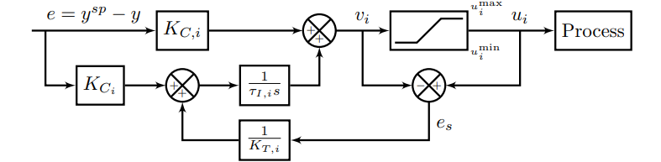
Anti-windup
All the controllers shown need anti-windup to «stop integration» during periods when the control action (v_{i}) is not affecting the process:
  Controller is disconnected (because of selector)
  Physical MV u_{i} is saturated
Selector or
saturation
K_{T,i}
Anti-windup using back-calculation. Typical choice for tracking constant, K_{T}=1

Slide 34
Design of selector structure
Rule 1 (max or min selector)
Use max-selector for constraints that are satisfied with a large input
Use min-selector for constraints that are satisfied with a small input
Rule 2 (order of max and min selectors):
If need both max and min selector: Potential infeasibility
Order does not matter if problem is feasible
If infeasible: Put highest priority constraint at the end
“Systematic design of active constraint switching using selectors.” Dinesh Krishnamoorthy , Sigurd Skogestad. Computers & Chemical Engineering, 2020

Slide 35
Valves have “built-in” selectors
A min-flow (z=0) gives a “built-in” max-selector (to avoid negative flow)
A max-flow (z=1) gives a “built-in” min-selector
So it’s not necessary to add these as selector blocks (but it will not be wrong).
  Both will always be satisfied because physical input constraints can never be violated.
  There is no danger of infeasibility /inconsistency here because we cannot have both z=0 and z=1 at the same time.

Slide 36
Anti-surge control
This is simple CV-MV switching
y^{sp} = y^{min}
PI
Minimize compression cost but keep safe operation (F>F^{min})
min u
s.t. y ≥ y^{min} (safety constraint)
u ≥ u^{min} = 0
(u= F_{R}=recycle flow, y=F=flow in compressor)
Disturbance (d): Feed flow F₀
Optimal solution has two active constraint regions:
  CV=y = y^{min} (for small F₀)
  MV=u = u^{min} = 0 (for large F₀)
Solved with PI-controller («anti-surge control»)
  y^{sp} = y^{min}
  Anti-windup: I-action is off when u=u^{min}=0
F₀
y=F
F^{sp}=F^{min}
FC
u^{min}=0
MAX
u=F_{R}
MAX-block to avoid negative flow.
Not needed because the input (valve) has «built-in» u ≥ 0.
We satisfy the input saturation rule:
«When the MV (u) saturates, control of the CV (y) can be given up»

Slide 37
Furnace control
Selector: This is CV-CV switching
with safety constraint
u_{A}
TC
T_{1s} = 500C
Input (MV)
u = Fuel gas flowrate
Output (CV)
y₁ = process temperature T₁
(with desired setpoint)
y₂ = furnace temperature T₂
(max constraint)
Rule: Use min-selector for constraints that are satisfied with a small input
MIN
u_{B}
TC
T_{2max}=700C
y₁=T₁
HP steam
u=min(u_{A},u_{B})
y₂=T₂
Flue gas
Process fluid (water)
u = input = manipulated variable (MV)
y = output = controlled variable (CV)
u=Fuel gas
Air
“Systematic design of active constraint switching using selectors.” Dinesh Krishnamoorthy , Sigurd Skogestad. Computers & Chemical Engineering, 2020

Slide 38
Example: Furnace control
Furnace control : Cannot give up control of y₁=T₁. What to do?
u_{A}
TC
T_{1s} = 500C
MIN
u_{B}
T_{2max}=700C
LS
TC
y₁=T₁
Inputs (MV)
u = Fuel gas flowrate
u₂ = Process flowrate
Output (CV)
y₁ = process temperature T₁
(with desired setpoint)
u=min(u_{A},u_{B})
y₂=T₂
Flue gas
Process fluid
u₂
u=Fuel gas
Air

Slide 39
Cannot give up controlling T₁
Solution: Cut back on process feed (u₂) when T₁ drops too low
This is complex CV-MV switching
TC
Using Input-input switching
T_{1s} = 500C
T’_{1s} = T_{1s}-5C=495C
u_{A}
TC
TC
MIN
u_{B}
T_{2max}=700C
LS
TC
y₁=T₁
Inputs (MV)
u = Fuel gas flowrate
u2 = Process flowrate
Output (CV)
y₁ = process temperature
(with desired setpoint)
u=min(u_{A},u_{B})
y₂=T₂
Flue gas
u₂
Note: Standard Split Range Control is not good here.
Could be two reasons for too little fuel
  Fuel is cut back by override (safety)
  Fuel at max,
So don’t know limit for MV1 to use in SRC-block.
Process fluid
u=Fuel gas
Air
u = input = manipulated variable (MV)
y = output = controlled variable (CV)

Slide 40
Cannot give up controlling T₁
Solution: Cut back on process feed (u₂) when T₁ drops too low
This is complex CV-MV switching
T_{1s} = 500C
T’_{1s} = T_{1s}-5C=495C
u_{A}
TC
TC
MIN
u_{B}
T_{2max}=700C
LS
TC
y₁=T₁
Inputs (MV)
u = Fuel gas flowrate
u2 = Process flowrate
Output (CV)
y₁ = process temperature
(with desired setpoint)
u=min(u_{A},u_{B})
y₂=T₂
Flue gas
u₂
  Solution: Two controllers with different setpoints
Process fluid
u=Fuel gas
Air
u = input = manipulated variable (MV)
y = output = controlled variable (CV)

Slide 41
Summary constraint switching:
Only three different cases (or maybe four)
MV-MV switching
  Need many MVs to cover whole steady-state range
  Use only one MV at a time
  Three options: 1. Split range control, 2. Different setpoints, 3. Valve position control (VPC)
CV-CV switching («override»)
  Must select between CVs
  Only one option: Many controllers with Max-or min-selector
CV-MV switching (because MV saturates)
3A. Simple: CV can be given up (follow «input saturation rule»)
  Don’t need to do anything (except anti-windup in controller)
3B. Complex: CV cannot be given up
  Combine MV-MC switching (three options) with CV-CV switching (selector)
Process
Process
Process
Process

Slide 42
Oops…out of time
Because the timr for the plenary was reduced from 60 to 40 minutes because of delays, I only got to this point during my presentation in Toulouse
But I think it was enough to give the audience the message:
  Put optimization into the control layer whenever feasible
  It’s a complement and not alternative to online model-based optimization

Slide 43
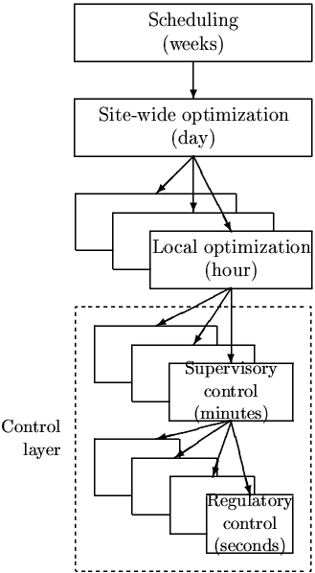
5. Systematic procedure for designing control system that achieves optimal operation

Slide 44
Use of models and data
RTO layer:
Nonlinear model of whole process
usually physical and static
MPC layer:
Multivariable dynamic linear model for each unit
usually from data
y_{1s}
y₁=CV₁
MPC
^ ^
d, x
y_{2s}
y₂=CV₂
Data reconciliation (static)
Or
Estimator (e.g. EKF)
PID-layer:
Dynamic linear model for each loop
usually from data.
H
H₂
Nonlinear model
u = valves
d
PROCESS
n^{y}
y = all measurements (online data)

Slide 45
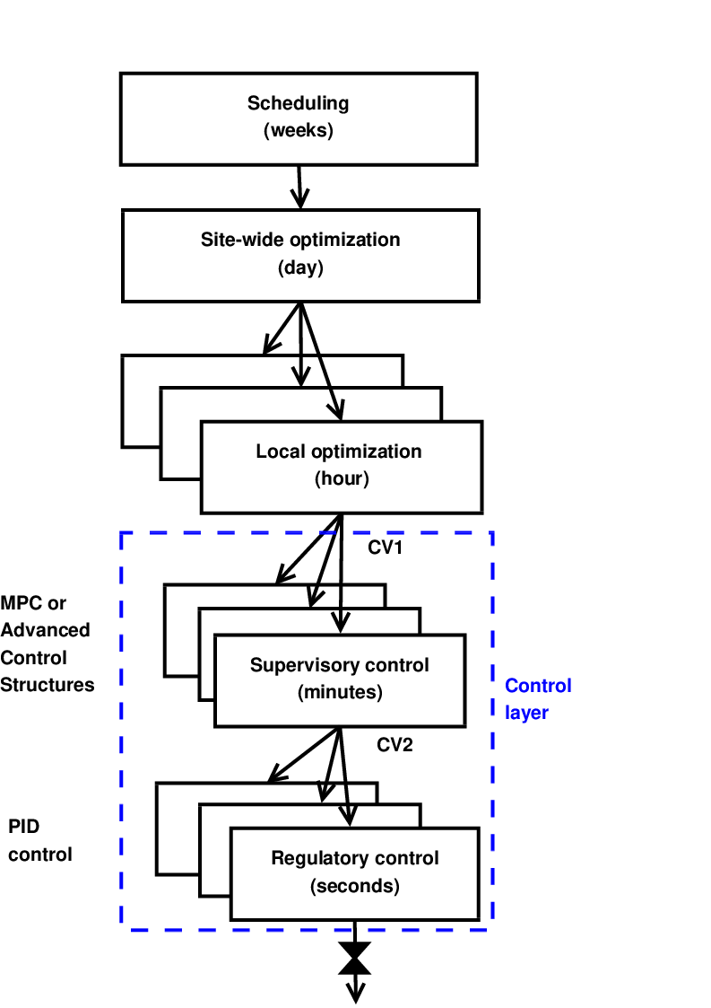
Systematic procedure for designing plantwide control system
Start “top-down” with economics:
Step 1: Define operational objectives and constraints
Step 2: Optimize steady-state operation
Step 3: Decide what to control (CV1 and CV2)
Step 4: Choose TPM location
Then design control system bottom-up:
Step 5: Regulatory control
Step 6: “Advanced/supervisory control” system
Step 7: Real-time optimization (Do we need it?)
MVs
S. Skogestad, ``Control structure design for complete chemical plants‘’, Computers and Chemical Engineering, 28 (1-2), 219-234 (2004).
Process

Slide 46

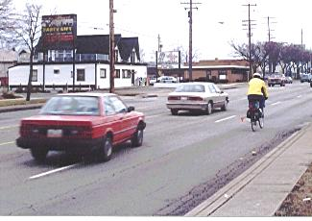
Example: Bicycle riding
Note: Design starts from the bottom
Hierarchical decomposition
Regulatory control (step 5):
  First need to learn to stabilize the bicycle
    CV2 = y₂ = tilt of bike
    MV = body position
Supervisory control (step 6):
  Then need to follow the road.
    CV1 = y₁ = distance from right hand side
    MV=CV2_{s}
  Usually a constant setpoint policy is OK, e.g. y_{1s}=0.5 m
Optimization layer (step 7):
  Which road to follow?
  RTO = GPS

Slide 47
Systematic design of simple advanced controllers (APC)
Process
First design simple control system for nominal operation
  With single-loop PID control we need to make pairing between inputs (MVs) and outputs (CVs):
  Should try to follow two rules
    «Pair close rule» (for dynamics). Pair such that we have small effective delay and large gain
      This is to get fast control and avoid instability
    «Input saturation rule»: «Pair MV that may saturate with CV that can be given up (at least when the MV constraint is reached)”.
      This avoids loss of control
      Gives simple CV-MV switching

Slide 48
Systematic design of simple advanced controllers (APC)
First design simple control system for nominal operation
  With single-loop PID control we need to make pairing between inputs and outputs:
  Should try to follow two rules
    «Pair close rule». Pair such that we have fast reponse and large gain
      This is to get fast control and avoid instability
    «Input saturation rule»: «Pair MV that may saturate with CV that can be given up”.
      This avoids loss of control
      Gives simple CV-MV switching
Then make a list of possible new contraints that may be encountered (because of disturbances, parameter changes, price changes)
Reach constraint on new CV
  Simplest: Find an unused input (simple CV-MV switching)
  Otherwise: CV-CV switching using selector
Reach constraint on MV (which is used to control CV)
  Simplest (If we followed input saturation rule):
    Can give ip controlling CV (Simple CV-MV switching)
    Don’t ned to do anything
  Otherwise (if we cannot give up controlling CV)
    Simplest: Find an unused input
      MV-MV switching
    Otherwise: Pair with a MV that already controls another CV
      Complex CV-MV switching
      Must combine MV-MV and CV-CV switching
Is this always possible? No, pairing inputs and outputs may be impossible with many constraints.
May then use MPC instead

Slide 49
Example : Level control
u1 = z1 (inflow valve position)
u2 = z2 (outflow valve position) (likely to saturate)
y1 = F1 (inflow): Should be controlled at setpoint F_{1,s} (if possible)
y2 = level: must always be controlled (at some SP)
Process
SP
Nomimal design with “pair-close” rule
F_{1,s}
LC
FC
F₁ [m3/s]
F_{1,m}
z1
Disturbance
F₂ [m3/s]
z2
Problem: outflow-valve may saturate at fully open (z2=1) and then we lose level control
Note: We did not following the “input saturation rule” which says:
Pair MV that may saturate (z2) with CV that can be given up (F1)

Slide 50
This gives simple CV-MV switching (if z2 saturates at fully open)
Nominal design with Reverse pairing (follows “input saturation rule”):
SP
LC
F_{2,s}
F_{1,m}
F₁ [m3/s]
FC
«long loop»
Disturbance
F₂ [m3/s]
BUT with Reverse pairing: Get “long loop” for flow control
In addition: loose control of y2= level if z1 (F1-valve) saturates
«Long loop» = Works through other loops

Slide 51
This is complex CV-MV switching
Alternative solution: Follow “Pair close”-rule and use Complex CV-MV switching.
When z2 saturates at max, use the other MV (z1) for level control and give up controlling F1
Get: “Bidirectional inventory control”
LC
Using
MV-MV
switching
SP-H
SP-L
F_{1,s}
MIN
LC
LC
FC
F₁ [m3/s]
F_{1,m}
Disturbance
F₂ [m3/s]
Avoid long loop for control of F1
Works both when F1-valve or F2-valve saturate at open
Overall: seems to be the best solution

Slide 52
This is complex CV-MV switching
Alternative solution: Follow “Pair close”-rule and use Complex CV-MV switching.
When z2 saturates at max, use the other MV (z1) for level control and give up controlling F1
Get: “Bidirectional inventory control”
SP-H
SP-L
F_{1,s}
MIN
LC
LC
FC
F₁ [m3/s]
F_{1,m}
Disturbance
F₂ [m3/s]
Recommended: Two controllers
SP-L = low level setpoint
SP-H = high level setpoint
Use of two setpoints is good for using buffer dynamically!!

Slide 53
Generalization of bidirectional inventory control

Slide 54
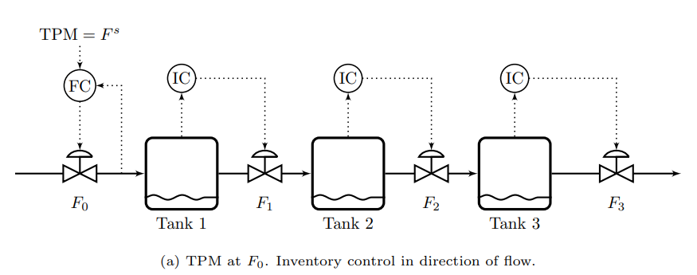
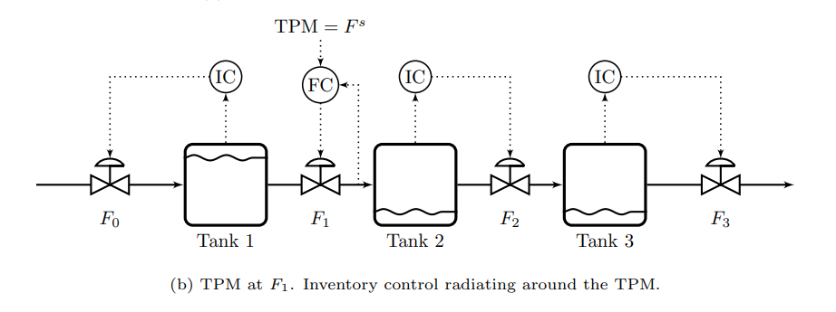
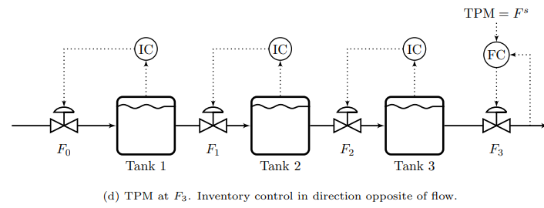
Radiation rule for
Inventory control
(Georgakis)
«Inventory loops are radiating around given flow (TPM)»
Follows «pair-close» rule
Avoids «long loops» for inventory control
TPM = throughput manipulator
(located at bottleneck = flow constraint)

Slide 55
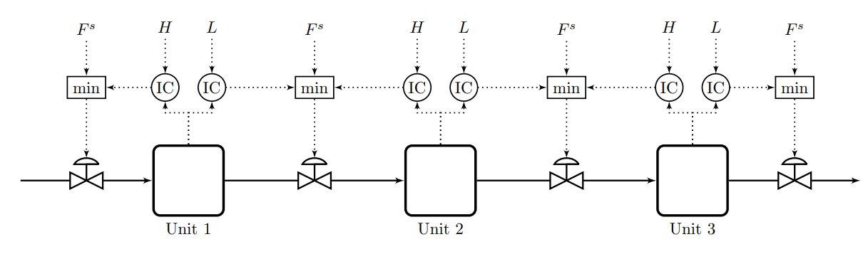
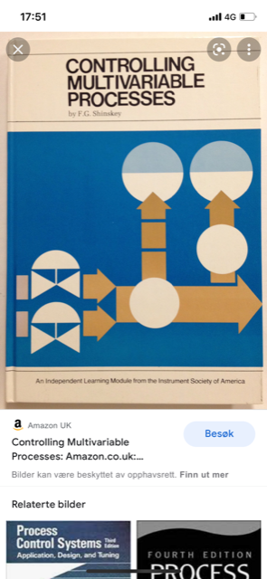
Very smart selector strategy: Bidirectional inventory control
Reconfigures automatically with optimal buffer management!!
Max flow:
F^{s}=∞
F.G. Shinskey, «Controlling multivariable processes», ISA, 1981
Cristina Zotica, Krister Forsman, Sigurd Skogestad ,»Bidirectional inventory control with optimal use of
intermediate storage», Computers and chemical engineering, 2022
,

Slide 56
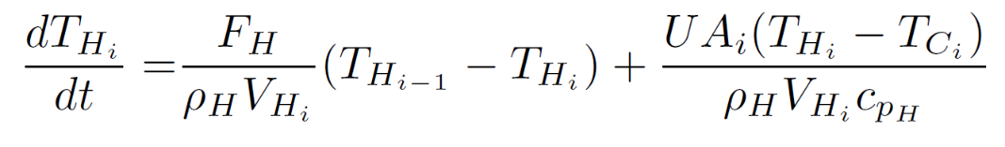
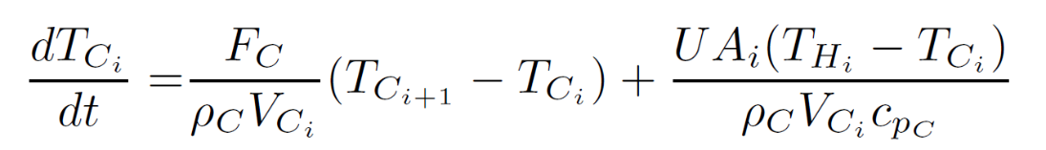
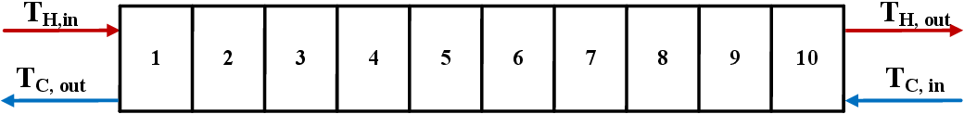
New example: Optimal operation of a cooler

Slide 57
Example: Optimal control of a cooler
Main control objective:
y₁=T_{H}=T_{H}^{sp}
Secondary objective (can be given up)
y₂= F_{H}=F_{H}^{sp}
Manipulated Variables:
u₁=z_{C} , u₂=z_{H}
Both valves may satúrate at max
Disturbance:
T_{C}^{in}
Cooling water

Slide 58
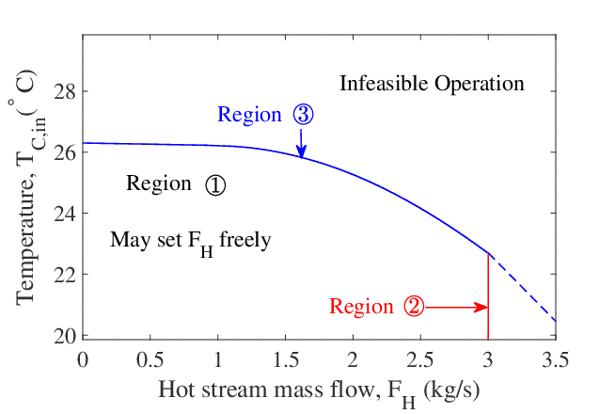
Optimization of Cooler
max y₂ (throughput)
s.t. y₁ = y₁^{sp} ← temperature
u₁ ≤ u₁^{max}
u₂ ≤ u₂^{max} ← max. throughput
y₂ ≤ y₂^{sp} ← desired throughput
Active constraint regions:
  y₁ = y₁^{sp}, y₂ = y₂^{sp} ← Nomimal = unconstrained
  y₁ = y₁^{sp}, u₂ = u₂^{max}
  y₁ = y₁^{sp}, u₁ = u₁^{max}
Input saturation pairing rule: It’s not possible to follow this rule since both MVs may saturate…
Will pair y₁ with u₁ for dynamic reasons («pair close rule»)
And use «complex» CV-MV switching logic when u₁ saturates

Slide 59
Pairings at nominal «unconstrained» operating point
F_{C} may saturate for a
large disturbance (T_{C}^{in})
Use F_{C} to control T_{H}

Slide 60
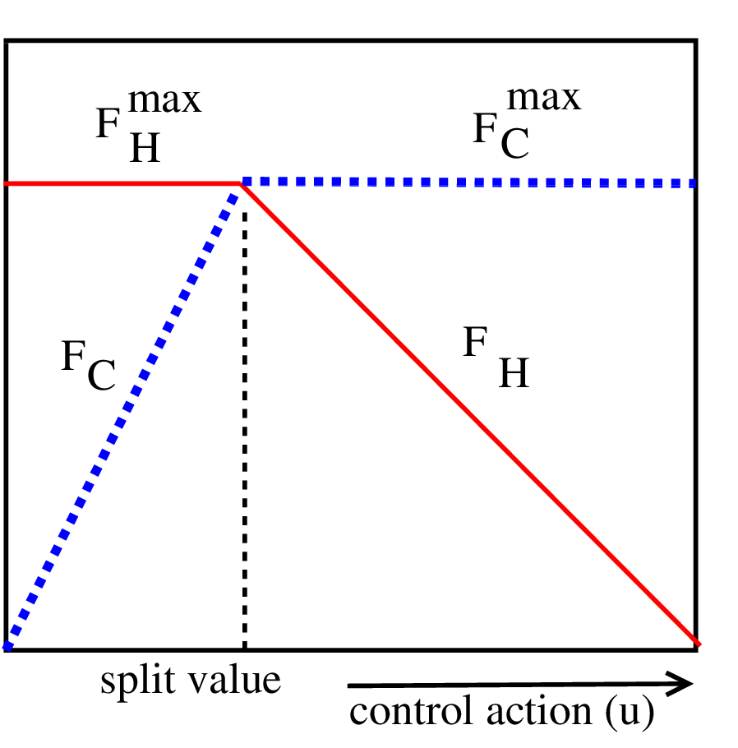
Alt.1: Split range control with min-selector
Complex CV-MV switching
=26C
Tuning of TC using SIMC rule:
  τ_{c} = 2θ = 88 s
  Kc = -0.55
  τ_{I} = 74 s

Slide 61
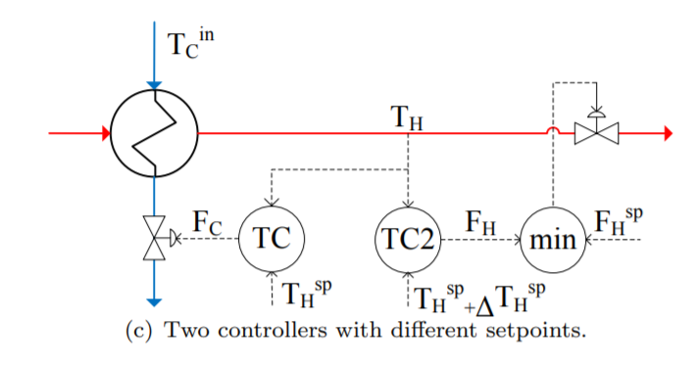
Alt.2 . Two controllers/setpoints and min-selector
Complex CV-MV switching
=26C
=27C

Slide 62
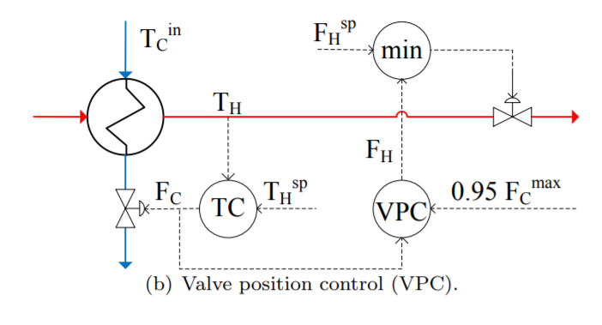
Alt. 3 VPC with min-selector
Complex CV-MV switching

Slide 63
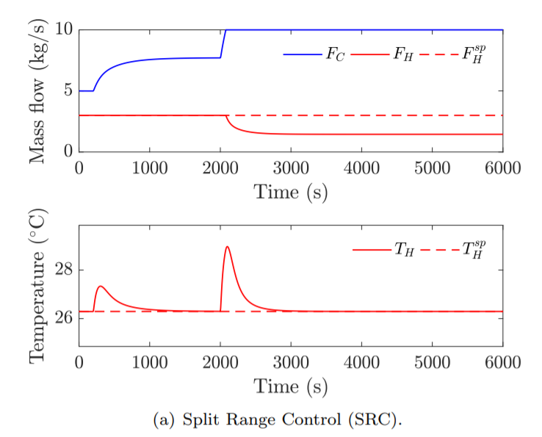
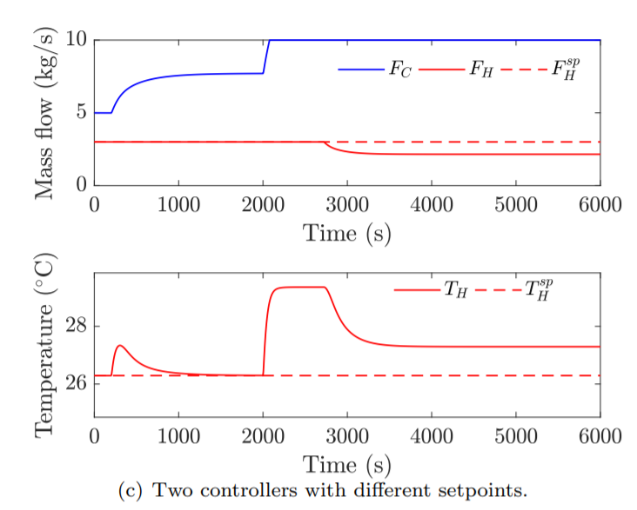
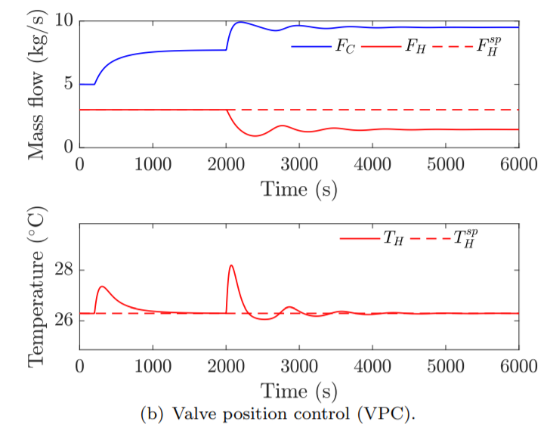
Complex CV-MV switching
Alt. 1 Split range control
Alt. 2 Two controllers/setpoints
Alt. 3 Valve position control
Disturbances: Tcin +2◦C at t = 200 s, Tcin additional +4 ◦C at t = 2000 s.

Slide 64
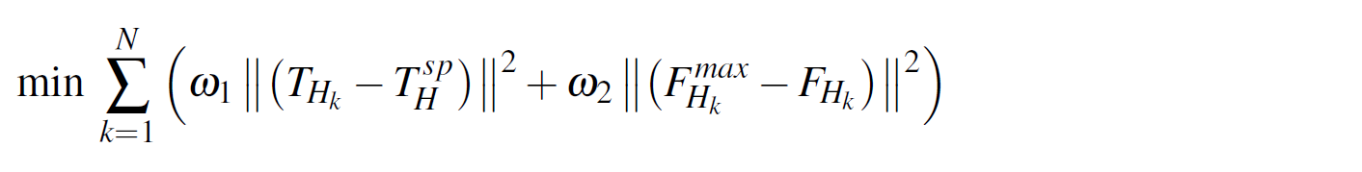
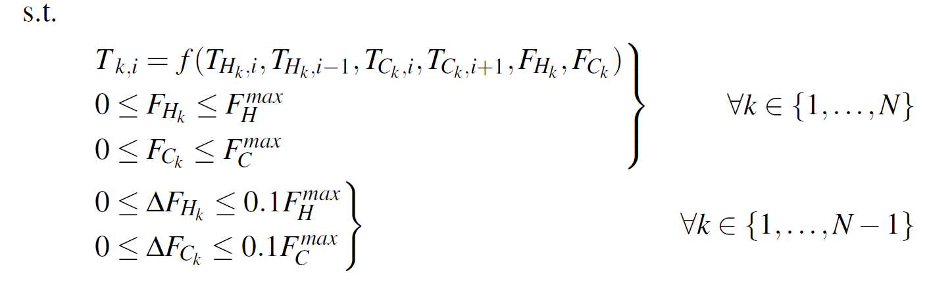


MPC for cooler
Tuning ← trial and error
← Objective function
(CV constraints)
Model →
MV constraints →
For represents the flow at the nominal point.

Slide 65
MPC vs Split range Control (PI)
Disturbance (T_{C}^{in})
t = 10 s; + 2°C
t = 1000 s; + 4°C
F_{C}
T_{H}
Red: Split Range Control (PI)
Yellow: MPC:
Δt = 50 s
ω₁ = 3
ω₂ = 0.1
F_{H}

Slide 66
Many people think they need to use MPC if they encounter constraints
True only for more complicated multivariable cases
In most cases PI(D)-control is simpler and equallly good
  Need anti-windup on the controller
=26C

Slide 67
Model predictive control (MPC)
Can include constraints explicitly
If lack of DOF to meet control specifications:
  Conventional: Use weights
    (Partially) give up variables with small weights in objective function.
  Use two-stage MPC with constraint priority list:
    Stage 1. Check for steady-state feasibility and give up low-priority constraints if necessary
    Stage 2. Solve conventional dynamic MPC

Slide 68
6. Conclusion
Put optimization into the control layer
  It’s much faster and more effective
Conventional APC works very well in many cases
  Optimization by feedback
    Self-optimizing control
    Active constraint switching
  Need to pair input and output.
    Advantage: The engineer can specify directly the solution
    Problem: May not be possible for complex cases
  Need model only for parts of the process (for tuning)
  Challenge: Need better teaching and design methods

