Slide 1
ADVANCED PROCESS CONTROL
Sigurd Skogestad
Department of Chemical Engineering
Norwegian University of Science and Technology (NTNU)
Trondheim
CNCA2021, 13 October 2021, Mexico (virtual)

Slide 2
Abstract
Title: Advanced process control.
Control engineers rely on many tools, and although some people may think that in the future there will be one general universal tool that solves all problems, like model predictive control, this is not likely to happen. The main reason is that the possible benefits of using more general tools may not be worth the increased implementation costs (including modelling efforts) compared to using simpler "conventional" advanced process control (APC) solutions. In particular, this applies to process control, where each process is often unique. In addition, for a new process, a model is usually not available, so at least for the initial period of operation a conventional scheme must be implemented.
Conventional APC, includes the “advanced” standard control elements that typically are provided at the DCS (distributed control system) level and which industry commonly uses to enhance control when simple single-loop PID controllers do not give acceptable control performance. Examples of such control elements are cascade control, selectors (override), split range control, input or valve position control (VPC), multiple controllers (and MVs) for the same CV, and nonlinear calculation blocks (including nonlinear feedforward and decoupling and linearizing adaptive gain elements).
Since its introduction in the 1940’s, about 80 years ago, conventional APC has largely been overlooked by the academic community, yet it is still thriving in industrial practice, even after 40 years with MPC. So it seems safe to predict that conventional APC (including PID control) will not be replaced by MPC, but will remain in the toolbox along with MPC. The goal of this talk is to take a systematic view on how to design a conventional APC system. The starting point is the plantwide optimal steady-state economic operation, with focus on constraints.
Some more details (not send to conference):
Since conventional APC it is not going away any time soon, it is definitely time to strengthen its theoretical basis and train students on how to use it in an effective manner.
The goal of this talk is to take a systematic view on how to design a conventional APC system. The starting point is to consider the plantwide optimal steady-state economic operation, with focus on constraints. The next issue to consider is inventory control, where the concept of throughput manipulator (TPM) is central as it determines the structure of the inventory control system. Following this, one needs to consider how active constraint switching can be implemented and this leads to selectors (for CV switching) and split range control, multiple controllers or VPC (for MV switching). Other issues are disturbances and nonlinearity, where cascade control and calculation blocks may be helpful.
The main disadvantage with conventional APC compared to MPC is that it is based on single-loop controllers, so one needs to pair outputs (CVs) with inputs (MVs). For most processes this works well, but for more complex cases with many constraint switches one may get significant benefits and simplifications with MPC. Other cases where MPC may offer significant benefits compared to conventional APC is for interactive processes and for cases with known future disturbances.

Slide 3




Trondheim
Arctic circle
Geiranger fjord
Trondheim

Slide 4
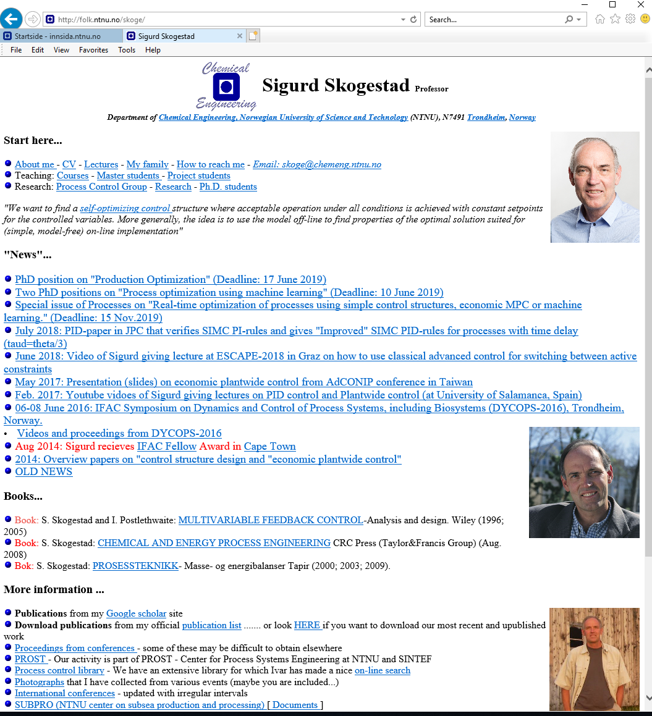
About Sigurd Skogestad
•1955: Born in Norway
•1978: MS (Siv.ing.) in chemical engineering at NTNU
•1979-1983: Worked at Norsk Hydro co. (process simulation)
•1987: PhD from Caltech (supervisor: Manfred Morari)
•1987-present: Professor of chemical engineering at NTNU
• 1994-95: Visiting Professor UC Berkeley
• 2001-02: Visiting Professor UC Santa Barbara
•1999-2009: Head of ChE Department, NTNU
•2015-..: Director SUBPRO (Subsea research center at NTNU)
Non-professional interests:
mountain skiing (cross country)
orienteering (running around with a map)
grouse hunting

Slide 5
“The goal of my research is to develop simple yet rigorous methods to solve problems of engineering significance”
One example: SIMC PID tuning rules (Skogestad, JPC, 2003)
«Probably the best simple PID tuning rules in the world»

Slide 6
Outline
Optimization and control
  Control hierarchy
  Want tight control of constraints
    Lagrange multipliers
    Selectors
Classical advanced (process) control (APC)
  Selectors
  Feedforward, decoupling and linearization blocks
    Input transformations (Feedback linearization)
  Other elements
    Split range control, valve position control, cascade
Conclusion. MPC vs. classical APC

Slide 7
Main notation
Control: Given setpoints
Disturbance
d=DV
Feedforward
Setpoint
y_{s} =CV_{s}
Controller
Process
Input
u=MV
Output
y=CV
Feedback
This talk: Focus on feedback
MV = Manipulated Variable
CV = Controlled Variable

Slide 8
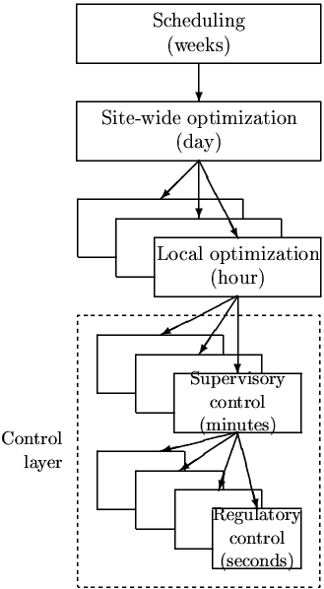
Process control: Hierarchical decision system
Manager
Process engineer
min J (economics)
_{hour}
Operator/RTO (usually steady-state)
CV1s
Setpoint control
(+ look after other variables)
minute
Supervisory control layer
”Advanced control”/MPC
CV2s
Stabilize + avoid drift
second
PID-control
u (MV) = valves

Slide 9
Process control: Hierarchical decision system
Manager
Process engineer
min J (economics)
_{hour}
Economic MPC
(EMPC)
or
Dynamic RTO
Setpoint control
(+ look after other variables)
minute
Stabilize + avoid drift
second
u (MV) = valves

Slide 10
Process control: Hierarchical decision system
Manager
Process engineer
min J (economics)
_{hour}
Economic MPC
(EMPC)
or
Dynamic RTO
Setpoint control
(+ look after other variables)
minute
Stabilize + avoid drift
second
CV2s
u (MV) = valves

Slide 11
Process control: Hierarchical decision system
Manager
Process engineer
min J (economics)
_{hour}
Operator/RTO (usually steady-state)
Focus of this talk
CV1s
Setpoint control
(+ look after other variables)
minute
Supervisory control layer
”Advanced control”/MPC
Stabilize + avoid drift
second
PID-control
u = valves

Slide 12
How do we design the control system for a large process?
Consider economics
  min_{u} J(u,d) s.t. g(u,d)≥0
Translate into control: Find good controlled variables (CV1) to keep at fixed setpoints
CV1 = Active constraints (can change!)
CV1 = «Self-optimizing» variables (related to gradient y = J_{u} = 0)
2. Design control system to control CV1 under varying conditions (disturbances)
Usually two control layers:
Supervisory control layer («advanced control»), CV1
Stabilizing control layer («PID control»), CV2

Slide 13
«ADVANCED/SUPERVISORY CONTROL» LAYER
Objectives :
1. Control primary variables CV1 at setpoints computed by RTO
    Tight control of active constraints is often desired for economic reasons.
  Feedforward from measured disturbances
    If helpful
  Make use of extra inputs
  Make use of extra measurements
2. Switch control structures (CV1) depending on operating region
  Change in active constraints
  Identify “self-optimizing variables”
  3. Keep an eye on stabilizing layer
    Avoid saturation in stabilizing layer, may require switching
Implementation:
Alternative 1: Advanced control based on ”simple elements” (decentralized control)
Alternative 2: MPC

Slide 14
Academia: MPC
MPC
    General approch, but we need a dynamic model
    MPC is usually implemented after some time of operation
    Not all problems are easily formulated using MPC
    Explicit control of changing active constraints requires additional logic
      Industry uses two-stage MPC with steady-state feasibility based on constraint priority list

Slide 15
Research question: Alternative simpler solutions to MPC
Would like: Feedback solutions that can be implemented without a detailed models
Machine learning?
  Requires a lot of data
  Can only be implemented after the process has been in operation
But we have "classical advanced control“ based on single-loop PIDs
  Extensively used by industry
  Problem for engineers: Lack of design methods
    Has been around since 1940’s
    But almost completely neglected by academic researchers
  Main fundamental limitation: Based on single-loop (need to choose pairing)

Slide 16
“Classical Advanced control” using simple control elements
Cascade controllers
Have Extra output (state) measurements
2. Feedforward elements
Have measured disturbance
3. Decoupling elements
Have interactive process
4. Linearization elements / Adaptive gain
Have Nonlinear process
5. Split-range control (or multiple controllers or VPC)
Need extra inputs (MV) to handle all conditions (steady state) (MV-MV switch)
6. Valve position control (VPC) (Input resetting/Midranging control)
Have extra inputs dynamically
7. Selectors
Have changes in active constraints (CV-CV switch)
APC: Often static nonlinear «function block»
One unifying approach is «Transformed inputs» (similar to feedback linearization)

Slide 17
How design classical APC elements?
Industrial literature (e.g., Shinskey).
Many nice ideas. But not systematic. Difficult to understand reasoning
Academia: Very little work

Slide 18
7. Change in CVs (active constraints) using selectors

Slide 19

Want tight control of constraints for economic reasons
min_{u} J(u,d)
s.t. g(u,d) ≥ 0
Active constraint: g_{A}=0
Tight control of g_{A} minimizes «back-off»
How can we identify and control active constraints?
Example. Drive from a to B in shortest time
J = T
u = power (gas pedal)
g1 = speed limit = v_{max} - v
g2 = safety limits
Straight road:
g_{A} = g1 (Speed limit)
B
A

Slide 20

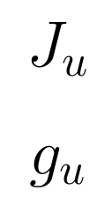

Feedback solution that automatically tracks active constraints by adjusting Lagrange multipliers (= shadow prices = dual variables) λ
Constraint control
(n_{c} slower PI/I-controllers)
g (measured constraint)
SP=0
Primal-dual feedback control.
Makes use of «dual decomposition» of constrained optimization
Selector on dual variables λ
Problem: Constraint control using dual variables is on slow time scale
0
MAX
Dual variables
Unconstrained optimization
(n_{u} PID-controllers)
SP=0
Gradient estimation
u
Primal variables
d
Process
y
g (measured constraint)
«Optimal Resource Allocation using Distributed Feedback-based Real-time Optimization». Risvan Dirza, Sigurd Skogestad, Dinesh Krishnamoorthy. IFAC Adchem Conference, 2021

Slide 21


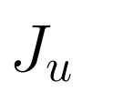
Alternative: Feedback solution with «direct» constraint control
Constraint controllers
(fast PID-controllers)
g (constraints paired with u1)
SP=0
SP=0
J_{u1}, J_{u2} = N^{T}J_{u} reduced gradients
(«self-optimizing variables»)
u1
u1o
J_{u1}
MAX/
MIN
PID
(changes!)
J_{u2}
Selector on primal variables (inputs)
Similar to selectors in APC
Gradient estimation
u1
u2
d
Process
y
g (measured constraint)
«Online Process Optimization with Active Constraint Set Changes using Simple Control Structure», D. Krishnamoorthy and S. Skogestad, I&EC Res., 2019
«Optimal controlled variables for ̈ polynomial systems». Jaschke, J.; Skogestad, S., J. Process Control, 2012

Slide 22
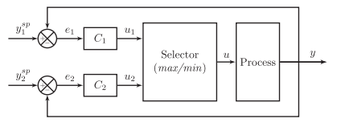
Selector (APC): One input (u), several outputs (y₁,y₂)
y₁
>
=
MAX
=
HS
u=min(u₁,u₂)
<
=
MIN
=
LS
y₂
Sometimes called “override”
Selectors are used for output-output (CV-CV) switching
  Example: Normally want to keep y1 at a setpoint,
    but y2 (higher priority) must not exceed constraint.
    With selector: When y2 reaches constraint, we give up control of y1.
    More generally: u₁=u_{o} is the optimal input value without constraint (can be given up)
  Can have many constraints paired with same input y.
Selectors work well, but require pairing each constraint with a given input (not always possible)

Slide 23
Design of selector structure
Rule 1 (max or min selector)
Use max-selector for constraints that are satisfied with a large input
Use min-selector for constraints that are satisfied with a small input
Rule 2 (order of max and min selectors):
If need both max and min selector: Potential infeasibility
Order does not matter if problem is feasible
If infeasible: Put highest priority constraint at the end
“Systematic design of active constraint switching using selectors.”
Dinesh Krishnamoorthy , Sigurd Skogestad. Computers & Chemical Engineering, Volume 143, (2020)

Slide 24
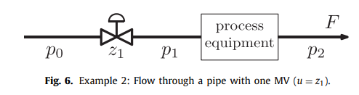

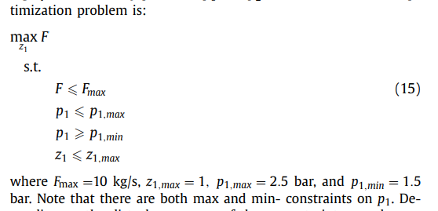
Example A. Maximize flow with pressure constraints
Input u = z₁
Want to maximize flow, J=-F:
Unconstrained: Optimal input is infinity:
Op

Slide 25
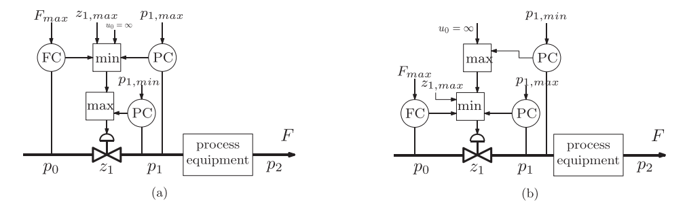
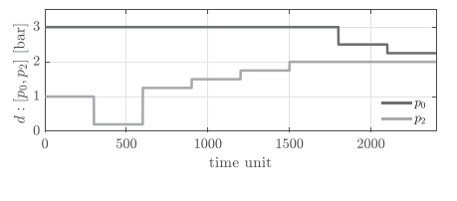
Desired input u₀ without constraints (can be given up) into first selector block
Disturbances in p₀ and p₂ (unmeasured)

Slide 26
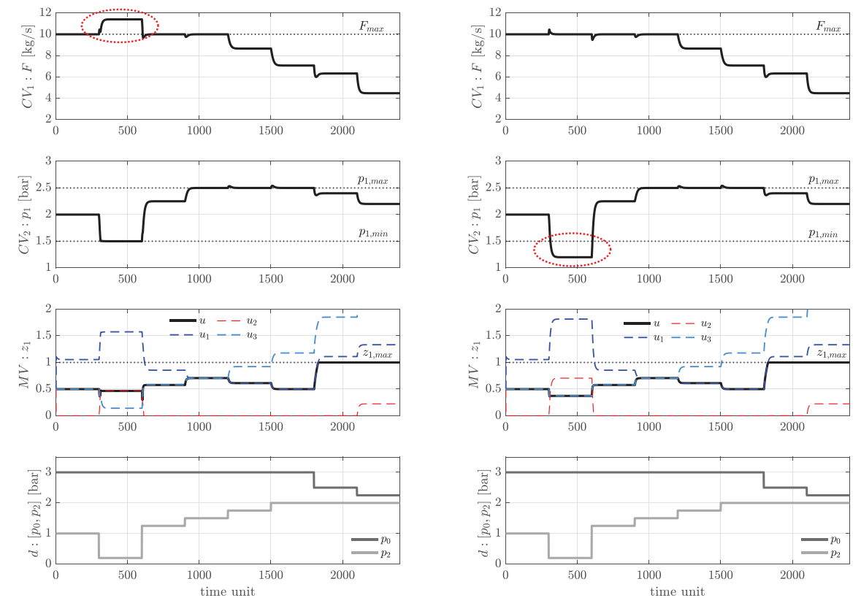
t>1800: u=zmax=1

Slide 27
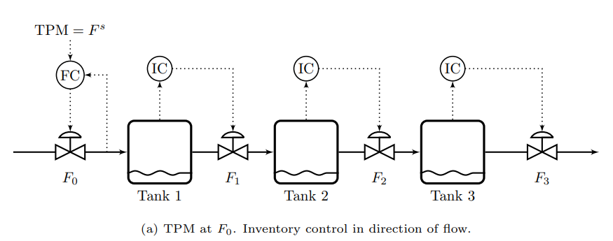
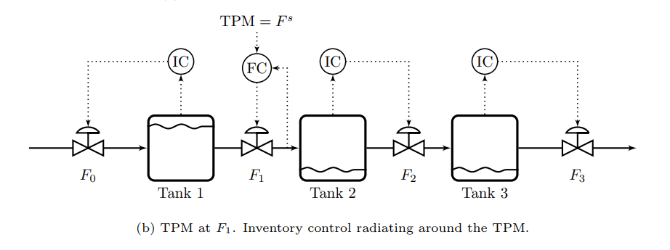
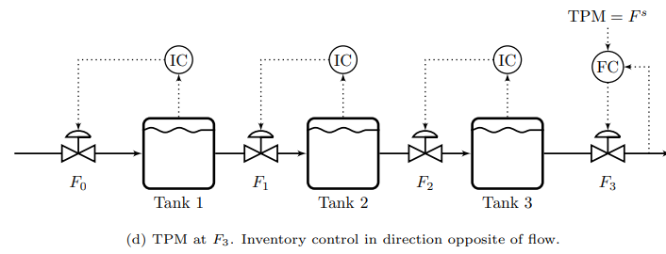
Example B. Maximize production
for serial process
Constraints on levels (H,L)
and valves/flows
TPM = throughput manipulator
Typically at bottleneck («active constraint»)
Disturbances: Temporary bottelenecks
(max-constraints) for F0, F1, F2 or F3

Slide 28
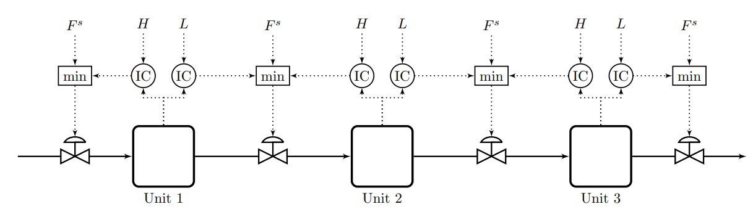
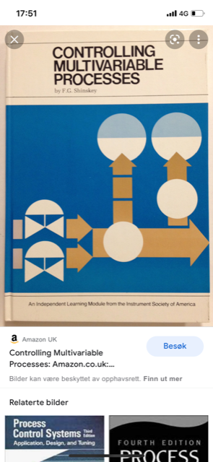
Example B. Very smart selector strategy: Bidirectional inventory control
Reconfigures automatically with optimal buffer management!!
Max flow:
F^{s}=∞
F.G. Shinskey, «Controlling multivariable processes», ISA, 1981
C. Zotica, S. Skogestad and K. Forsman, Comp. Chem. Eng, 2021

Slide 29



=∞
=∞
=∞
1
F₀=1
F₁=1
F₂=1
F₃=1

Slide 30
=∞
=∞
1
0.5
F₀=1
F₁=0.5
F₂=1
F₃=1

Slide 31
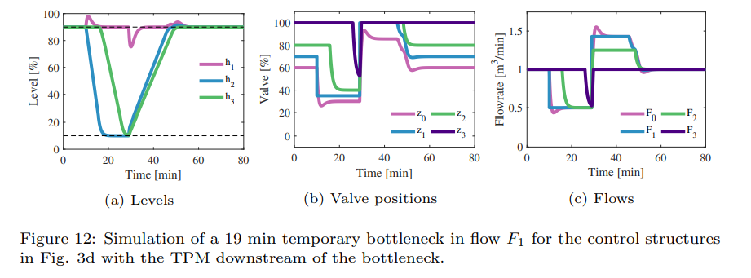
=∞
=∞
1
0.5
F₀=0.5
F₁=0.5
F₂=1
F₃=1

Slide 32

=∞
=∞
1
0.5
F₀=0.5
F₁=0.5
F₂=0.5
F₃=1

Slide 33

=∞
=∞
=∞
1
0.5
F₀=0.5
F₁=0.5
F₂=0.5
F₃=0.5

Slide 34
=∞
=∞
1
F₀=1
F₁=1
F₂=1
F₃=1
Challenge: Can MPC be made to do his? Optimally reconfigure loops and find optimal buffer? I doubt it. We tried.

Slide 35
Important insight
Many problems: Optimal steady-state solution always at constraints
In this case optimization layer may not be needed
  if we can identify the active constraints and control them using selectors (Examples A and B).

Slide 36
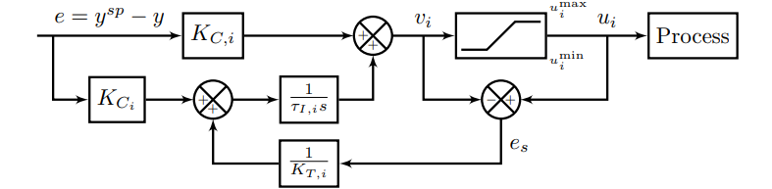
Anti-windup
All the controllers shown need anti-windup to «stop integration» during periods when the control action (v_{i}) is not affecting the process:
  Controller is disconnected (because of selector)
  Physical MV u_{i} is saturated
Selector or
saturation
K_{T,i}
Anti-windup using back-calculation. Typical choice for tracking constant, K_{T}=1

Slide 37
Challenges selector design
Standard approach requires pairing of each active constraint with a single input
  May not be possible in complex cases
Stability analysis of switched systems is still an open problem
  Undesired switching may be avoided in many ways:
    Filtering of measurement
    Tuning of anti-windup scheme
    Minimum time between switching
    Minimum input change

Slide 38
“Classical Advanced control” using simple control elements
Cascade controllers
Have Extra output (state) measurements (similar to state feedback)
2. Feedforward elements
Have measured disturbance
3. Decoupling elements
Have interactive process
4. Linearization elements / Adaptive gain
Have Nonlinear process
5. Split-range control (or multiple controllers or VPC)
Need extra inputs (MV) to handle all conditions (steady state) (MV-MV switch)
6. Valve position control (VPC) (Input resetting/Midranging control)
Have extra inputs dynamically
7. Selectors
Have changes in active constraints (CV-CV switch)
APC: Often static nonlinear «function block»
One unifying approach is «Transformed inputs» (similar to feedback linearization)

Slide 39
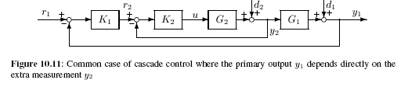
1. Cascade control
Use extra measurement y₂ to improve control of primary output y₁
Cascade: MV for outer primary controller is the setpoint r2 to inner secondary controller
Fast inner loop: Eliminate d2 and nonlinearity in G2
        Proof: Ideally y2 = r2
Primary
Secondary loop (fast)
Design: First design fast inner/secondary controller (can be just P-control)
Then design slower outer/primary controller (PI-controller)
Closed-loop time constant for outer loop at least 4 times larger (slower)
An alternative approach that uses extra measurements to improve control is «Full state feedback».

Slide 40
2,3,4.
Feedforward, Decoupling, Linearization
Unified approach (for static case): «Transformed» inputs v (and outputs)*
Greg Shinskey (1981): “There is no need to be limited to single measurable or manipulable variables. If a more meaningful variable happens to be a mathematical combination of two or more measurable or manipulable variables, there is no reason why it cannot be used.”
Motivation: ratio control
*«Transformed Manipulated Variables for Linearization, Decoupling and Perfect Disturbance Rejection»,
C Zotica, N Alsop, S Skogestad, IFAC World Congress, 2020

Slide 41
MOTIVATING EXAMPLE 1: MIXING PROCESS
RATIO CONTROL
with outer cascade (to adjust ratio setpoint)
(q₂/q₁)_{s}
q_{1,m}
q_{2,s}
x
q₁ [m3/s]
C₁ [mol/m3]
FC
q_{2,m}
Concentrate
C₂ small
(Water)
∞
H
LC
CC
c_{m}
c
q [m3/s]
c [mol/m3]
c_{s}
Diluted product
Input u=q2.
Transformed input v = q2/q1
Gives “perfect” feedforward control for d=q1
Potential problem for outer feedback loop (composition controller, y=c):
  Gain from MV = (q2/q1)_{s} to CV=c will vary because of multiplication with q1,m
  Outer loop must handle disturbances in c1 and c2

Slide 42
Improved RATIO CONTROL = Ideal TRANSFORMED INPUT from static model
v
q_{1,m}
C_{1,m}
Nonlinear Function block
q_{2,s}
q₁ [m3/s]
C₁ [mol/m3]
FC
q_{2,m}
Concentrate
C₂
Water
∞
H
LC
CC
c_{m}
c
q [m3/s]
c [mol/m3]
c_{s}
Transformed input v = Right-Hand-Side of static model for y=c:
  c = (q1 c1 + q2 c2)/(q1+q2)
  Solve with respect to input q2.
  Get “nonlinear function block”: q2 = q1*(c1-v)/(v –c2)
Gives “perfect” feedforward control for disturbances in q1, c1 and c2.
and also gives linear response (y=v) for controller CC
=v

Slide 43
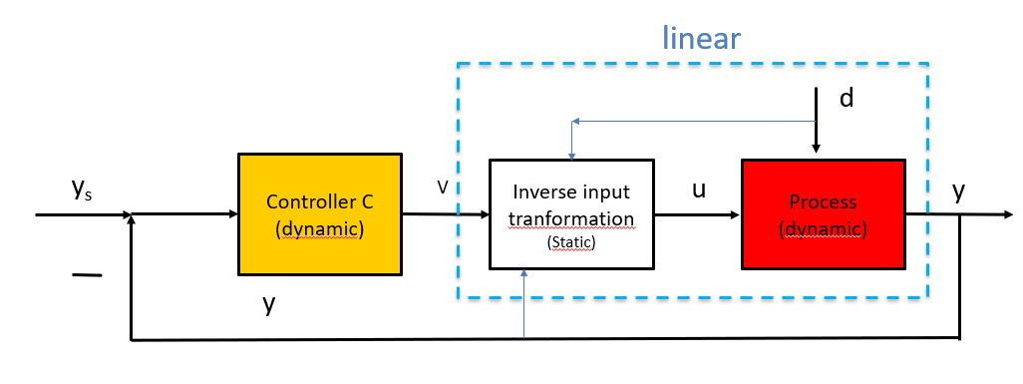
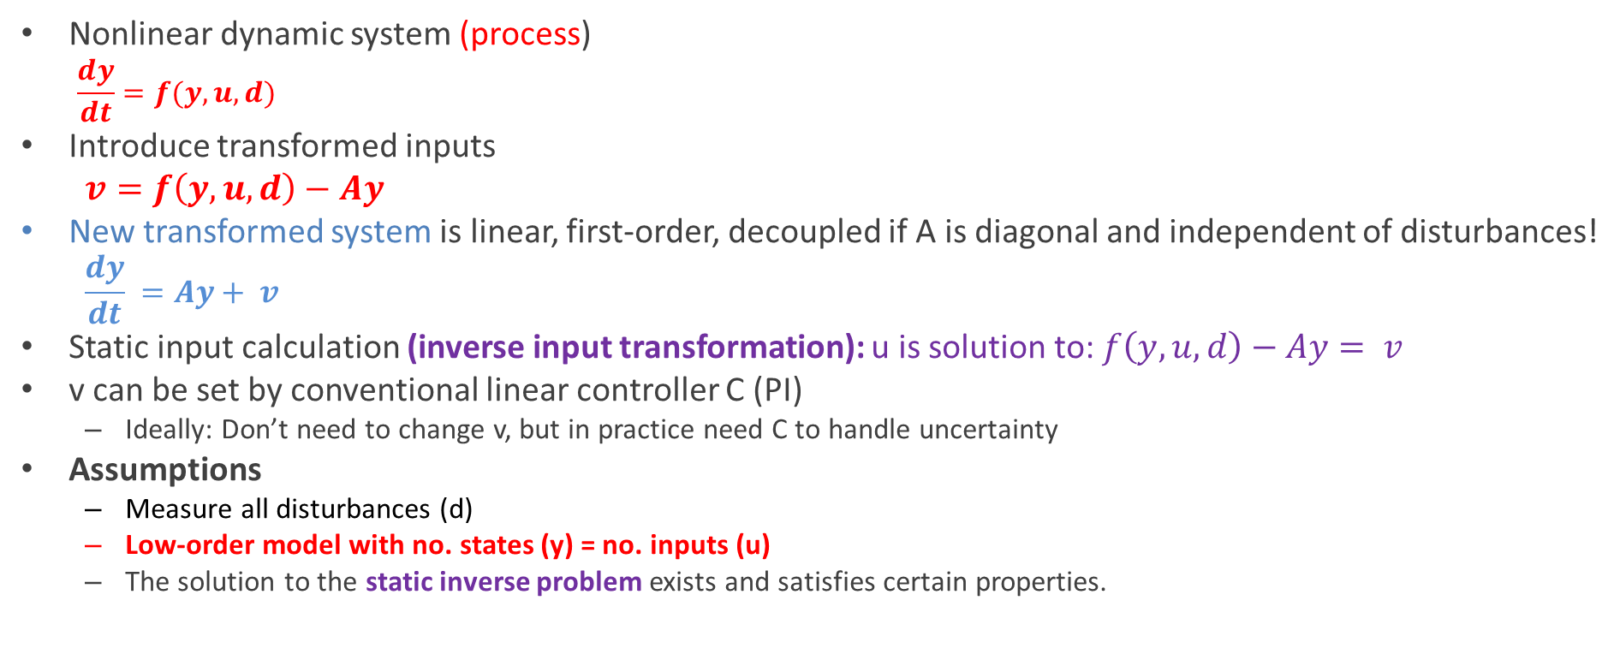
Dynamic case (~ feedback linearization, Isidori)
Nonlinear dynamic system (process)
  $$\frac{dy}{dt}=f(y,u,d)$$
Introduce transformed inputs
  $v=f\left(y,u,d\right)−Ay$
New transformed system is linear, first-order, decoupled if A is diagonal and independent of disturbances!
  $$\frac{dy}{dt} =Ay+ v$$
Static input calculation (inverse input transformation): u is solution to: $f\left(y,u,d\right)−Ay= v$
v can be set by conventional linear controller C (PI)
  Ideally: Don’t need to change v, but in practice need C to handle uncertainty
Assumptions
  Measure all disturbances (d)
  Low-order model with no. states (y) = no. inputs (u)
  The solution to the static inverse problem exists and satisfies certain properties.

Slide 44
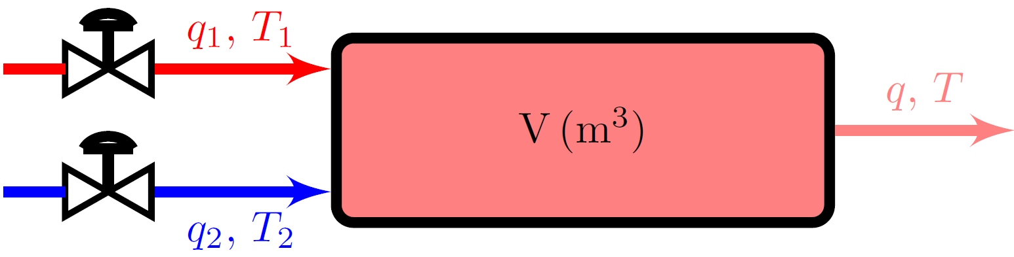
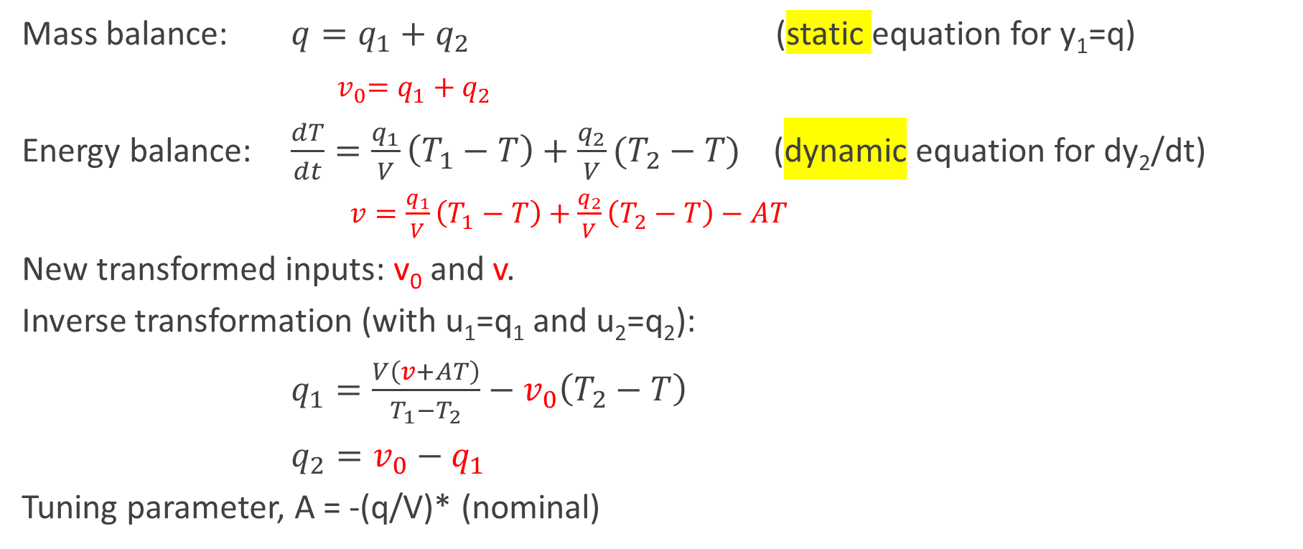
Example 2. Mix hot (1) and cold (2) water, y=[q T]
Mixer
Assume V constant
Mass balance: $q=q_{1}+q_{2}$ (static equation for y₁=q)
${ v}_{0}=q_{1}+q_{2}$
Energy balance: $\frac{dT}{dt}=\frac{q_{1}}{V}\left(T_{1}−T\right)+\frac{q_{2}}{V}(T_{2}−T)$ (dynamic equation for dy₂/dt)
$v=\frac{q_{1}}{V}\left(T_{1}−T\right)+\frac{q_{2}}{V}\left(T_{2}−T\right)−AT$
New transformed inputs: v₀ and v.
Inverse transformation (with u₁=q₁ and u₂=q₂):
$q_{1}=\frac{V\left(v+AT\right)}{T_{1}−T_{2}}−v_{0}\left(T_{2}−T\right)$
$q_{2}=v_{0}−q_{1}$
Tuning parameter, A = -(q/V)* (nominal)

Slide 45

Resulting Transformed system y₁=q, y₂=T
$y1=v0$
$\frac{dy2}{dt}=Ay2+v$
Transformed system
Linear, decoupled and independent of disturbances

Slide 46
Simulation responses with transformation only.
-> Perfect disturbance rejection and decoupling
u
y₁
1. d₁=T₁: 20 ->22 °C at t = 50 s
2. d₂=T₂: 50 ->55 °C at t = 100 s
3. y_{2s}=T_{s}: 35 ->36 °C at t = 150 s
4. y_{1s}=q_{s}: 10 ->11 kg/s at t = 200 s
1,2: v₀ and v constant
3: Step in v
4: step in v₀
y₂
d

Slide 47
Use of extra MV (inputs):
One CV, many MVs
Two different cases:
5. MV-MV switching: Need several MVs to cover whole range at steady state
  We want to use one MV at a time
6. Have extra dynamic MV
  Both MVs are used all the time

Slide 48
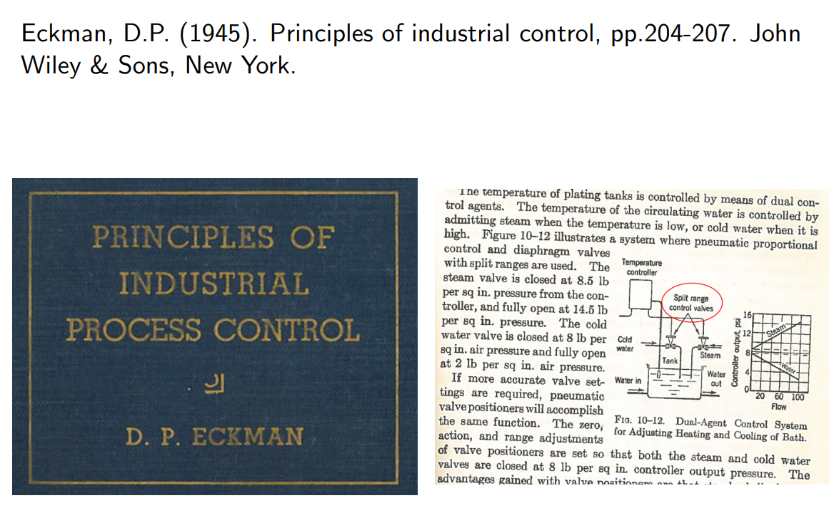
5. Extra inputs (MV) to handle all conditions (steady state)
1. Split-range control
Alternatives to Split-range control*:
  2. Multiple controllers with different setpoints
  3. Valve position control
* A. Reyes-Lua and S. Skogestad, «Systematic design of active constraint switching using classical advanced control structures», Ind.Eng.Chem.Res, Vol. 59, 2229-2241 (2020)

Slide 49
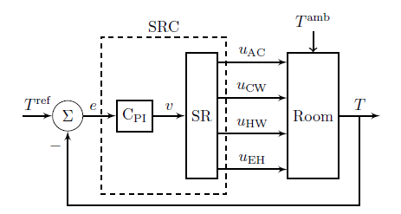
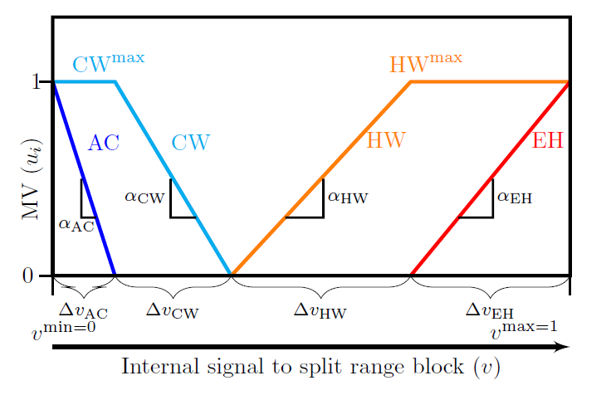
Example: Room heating with one CV (T) and 4 MVs
MVs (two for summer and two for winter):
AC (expensive cooling)
CW (cooling water, cheap)
HW (hot water, quite cheap)
Electric heat, EH (expensive)
y=T
Alt. 1 Split-range control (SRC).
= 22ºC
Note: may adjust the location of split (x-axis) to make loop gains equal.
Disadvantage SRC: 1. Must use same integral time for all MVs
2. Does not work well for cases where constraint values change

Slide 50
Example: Room heating with one CV (T) and 4 MVs
MVs (two for summer and two for winter):
AC (expensive cooling)
CW (cooling water, cheap)
HW (hot water, quite cheap)
Electric heat, EH (expensive)
y=T
Alt. 2. Multiple controllers with different setpoints
23ºC
C₁
22ºC
C₂
21ºC
C₃
20ºC
C₄

Slide 51
Example: Room heating with one CV (T) and 4 MVs
MVs (two for summer and two for winter):
AC (expensive cooling)
CW (cooling water, cheap)
HW (hot water, quite cheap)
Electric heat, EH (expensive)
y=T
Alt. 3. Input resetting (VPC)
10%
C₁
10%
C₂
10%
C₃
22ºC
C₄

Slide 52
Summary MV-MV switching
Use Alt.1 (split range control) for cases where the MV ranges (max and min values) are fixed.
  Advantage: Easy to understand, because SR-block shows clearly sequence of MVs
Use Alt. 2 (controllers for different setpoints) for cases where MV ranges vary
  Advantage: Easier to implement than SRC and can have different controller tunings
Use Alt. 3 (input resetting) for cases where CV (y) should always be controlled by same MV
  But gives some economic loss

Slide 53
6. Extra inputs (MVs) dynamically: Valve position control (VPC)
This VPC is active all the time with the aim «resetting» or «midranging» the input.

Slide 54
EXAMPLE. Use of bypass (extra input) for fast control
closed
q_{B}
T_{hot}
q_{Bs}
FC
TC
TC: Fast control of CV=T_{hot} using the “dynamic” MV2=q_{B}
FC: Resets MV2=q_{B} to its setpoint (q_{bs}) (e.g. 5%) using MV1=CW

Slide 55
When use MPC?
When conventional APC performs poorly or becomes complex
Cases with many changing constraints (where we cannot assign one input to each constraint)
Interactive process
Know future disturbances and setpoint changes (predictive capability)

Slide 56
Conclusion Advanced process control
Conventional APC works very well in may cases
  Optimization by feedback (active constraint switching)
  Need to pair input and output.
    Advantage: The engineer can specify directly the solution
    Problem: Unique pairing may not be possible for complex cases
  Need model only for parts of the process (for tuning)
  Challenge: Need better teaching and design methods
MPC may be better (and simpler) for more complex multivariable cases
  But MPC may not work on all problems (Bidirectional inventorycontrol)
  Main challenge: Need dynamic model for whole process
  Other challenge: Tuning may be difficult

Slide 57

Optimal centralized
Solution (EMPC)
Academic process control community fish pond
Simple solutions that
work (selector, PID++)
Sigurd (me)

Slide 59
Extra

Slide 60
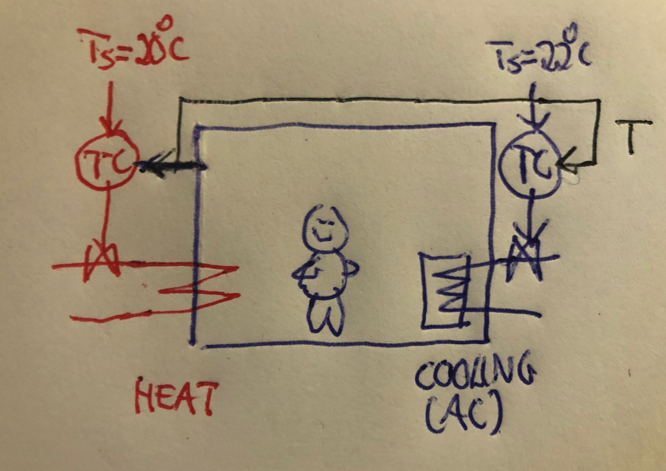
Alt. 2. Several controllers with different setpoints
Example
CV=y= room temperature
MV1 = u1 = cooling
CV^{spH} = 22°C (summer)
MV2 = u2 = heating
CV^{spL} = 20 - 2 = 20°C (winter)
Between 20°C and 22°C:
Temperature drifts with both inputs saturated:
    heating off, u1=0
    cooling off, u2=0
Need different setpoints to
Avoid using cooling and heating at the same time
avoid fighting between controllers
Note: The order of when to use each MV is determined by the setpoints. This also works if we have to two or more MVs with the same sign, for example, if we have two heating sources: hot water (as shown in figure) and more expensive electric heat. Then we could add a temperature controller for the electic heat with an even lower setpoint, for example, Ts=18C.

Slide 61
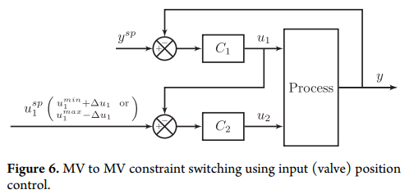
Alt. 3. Input (valve) position control (VPC)
Keep the original loop (u1-y)
Use u2 to avoid saturation of u1 (VPC)
Advantage: Always use u1 for control of y
Disadvantages: Always use u1 (cannot put at constraint -> economic loss)
Important: Loop C2 with u2 is not active all the time, only when u1 is close to saturation

Slide 62
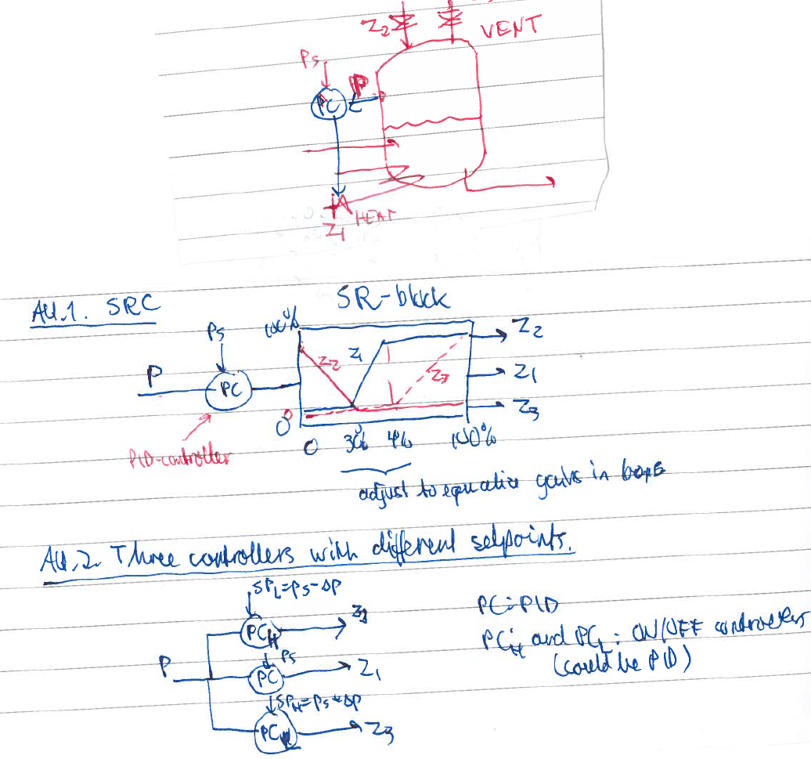
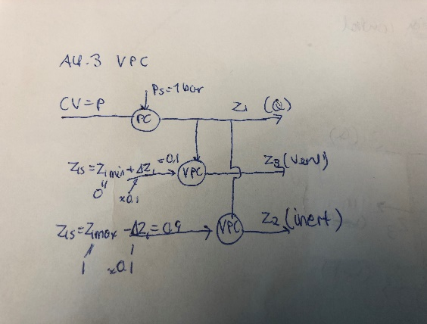
Example MV-MV switching: Pressure control
INERT
z₃
CV=p
MV1=heat (Q)
MV2=inert
MV3=vent
Normally: Control CV=p using MV1=Q
but if Q=0 we must use MV3=vent
and if Q=max we must use MV2=inert
=1 bar
z₁
z₂
z₃
Alt.3: VPC
Always use Q (z1) to control p.
Need two VPC’s:
Use vent (z3) to avoid Q=0
Use inert (z2) to avoid Q=max
z₃
z₂
=0.9 bar
z₂
=1 bar
=1.1 bar
z₃

