Slide 1
DYCOPS conference
Trondheim, June 2016

Slide 2
Ethanol (A) – propanol (B) – butanol (C)
99% A
Prefractionator: 15 stages
Main column: 53 stages
Feed: Equimolar
99% B (0.6% A, 0.4% C)
99% C

Slide 3
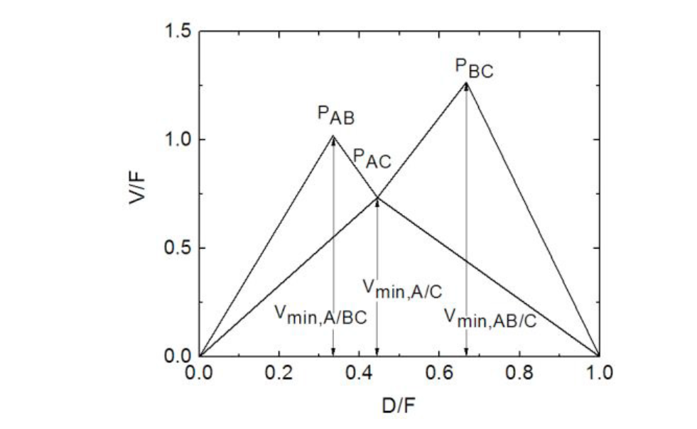

Slide 4
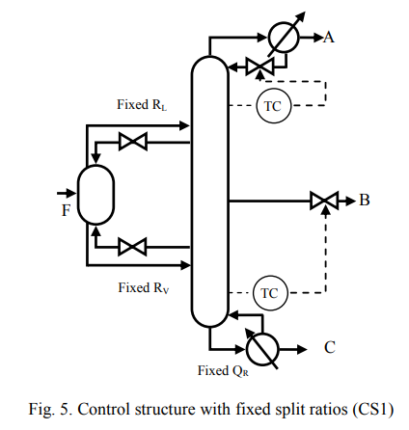

Slide 5
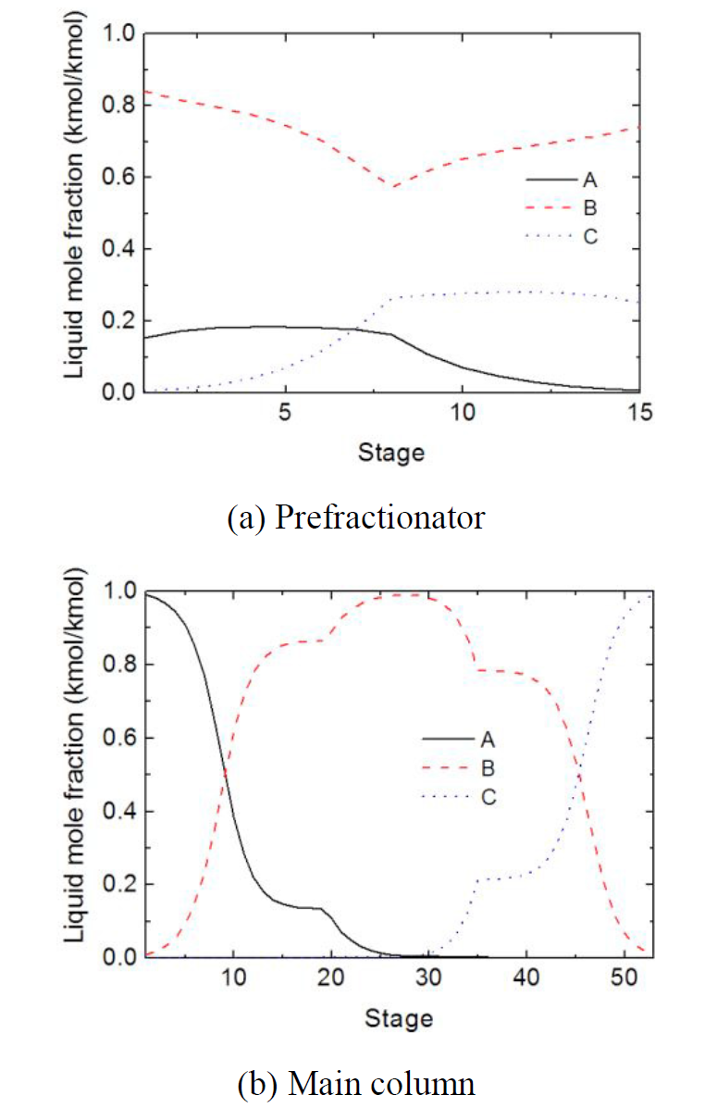

Slide 6
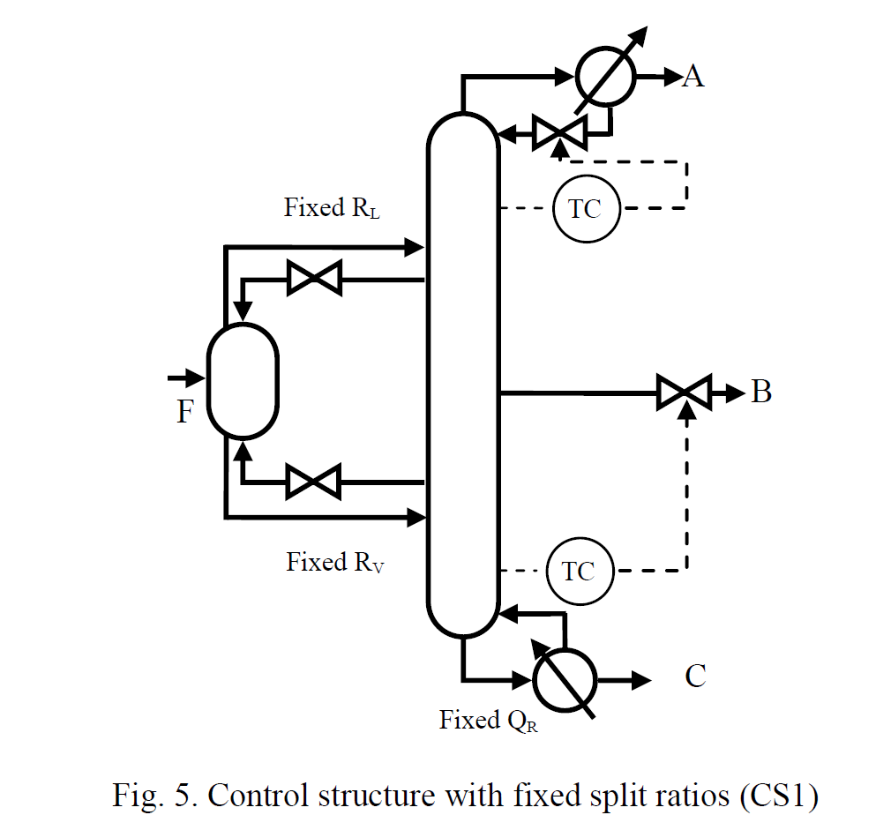
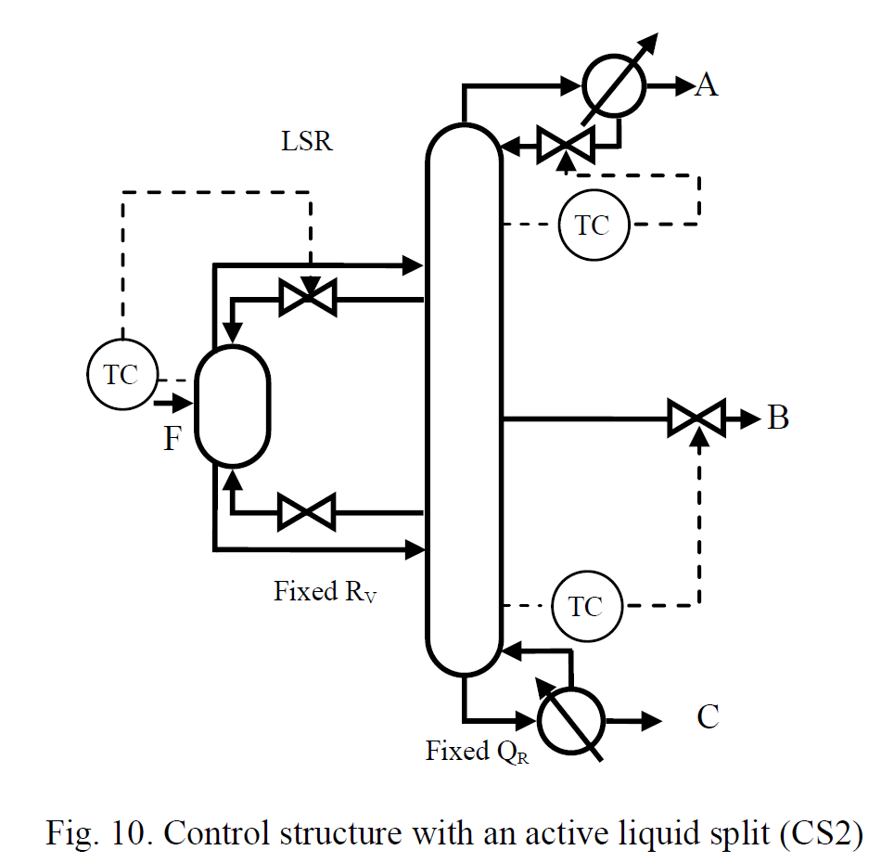

Slide 7
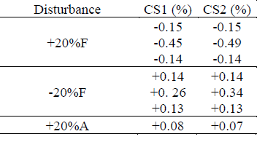
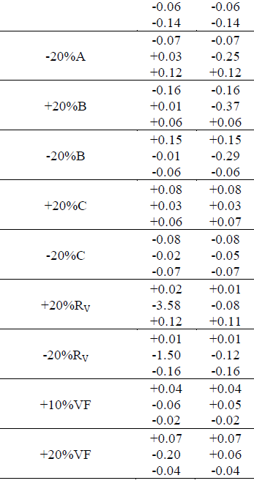
Conclusion:
Most disturbances are handled well both with CS1 and CS2
Except: CS1 is not acceptable for disturbances in R_{V} because of unpure side stream

Slide 9
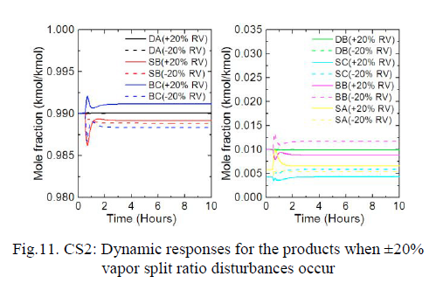
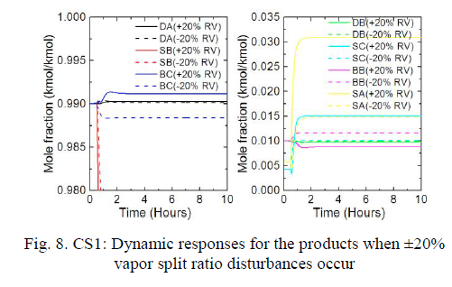

Slide 10
Conclusion
CS2 is a good structure

