Slide 1
Multi stream, multi phase heat exchangers
Modeling, optimization and heat integration
Candidate: Axel Holene ;
Supervisors: Sigurd Skogestad, Johannes Jäschke ;

Slide 2
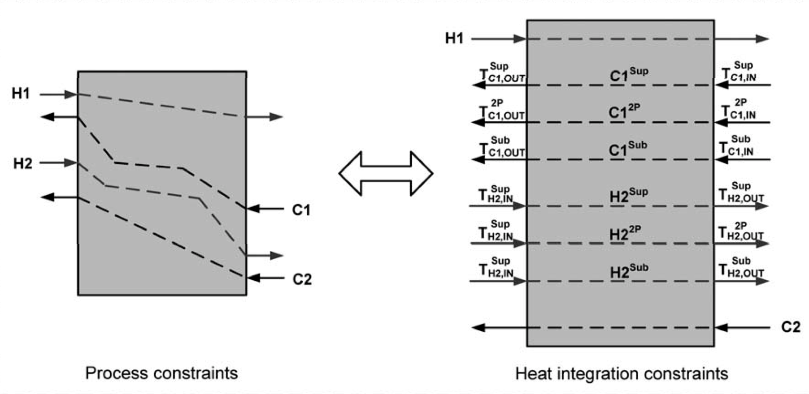
Modeling
Mass and energy balances
Pinch concept
Challenges:
Multiple hot and cold streams
Phase transitions

Slide 3
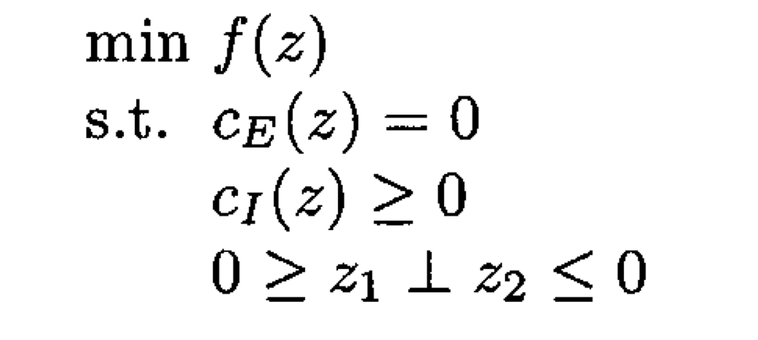
Optimization
Non-linearity, non-convexity
Complementarity constraints
Violation of LICQ and MFCQ constraint qualifications
Really funky KKT Conditions
Notes:
Mangasarian-Fromovitz Constraint Qualification

Slide 4
LICQ violation
Linear dependence between gradients of active constraints

Slide 5
Programming
GAMS – General Algebraic Modeling System
Python/Gnuplot
Model Ravi /ALL/
Solve Ravi using MINLP minimizing Z;
*****************************
MODEL STATISTICS
BLOCKS OF EQUATIONS 43 SINGLE EQUATIONS 260
BLOCKS OF VARIABLES 32 SINGLE VARIABLES 228 3 projected
NON ZERO ELEMENTS 804 NON LINEAR N-Z 314
DERIVATIVE POOL 10 CONSTANT POOL 49
CODE LENGTH 2,068 DISCRETE VARIABLES 9
GENERATION TIME = 0.032 SECONDS 4 Mb DEX239-239 Aug 29, 2012
EXECUTION TIME = 0.035 SECONDS 4 Mb DEX239-239 Aug 29, 2012

Slide 6
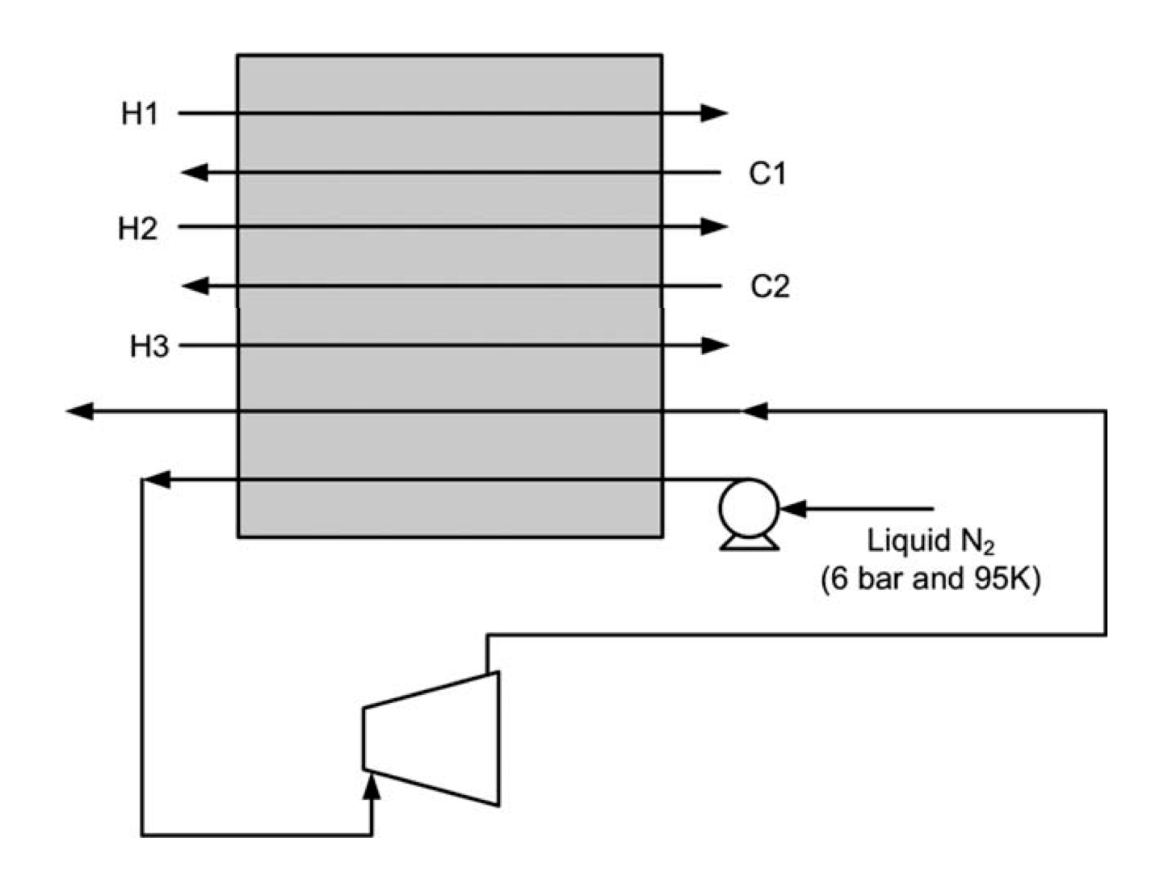
Heat integration example

Slide 8
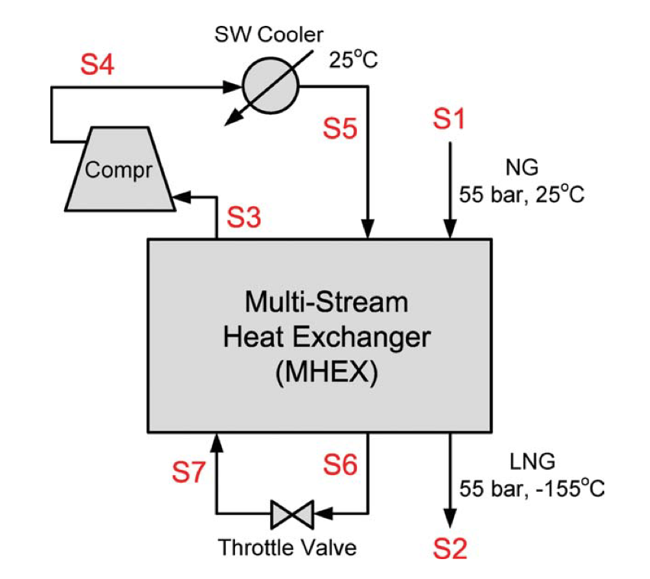
Future work
PRICO process
Optimization of LNG process

