Slide 1
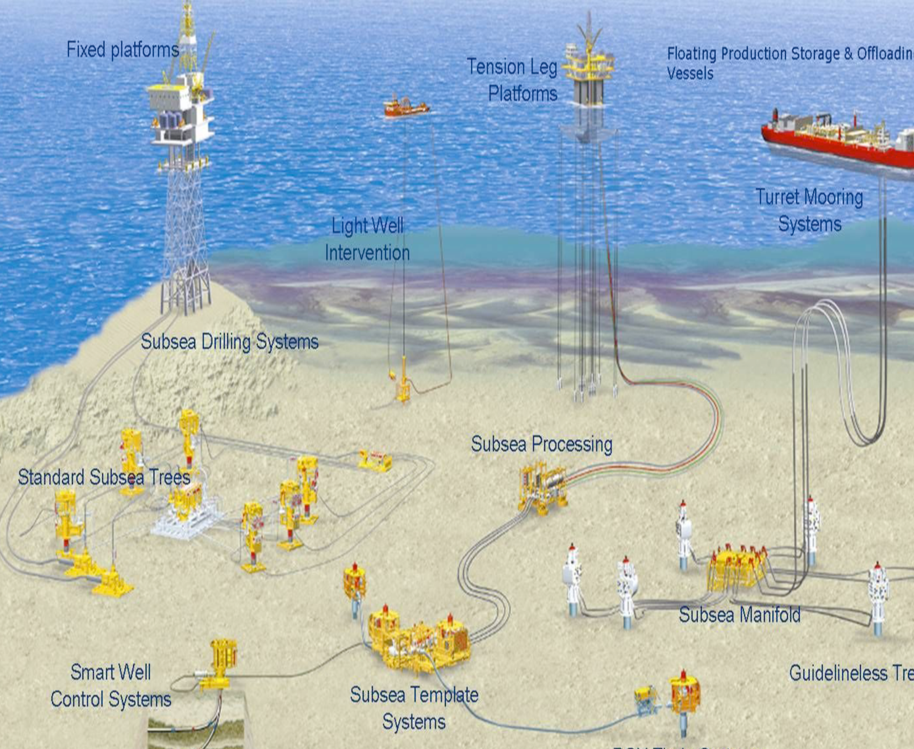
Slug flow in S-shaped risers
Simulation of Slug flow using LedaFlow
Mahnaz Esmaeilpour
Supervisor: Sigurd Skogestad
Co-supervisor: Esmaeil Jahansahi

Slide 2
Slug flow in S-shaped risers
Comparing acoustic signal and pressure (step test, frequency domain)
Simulating S-riser in LedaFlow® and comparing to experiments
Making stability map based on both experimental and simulation in LedaFlow
Making bifurcation diagram of Pressure with simulation in LedaFlow
Density measurement using gamma sensor
Comparing density from gamma sensor to acoustic sensor results

Slide 3
Step test

Slide 4
