Slide 1
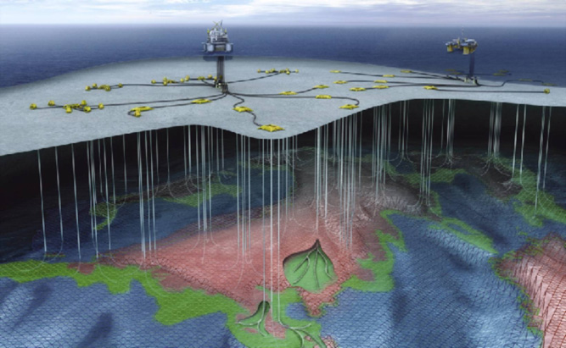
Optimization of Oil Production

Slide 2
introduction
Ane Cecilie Duus
Optimization of oil production
Supervisor: Sigurd Skogestad
Co-Supervisors: Chriss Grimholt & Johannes Jäscke

Slide 3
Troll west rig

Slide 4
Why Relevant?
In existing reservoirs 50% oil stay unrecovered.
Increase by 1% can increase value by 10-20 billion NOK.
Most potential lies in production technology.

Slide 5
Project:
Modelling the system
Finding optimal well pressures
Finding candidates for self-optimizing CV’s

Slide 6
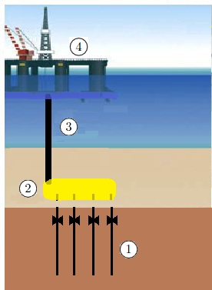
Model
Wells
Manifold
Production Pipe
Separator pressure

Slide 7
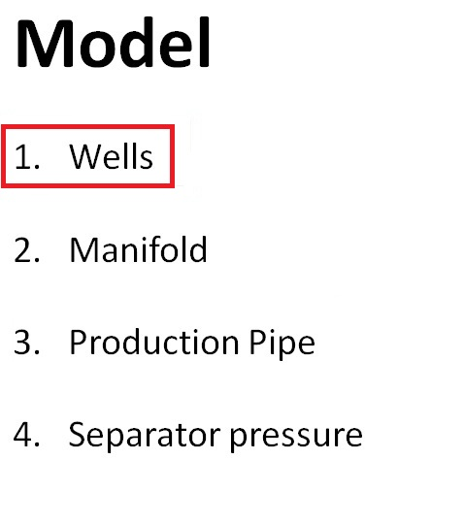

Slide 8
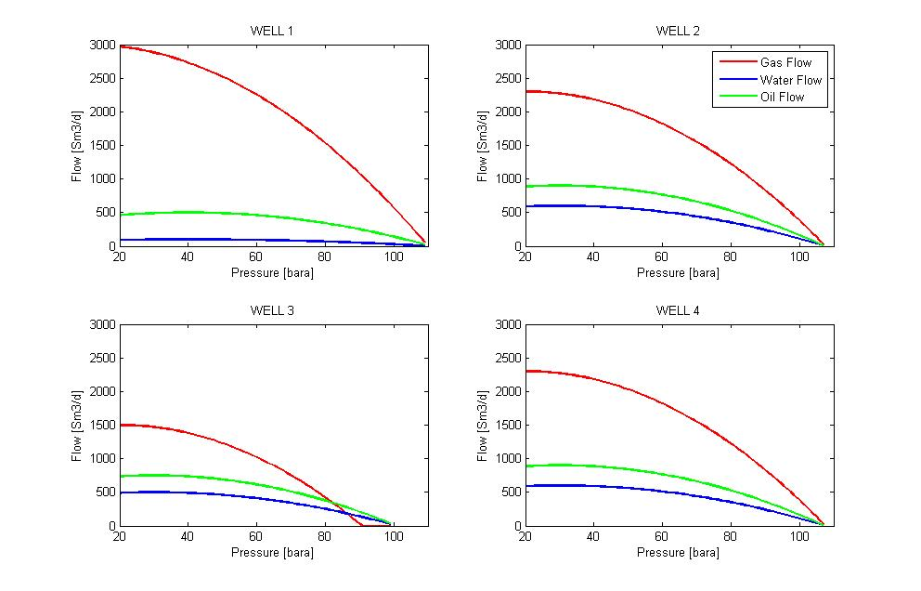
1. Well Preformance Curves

Slide 9
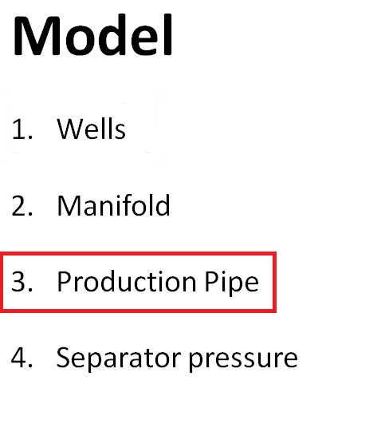

Slide 10
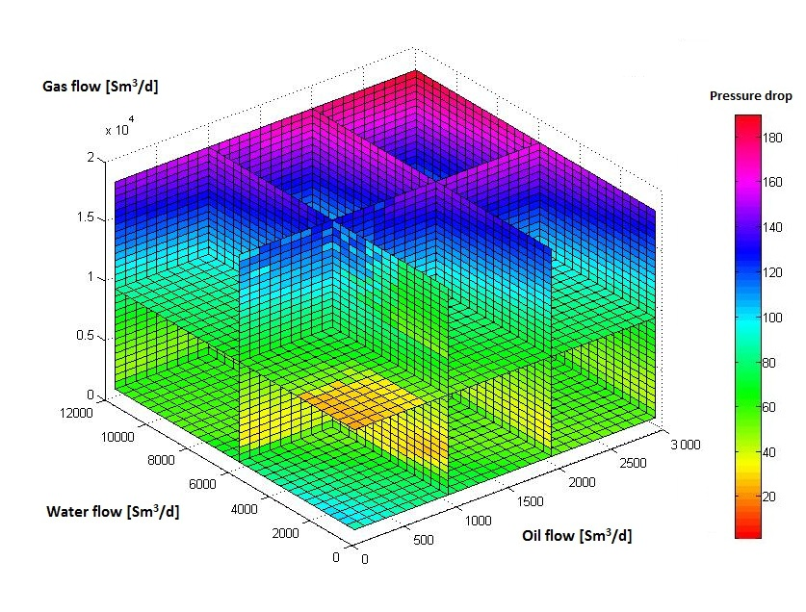
3. Pressuredrop Relations

Slide 11
Optimization
Objective function:
Maximize oil flow in production line

Slide 12
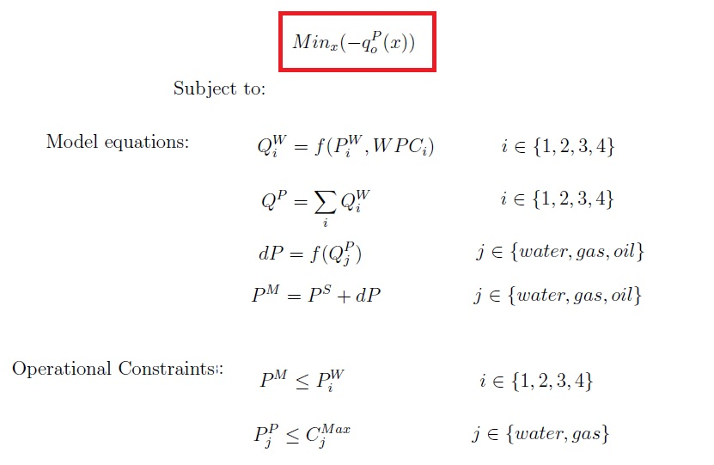
Objective Function

Slide 13
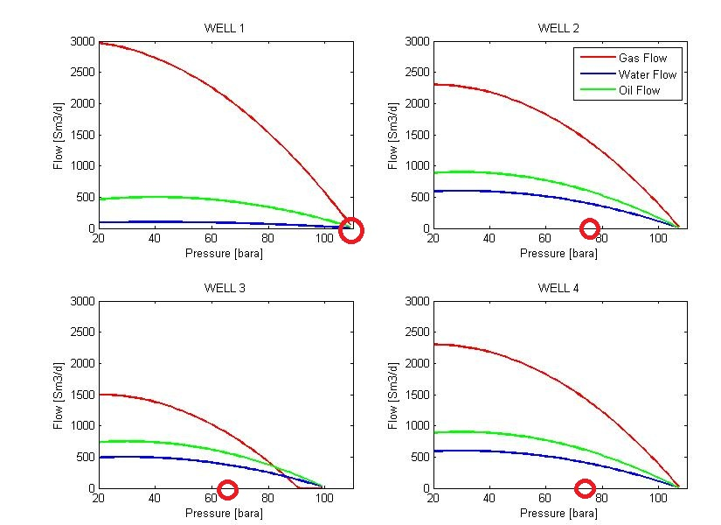
Result: Optimal Well Pressures

Slide 14
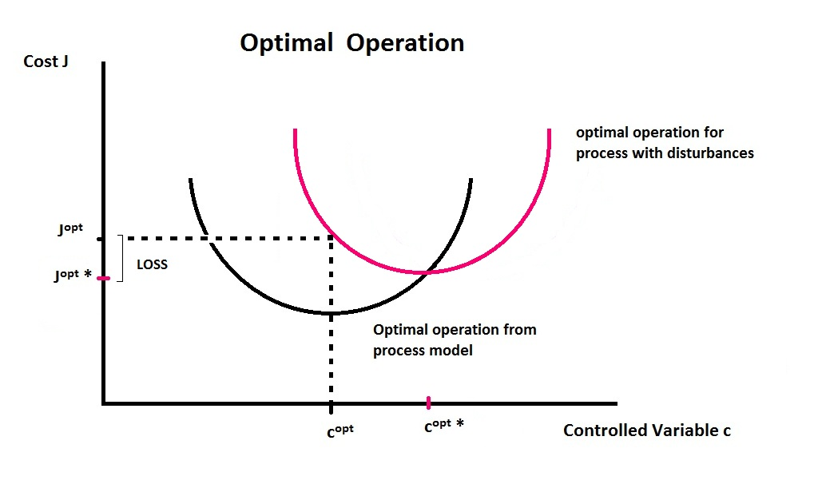
Effect of disturbance?

Slide 15
Self-optimizing variables
Implementing disturbance in well compositions
Applying the Null Space Method
Loss evaluation:
3 times less than without control
Potential for further work on control structures

