Slide 1
Midterm presentation,
master thesis
Student: Fredrik Gjertsen
Title of thesis: Models for on-line control of polymerization processes
Supervisor: Prof. Sigurd Skogestad, NTNU
Co-supervisor: Peter Singstad, Cybernetica AS
Goal: To extend established knowledge and process models on semi-batch emulsion copolymerization to formulate models for tubular reactors for similar systems.

Slide 2
Agenda
The background for the work
The purpose of the thesis work
Strategies towards achieving proper process models
Results so far
Thoughts on how to implement the models in an on-line simulator for optimization and control

Slide 3
Background
Same chemical process as previously studied
Emulsion copolymerization
Summer internship & specialization project
Previously studied as a semi-batch process
Part of the European research project COOPOL
The semi-batch reactor setup is the setup of primary interest, but new reactor setups, i.e. tubular reactors are also explored.

Slide 4
Purpose of the work
The purpose of the work is to establish an efficient model for a smart-scale tubular reactor to be used for on-line optimization and control.
Modeling approaches:
Finite differences (The Numerical Method of Lines)
Incremental model with variable transformation, yielding a model of moving control volumes
Mass diffusion effects for the reactor are explored using experimental RTD data, and the established models are compared to this.
For the purpose of continuous reactors, micellar nucleation is included in the model as an alternative to seeded polymerization.

Slide 5
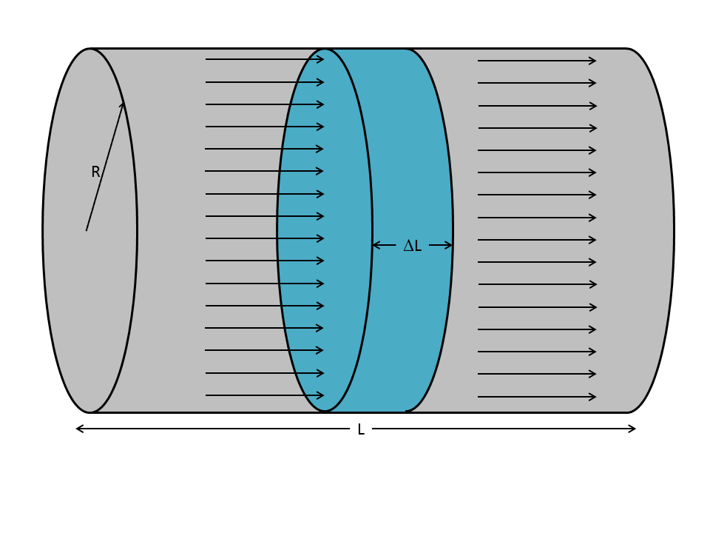
Mathematical modeling
Starting point: An arbitrary volume, for which the amount of an arbitrary (intensive) quantity (φ) is considered.
(a shell balance is an alternative approach to the exact same result)
$$\begin{matrix}Net accumulation \\ of quantity\end{matrix}= \begin{matrix}Net transport over boundary \\ + net generation\end{matrix}$$
$$\frac{∂}{∂t} \left(\iiint_{V}{φ dV}\right)=−∯_{S}{\left(\vec{v}φ\right)∙\vec{n} dS} + ∰_{V}{\tilde{σ}} dV$$
$$\frac{∂φ}{∂t} + ∇\left(vφ\right)= \tilde{σ}$$
$$\frac{∂φ}{∂t} + \frac{∂}{∂z}\left(vφ\right)= \tilde{σ}$$
$$\frac{∂φ}{∂t} + \frac{∂}{∂z}\left(v_{s}φ\right)=D_{e}\frac{∂^{2}φ}{∂z^{2}} + \tilde{σ}$$

Slide 6
A quick summary
The tubular reactor is described by partial differential equations in both time and space
More complexity introduced, compared to semi-batch setup
System(s) of ordinary differential equations is preferred
What strategy should be used to reduce the model?
Discretization in space should be performed
Numerical efficiency is important
Using experimental RTD data for the reactor, the mixing effects of the reactor can be accounted for in each case (each model)
Is the effective mass diffusion negligible?

Slide 7
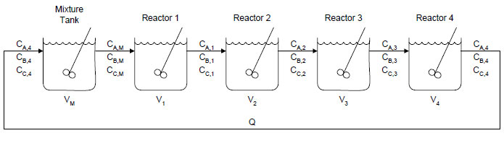
Approach 1: Finite differences
(referred to as the NMOL approach)
Partial differential equations are discretized in space, yielding ordinary differential equations in time for each discrete position.
This strategy is referred to as the Numerical Method of Lines, which is a traditional approach to solve partial differential equations.
In practice, this approach is similar to the well-known tanks-in-series strategy model.
Calculations show that a large amount of discretization points is needed
This may constitute a problem with respect to implementing the model on-line

Slide 8
Approach 1: Finite differences
Approximation based on Taylor series:
$${\frac{df}{dx}}_{}≈\frac{f\left(x_{n+1}\right)−f\left(x_{n}\right)}{∆x}$$
$${\frac{d^{2}f}{dx^{2}}}_{}≈\frac{f\left(x_{n+1}\right)−2f\left(x_{n}\right)+f(x_{n−1})}{{\left(∆x\right)}^{2}}$$
Tanks in series RTD:
$$E\left(t\right)= {\left(\frac{1}{τ}\right)}^{n}e^{−\frac{t}{τ}}\frac{t^{n−1}}{\left(n−1\right)!}$$

Slide 9
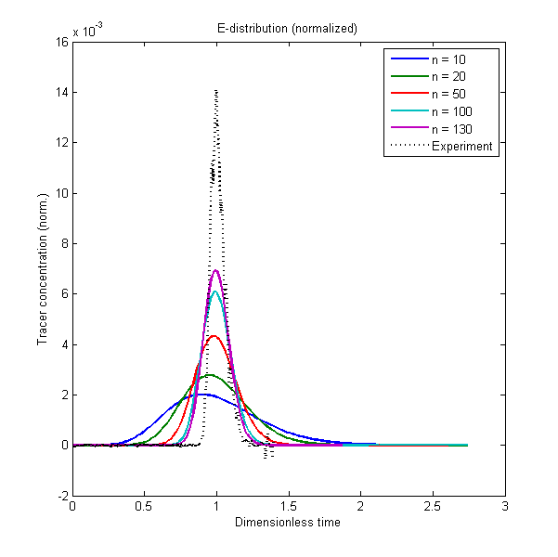
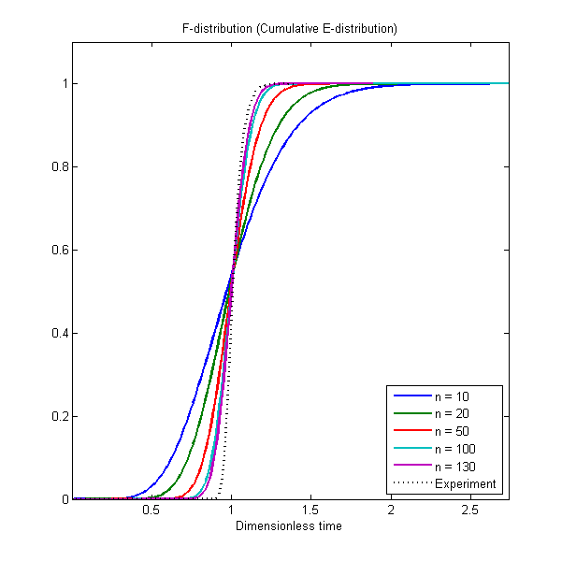
Residence time distribution, finite differences
In doing an RTD experiment using an inert tracer compound, the required number of tanks in series, i.e. the spacing of the spatial discretization, can be determined.
Calculations show that a large amount of discretization points is needed

Slide 10
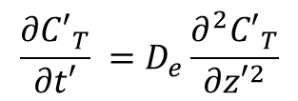
Transformation of variables
Running an inert tracer compound through the reactor can indicate the RTD of the reactor.
Note: No net generation of inert in the reactor.
Transformation of the model equations to an alternative coordinate system:
$$\frac{∂C_{T}}{∂t} + \frac{∂}{∂z}\left(v_{s}C_{T}\right)=D_{e}\frac{∂^{2}C_{T}}{∂z^{2}}$$
$$z′=z −v_{s}t$$
$$t′=t$$
$$\frac{∂{C′}_{T}}{∂t′} =D_{e}\frac{∂^{2}{C′}_{T}}{∂{z′}^{2}}$$
The equation is now separable, and can be solved analytically.
Important: This specific equation is for an inert tracer component only, and the equation will be more complicated for a reacting species.

Slide 11
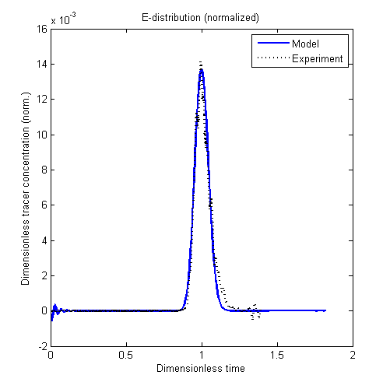
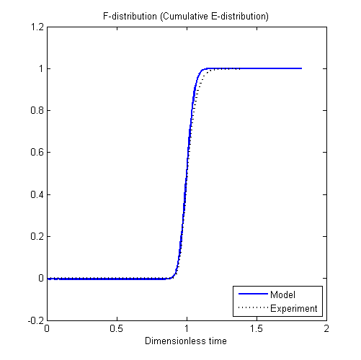
Residence time distribution, change of variables
Simulation with effective diffusivity adjusted:

Slide 12
Approach 2: Mobile (finite) control volumes
(referred to as the MCV approach)
Each discrete control volume behaves like a (small) traditional batch reactor, with ordinary differential equations in time for the model equations. The positions of the control volumes vary throughout the reactor.
$$\frac{∂φ}{∂t′}=\tilde{σ}′$$
The control volumes are not physically connected, meaning that model outputs at specific points in space, e.g. reactor outlet, must be the result of an interpolation.
Experimental RTD can be utilized to determine the size and internal spacing between the moving reactor units.
How many units are needed, and how large (long) should they be?

Slide 13
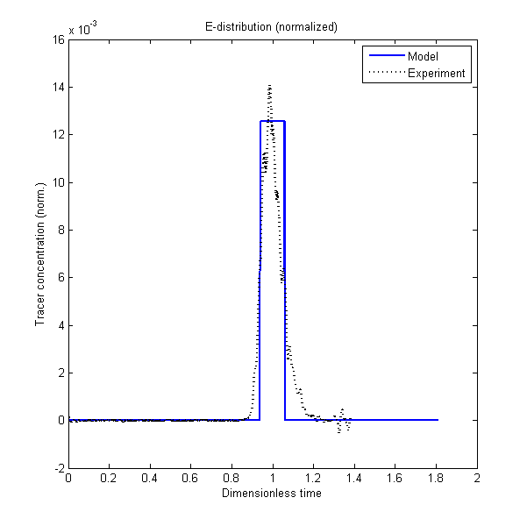
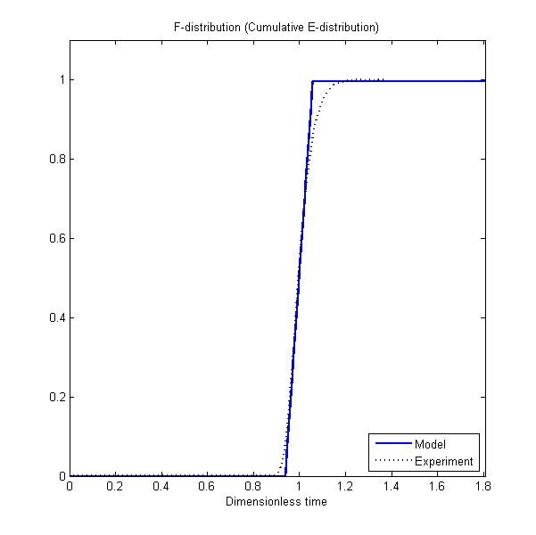
Residence time distribution, MCV

Slide 14
Thoughts on controller implementation
Numerical stability and efficiency
Some parts of the model are sensitive to stiffness
A low demand for computational effort is desired
Functioning estimator
The estimator must run smoothly and not intervene with the ordering of moving control volumes in the MCV approach.
The controller tuning is not trivial/obvious

Slide 15
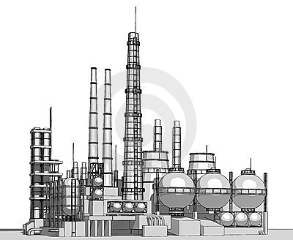
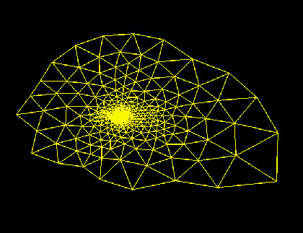
Controller performance simulation strategy
Measured plant behavior
Controller action
Controller and estimator algorithms, governed by a numerically efficient model.
Plant* representation, governed by a less numerically efficient, but perhaps more accurate, model.
* In this work, the plant is the isolated behavior of the single reactor in mind.

Slide 16
Summary
The NMOL model is less numerically efficient than the MCV model. In order to get satisfying performance for the NMOL approach, the number of discretization points needs to be significantly lower than what the RTD experiments suggest (in order to achieve correct mixing conditions).
A proposal is to use the less numerically efficient model (NMOL) as a plant replacement model and the MCV model for on-line control purposes.
Next steps: - Off-line parameter estimation using experimental data - Implementation with the Cybernetica CENIT software for control studies. Temperature control, feedrate control to achieve better conversion of monomer, etc.

