Slide 1
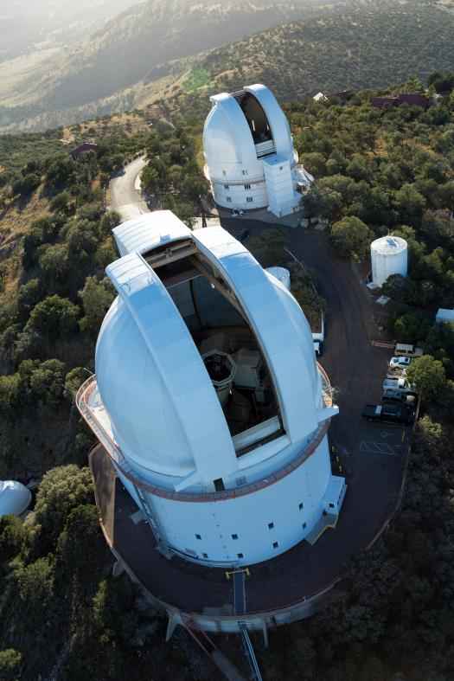
Optical Observations of J1023+0038: An LMXB in Transition
Paul A. Mason
New Mexico State University
Emmanuel Gonzalez
University of Texas at El Paso
Edward L. Robinson
University of Texas at Austin
Special thanks to Jorge I. Zuluaga
for discussion on time-scale estimates.

Slide 2
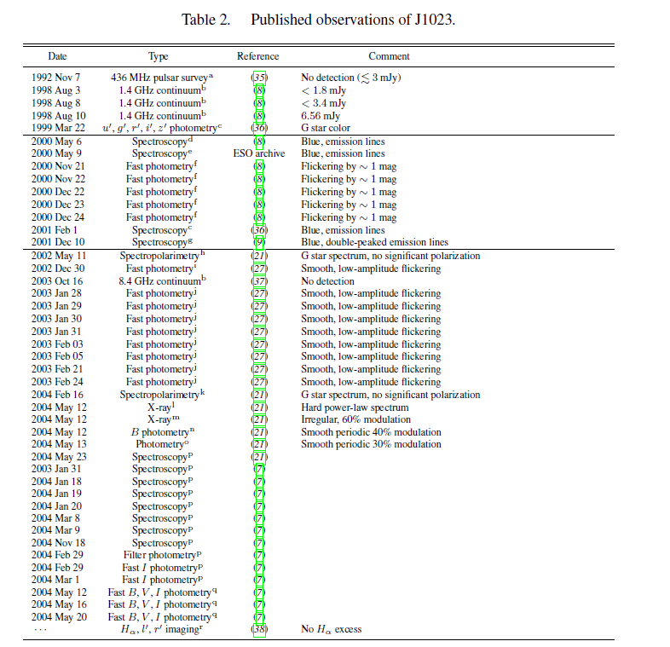
J1023 +0038 Observational timeline
Pulsar detected
Accretion disk active
Pulsar not detected even after disk disappeared
Pulsar detected

Slide 3
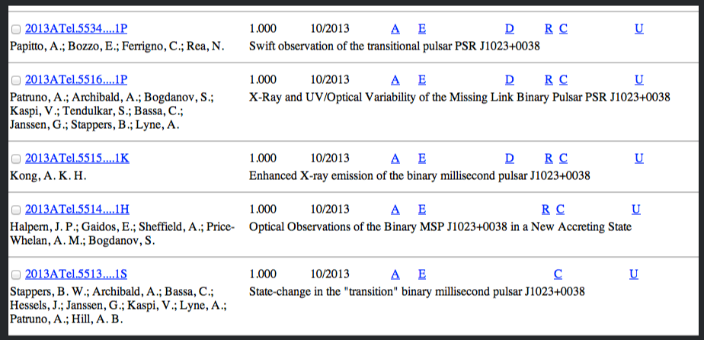
J1023 +0038 Observational timeline
Jan 2003 Woudt et al. light curve shows accretion low-state.
Oct 2003 VLA upper limit <0.20 mJy at 8.4 GHz (Mason et al. 2006)
Jan and March 2004 Homer and Thorstensen light curve shows accretion low-state.
Jun 28, 2004 flux density ~75mJy in 140s spin period (Archibald 2009)
March 2005 no Hard X Ray or blue light indicating no accretion disk or emission lines.(Homer et al. 2006)
Dec 2008~Nov 2010 VLBI(<10mas) 1.6 GHz 0.4~3.0 mJy (Highly Variable radio) (A.T. Deller et al. 2012)
Binary not detected in 2010 by WISE all-sky-survey with 12 and 22μm bands or Herschel far-IR imaging at 70 and 160 μm. Remnant of accretion disk seen from dust grains. (Wang preprint 2012)
2013 – Transition from pulsar to an accreting LMXB
Our observations:
High speed (5-10 sec) optical photometry McDonald Observatory
2.1-m telescope.
2011, 2012
2014, 2015

Slide 4
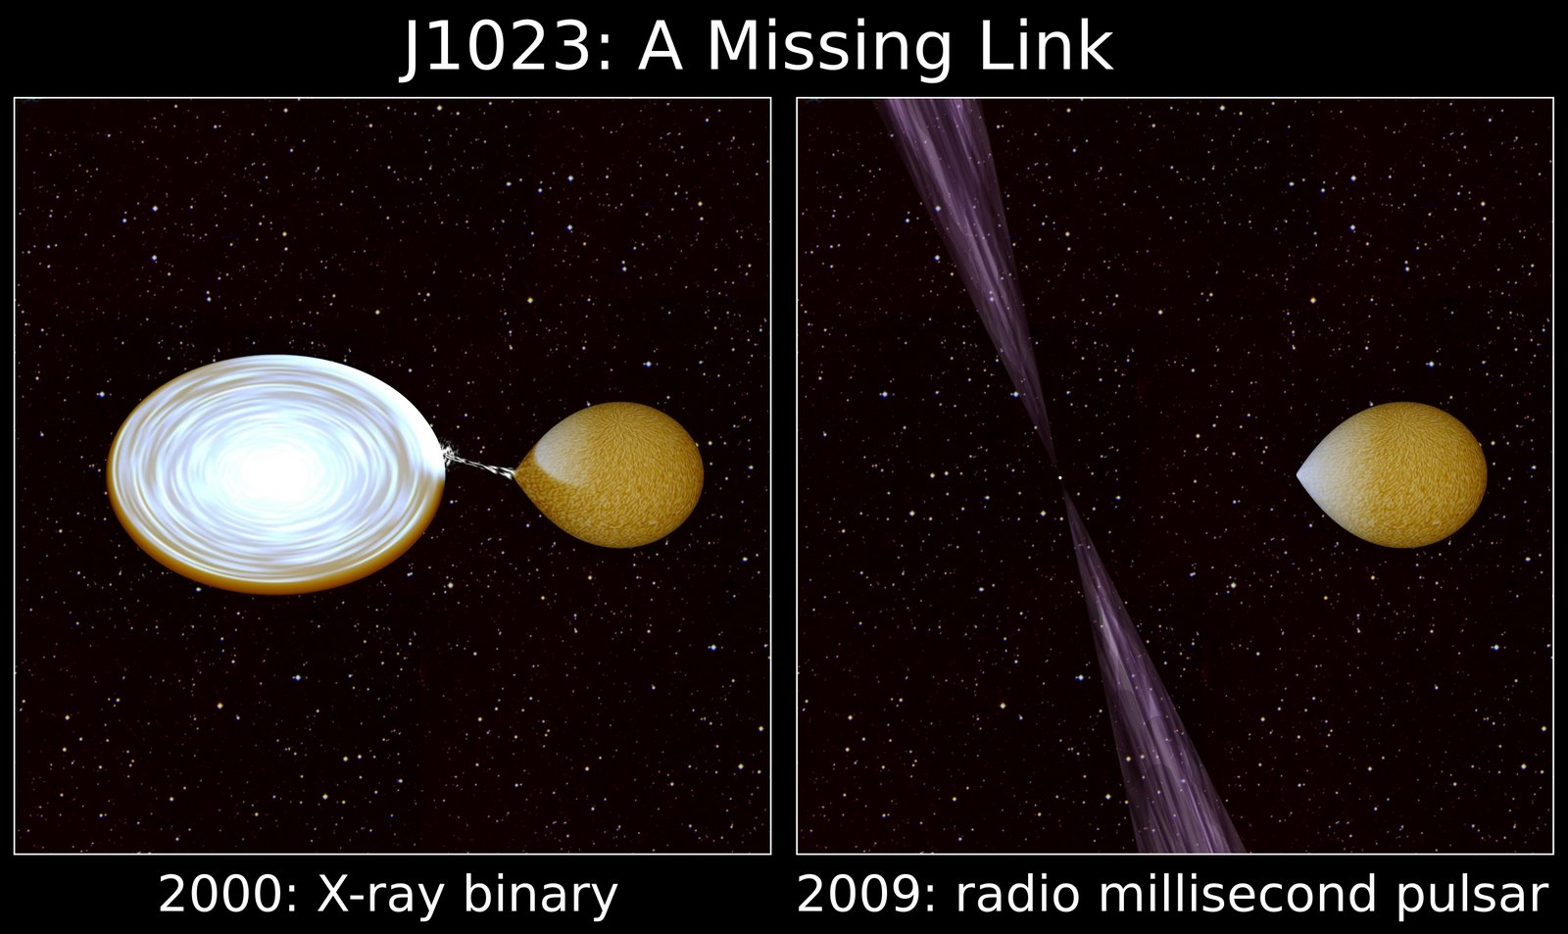
Accretion spins up the neutron star, then the pulsar turns on.
Accretion resumes and pulsar turns off.

Slide 5
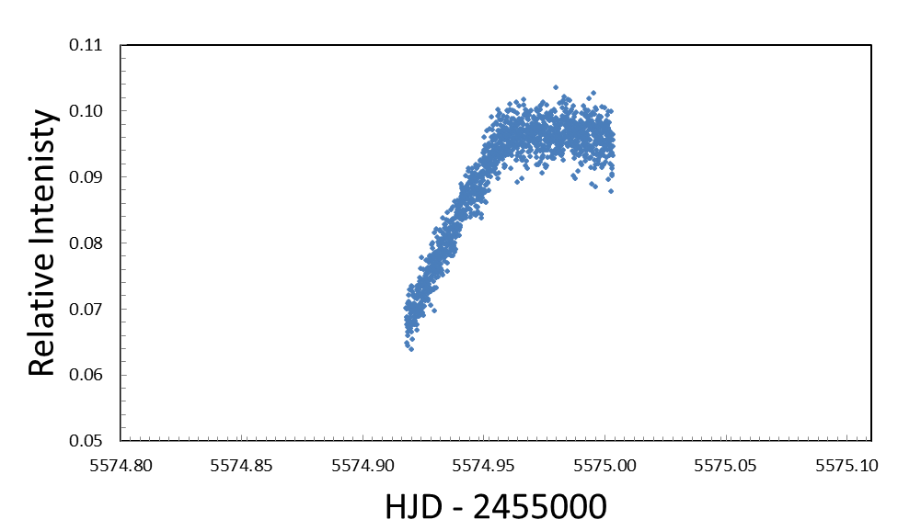
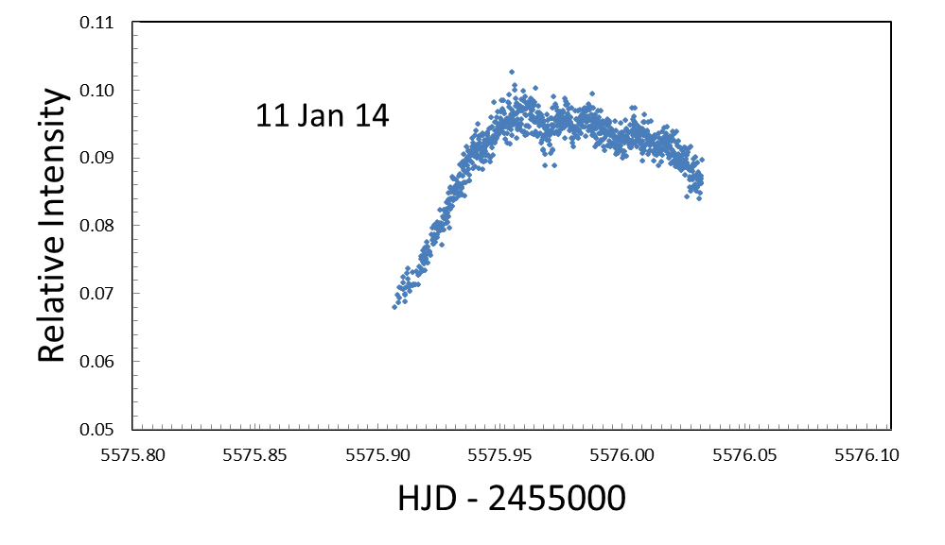
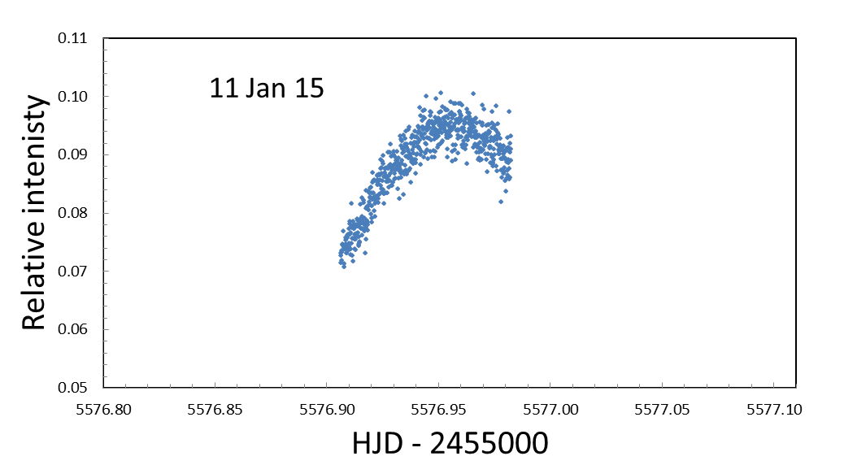
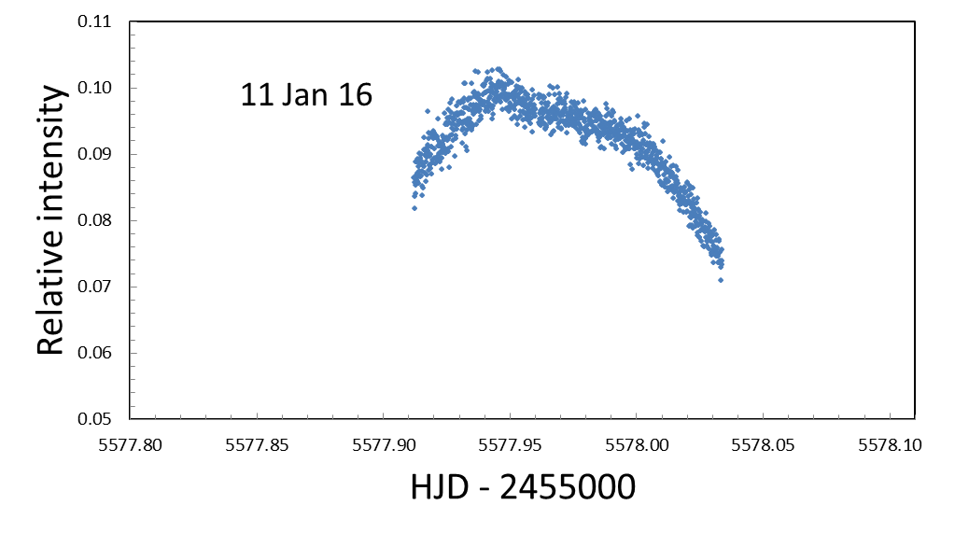
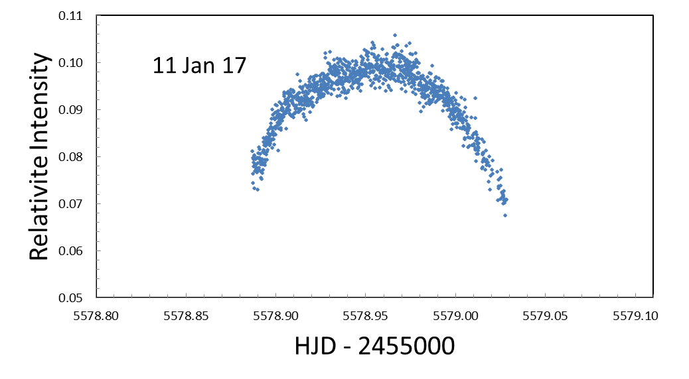
B-Band light curves.
McDonald Observatory, 2.1m telescope in 2011.
11 Jan 13

Slide 6
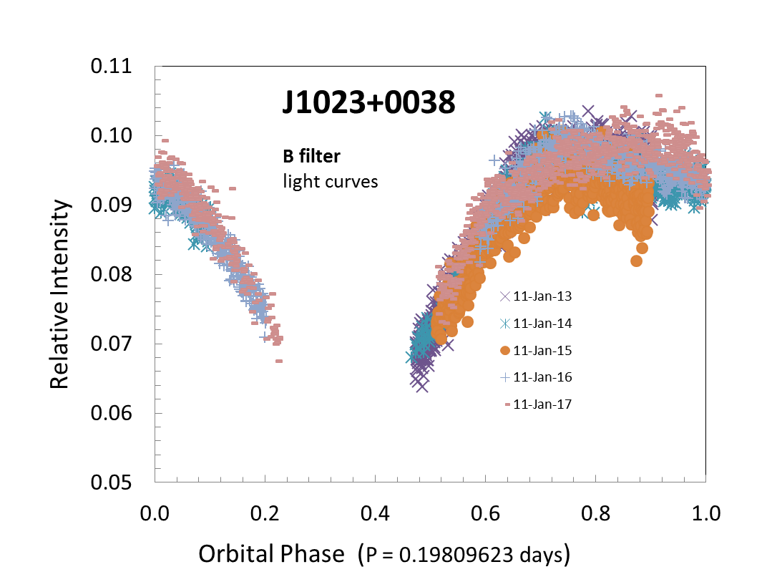

Slide 7
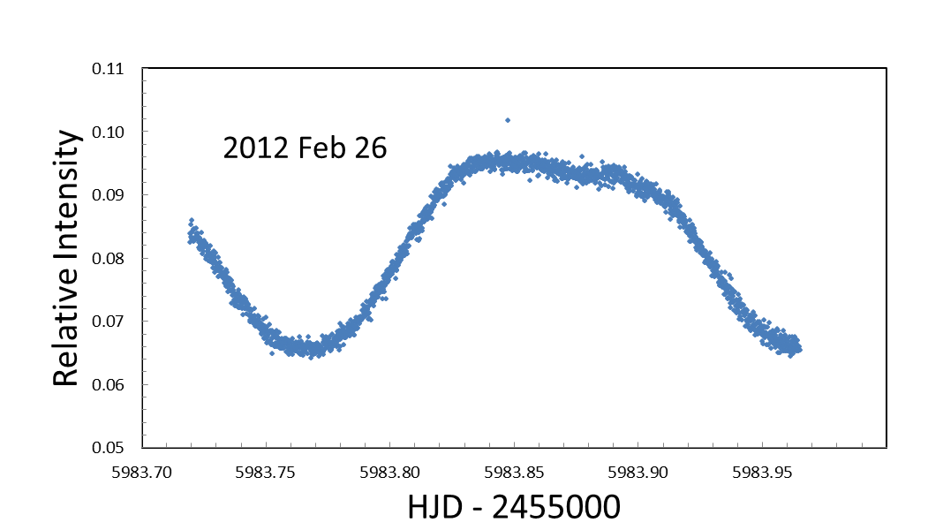
Broadband light curves (BVR Filter)
McDonald Observatory, 2.1m telescope in 2012.

Slide 8
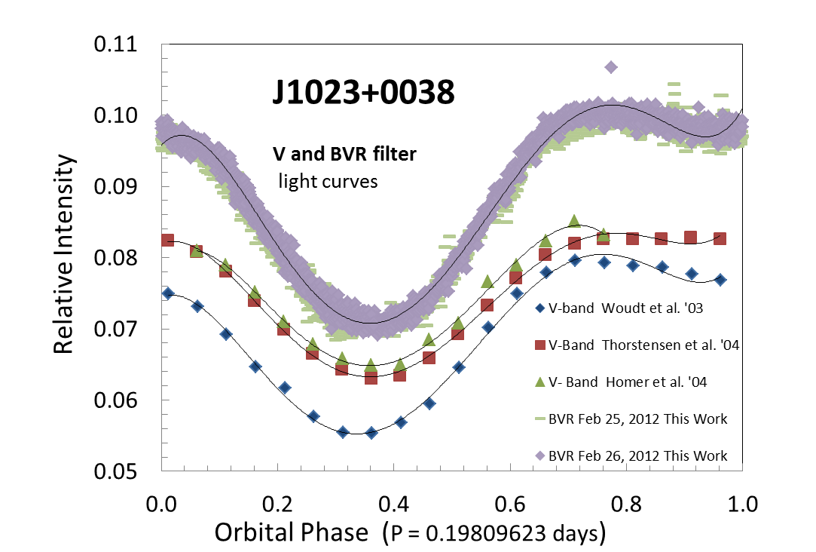

Slide 9
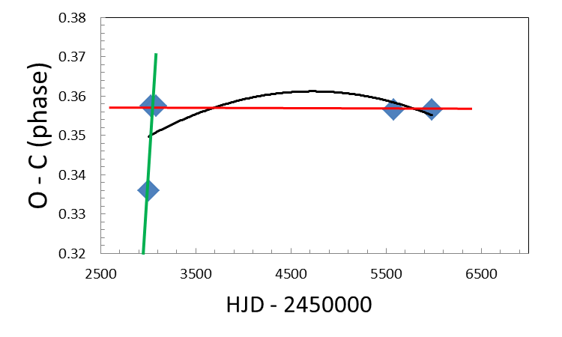
The orbital period is 0.19809623(2) days and has not changed significantly over 9 years of (LMXB) quiescence.

Slide 10
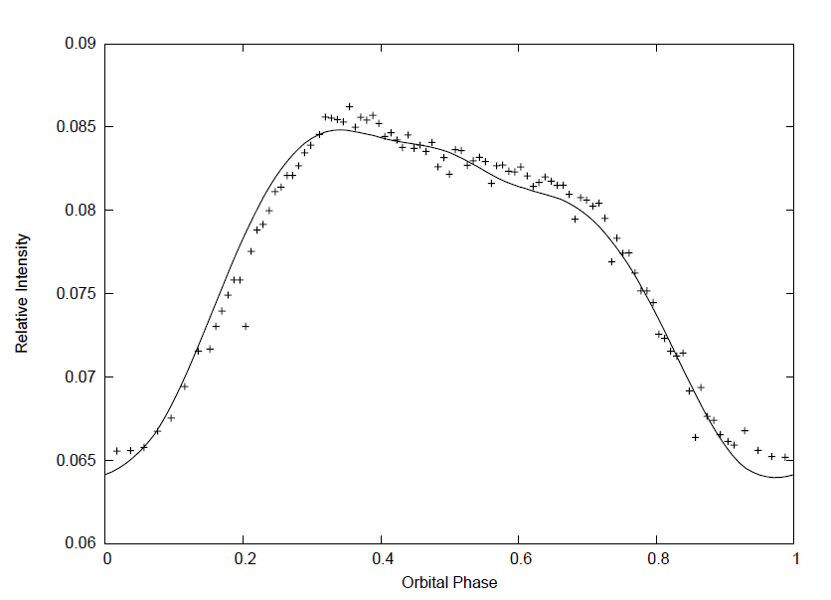
BVR (broadband) filter Date
Model Parameters: inclination = 46 degrees T_2 = 5800 K
Dark Spot on star 2, size = 5 degrees, located on back side

Slide 11
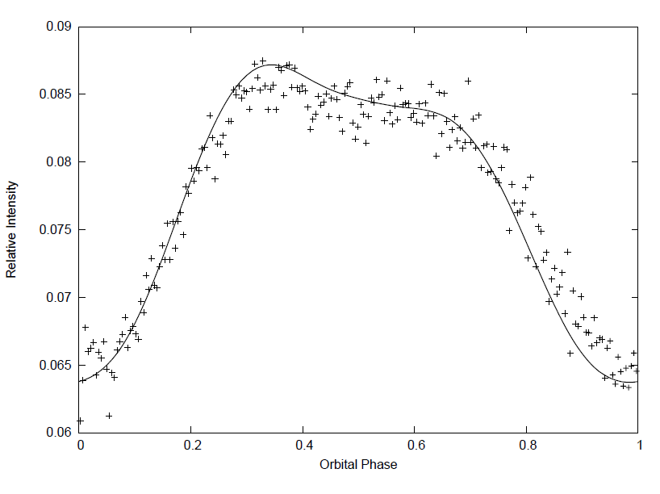
V filter Date
Model Parameters: inclination = 46 degrees T_2 = 5800 K
Dark Spot on star 2, size = 5 degrees, located on back side

Slide 12
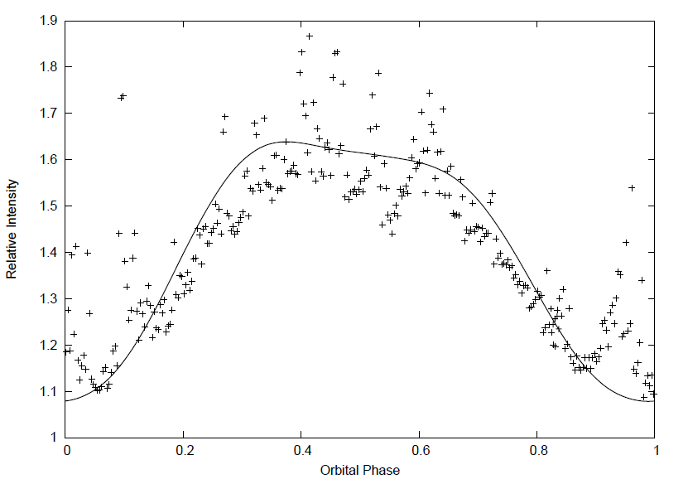
B filter Date
Model Parameters: inclination = 46 degrees T_2 = 5800 K
Dark Spot on star 2, size = 5 degrees, located on back side

Slide 13
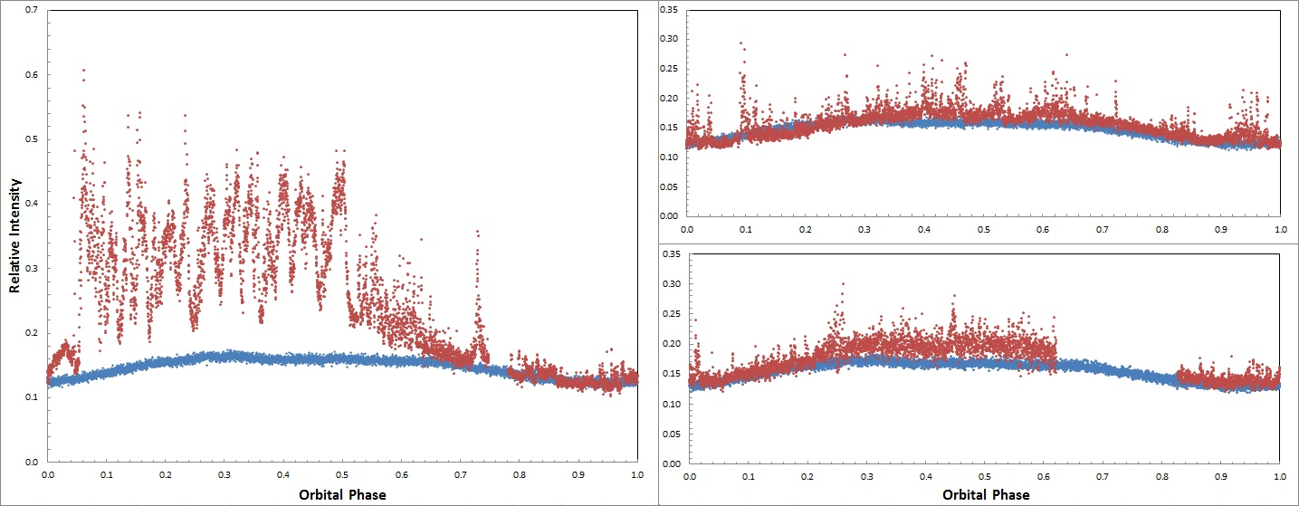
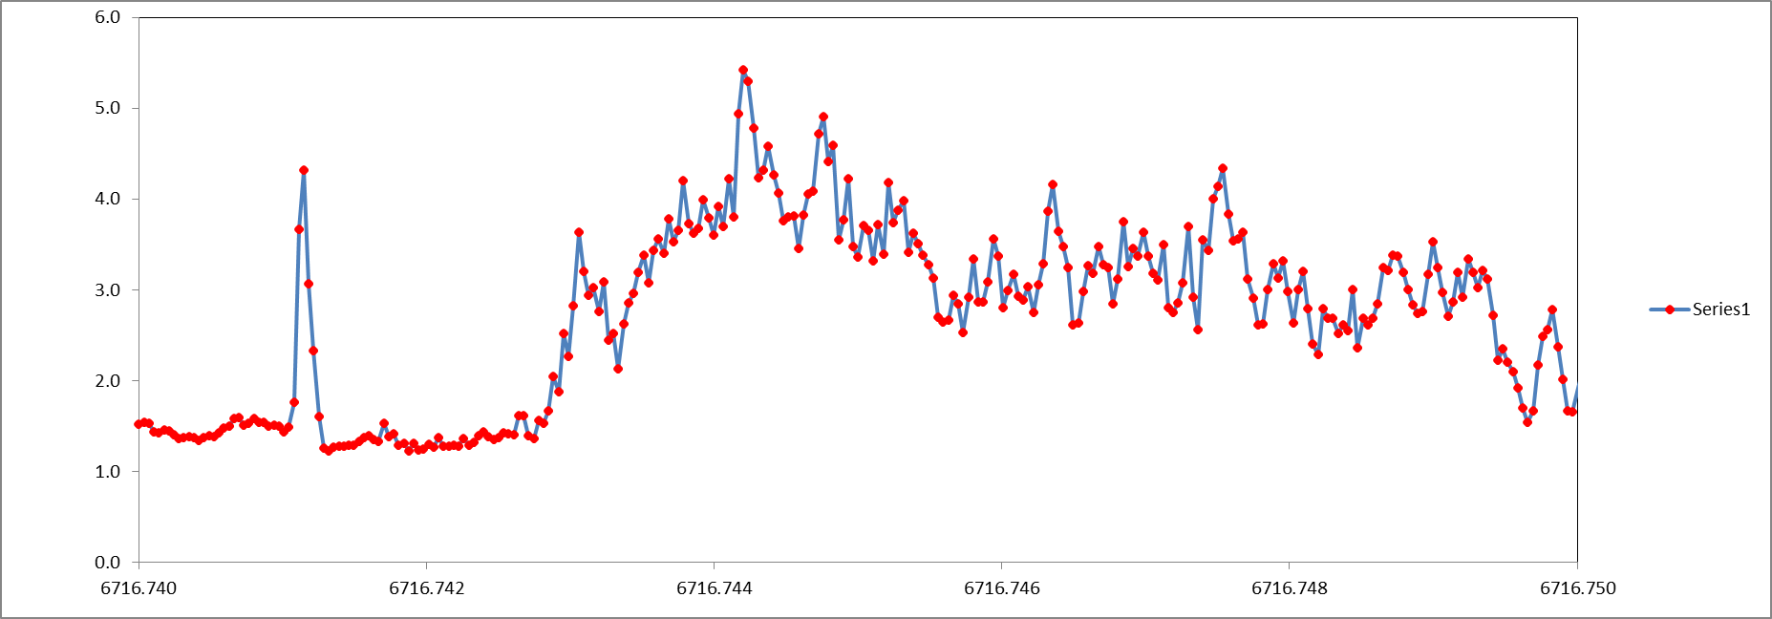
J1023+0038 (after scaling)
Outburst light curve (red) LMXB
Quiescent Light curve (blue) Pulsar
J1023+0038
Outburst light curve (red) LMXB
Quiescent Light curve (blue) Pulsar
_
- 2 min -
30 s
Ask about our model for this..

Slide 14
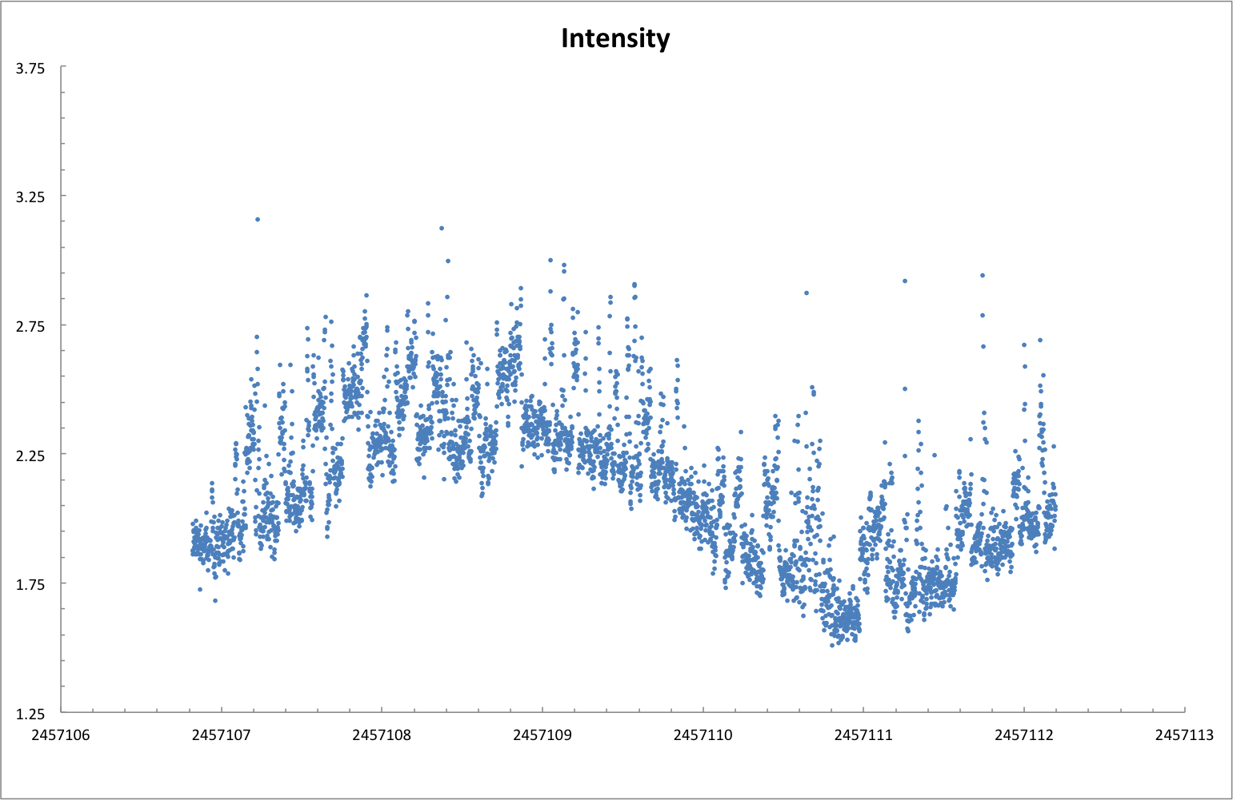
J1023+0038 (March 2015)
X-ray Heated Secondary and Accretion Flaring

Slide 15
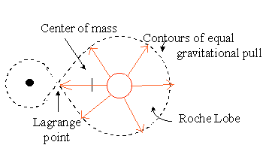
Type I X-ray burst triggers Roche Lobe overflow?

Slide 16
Type I X-ray burst triggers Roche Lobe overflow?
Burst occurs

Slide 17
Type I X-ray burst triggers Roche Lobe overflow?
Burst occurs
Companion star expands
Roche lobe overflows

Slide 18
Type I X-ray burst triggers Roche Lobe overflow?
- 2 min -
30 s
Roche lobe overflows

Slide 19
Conclusions
J1023+0038 frequently transitions between accretion-powered LMXB and a spin powered pulsar
The binary orbital period is 0.19809623(2) days and has not changed significantly over 9 years
A model involving burst induced accretion is consistent with observations.
Thank you for your attention!
-Paul A. Mason (pmason@nmsu.edu)

