Slide 1
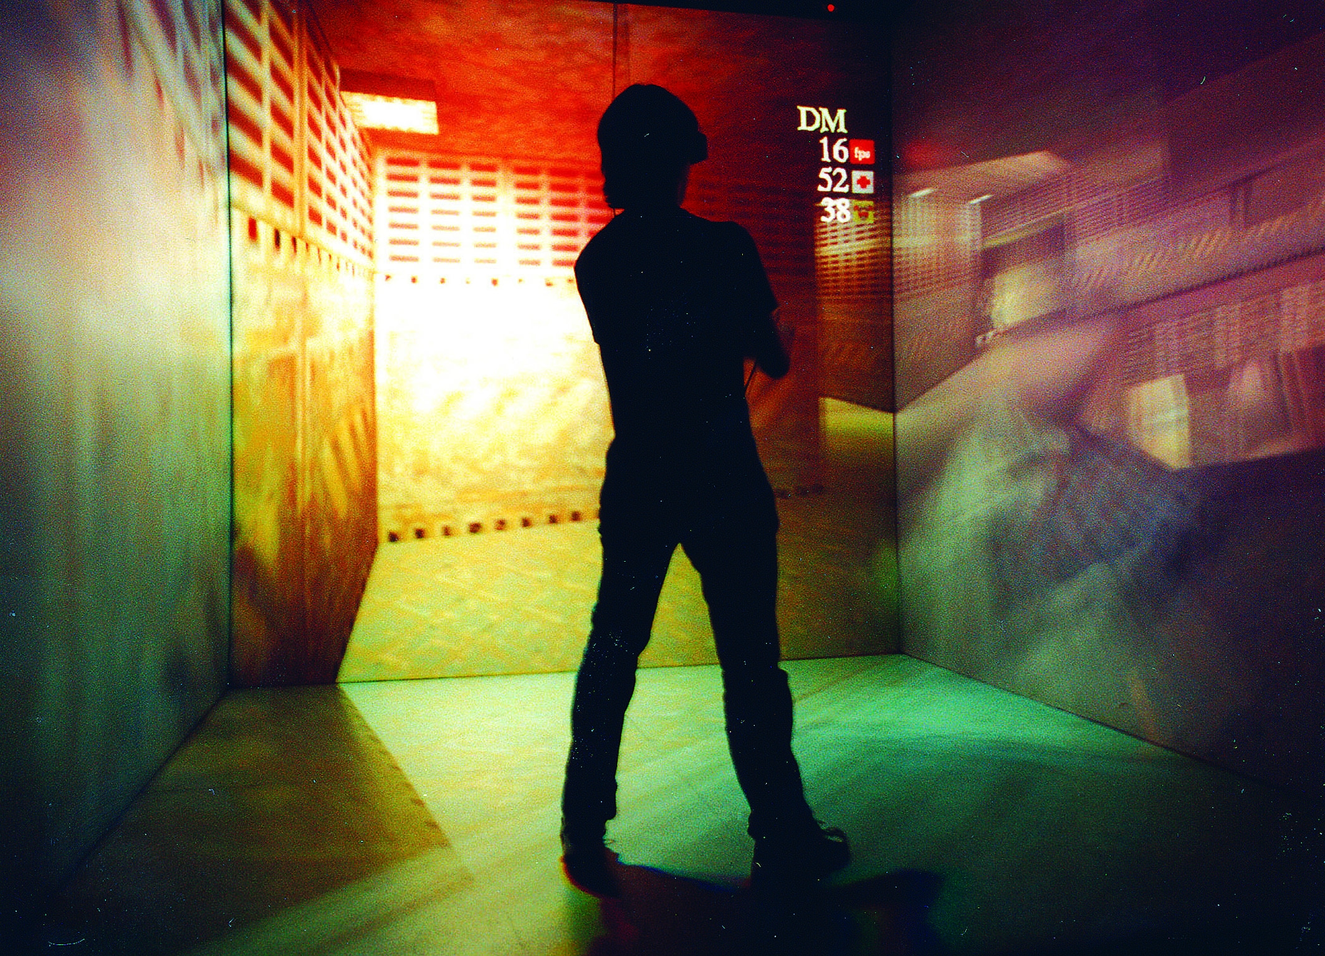
Mubil- A digital laboratory
Alexandra Angeletaki
Letizia Jaccheri

Slide 2
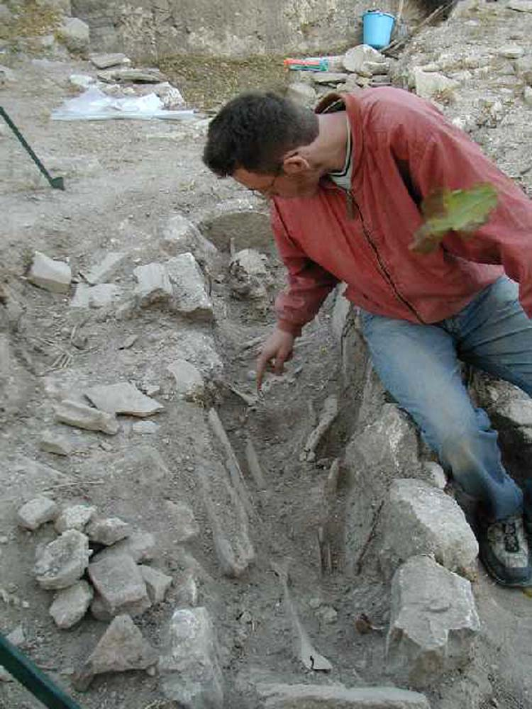
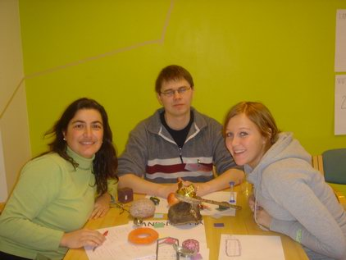
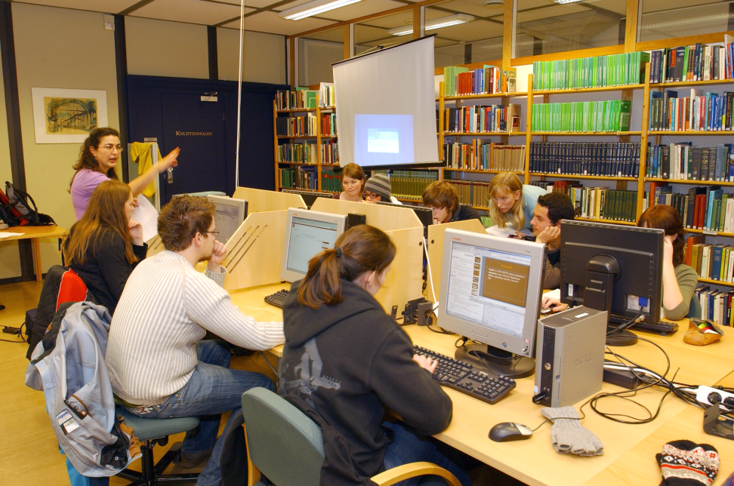
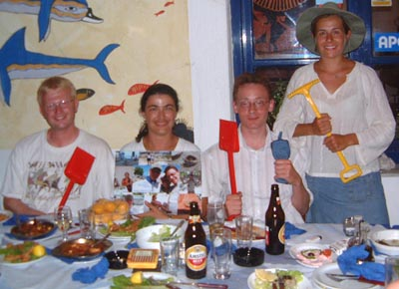
Min bakgrund

Slide 3
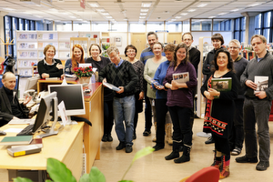
Gunnerus library in Trondheim
Notes:
Ved Gunnerusbiblioteket finnes det en god del historisk arkivmateriale og fra DKNVS virksomhet og samlinger og 400.000 bilder med portretter og landskaper fra Trondheim og omegn. Mye av det er tilgjengelig via vår databaser. For mer info se: http://www.ntnu.no/ub/spesialsamlingene/
Gunnerus libary owns a great collection of historical archives and 400.000 pictures from the area around the city. Yoy can purchase our collectuon through our website.

Slide 4
Notes:
The trnsformationof the physical objects to digital or 3d objects brings in our times through technology a new dimension to exoeriencing Knowledge.

Slide 5
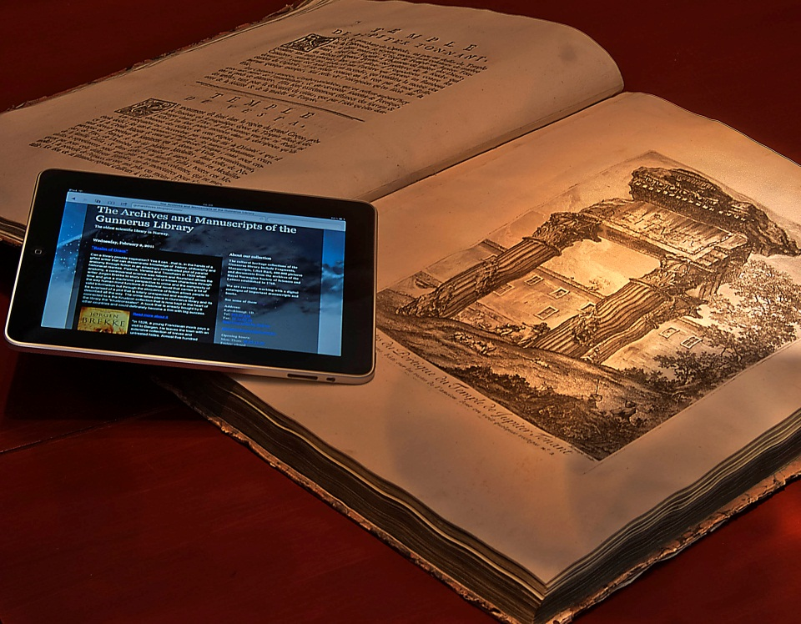
Virtuell biblioteket
Pergamenter
Manuskripter
Bøker
Kart
Arkiv
Museumsgjenstander
Bilder
Videoer

Slide 6
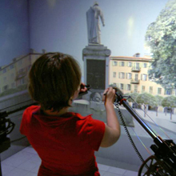
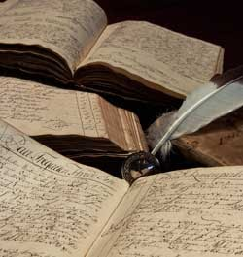
Mubil:ny teknologi-gammelt innhold

Slide 7
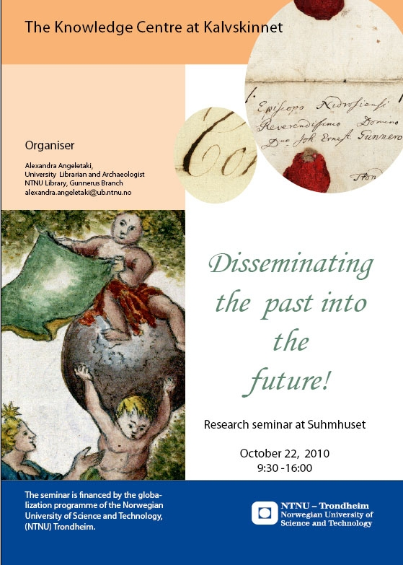
Partnere
Gunnerusbiblioteket
IDI
Percro
Statsarkivet
Vitenskapmuseet

Slide 8
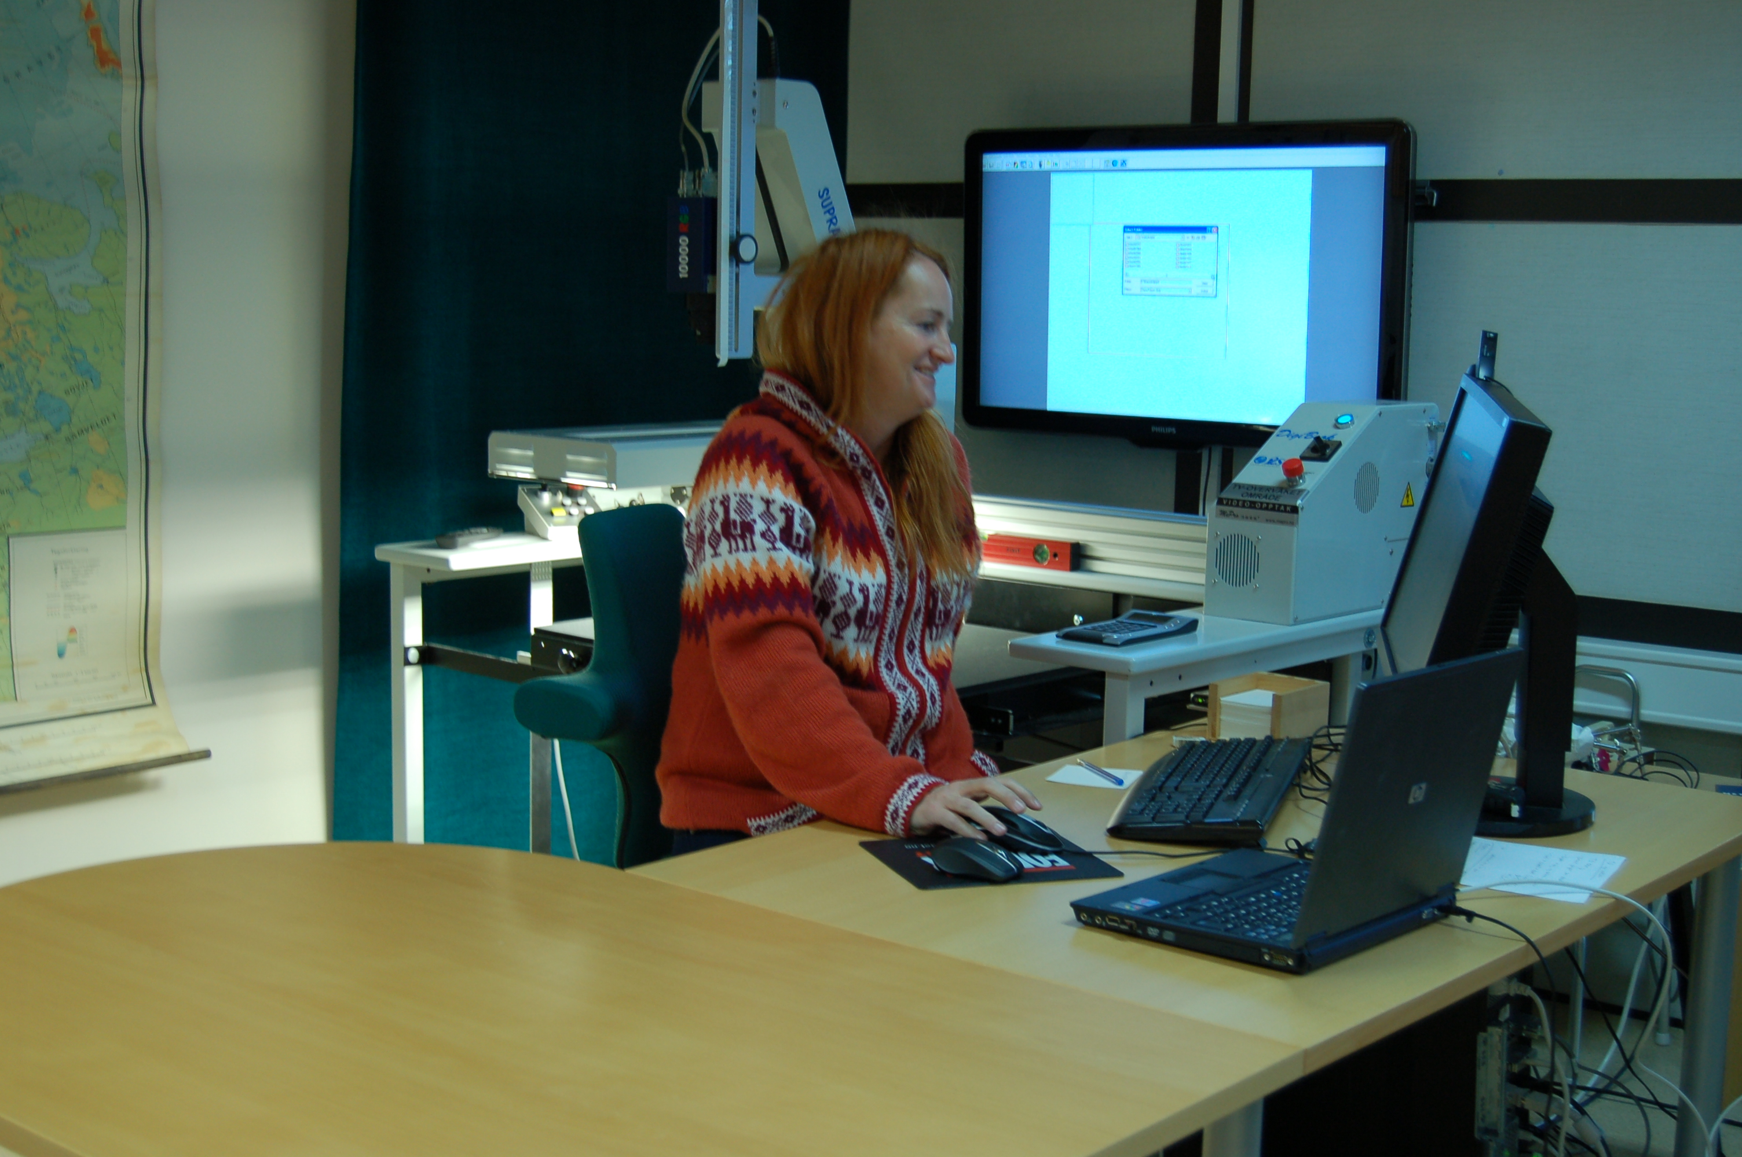
Historier som skal fortelles

Slide 9
Verkstedet

Slide 11
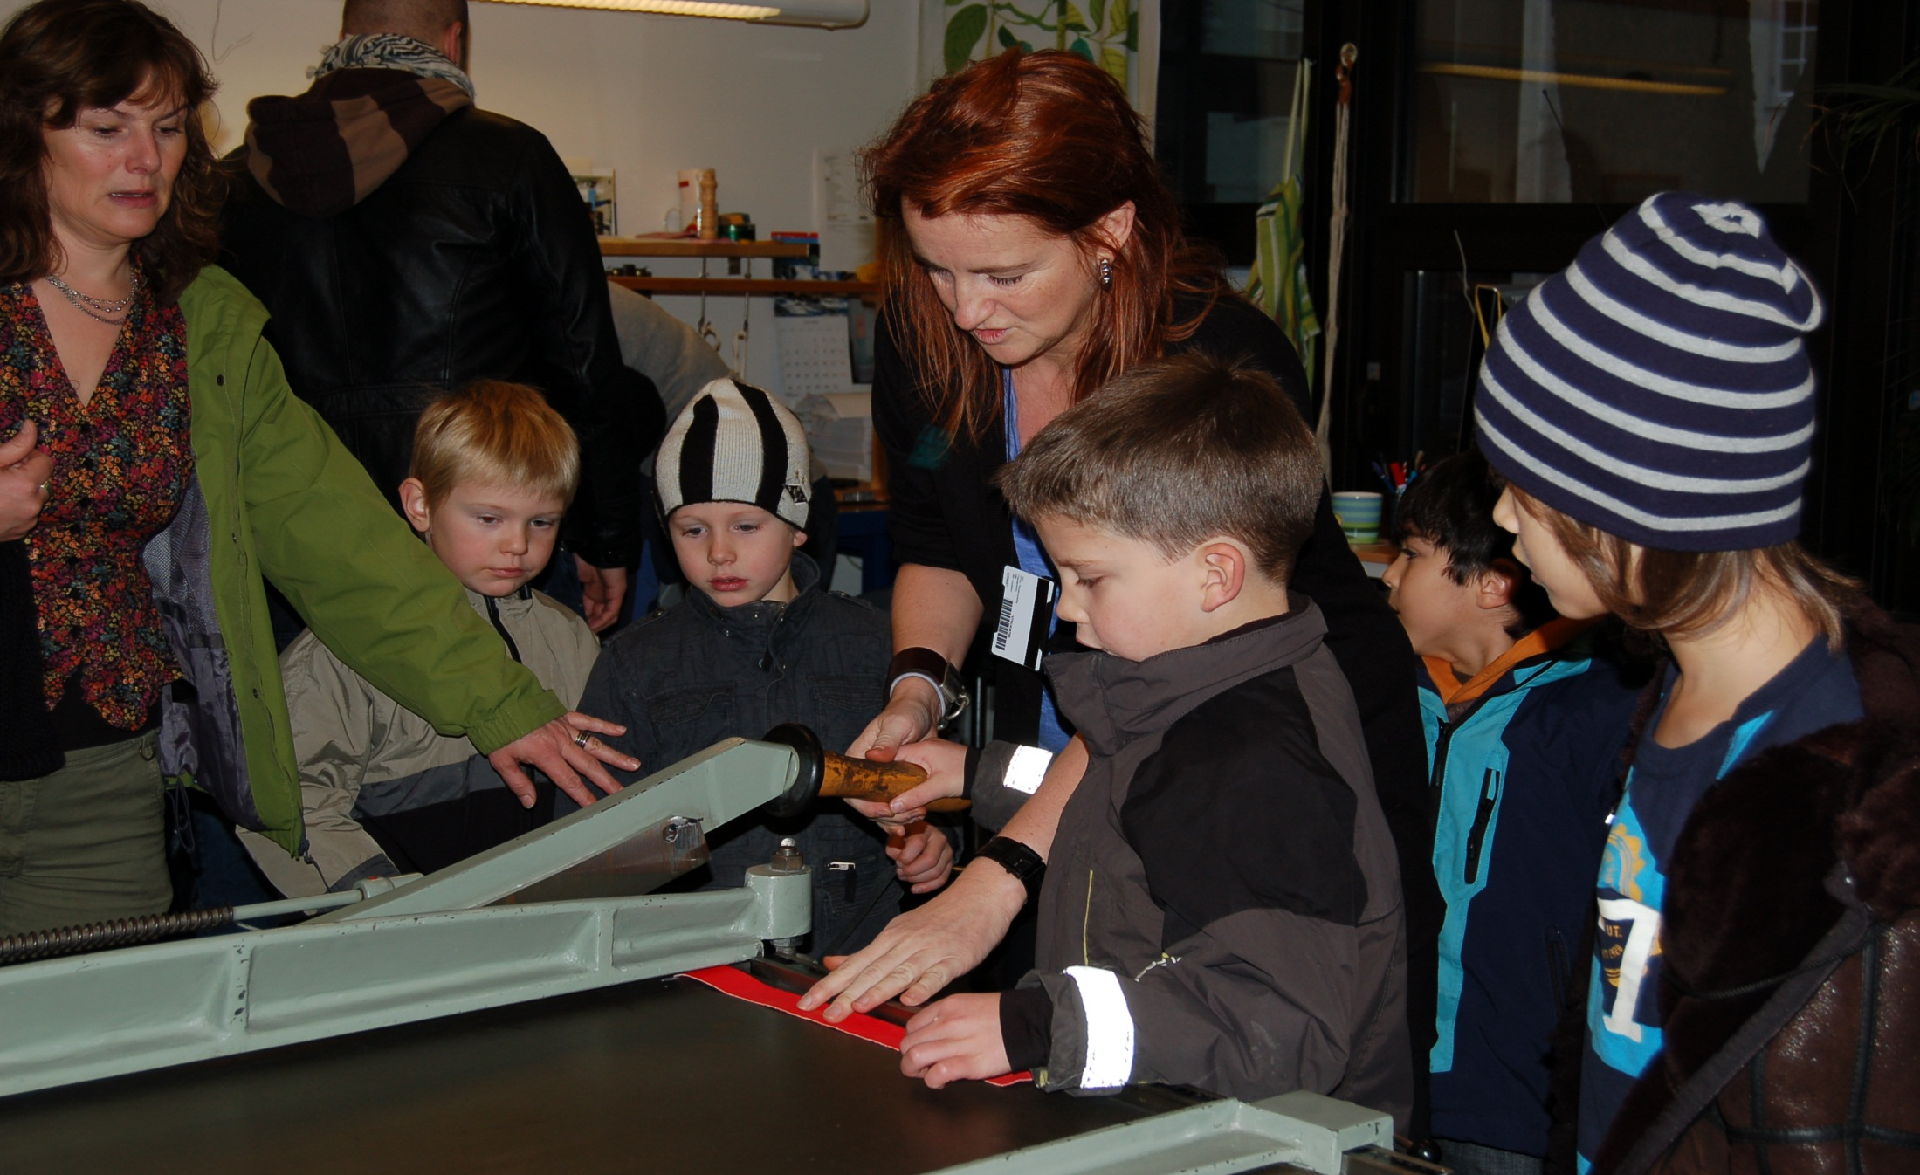
Til hvem?

Slide 12
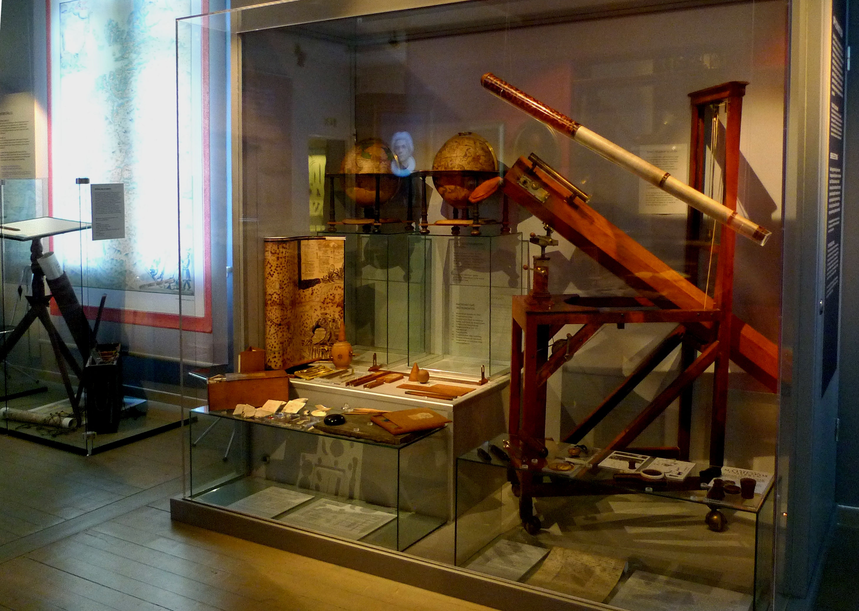

Slide 13
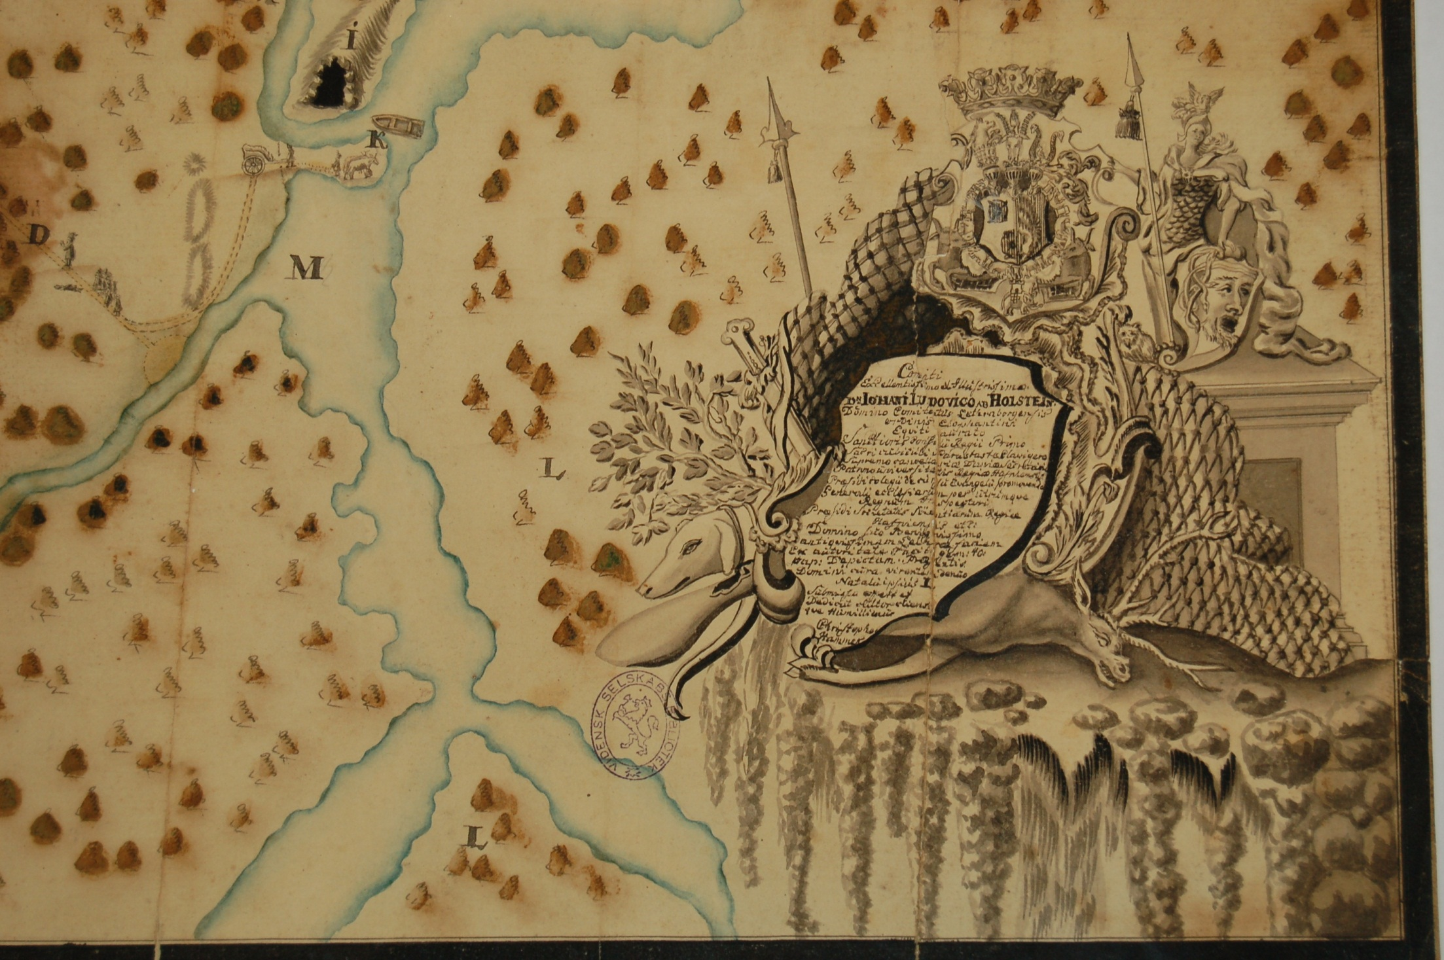

Slide 14
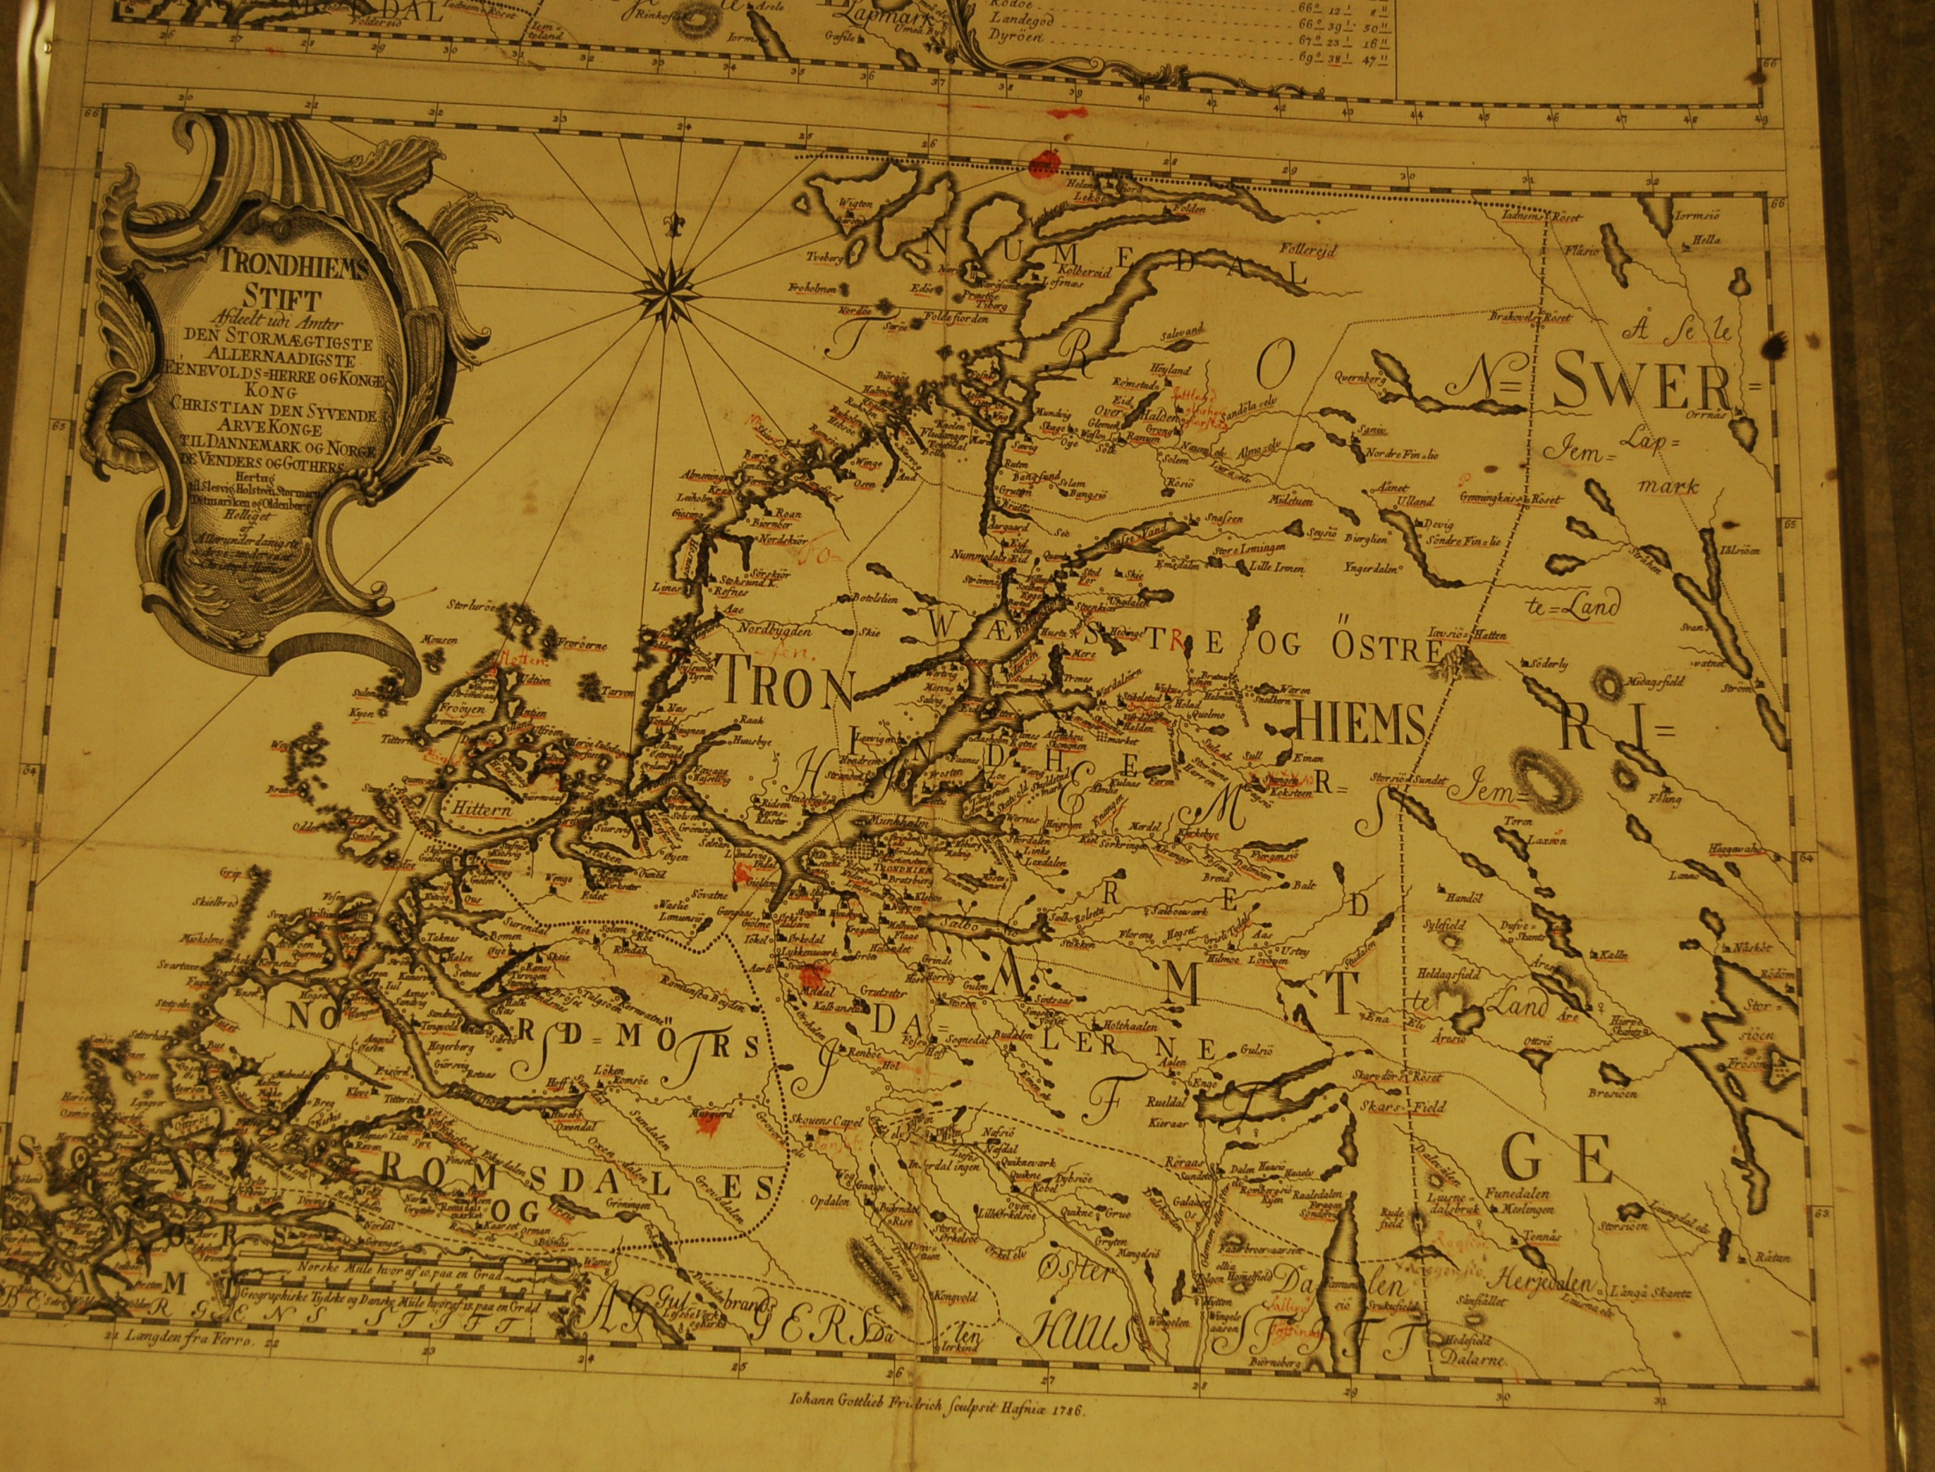

Slide 15
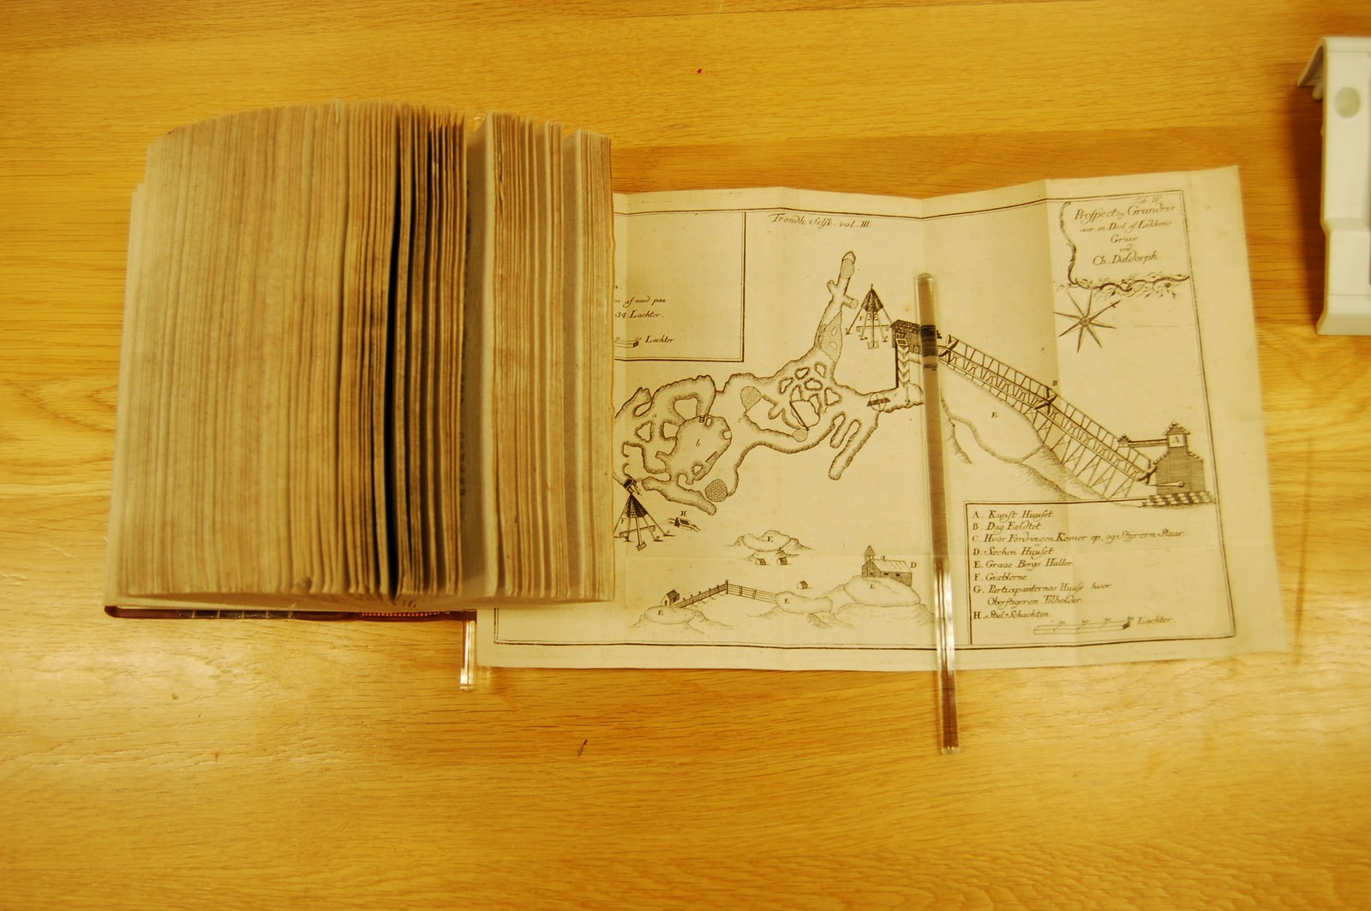

Slide 16
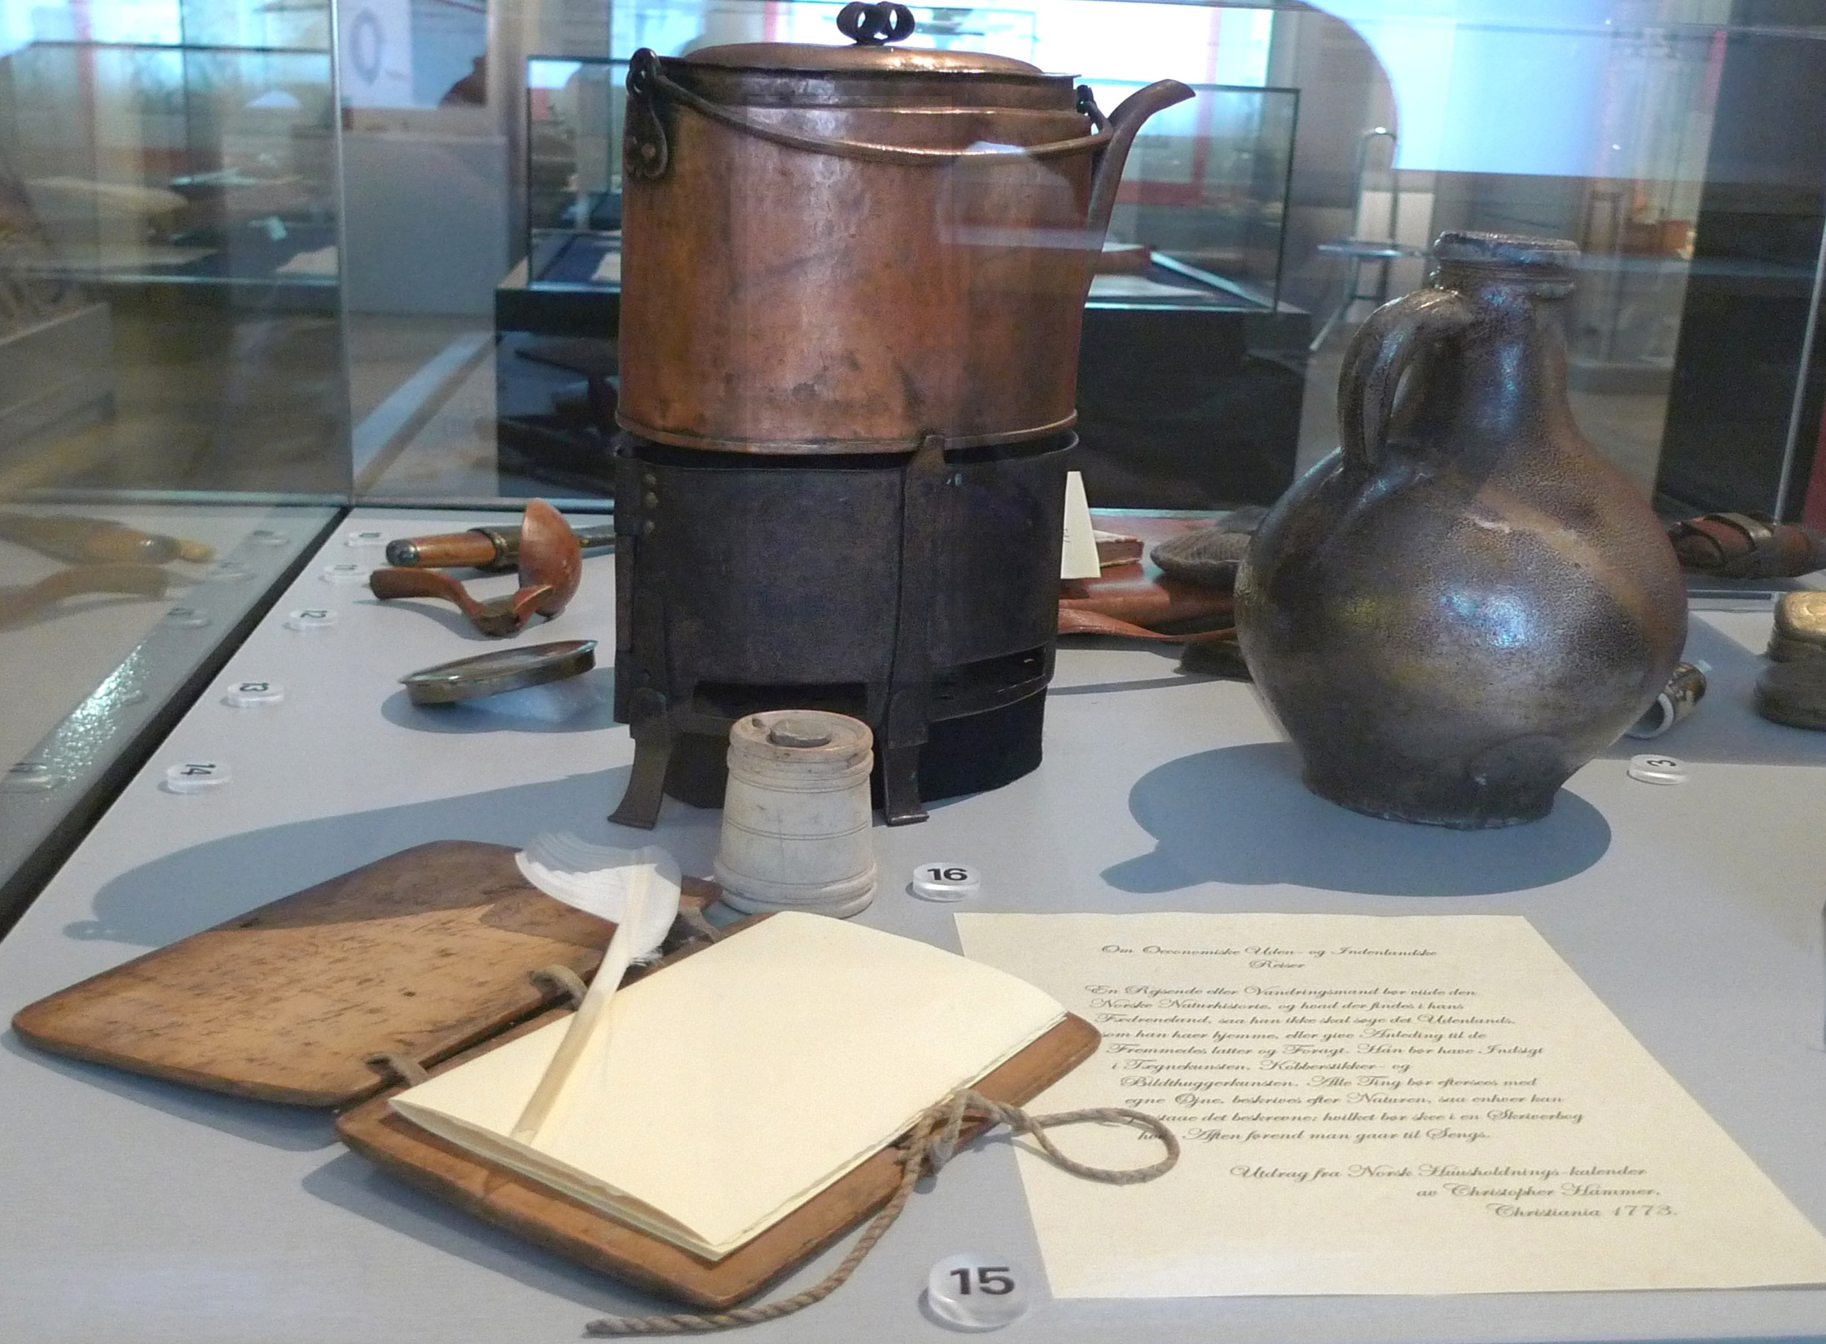
Notes:
1720-1804

Slide 17
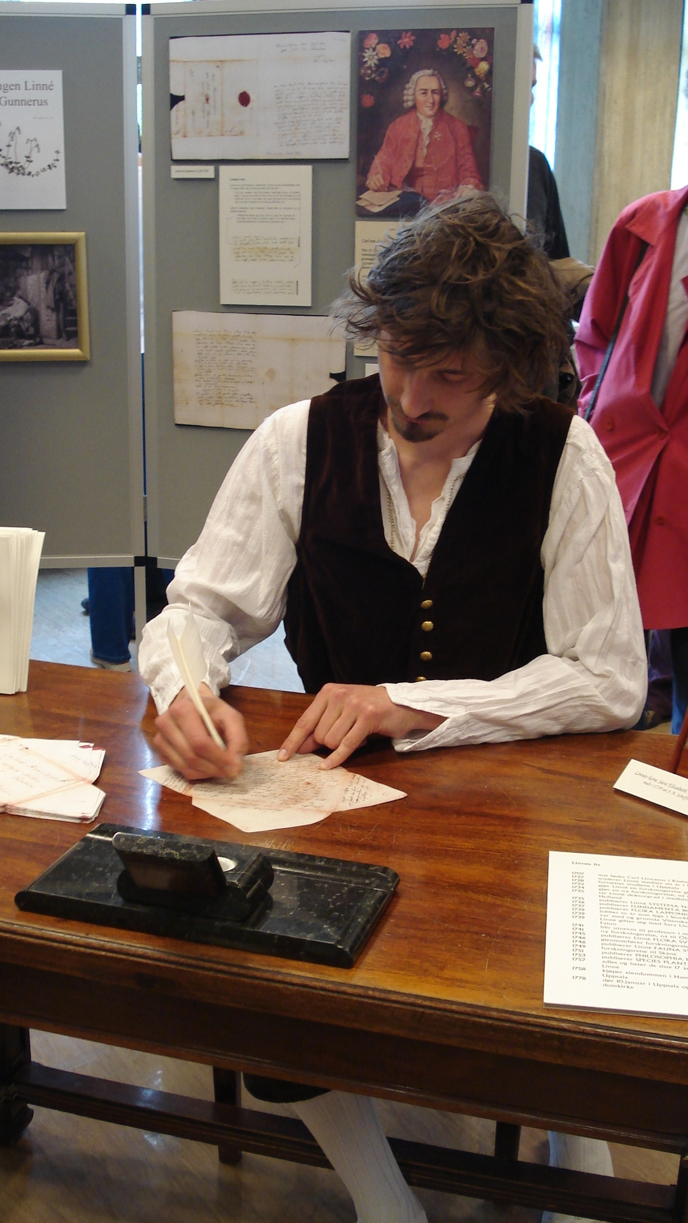
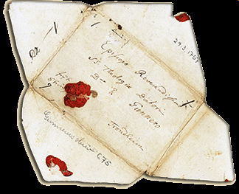

Slide 18
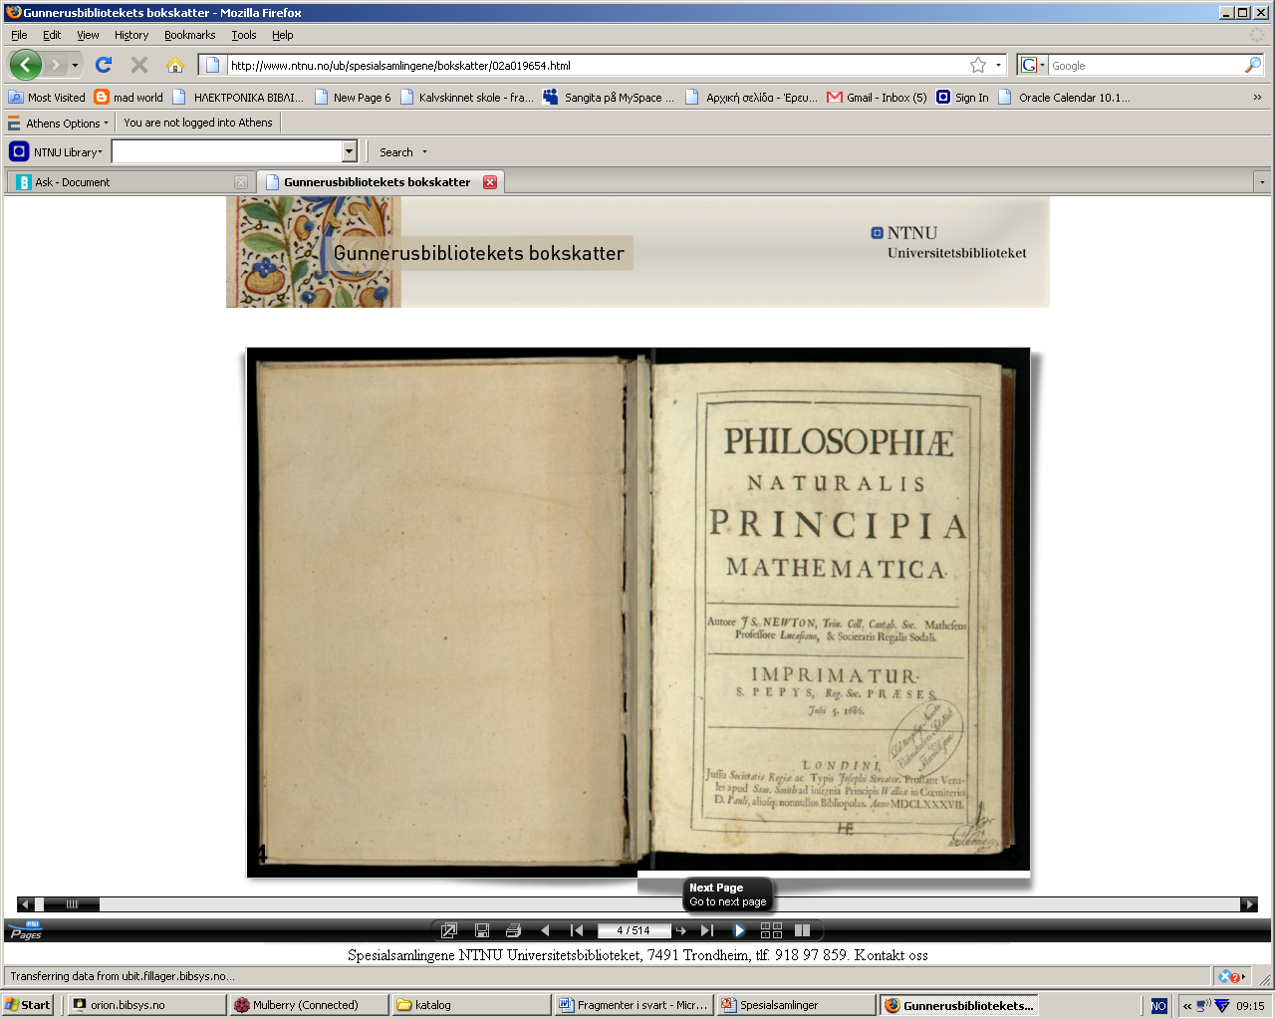
bokskatter
Gunnerus: Flora Norvegica
Newton Philosophiae Naturalis
Notes:
http://www.ntnu.no/ub/spesialsamlingene/bokskatter

Slide 20
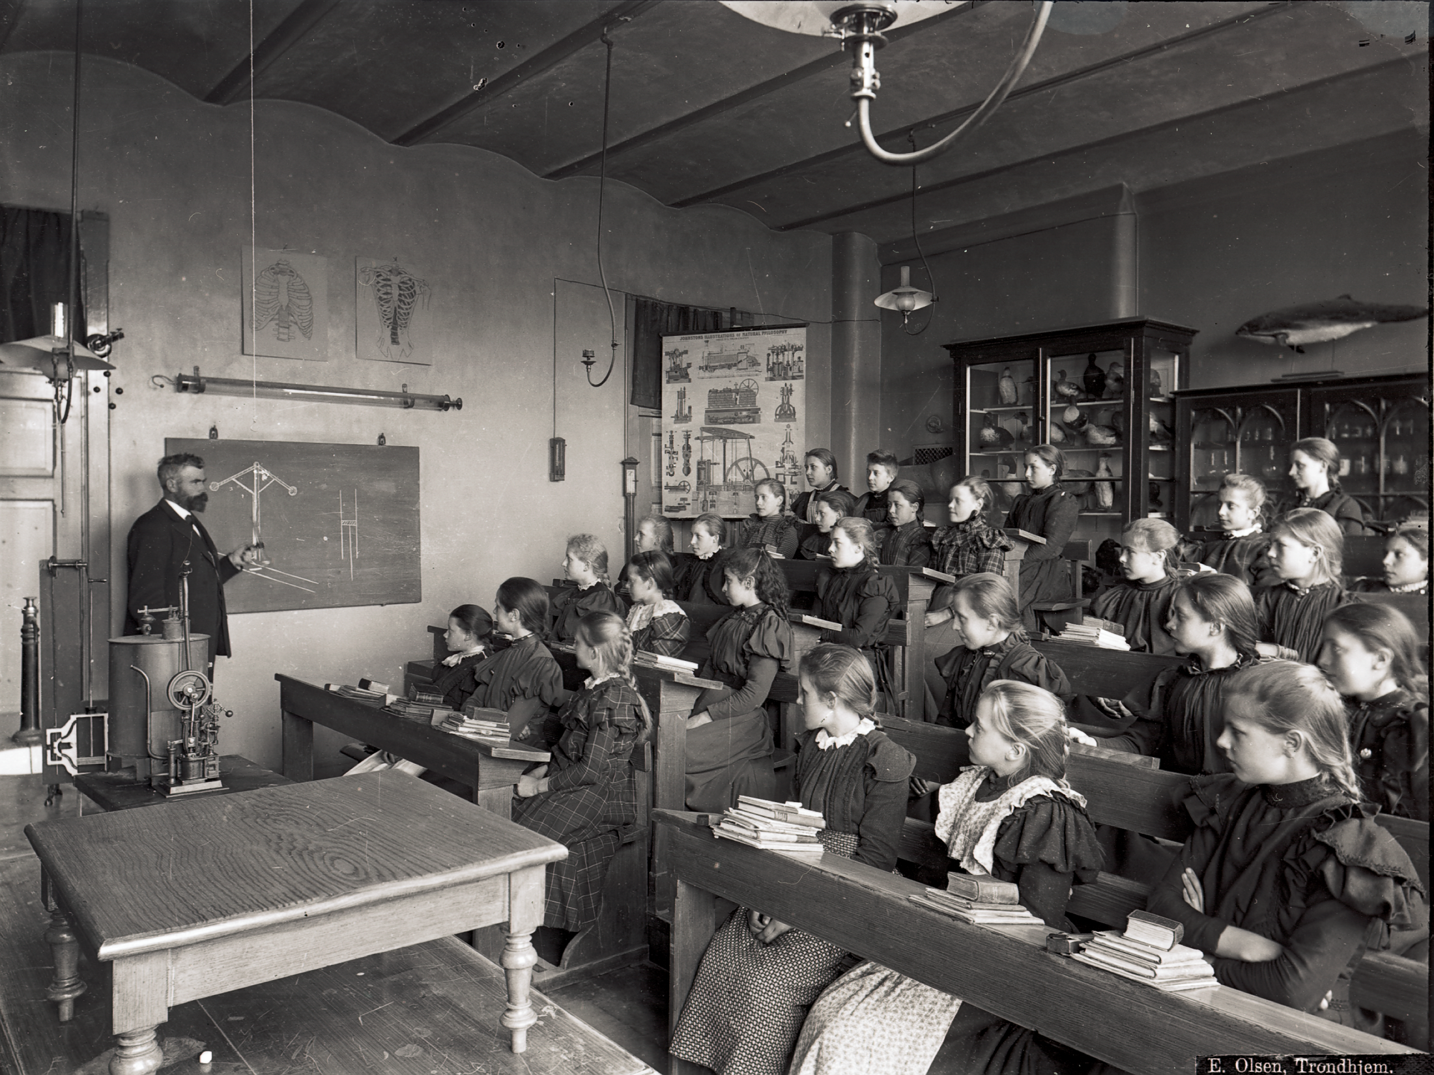

Slide 21
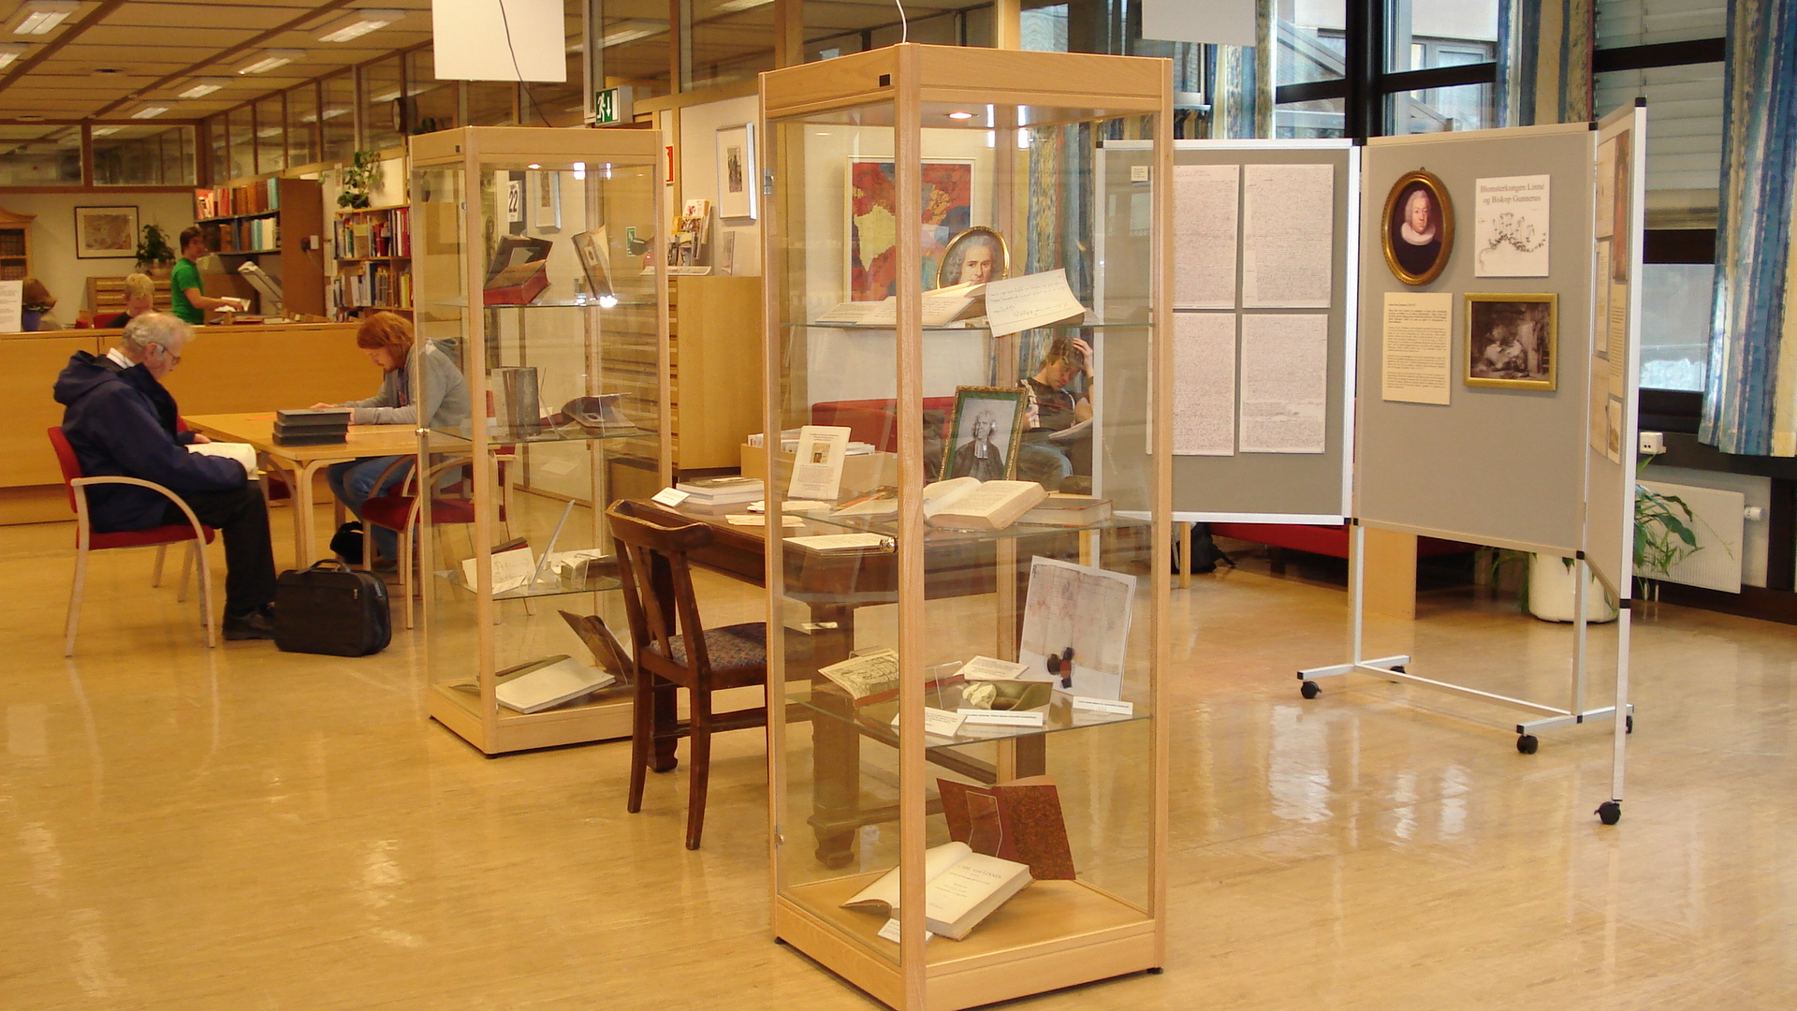

Slide 22
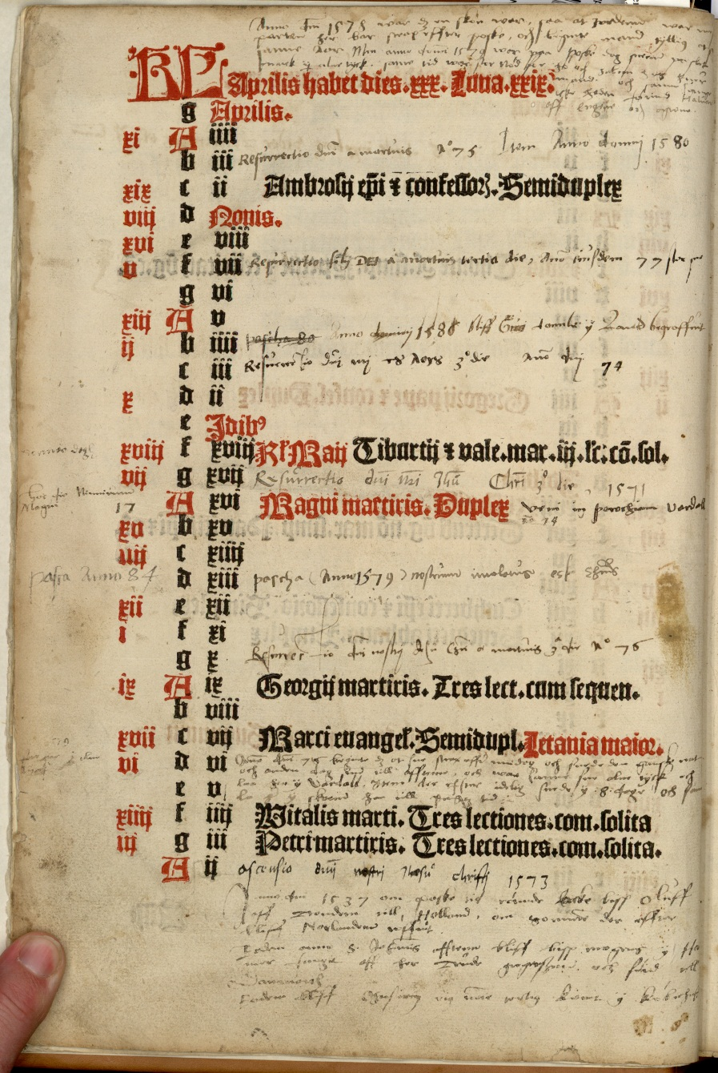
Lux illuxit
Video med musikk
Wikipedia side
«Performance»
på biblioteket

Slide 23
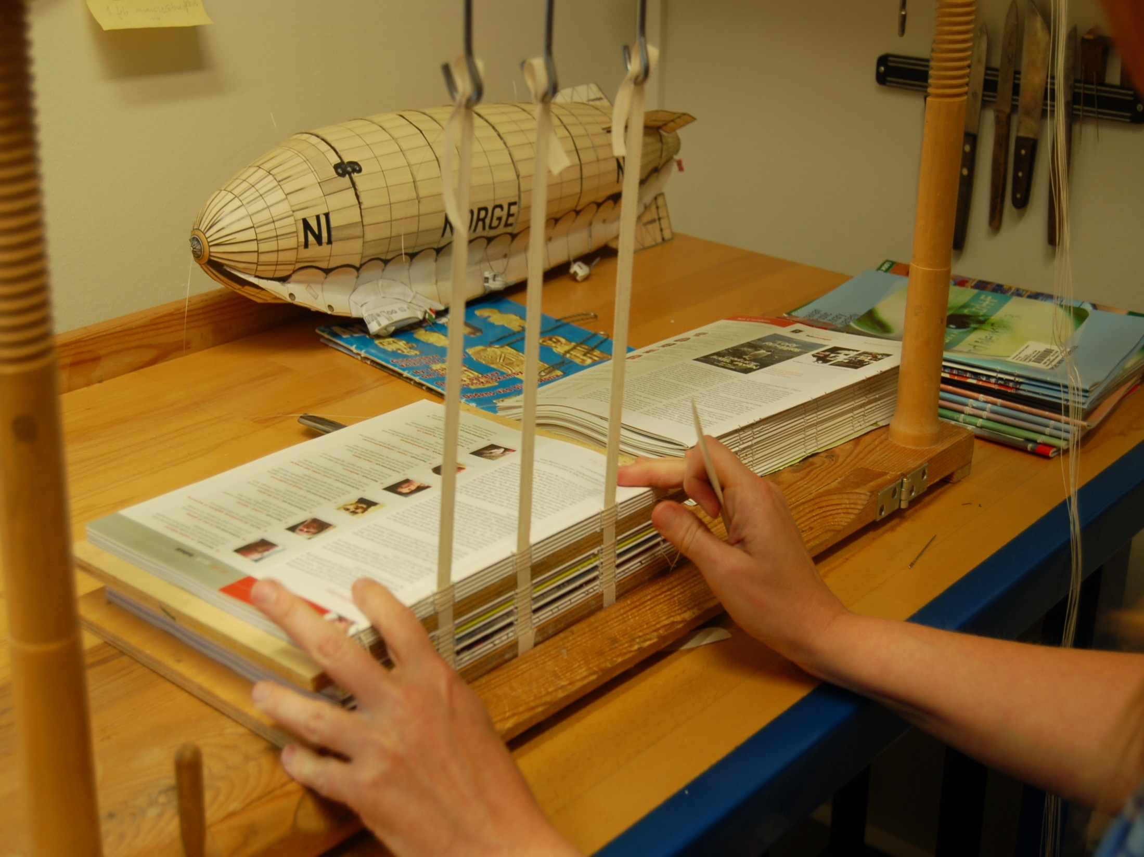

Slide 24
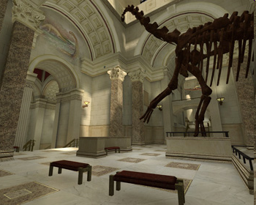
Notes:
The Museum:Source Project is an ambitious effort to model a complete natural history museum in 3D for Counter-Strike, the most popular online action game in the world. More than just a fun game level, the project is part of a novel approach to science education: infiltrating the $10 billion-a-year video game industry with truly educational content. The idea is to go beyond a simple "museum-like" virtual world and create a real museum complete with informative, lifelike exhibits. While gamers will play for fun, they'll be exposed to educational content in the process.
The process is simple in concept, and complex in application. Utilizing an arsenal of 3D and graphics tools, the level designer crafts a virtual building with all of the visual details created by real world architects and interior designers. From marble walls to ornate column capitals, every element of the museum building is modeled in three dimensions, textured, and placed in position. Specialized software tools allow for adding shiny metallic trim details to floor tiles and creating atmospheric beams of light complete with dust motes floating about. The process takes weeks or months depending on the complexity of the level. The Museum:Source level is expected to take 6 months start to finish.

Slide 25
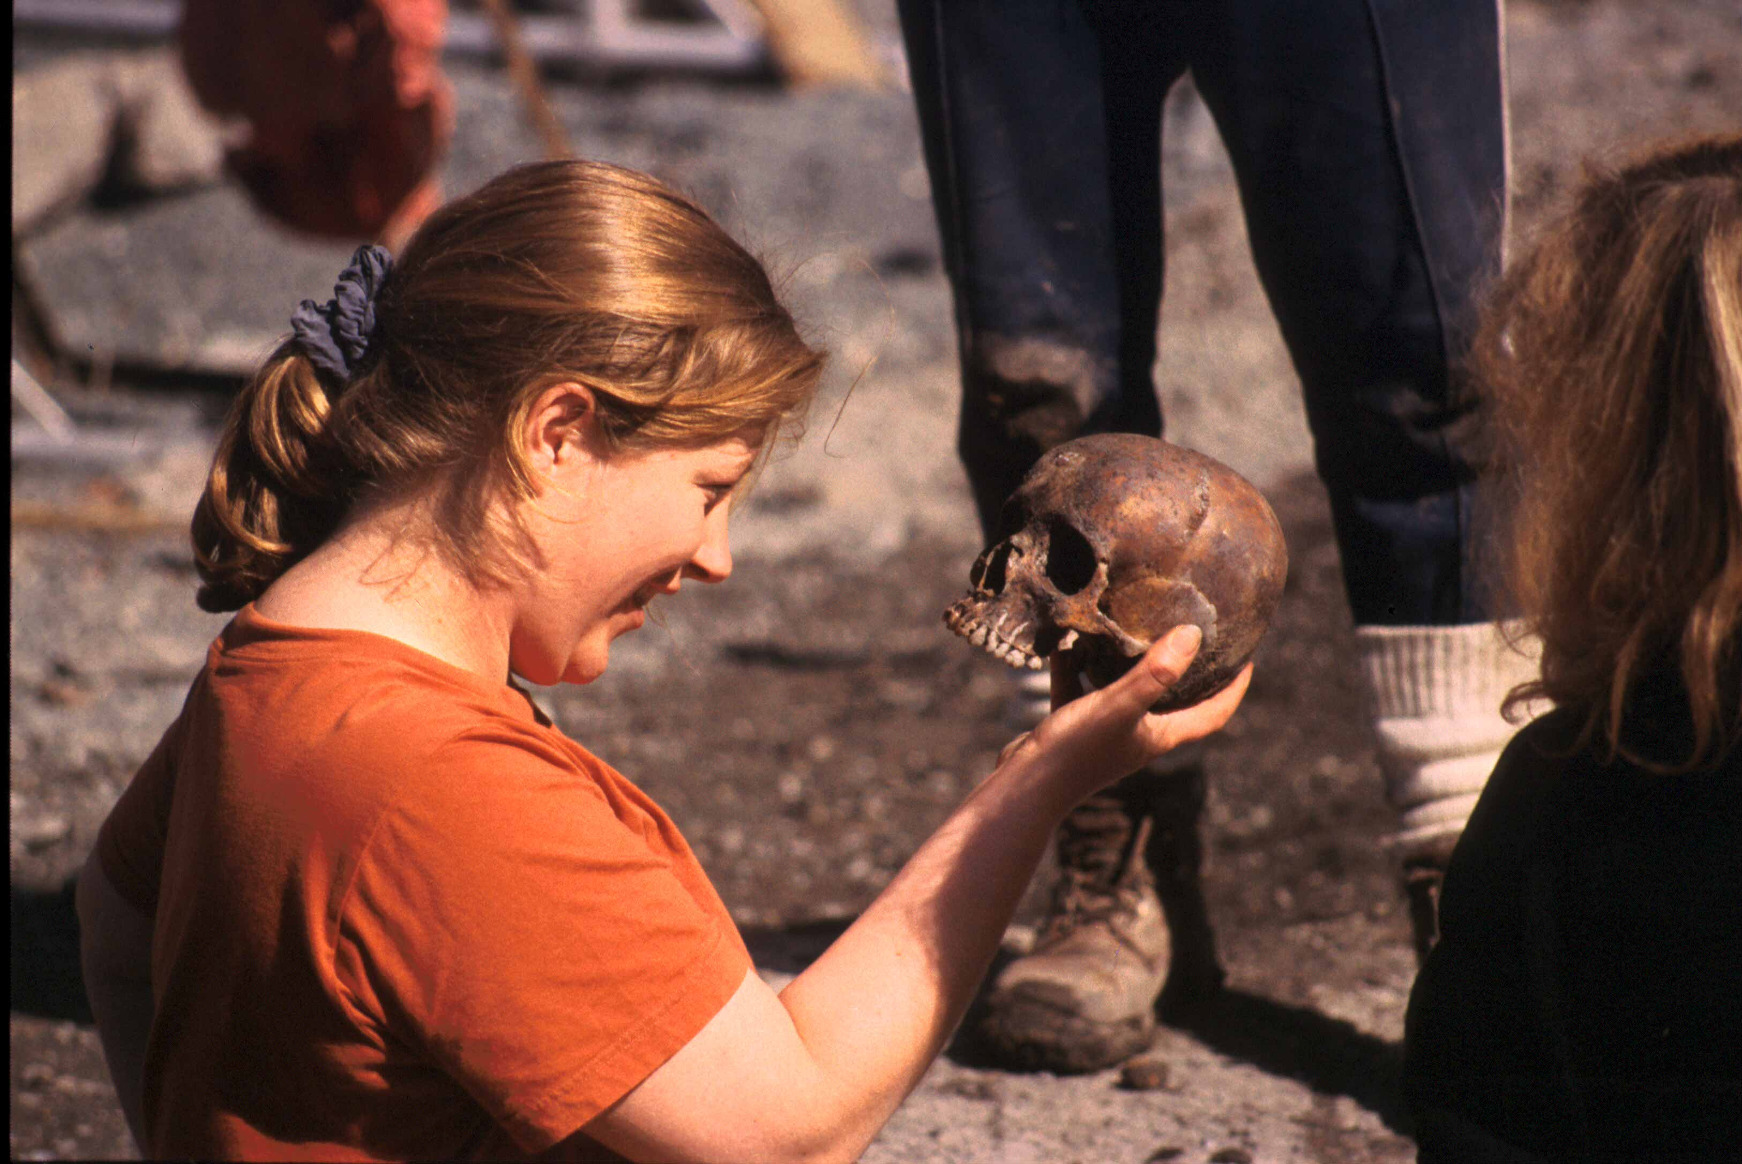
Det er en faglig utfordring og en mulighet til å lære om deg selv i samspill med andre.

