Slide 1
Value of Information Analysis in Spatial Models
Jo Eidsvik
Jo.eidsvik@ntnu.no

Slide 2
Plan for course
Time | Topic
Monday | Introduction and motivating examples
 | Elementary decision analysis and the value of information
Tuesday | Multivariate statistical modeling, dependence, graphs
 | Value of information analysis for dependent models
Wednesday | Spatial statistics, spatial design of experiments
 | Value of information analysis in spatial decision situations
Thursday | Examples of value of information analysis in Earth sciences
 | Computational aspects
Friday | Sequential decisions and sequential information gathering
 | Examples from mining and oceanography
Every day: Small exercise half-way, and computer project at the end.

Slide 3
Formula for VOI

Slide 4
Formula for VOI
Spatial alternatives.
Spatial uncertainties.
Spatial value function.
Spatial data.

Slide 5
Information gathering
.
 | Perfect | Imperfect
Total | Exact observations are gathered for all locations. This is rare, occurring when there is extensive coverage and highly accurate data gathering. | Noisy observations are gathered for all locations. This is common in situations with remote sensors with extensive coverage, e.g. seismic, radar, satellite data.
Partial | Exact observations are gathered at some locations. This might occur, for instance, when there is careful analysis of rock samples along boreholes in a reservoir or a mine. | Noisy observations are gathered at some locations. Examples include hand-held (noisy) meters to observe grades in mine boreholes, electromagnetic testing along a line, biological surveys of species, etc.

Slide 6
Decision situations and values
.
 | Assumption: Decision Flexibility | Assumption: Value Function
Low decision flexibility; Decoupled value | Alternatives are easily enumerated | Total value is a sum of value at every unit
High decision flexibility; Decoupled value | None | Total value is a sum of value at every unit
Low decision flexibility; Coupled value | Alternatives are easily enumerated | None
High decision flexibility; Coupled value | None | None

Slide 7
Low versus high decision flexibility
.
High flexibility:
Farmer can select individual forest units.
Low flexibility:
Farmer must select all forest units, or none.

Slide 8
Decoupled versus coupled value
.
Farmer must decide whether to harvest at forest units, or not.
Value decouples to sum over units.
Petroleum company must decide how to produce a reservoir.
Value involves complex coupling of drilling strategies, and reservoir properties.

Slide 9
Computation - Formula for VOI
Main challenge.
Computations :
Easier with low decision flexibility ( less alternatives).
Easier if value decouples (sums or integrals split).
Easier for perfect, total, information (upper bound on VOI).
Sometimes analytical solutions, otherwise approximations and Monte Carlo.

Slide 10
Techniques – Computing the VOI
Inner integral.
Outer integral.
Techniques :
Fully analytically tractable for two-action, Gaussian, linear models.
Analytical or partly analytical for Markovian models, graphs.
(Monte Carlo sample over data, analytical for inner expectation.)
Various approximations and Monte Carlo usually applicable.
Should avoid double Monte Carlo (inner and outer). Too time consuming.

Slide 11
Fully analytical
Inner integral analytical. Linear combination of data.
Gaussian.

Slide 12
Partly analytical, Monte Carlo for rest
Inner integral solved.
Use sampling.

Slide 13
Examples of other approximations
Rock hazard example in mining : Laplace approximations.
Petroleum production example : Monte Carlo simulation and regression.

Slide 14
We will rock you – rock hazard example
Decisions about stabilizing rock mass.
Borehole information. How much and where?
Model is a represented by Gaussian process, with Poisson count measurements.
VOI analysis done by a Gaussian approximations and Laplace approximations.

Slide 15
We will rock you – Spatial GLM
Add support at tunnel locations where risk of rock fall is too high.
What is the value of additional borehole information about spatial joint counts?

Slide 16
We will rock you – Model
.
Risk of rock fall is tied to the number of joints in rocks.
Spatial joint intensity.
Data are collected in boreholes.
Design of boreholes is important.

Slide 17
Values
.
Costs of adding supports, and costs if support is not added and rock collapse.

Slide 18
Approximations
.
Gaussian approximation, Laplace approximation,
and matrix approximation.
Evangelou and Eidsvik, 2017, The Value of Information for correlated GLMs, JSPI, p 30-48.

Slide 19
Approximations (ii)
.
Evangelou and Eidsvik, 2017, The Value of Information for correlated GLMs, JSPI, p 30-48.

Slide 20
Approximations (ii)
.
Exercise:
Compute the log Gaussian expectation.

Slide 21
Results – data gathering options
Study the value of different borehole information, and compared with the prices.
Test half of planned boreholes, with half of samples (every other).
Test quarter of boreholes, with dense sampling.
Do no testing.

Slide 22
Results – decision regions
No testing.
We here gather the data that is most valuable compared with its price.
This data gathering decision could also be made according to a budget. Then we collect data that has the largest VOI, as long as it is less than the budget.

Slide 23
Results
P1 and P2 depend on the length of boreholes, and number of tests.
The number of tests are here the same for the two data gathering options.
Half-half drills about twice as long as the Quarter option.

Slide 24
Wrap up
Analytical expressions allows fast computations, and eases sensitivity analysis, etc.
Approximations must be checked (time consuming MCMC, asymptotics, etc.)
VOI of subset testing can be effective when there is correlation. Two dense data samples does not give double information.

Slide 25
Reservoir dogs - petroleum example
Decisions about drilling alternatives.
Seismic information. Which kind?
Model is a represented by spatial process, obtained by simulations.
VOI analysis done by a simulation-regression approach.

Slide 26
Fluid flow modeling example
.
Most reservoir decisions require reservoir simulation, fluid flow is important for the value calculcation.
Develop with a drilling plan,
or not develop at all:
Value computed from petroleum reservoir simulation.
Dutta et al., 2017.

Slide 27
Reservoir flow in heterogeneous media
Injection of water, pushing oil out.
Flow in the reservoir depends on the composition of rocks, porosity, permeability, faults, etc.
Seismic data can help identify these important reservoir properties.
Very non-linear relations!

Slide 28
Computation - Formula for VOI
Computationally challenging:
No decoupling in space. Joint optimization over all alternatives.
Non-linear value function and seismic data.

Slide 29
Prior - Reservoir uncertainty
Prior is .
This distribution of reservoir variables is usually represented by multiple Monte Carlo realizations from the prior distribution.
Sample 1
………….
Sample 1000

Slide 30
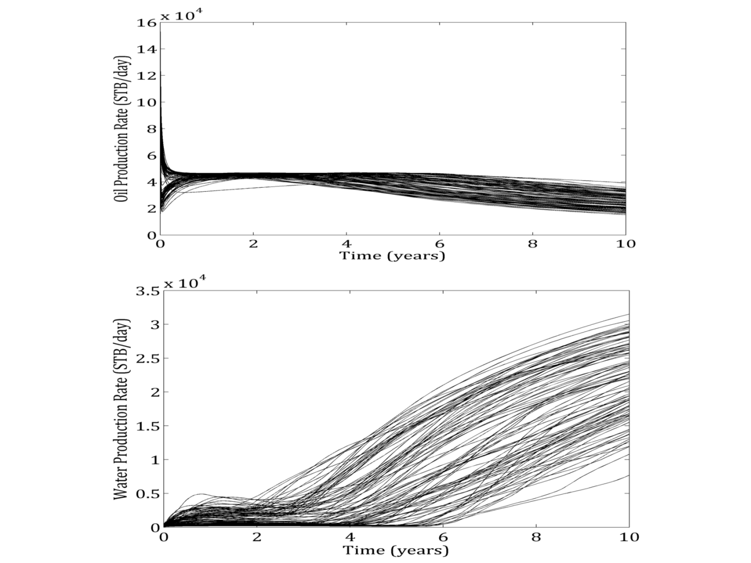
Flow simulation and value
.
Flow simulation gives amount of recoverable oil, for each realization, with the development cost subtracted.

Slide 31
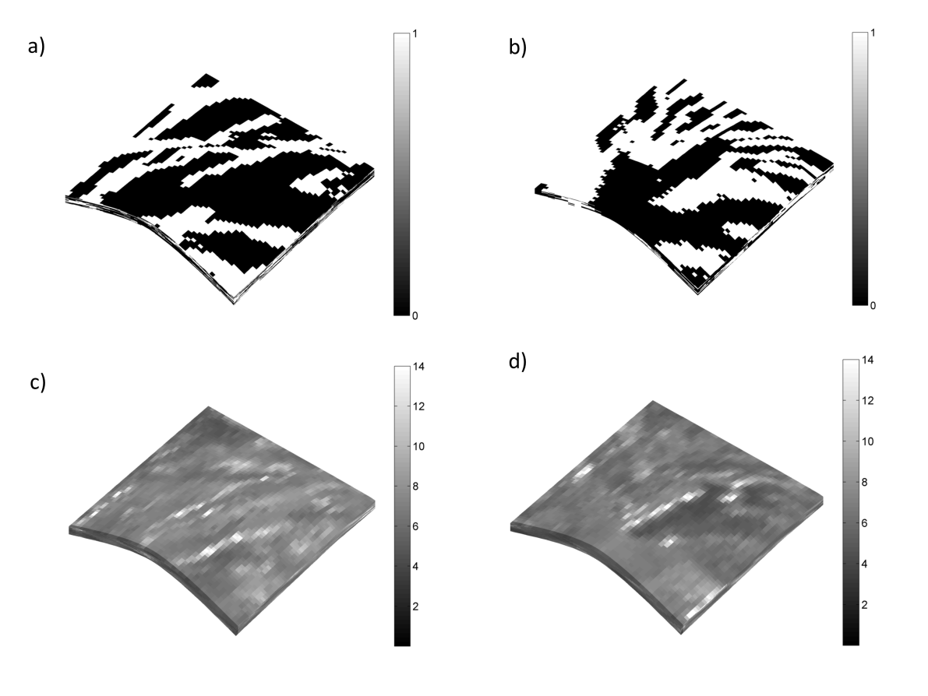
Likelihood - Seismic data
.
The likelihood is non-linear, but we can generate synthetic seismic data from the likelihood model, given realizations of reservoir properties.

Slide 32
Linking variables
Fluid flow model
Seismic model
Complex geology

Slide 33
Value and seismic data
.
- Random draws of geologic scenario (meandering channels or delta):
Draw rock-type realizations
Draw porosity realizations
Draw permeability realizations
Draw value by fluid flow simulation and economics
Draw seismic data using physics
We next use these samples for VOI approximation.

Slide 34
Computation
Outer expectation:
Inner expectation:
Monte Carlo (outer) and simulation-regression for inner expectation!

Slide 35
Simulation-regression algorithm
Outer expectation
Inner expectation
Simulate uncertainties:
Simulate values, for all alternatives:
Simulate data:
Regress samples to fit conditional mean:

Slide 36
Regression results
.
We use partial least squares (PLS) regression, useful for the large-size seismic data sets.
 | 10-20 Hz seismic | 10-40 Hz seismic | 10-60 Hz seismic
VOI | 578 (555-590) | 583 (560-600) | 585 (565-600)
VOI only very large, but slightly larger for more detail in the seismic data, since we are interested in ‘overall’ flow properties.

Slide 37
Wrap up
The type of simulation and regression would be very case specific.
If there are lots of alternatives, some kind of clustering of alternatives should be used.
VOI approximation is difficult to check, but bootstrap (or bagging) can be used to study uncertainty, and to do sensitivity over different regression models.

Slide 38
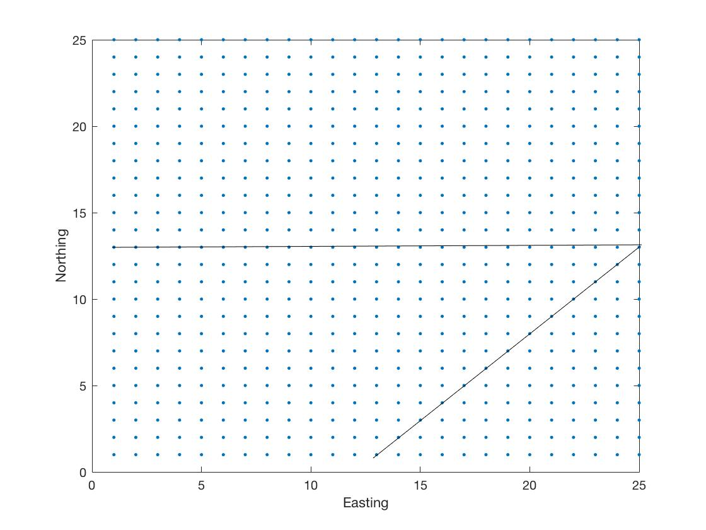
Project case : alternatives
Suppose there is a 25 x 25 grid of reservoir variables. We want to flood the reservoir either from the west, or from the south.
Sink.
Alternative 2 source.
Alternative 1 source.

Slide 39
Project case : models
There is uncertainty in the reservoir properties, possibly a channel with larger permeability in the middle, and some heterogeneity.
We can sample from the model as follows:
Draw a regression parameter:
Draw a Gaussian process on the 25 x 25 grid:
Permeability is log-Gaussian:
Use gamrnd or rgamma
Use Cholesky method

Slide 40
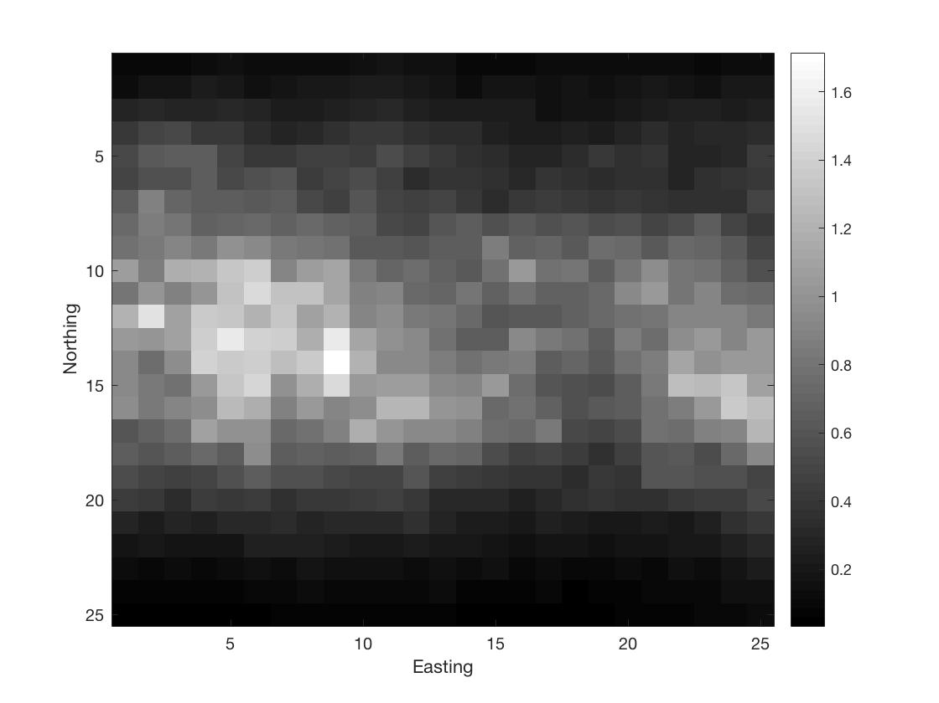
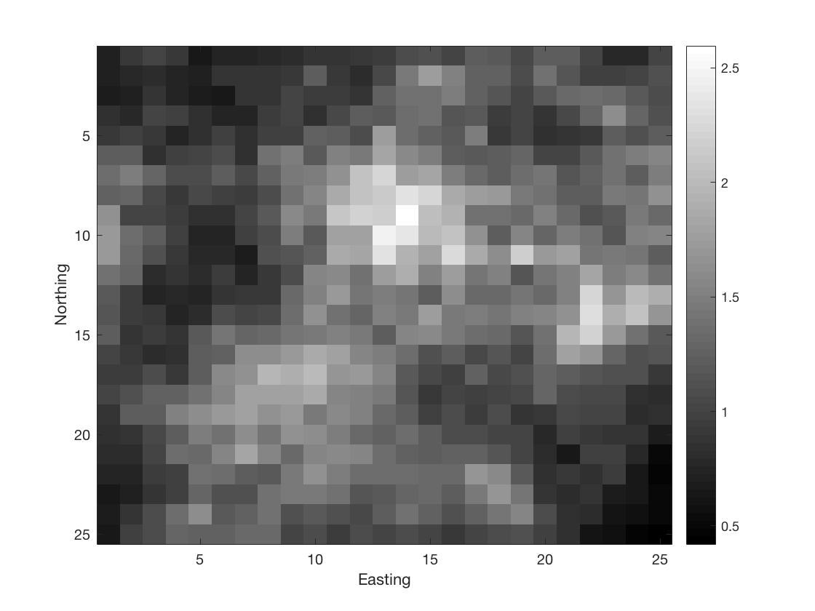
Project case : models
Variability due to the regression uncertainty and the spatial heterogeneity.
Two permeability realizations

Slide 41
Project case : values
Value is set as the time-of-flight: time it takes a particle to travel from the source to the sink. Smaller is better, larger ‘value’. (This is used as a proxy for flow.)
For each alternative (west or south), we compute time-of-flight as follows:
Distance is 1 for ‘west’ alternative, 1.5 for ‘south’ alternative.
Sum inverse permeability variables along the line.
Large permeability, smaller time of flight.

Slide 42
Project case : data
Data is the log-ratio of the variability in the center N-S line compared with the center E-W line. (This might be a result of processing seismic data.)
Large data.
Small data.

Slide 43
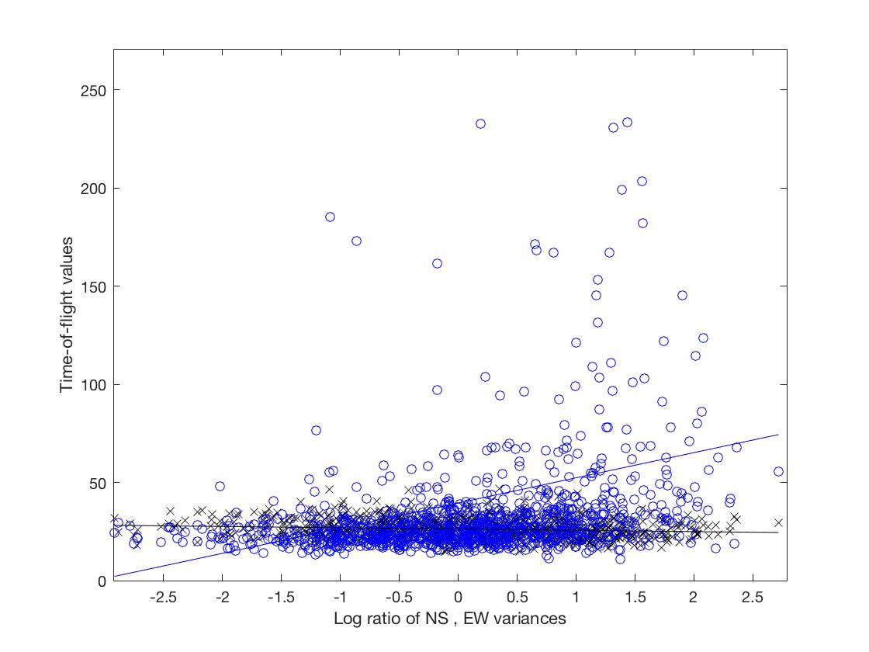
Project case : regression
Estimate the conditional expected values by simple linear regression, using the samples of values and data. Do this for both ‘west’ and ‘south’ alternative.

Slide 44
Project case : VOI approximation
Best alternative seems to depend on high or low data. This should give positive VOI.

